Slide 1
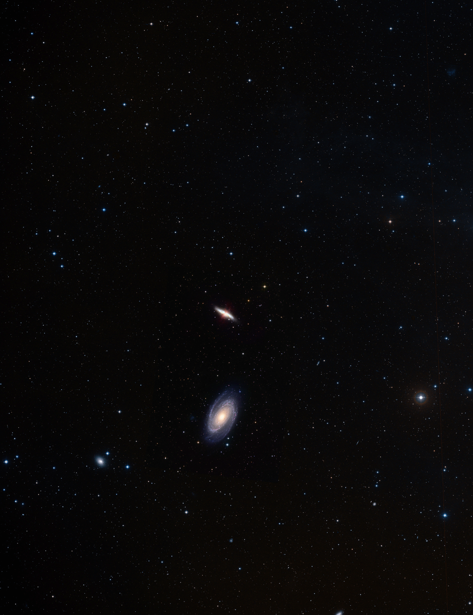
Fox News: Does Science Support the Book of Genesis?
www.reasons.org f
www.facebook.com/RTBHughRoss

Slide 2
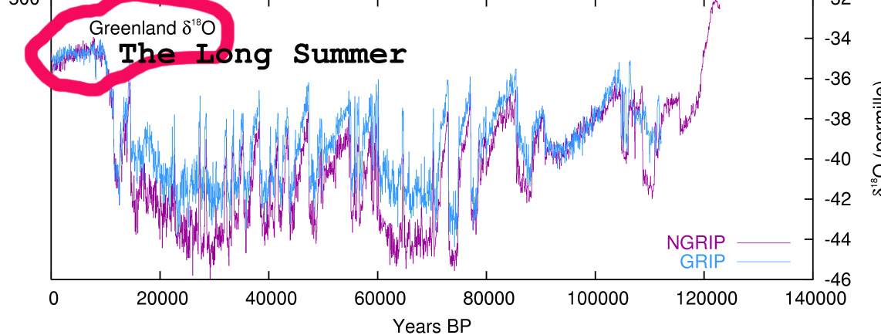
Notes:
NGRIP and GRIP

Slide 3
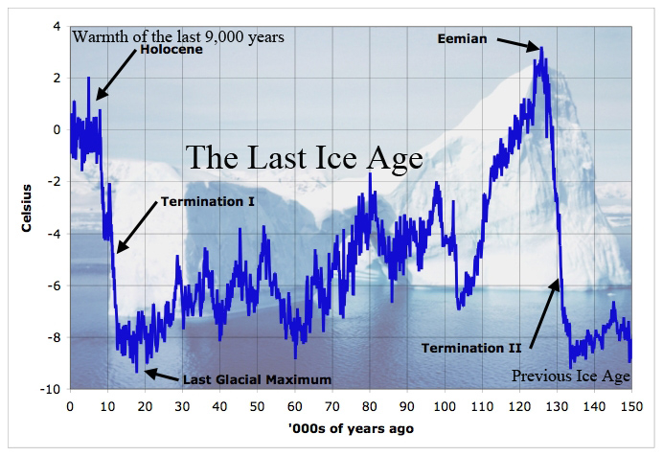
Notes:
NEEM (150,000 years)
On July 3 we were farthest from the Sun.

Slide 4
