Slide 1
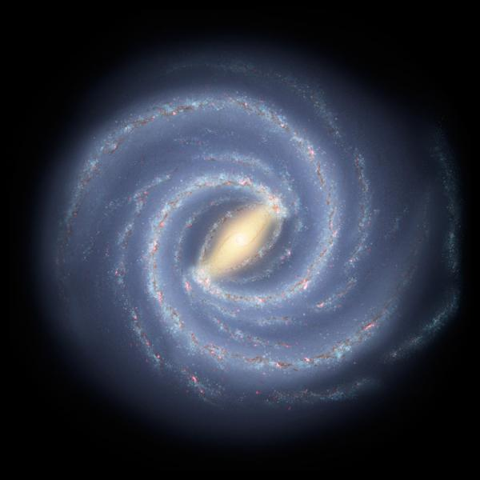
NASA/JPL-Caltech/R. Hurt (SSC-Caltech)

Slide 2
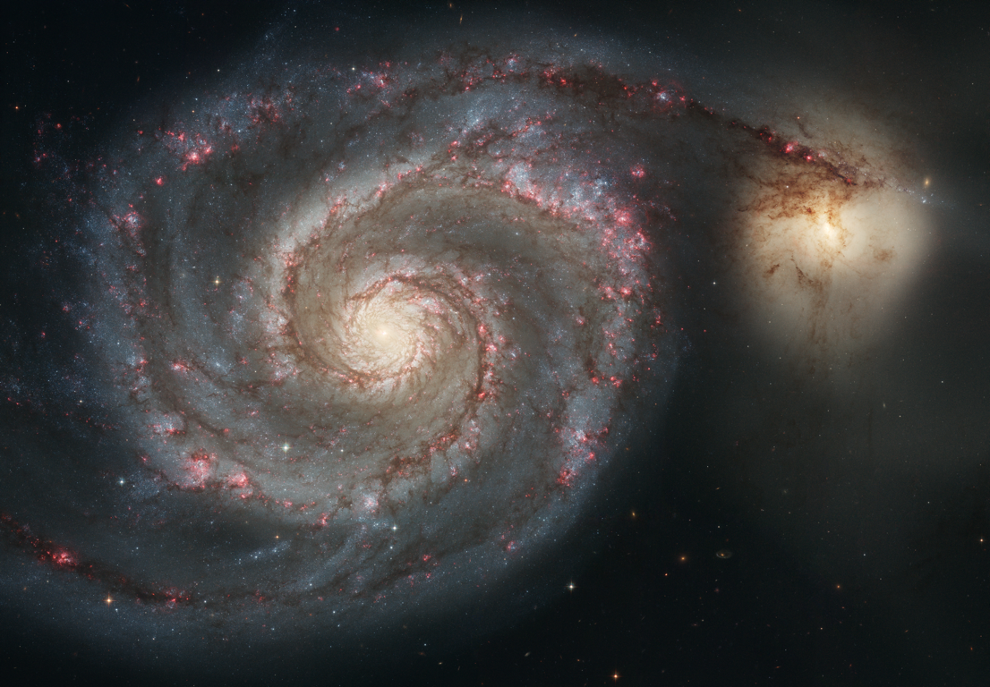
Notes:
M51, 4000 x 2776 pixels
credit: NASA/ESA/Hubble Space Telescope(STScI/AURA)

Slide 3
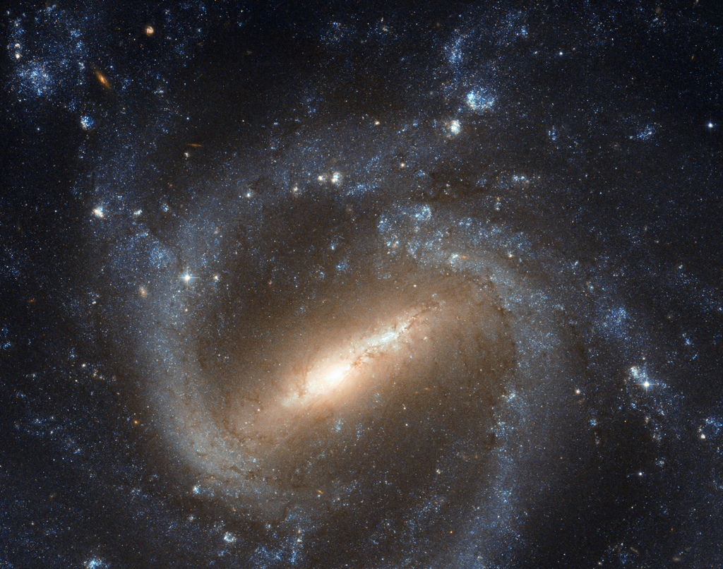
NASA/ESA/Hubble SM4 ERO Team
Notes:
NGC 1073
credit: NASA/ESA/Hubble Space Telescope

Slide 4
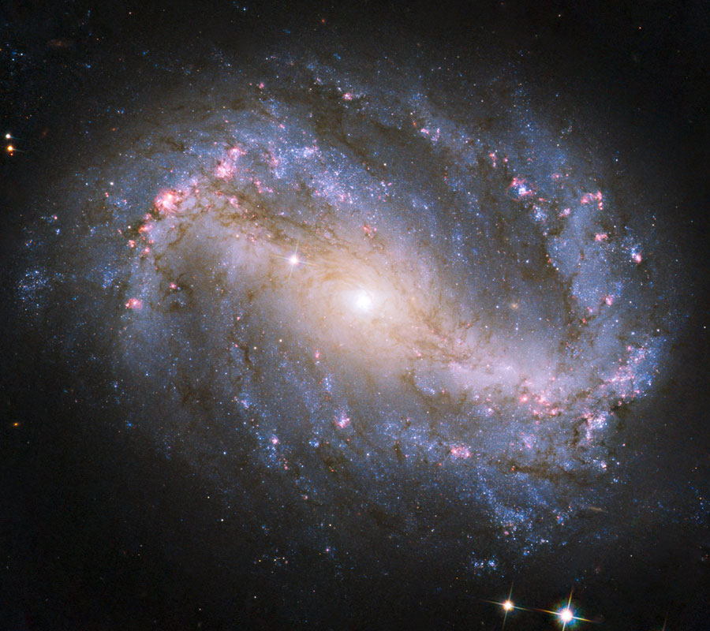
NASA/ESA/Hubble SM4 ERO Team
Notes:
NGC 6217
credit: NASA/ESA/Hubble SM4 ERO Team

Slide 5
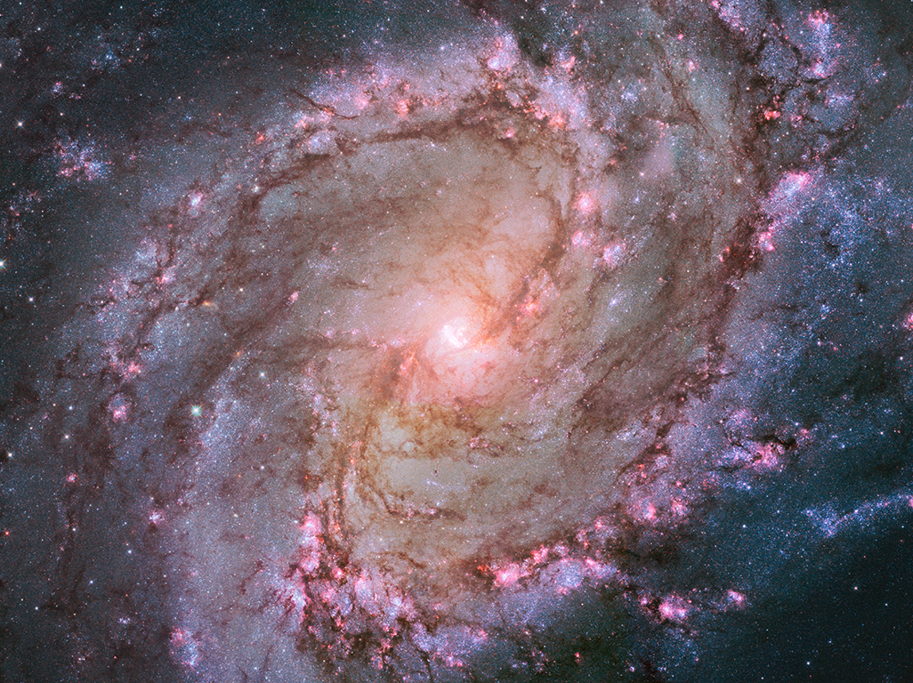
NASA/ESA/Hubble Heritage Team (STScI/AURA)
Notes:
M 83
credit: NASA/ESA/Hubble Heritage Team (STScI/AURA)

Slide 6
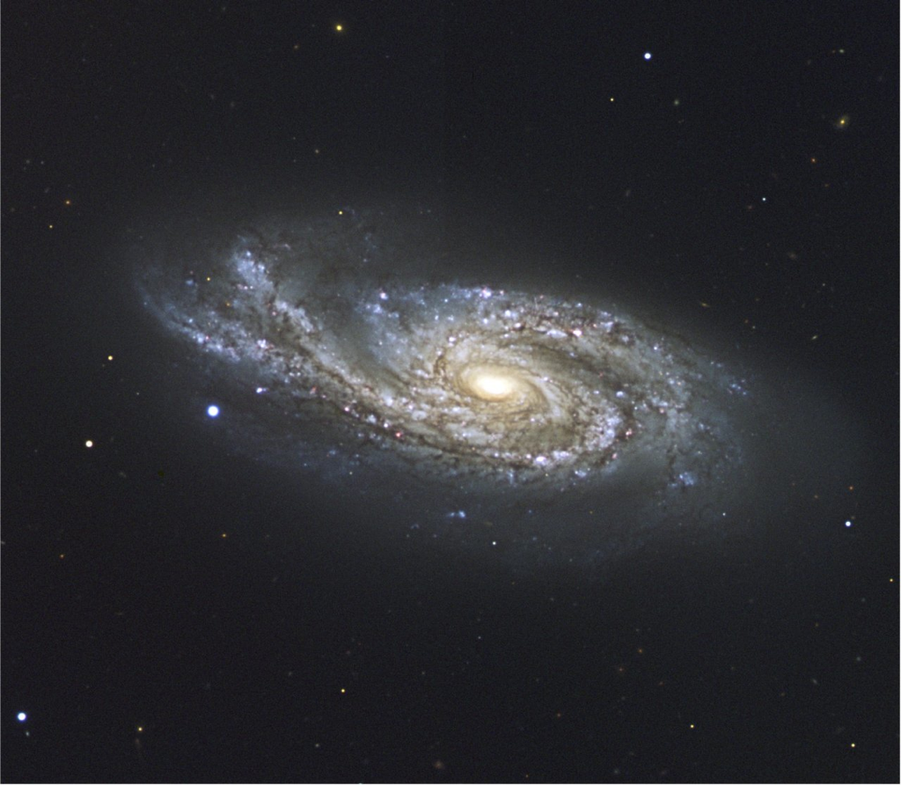
ESO
Notes:
NGC 908

Slide 7
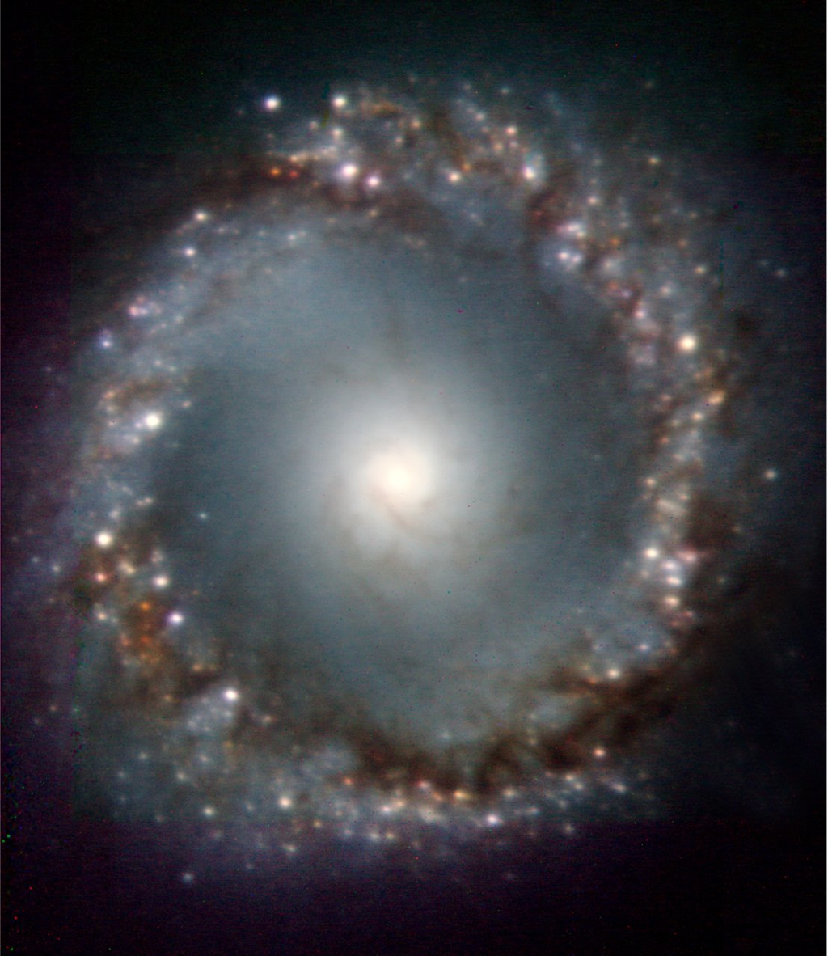
ESO
Notes:
center of the active galaxy NGC 1097

Slide 8
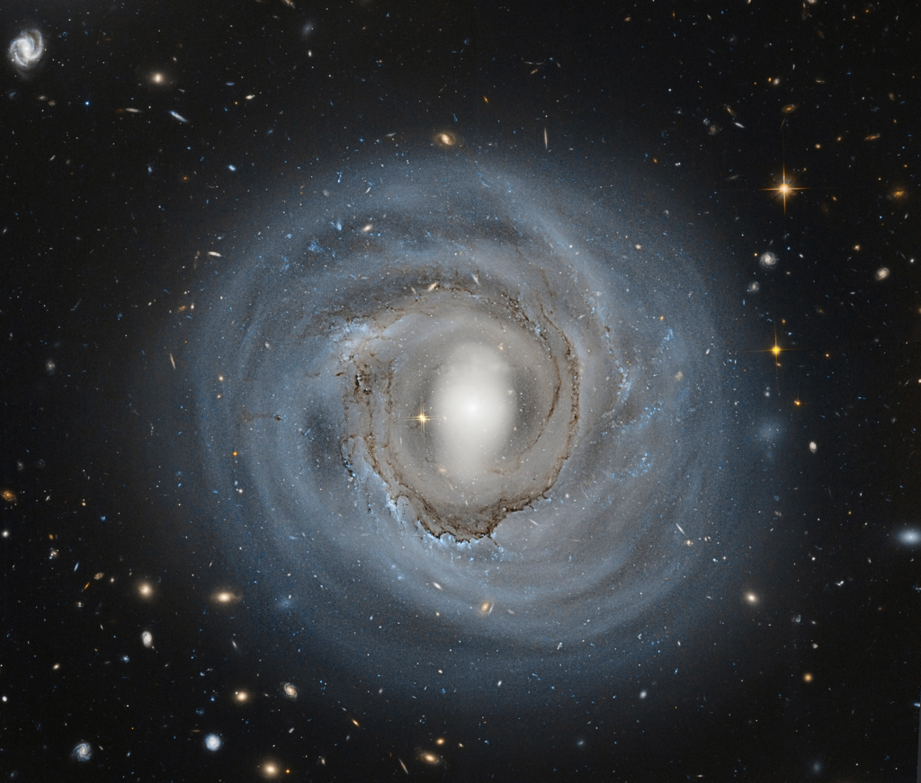
ESO
Notes:
NGC 4921 in the Coma Cluster about 310 million light years away
credit: NASA, ESA, Hubble Heritage Archive

Slide 9
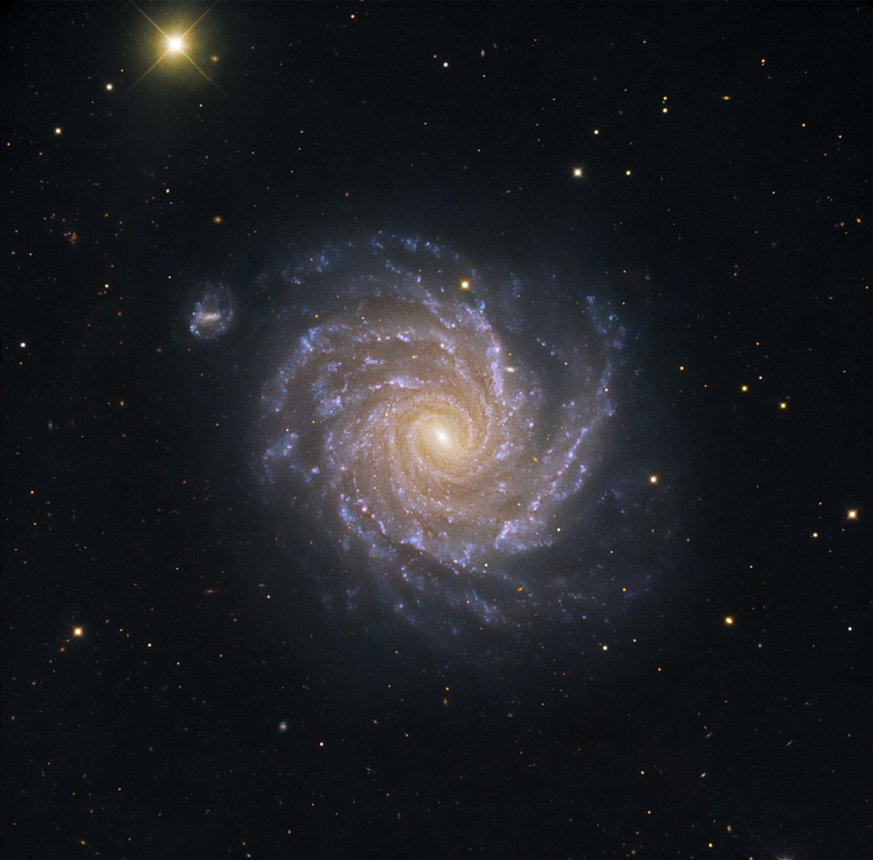
ESO
Notes:
NGC 1232

Slide 10
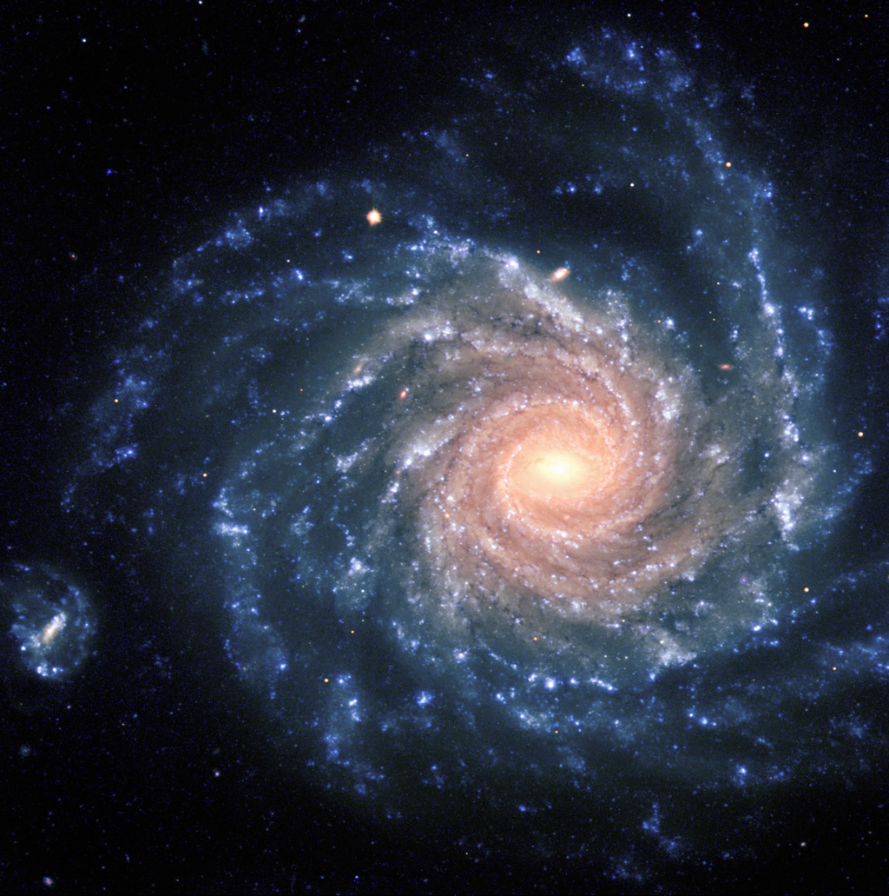
ESO
Notes:
NGC 1232
credit: ESO, FORS

Slide 11
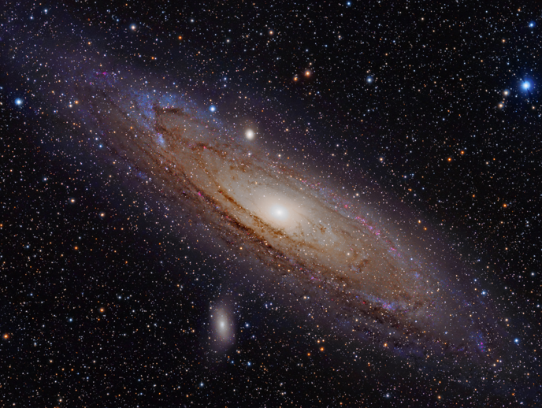
Adam Evans
Notes:
Andromeda Galaxy
credit: Adam Evans, Creative Commons Attribution

Slide 12
NASA/JPL-Caltech/R. Hurt (SSC-Caltech)

Slide 13
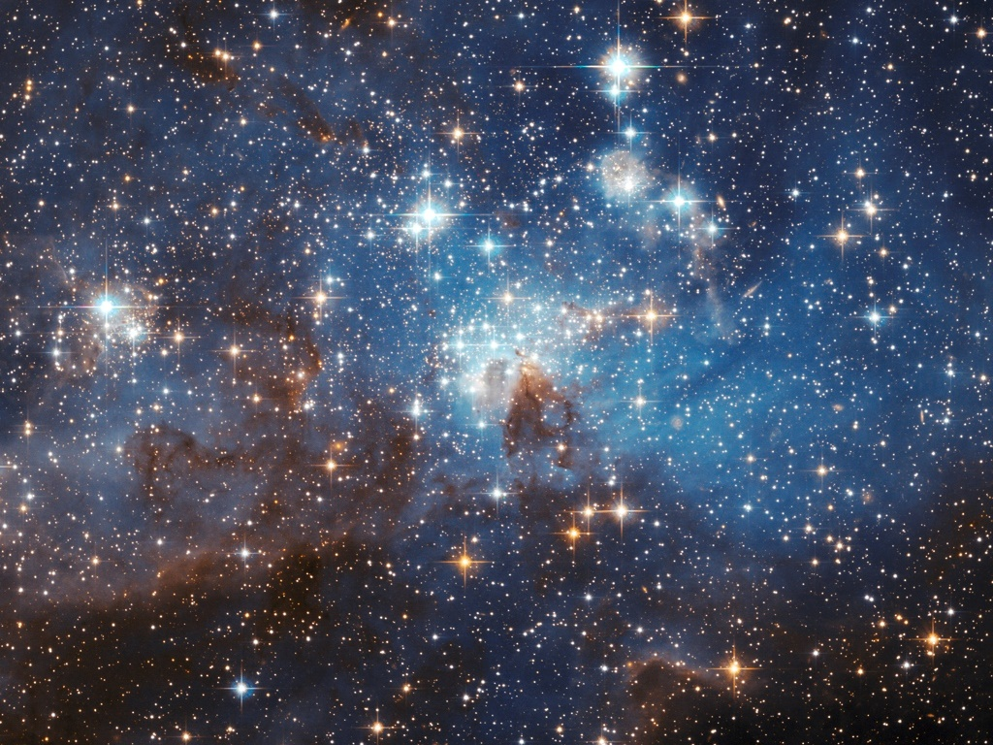
credit: NASA//ESA/Hubble Heritage Team (STScI/AURA)
acknowledgment: D. Goulermis (Max Planck Instititute)
Notes:
Sun’s parent giant molecular cloud was polluted with aluminum-26 from the Wolf-Rayet winds of many nearby supermassive stars.
Aluminum-26 thermally processed the planetesimals from which Earth formed. This processing drove off volatiles from the primordial Earth.

Slide 14
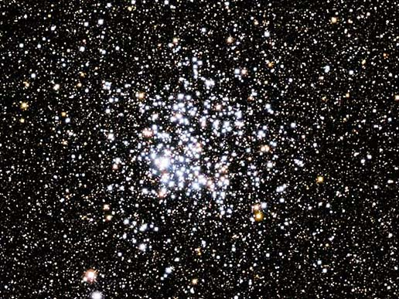
NASA
Notes:
Emerging solar system gained many other life-critical elements from 3-4 different nearby supernova eruptions and from many nearby asymptotic giant branch stars.

Slide 15
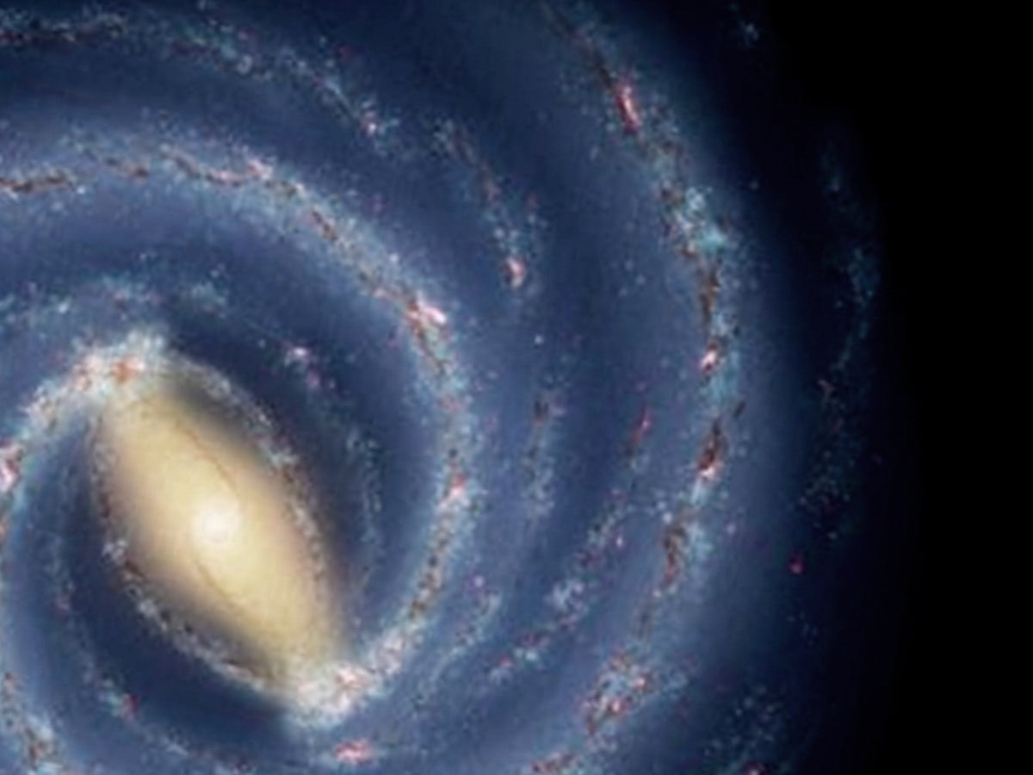
Abundance of metals
metallicity level
0 2 4 6 8 10 12 14 16
distance from galactic center (kpc)
NASA/JPL-Caltech

Slide 16
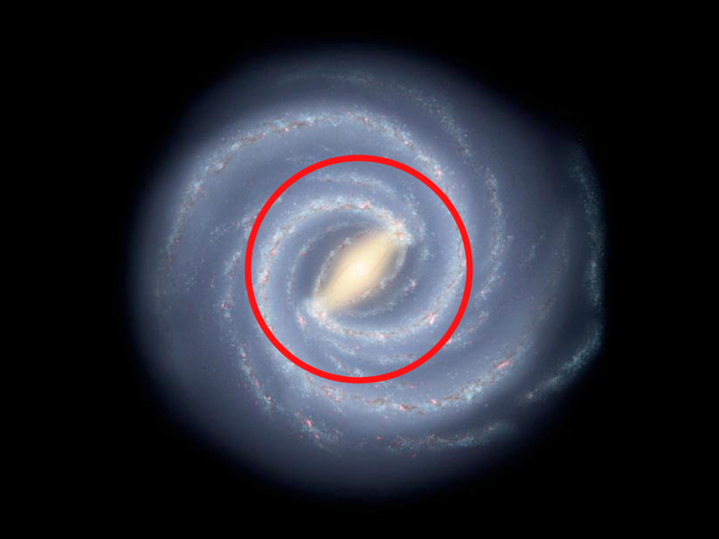
Expelled to Safety
Sun then
Sun now
NASA/JPL-Caltech/R. Hurt (SSC-Caltech)
Notes:
But, recent discoveries of Earth-sized planets reveal that Earth-like planets will be far too water-rich for advanced life—at least 10% water and possibly up to 50% water.
Earth’s water content is just 0.03%. How did Earth lose most of its water?

Slide 17
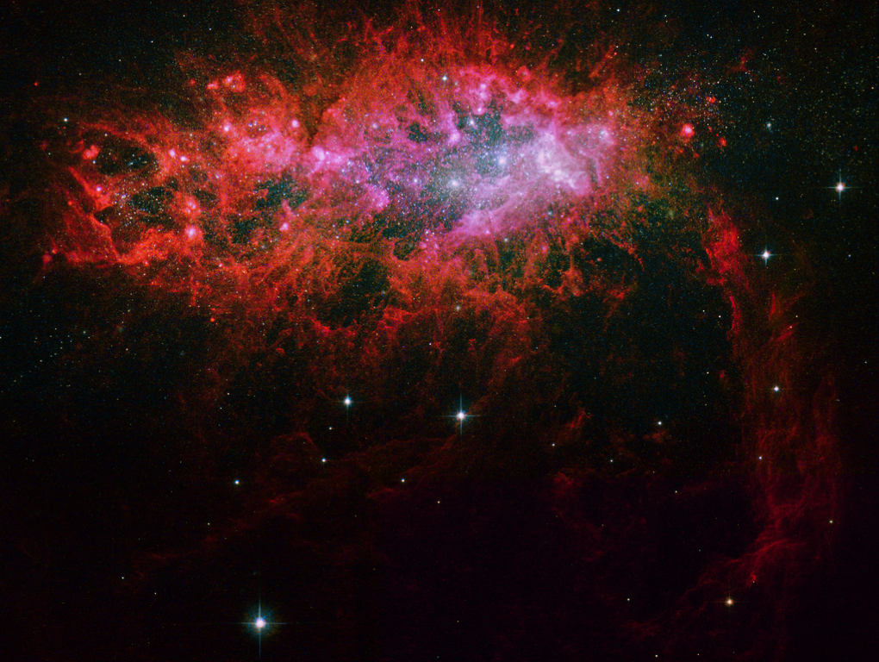
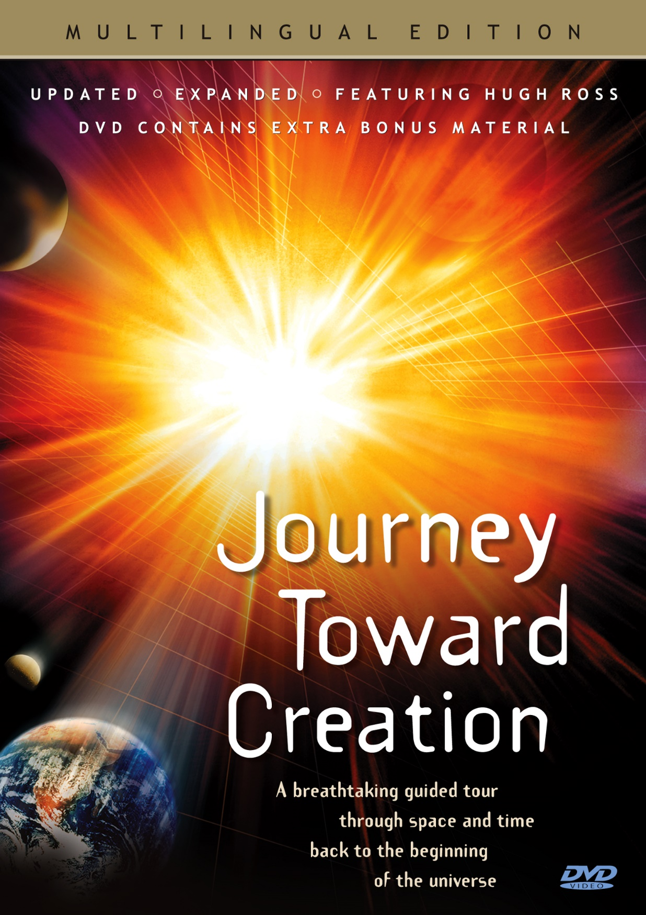
NASA/ESA/Hubble Heritage Team (STScI/AURA)

