Slide 1
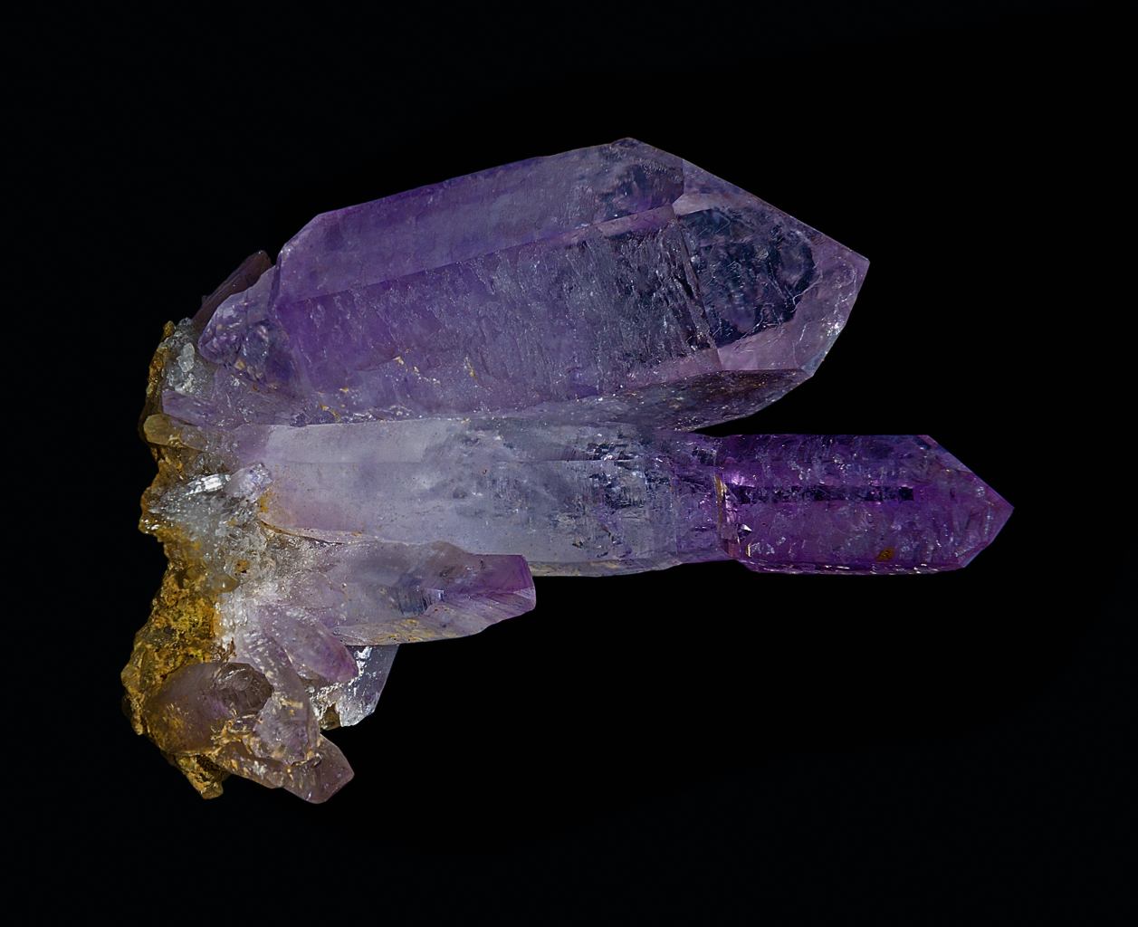
Mineral Growth History
Giant molecular clouds 12
Primitive meteorite formation 60
Achondritic formation 250
Life-initiated tectonics 1,500
Biology, GOEs, and ice ages 4,300

Slide 2
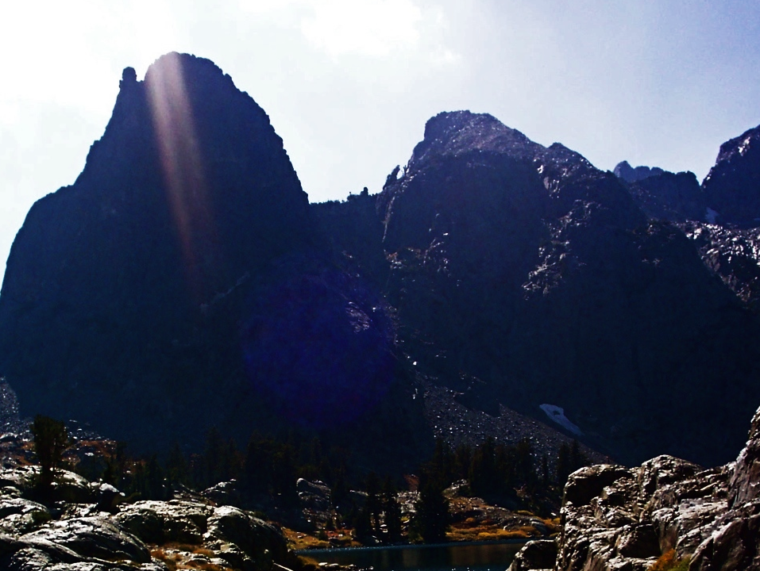
Solar Luminosity
100%
90%
80%
0 1 2 3 4 5 6
Sun’s age (billions of years)
Hugh Ross
Notes:
Advanced life can tolerate only a tiny change in solar luminosity.

Slide 3
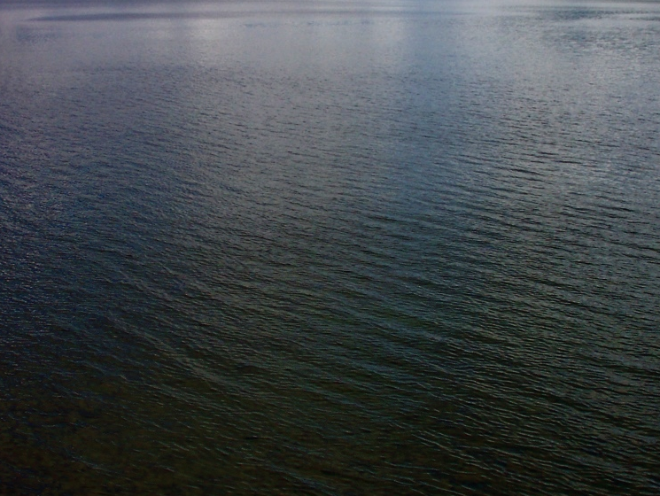
photosynthesis + methanogenesis:
CO2 + 2H2O CH4 + 2O2
sunlight:
CH4 + 2O2 CO2 + O2 + 4H
net reaction:
CO2 + 2H2O CO2 + O2
Notes:
80% of the world’s manganese ores were laid down during the GOE.

Slide 4
Solar Luminosity
100%
90%
80%
0 1 2 3 4 5 6
Sun’s age (billions of years)
Hugh Ross
Notes:
Advanced life can tolerate only a tiny change in solar luminosity.

Slide 5

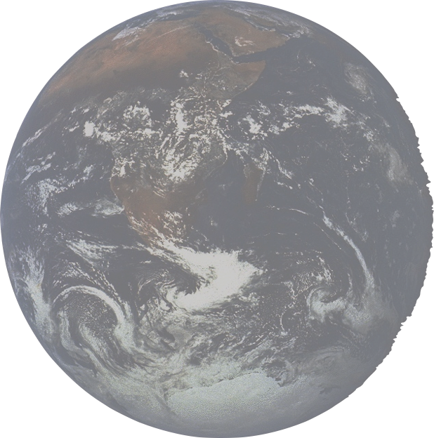

Atmospheric Oxygen
20%
15%
10%
5%
0
0 1 2 3 4
age of Earth (billions of years)
NASA

Slide 6
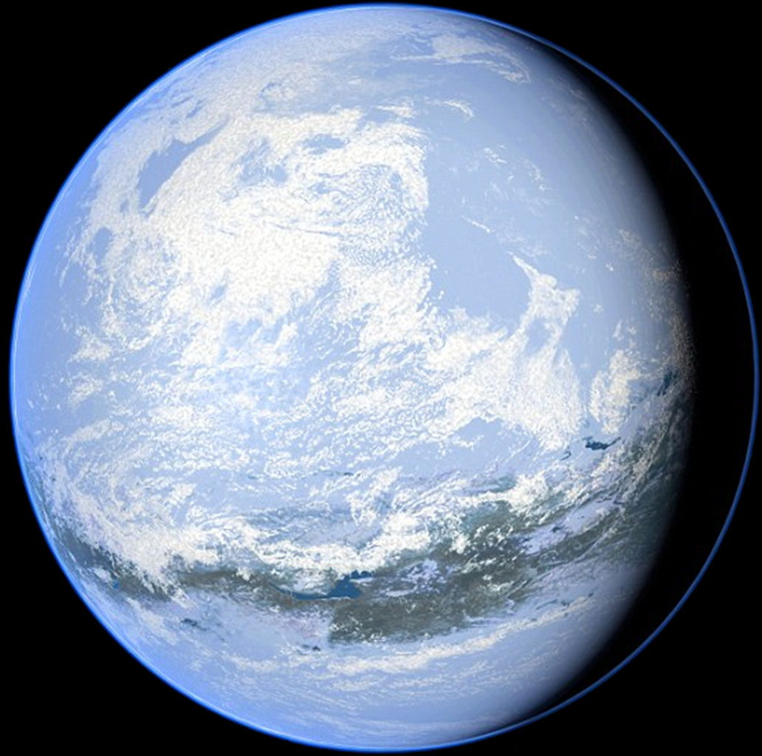

Slide 7
