Slide 1
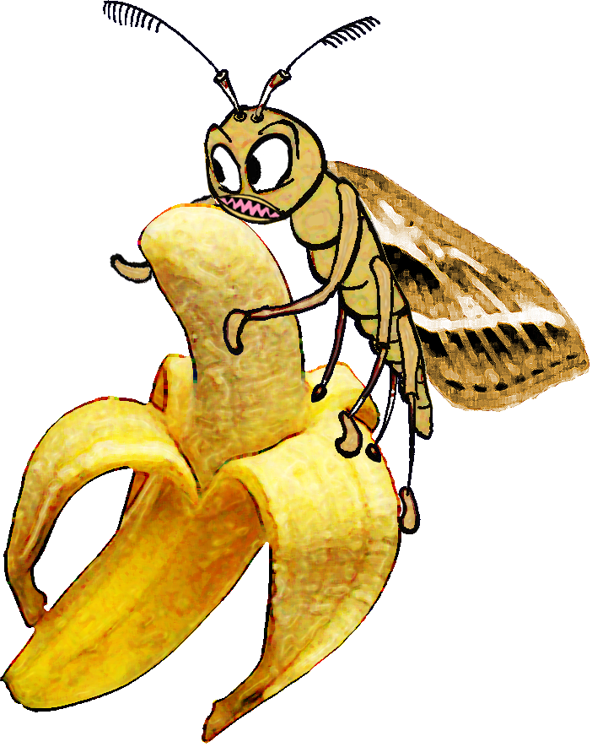
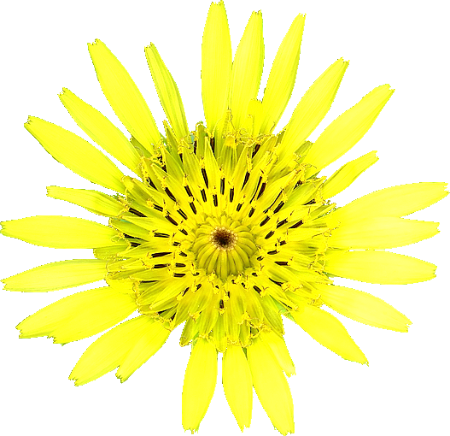
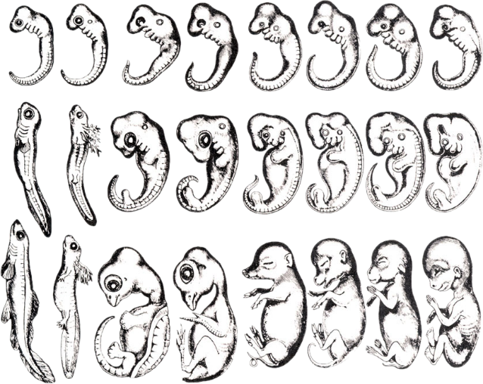
Evolution Fails
Epic
^
Richard Deem,
Paradoxes Class, April 27, 2014
Notes:
Survey about “Designs in DNA.”  Our topic today is “Evolution Fails.” You are probably thinking the title is incomplete. “Evolution Fails” What? The title really is “Evolution Fails.” Any of you have sons or daughters under the age of 25. If so, you might recognize that they have turned the verb “fail” into a noun. So, the phrase, “That’s a fail” refers to some kind of failure, usually involving something dumb. If you want to emphasize the fail, you call it an “epic” fail. So, if you go to YouTube and look up “epic fail” you will find things like these. Play video.  So, we are going to look at evolution’s “epic fails.” 

Slide 2
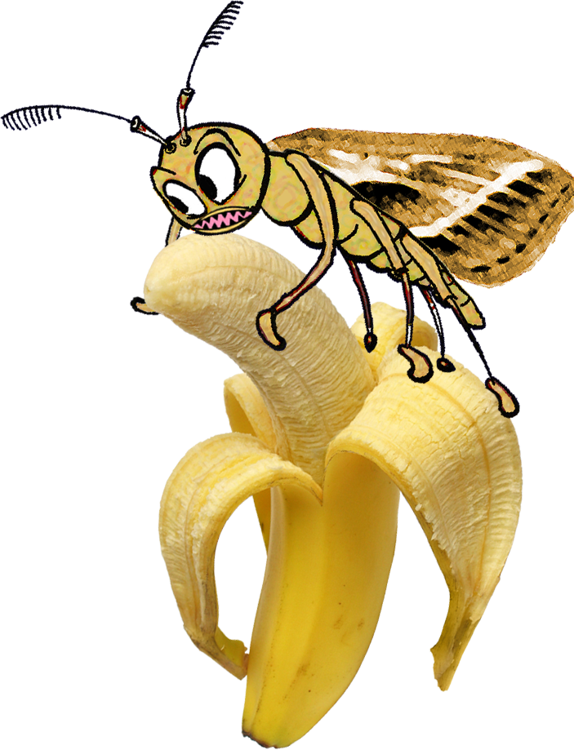
Fail #1: Hedylepta
Banana eating moth “best example of evolution”
Notes:
Our first evolution fail is Hedylepta, which is the banana-eating moth. How many of you have ever heard of this “best example of evolution?” I found out about the Hedylepta story because of the RTB apologist email list. A son of one of the apologists while studying in a Christian college had become an evolutionists because of this example of evolution in action.

Slide 3

Kenneth Miller, 1997
Notes:
The example became famous in this 1997 televised evolution/creation debate. In this video excerpt Philip Johnson is asking the question and Kenneth Miller is responding. Play video. Anybody ever heard of Kenneth Miller? He is actually the co-author of the current California high school biology teaching textbook. 

Slide 4
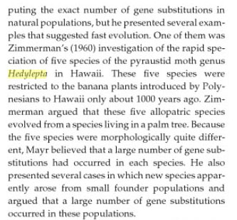
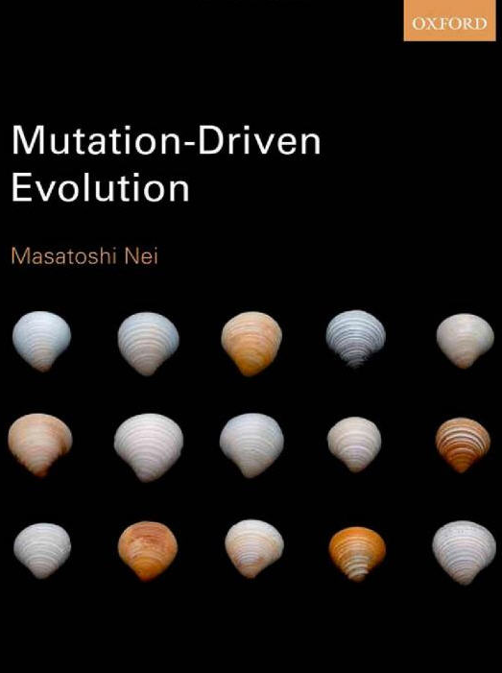

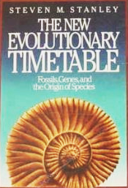

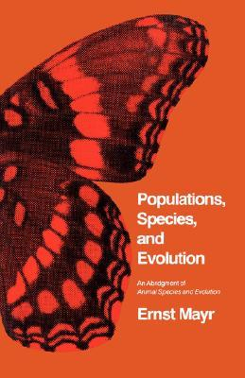
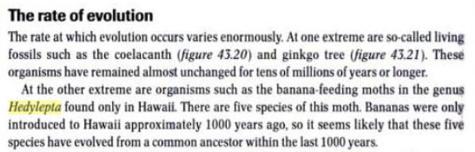
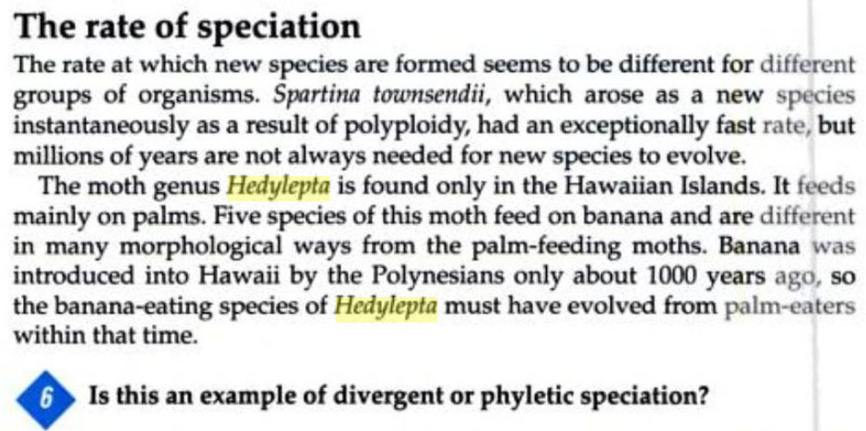

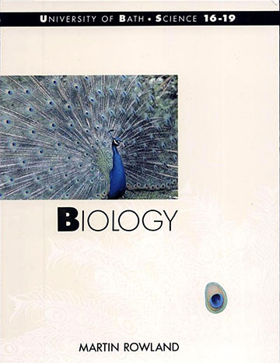
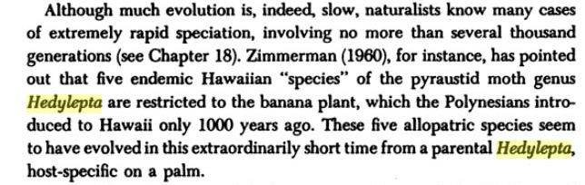

The Story Goes On…
Notes:
The story of Hedylepta has made it  into a number of textbooks. So, it must be true. Right?  And here are some excerpts from those textbooks. 

Slide 5
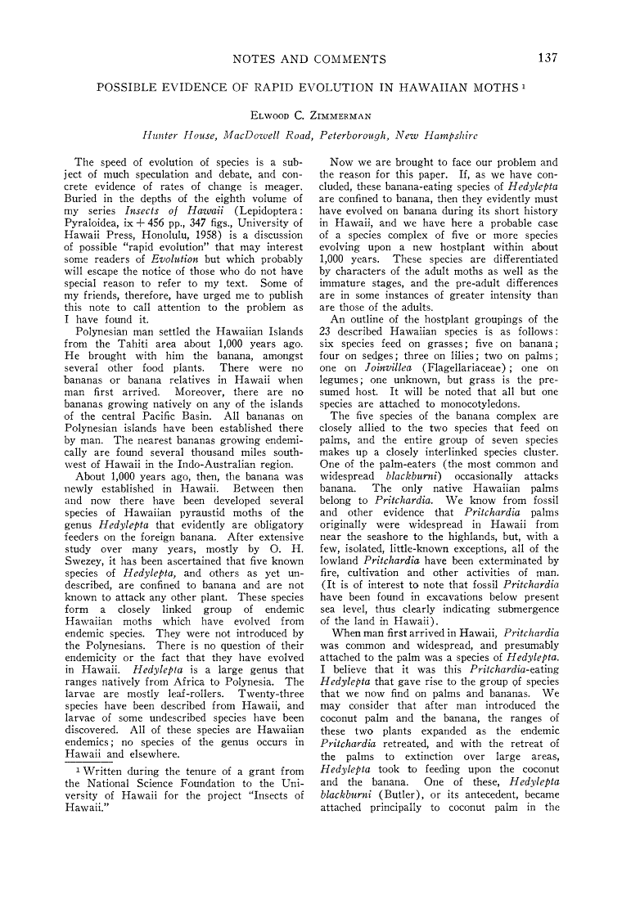
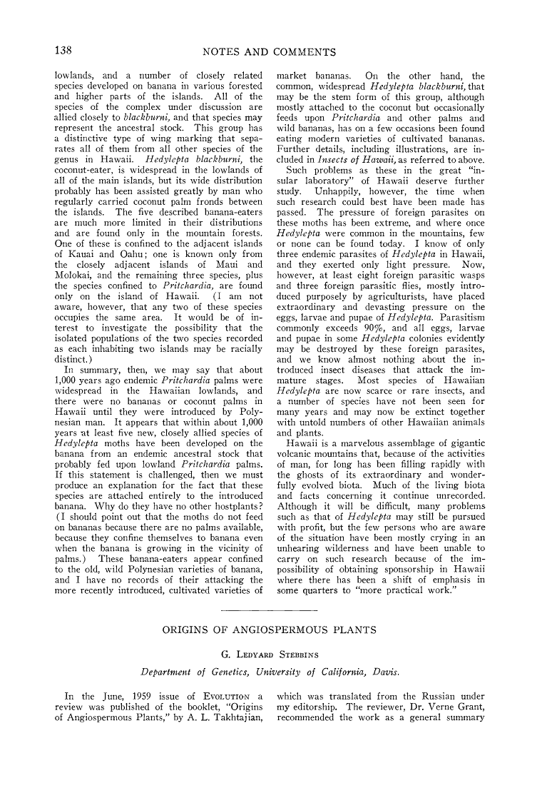
“Possible Evidence of Rapid Evolution in Hawaiian Moths”
Zimmerman, E. 1960. Possible evidence of rapid evolution in Hawaiian moths. Evolution 14: 137-138.
Notes:
 The claim comes from this short, 2-page article published by Elwood Zimmerman in 1960. However, Hedylepta is a moth and not a butterfly, as stated by Miller. And the number of species is quoted as being 5 and not 2 as claimed by Miller. There is no mention anywhere in this article of these species as having evolved “mouthparts that only allow them to feed on bananas.” You will notice that the title says “possible evidence.” How strong is this evidence? 

Slide 6
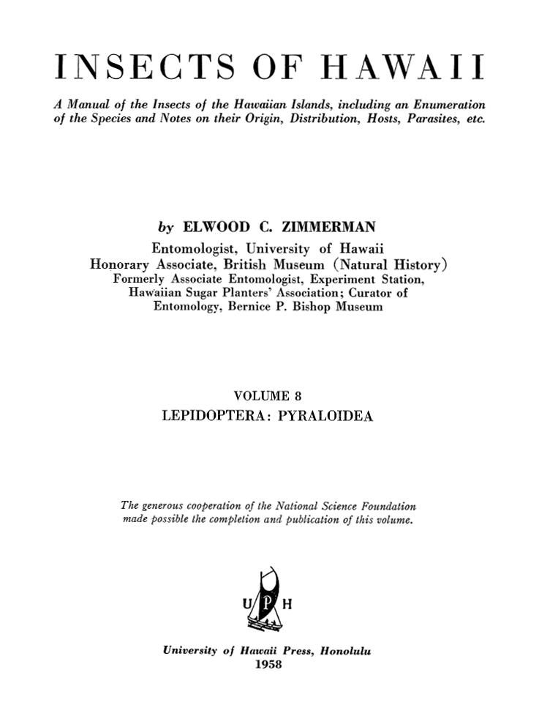
Insects of Hawaii, Volume 8
Notes:
It turns out that the main source of information on these moths  comes from this volume, Insects of Hawaii, Volume 8, published by Zimmerman in 1958. The volume and many others is available online through the University of Hawaii. 

Slide 7
Species of Hedylepta (Omiodes)
Species | Discovery | Island(s) | Food source
accepta | Butler, 1877 | Kauai, Oahu, Molokai, Maui, Hawaii | grasses/sugar cane
anastrepta | Meyrick, 1899 | Oahu, Molokai, Hawaii | sedges
anastreptoides | Swezey, 1913 | Hawaii | sedges
antidoxa | Meyrick, 1904 | Kauai, Oahu | sedges
asaphombra | Meyrick, 1899 | Kauai, Oahu, Molokai, Hawaii | Joinvillea, Flagelleraceae
blackburni | Butler, 1877 | Kauai, Oahu, Molokai, Maui, Lanai, Hawaii | palms, bananas
continuatalis | Wallengren, 1860 | Kauai, Oahu, Molokai, Maui, Lanai, Hawaii | grasses
demaratalis | Walker, 1859 | Niihau, Kauai, Oahu, Molokai, Maui, Hawaii | grasses
epicentra | Meyrick, 1899 | Oahu | sedges
euryprora | Meyrick, 1899 | Hawaii | bananas
fullawayi | Swezey, 1913 | Hawaii | bananas
giffardi | Swezey, 1921 | Hawaii | grasses
iridias | Meyrick, 1899 | Hawaii | lilies
laysanensis | Swezey, 1914 | Laysan | grasses
localis | Butler, 1879 | Kauai, Oahu, Molokai, Maui, Lanai, Hawaii | grasses
maia | Swezey, 1909 | Kauai, Oahu | bananas
meyricki | Swezey, 1907 | Hawaii | bananas
monogona | Meyrick, 1888 | Kauai, Oahu, Molokai, Maui, Lanai, Hawaii | legume Erythrina
monogramma | Meyrick, 1899 | Kauai, Oahu, Molokai, Hawaii | lilies
musicola | Swezey, 1909 | Molokai, Maui | bananas
pritchardii | Swezey, 1948 | Hawaii | palms
scotaea | Hampson, 1912 | Oahu, Molokai, Hawaii | lilies
telegrapha | Meyrick, 1899 | Hawaii | unknown
Notes:
There are 23 species of Hedylepta all endemic to Hawaii. However, most of the species when originally classified were put in the genus Omiodes, not Hedylepta. However, Zimmerman changed the genus name to Hedylepta in his 1958 volume. Eugene Munroe changed the genus back to Omiodes in 1989, which is how they are currently classified. All species except monogona eat various monocot species. Five species,  shown here feed “exclusively” on banana, according to Zimmerman’s volume. 

Slide 8
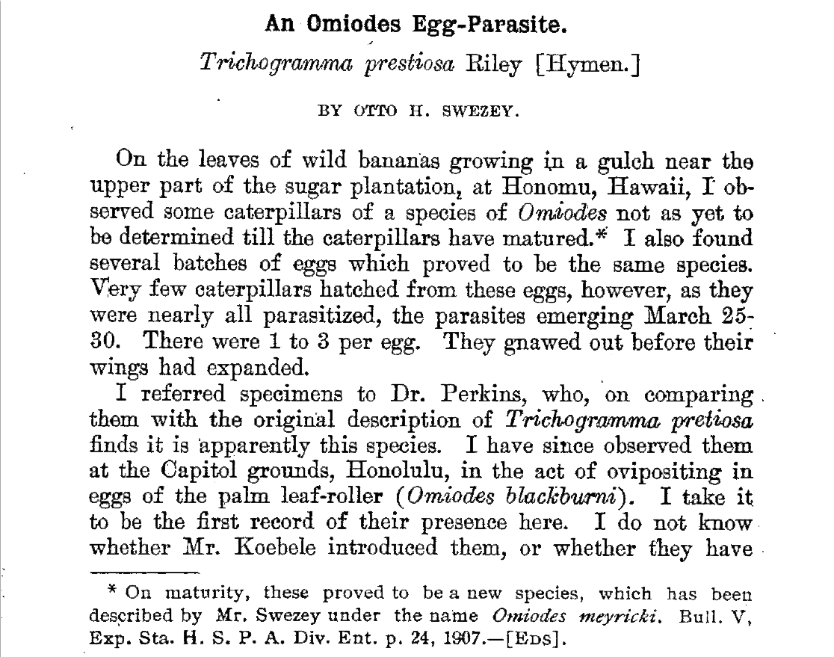
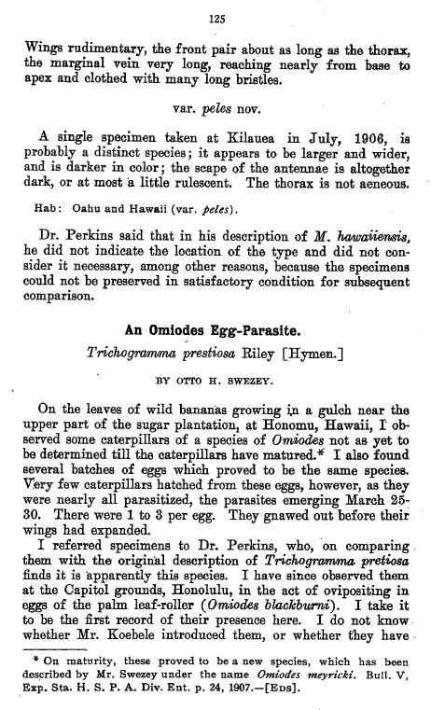
Rapid Demise of Banana Omiodes
Proc Hawaiian Entomol Soc 2(02): 035-087 August, 1908 – June 1909.
Notes:
Soon after their discovery, several species of Omiodes, including all the banana-eating species came under heavy predation from parasitic wasps. These wasps were introduced to control non-native caterpillars that were eating Hawaiian crops.  This edition of the Proceedings of the Hawaiian Entomological Society describes the discovery of the banana-eating species Omiodes meyricki.  According to the Proceedings,  “Very few caterpillars hatched from these eggs, however, as they were nearly all parasitized…” So, the banana-eating species were already in trouble over 100 years ago. At this point, they haven’t been seen in many years and are probably extinct. 

Slide 9
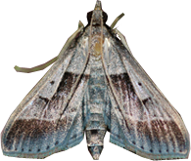
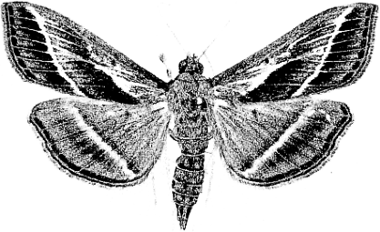
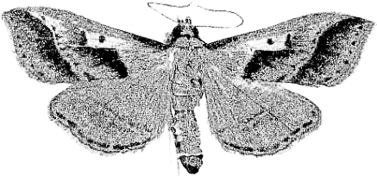
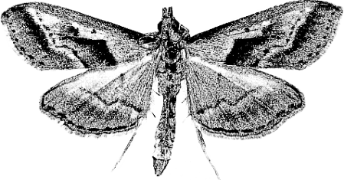
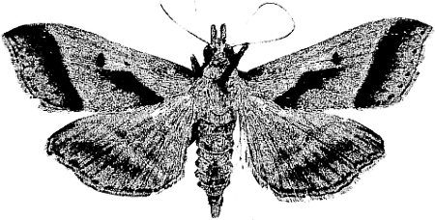
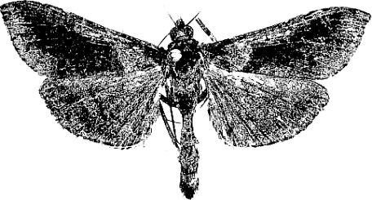
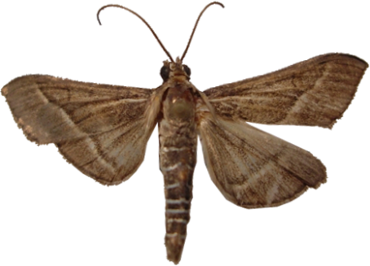
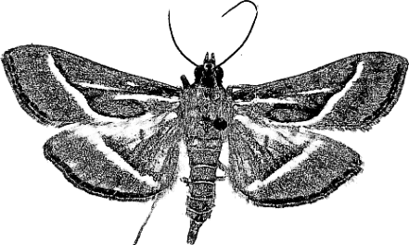
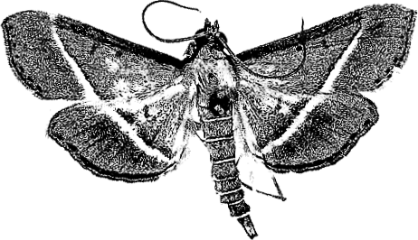
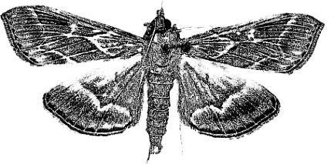
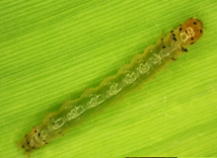
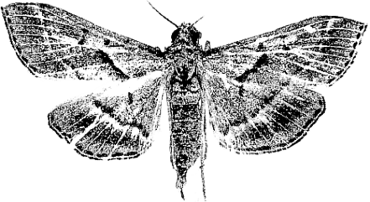
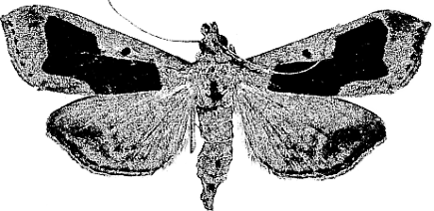
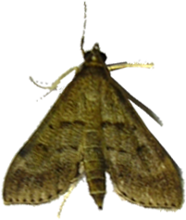
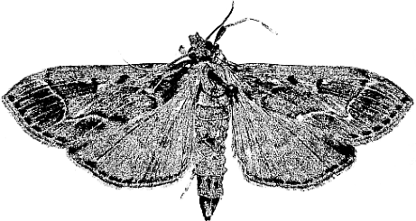
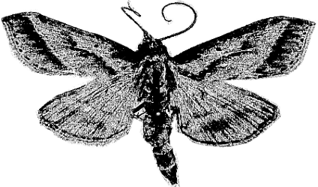
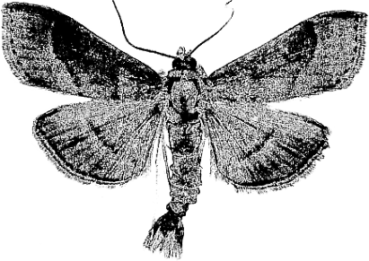
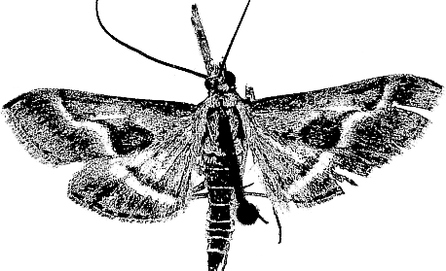
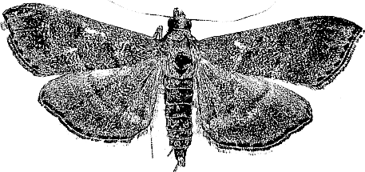
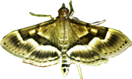
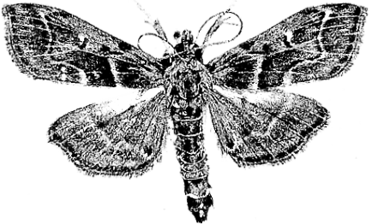
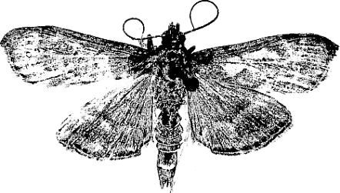
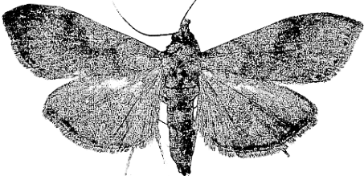
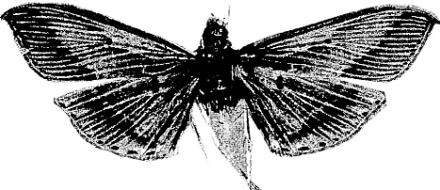
Omiodes Species of Hawaii
accepta
anastrepta
anastreptoides*
antidoxa
asaphombra*
blackburni
continuatalis
demaratalis
epicentra*
euryprora*
fullawayi*
giffardi*
iridias*
laysanensis*
localis
monogramma
musicola*
pritchardii*
scotaea
telegrapha*
Zimmerman, E. 1958. Insects of Hawaii, Volume 8
Notes:
These are twenty of the 23 species. Three species are not shown (Monogona, maia, meyricki) because they are quite rare. The species that eat banana are shown in orange. Those with an asterisk are either endangered or extinct, including all the banana-eating species.  These are color images of a few species.  The caterpillars are all light green in color, as shown here. 

Slide 10
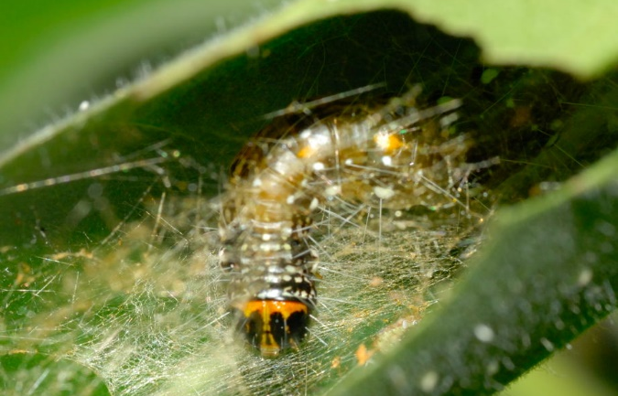
Leaf Roller Caterpillars
Notes:
All the caterpillars of Omiodes are  called leaf rollers, because they produce silk threads and roll the leaves up in order to hide while eating. So, they eat the leaves of bananas, palms, sedges, and grasses. No specialized mouth parts are necessary to eat one species of plant leaf over another. Is there any evidence that evolution is required to eat a particular kind of plant? Are species that eat one kind of plant more closely related to each other than species that eat different plants?

Slide 11
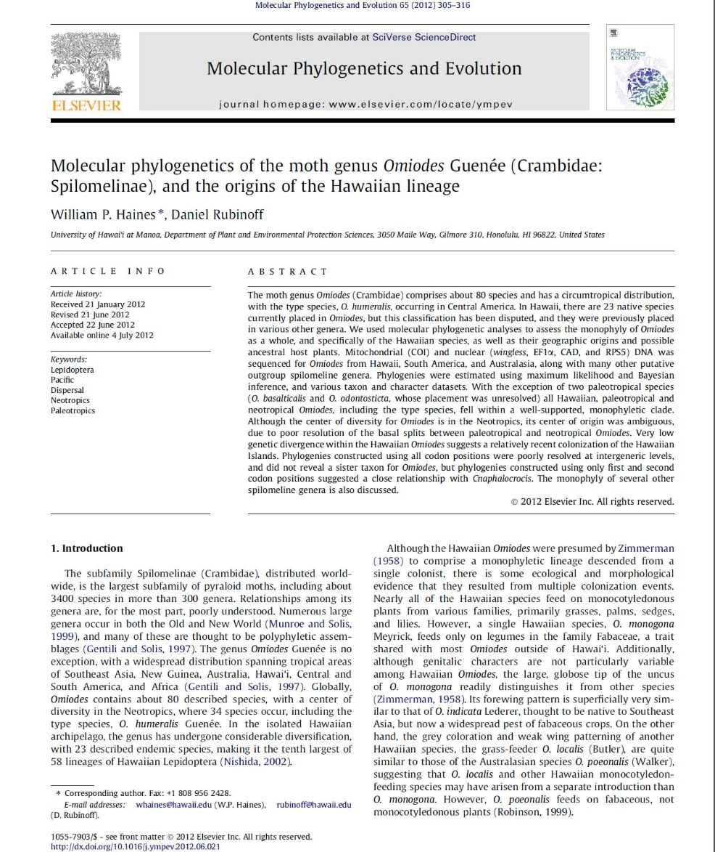
Molecular phylogenetics of the moth genus Omiodes Guenée (Crambidae: Spilomelinae), and the origins of the Hawaiian lineage
Notes:
The questions the “evolution” of Hawaiian Omiodes are partially answered in this article, published in 2012. Scientists examined 81 taxa, including 10 Hawaiian species for their genetic similarity. Unfortunately, they did not include any of the banana-eating species, since they could not be found. 

Slide 12
Genes Sequenced
Gene | Base Pairs
Cytochrome c oxidase subunit 1 | 1389
Wingless | 414
Elongation factor 1α | 750
Ribosomal protein S5 | 597
Carbamoylphosphate synthetase/ aspartate transcarbamylase/ dihydroorotase (CAD) | 615
William P. Haines, Daniel Rubinoff. 2012. Molecular phylogenetics of the moth genus Omiodes Guenée (Crambidae:
Spilomelinae), and the origins of the Hawaiian lineage. Molecular Phylogenetics and Evolution 65 (2012) 305–316.
Notes:
They sequenced these five genes, which were selected because they tend to have higher genetic variability than other genes. 

Slide 13
Genetic Variability of Omiodes
William P. Haines, Daniel Rubinoff. 2012. Molecular phylogenetics of the moth genus Omiodes Guenée (Crambidae:
Spilomelinae), and the origins of the Hawaiian lineage. Molecular Phylogenetics and Evolution 65 (2012) 305–316.
Notes:
This is a graph of the genetic variability of Omiodes and related genera for those five genes.  The green bars represent the genetic variability for Omiodes outside Hawaii  and the purple bars represent the genetic variability for Hawaiian Omiodes. So, the Hawaiian Omiodes are much less genetically diverse than those outside Hawaii. However, the article also indicated that all geographically contiguous species were less diverse than groups as a whole, although the data was not presented in the publication. 

Slide 14
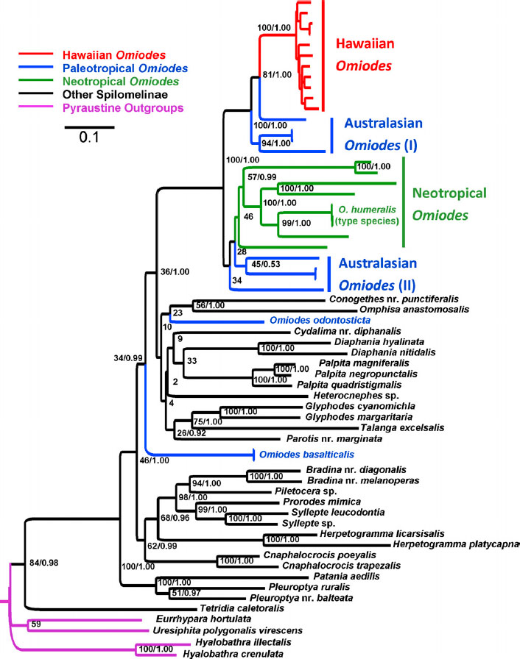
Genetic Phylogeny of Omiodes
William P. Haines, Daniel Rubinoff. 2012. Molecular phylogenetics of the moth genus Omiodes Guenée (Crambidae:
Spilomelinae), and the origins of the Hawaiian lineage. Molecular Phylogenetics and Evolution 65 (2012) 305–316.
Notes:
This is a phylogenetic tree generated for this data. A computer program compares the sequence similarities and differences to determine what species are similar to each other. For example,  these two species are quite similar, because they come from  the same branch point. And those two species are somewhat similar  to the species below, since they are connected at the  next level up branch point. In this phylogeny, the  Hawaiian Omoides can be seen in the top, clustering along with some of the Australian Omiodes. 

Slide 15
Genetic Phylogeny of Hawaiian Omiodes
O. monogona legume
O. continuatalis grasses
O. demaratalis grasses
Hawaiian
O. monogramma lilies
O. accepta grasses
Sugar cane
O. localis grasses
O. antidoxa sedges
O. anastrepta sedges
O. anastreptoides sedges
O. scotaea lilies
O. blackburni palms
Bananas
O. poeonalis (Australia)
O. diemenalis (Australia)
O. indicata (SE Asia)
Omiodes sp. (Papua New Guinea)
William P. Haines, Daniel Rubinoff. 2012. Molecular phylogenetics of the moth genus Omiodes Guenée (Crambidae:
Spilomelinae), and the origins of the Hawaiian lineage. Molecular Phylogenetics and Evolution 65 (2012) 305–316.
Notes:
This is close-up of the genetic phylogeny of the Hawaiian Omiodes and related species. I have added the food source of the species so we can see if that makes a difference in phylogeny. The Hawaiian species  cluster into two main groups.  Both clusters contain species that eat grasses.  Both clusters contain species that eat lilies.  Scotaea and blackburni cluster together as being most similar,  but one eat lilies and the other palms. Omiodes blackburni, in addition to eating coconut palms, also eats bananas. And Omiodes accepta eats grasses, sedges  and also sugar cane. Sugar cane wasn’t introduced into Hawaii until 150 years ago, so accepta must have evolved super fast. The truth is that some of these species can use multiple leaf sources for food and no evolution is required for them to jump from one food source to another. So, this data shows that food source is not related to phylogeny. 

Slide 16
What Miller Got Wrong
Fact | Ken Miller | Actual
Genus | Hedylepta | Omiodes
# species | 2 | 5
Specialized mouth parts | Yes | No
Changing food source requires evolution | Yes | No
Food source | Only banana | Banana & ?
Epic Fail!
Notes:
So, what did Kenneth Miller’s get wrong? He named the wrong genus, since it was Omiodes instead of Hedylepta. It was 5 species instead of 2. There was no evolution of specialized mouth parts. And molecular phylogeny of Hawaiian Omiodes shows that food source is not related to evolution. The only thing that might be right is that the five species feed on only on banana. But even that claim cannot be tested, since all 5 banana-eating species are now extinct. So, the  banana-eating moth story is an evolutionary epic fail! 

Slide 17
Fail #2: Speciation of Goatsbeard (Tragopogon miscellus)
Newly evolved species since 1940?
Notes:
Our next example of evolutionary epic fails comes from speciation of Goatsbeard plants, which were supposed to have evolved since 1940. 

Slide 18
TalkOrigins Website
“Three species of wildflowers called goatsbeards were introduced to the United States from Europe shortly after the turn of the century. Within a few decades their populations expanded and began to encounter one another in the American West. Whenever mixed populations occurred, the species interbred (hybridizing) producing sterile hybrid offspring. Suddenly, in the late forties two new species of goatsbeard appeared near Pullman, Washington. Although the new species were similar in appearance to the hybrids, they produced fertile offspring. The evolutionary process had created a separate species that could reproduce but not mate with the goatsbeard plants from which it had evolved.”
http://www.talkorigins.org/faqs/speciation.html
Notes:
This story comes from the TalkOrigins website, which is a major promoter of evolution. Here’s the story. Read story. 

Slide 19

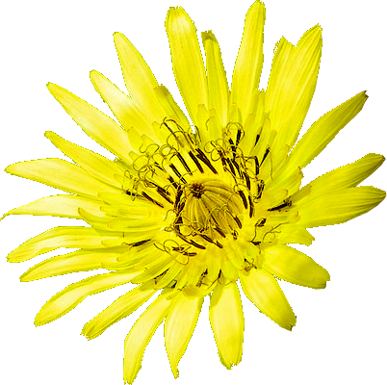
Generation of T. miscellus
Tragopogon miscellus
Tragopogon pratensis
Tragopogon dubius
Notes:
So,  Tragopogon pratensis combined with  Tragopogon dubius to form a  new species (Tragopogon miscellus) that  could not backcross with either parental species. Speciation in action! Evolution is confirmed! 

Slide 20

Mitosis (Normal Cell Division)
Notes:
In order to understand what happened to these goatsbeard species, we need to understand how sexual reproduction works. Since most of you have taken at least high school biology, this will be a review. Most species (including us) are diploid – that is, we have two copies of each chromosome. Goarsbeard species have 6 pairs of chromosomes. In normal cell division, called mitosis, the paired chromosomes  are duplicated then pulled to opposite ends of the cell as it divides. The result are two identical daughter cells that contain a pair of each chromosome. 

Slide 21
Meiosis
Haploid gametes
Notes:
In the sex cells or gametes, there is a reductive cell division, in which the final cell division is  not accompanied by chromosomal duplication. So, each daughter cell gets one copy of each chromosome. The gametes are termed “haploid.” 

Slide 22
Gamete Fusion
Diploid organism
Notes:
The embryo is formed when the two gametes fuse, restoring the diploid chromosome number. 

Slide 23
Gamete Fusion of Two Species
Tragopogon pratensis
Hybrid
Tragopogon dubius
Notes:
In the case of two different goatsbeard species,  fusion of gametes produces a hybrid. However, since the chromosomes were not completely compatible, the hybrid is sterile, since meiosis of the hybrid is unsuccessful. 

Slide 24
Tetraploid Hybrid Formation
Diploid gametes
Tragopogon pratensis
2N = 12
Tragopogon dubius 2N=12
Tragopogon miscellus
2N = 24
Notes:
There were two separate instances of meiosis failure in which two different species of goatsbeard, Tragopogon pratensis and Tragopogon dubius  both duplicated their chromosomes prior to the  final gamete division, producing diploid gametes.  When gametes from these species combined a tetraploid organism was produced. You will notice that there are now 12 pairs of chromosomes instead of 6. How much new information was created when the tretraploid species was formed? 

Slide 25
No Backcross
Tragopogon pratensis
2N = 12
Tragopogon dubius 2N=12
Tragopogon miscellus
2N = 24
Notes:
Why doesn’t the backcross work? When diploid species of Goatsbeard  undergoes meiosis, there are 6 chromosomes in the gametes. When the tetraploid species  undergoes meiosis there are 12 chromosomes. When gametes from  either diploid species  cross with the tetraploid species there is a chromosome mismatch. So, the backcross fails not because of any kind of evolution of new information, but simply because a mismatch in chromosome number. 

Slide 26
Goatsbeards Conclusions
The origination of a new species of goatsbeard was due to a single genetic event that created a tetraploid plant
Chromosomal mismatch prevented parental backcross
No new information created
Epic Fail!
Notes:
 The origination of a new species of goatsbeard was due to a single genetic event that created a tetraploid plant.  The inability of the new species to cross with parental species was simply due to chromosomal mismatch.  So, no new information was created during this “speciation” event. The Goatbeards story is an  evolutionary epic fail!

Slide 27
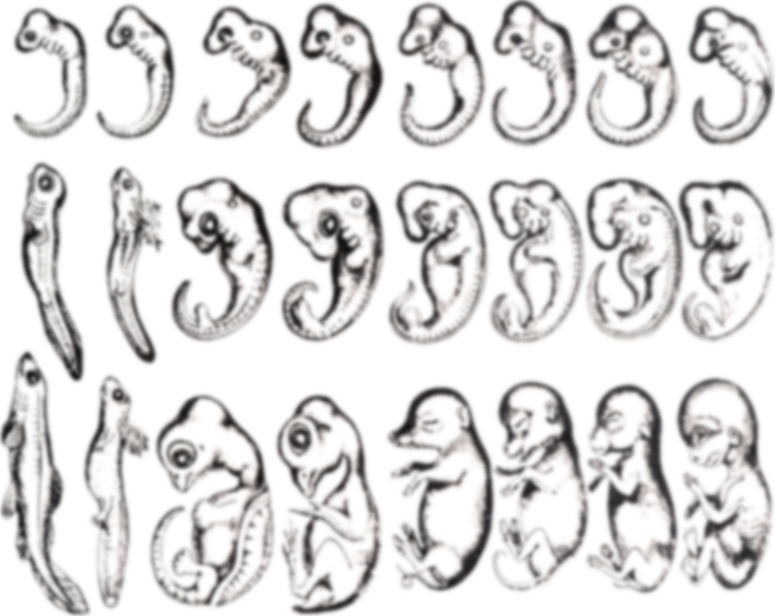
Fail #3: Ontogeny Recapitulates Phylogeny
Ernst Haeckel’s Embryos/von Baer’s law
Notes:
I know that most of you took biology in high school. On a show of hands, how many of you learned about the evolutionary concept of “ontogeny recapitulates phylogeny”? In my high school biology course in 1968, we were taught that this concept was true that the ontogeny or developmental process went though stages of a species’ phylogeny or the pathway by which the species had evolved. 

Slide 28
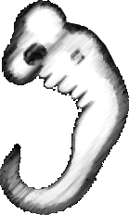



Embryos Pass Through a Common (Phylotypic) Stage?
Evolutionary Hourglass
Notes:
The modern version of the theory comes from a concept first developed by Karl von Baer in 1828. According to this theory embryos go through a kind of  evolutionary hourglass, in which different species pass through a  common, phylotypic stage, before going on to  differentiate into their respective species. 

Slide 29
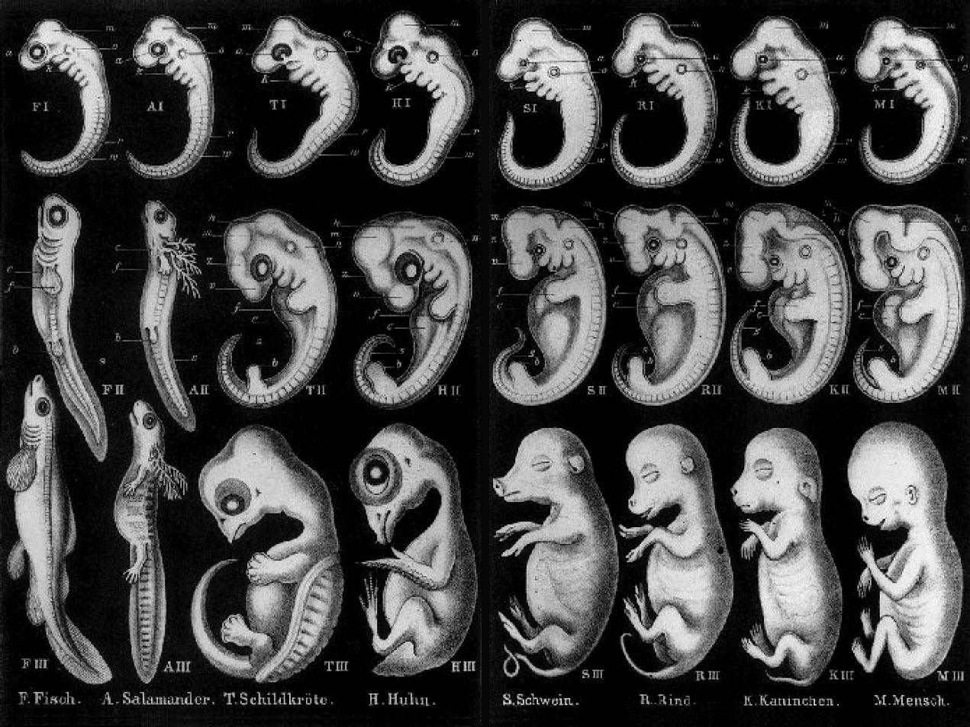
Ernst Haeckel’s Embryos
Fish
Salamr
Tortoise
Chicken
Pig
Cow
Rabbit
Human
Haeckel E (1874) Anthropogenie oder Entwickelungsgeschichte des Menschen. Engelmann, Leipzig
Notes:
This idea was made famous by Ernst Haekel, whose drawings of embryos probably made it into the textbook you studied in high school.  These are the species supposedly depicted by these drawings.  In the “tailbud” stage, all the embryos were supposed to look the same. 

Slide 30

Haeckel’s Supporters
“Embryos of different species (of vertebrate) pass through identical embryonic stages before acquiring their specific features.”
(Butler and Juurlink, 1987)
Butler H, Juurlink, BHJ (1987) An atlas for staging mammalian and chick embryos. CRC Press, Boca Raton, Florida
Notes:
There are contemporary scientists and textbooks that promote this idea. Butler and Juurlink say, “Embryos of different species (of vertebrate) pass through identical embryonic stages before acquiring their specific features.” 

Slide 31
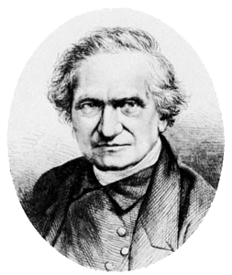
Haeckel’s Critics
“There is no stage of development in which the unaided eye would fail to distinguish between them [vertebrate embryos] … a blind man could distinguish between them.”
(Adam Sedgwick, 1894).
Sedgwick, Adam (1894) On the law of development commonly known as von Baer’s law; and on
the significance of ancestral rudiments in embryonic development. Q J Microsc Sci 36: 35–52.
Notes:
However, even in the 19th century Haeckel had his critics. Adam Sedgwick said that a blind man could distinguish between vertebrate embryos. 

Slide 32

Haeckel’s Critics
“…there are no grounds for the view that an organism as it develops passes through systematic categories of differing ‘values’, or of differing degrees of estrangement from organisms of other groups…”
(Gavin de Beer, 1951)
Gavin De Beer. 1951. Embryos and Ancestors, Clarendon Press.
Gavin de Beer. 1951. Embryos and Ancestors.
Notes:
And, of course, there are more contemporary critics of Haeckel’s idea. Gavin de Beer, in Embryos and Ancestors, said, “…there are no grounds for the view…”

Slide 33
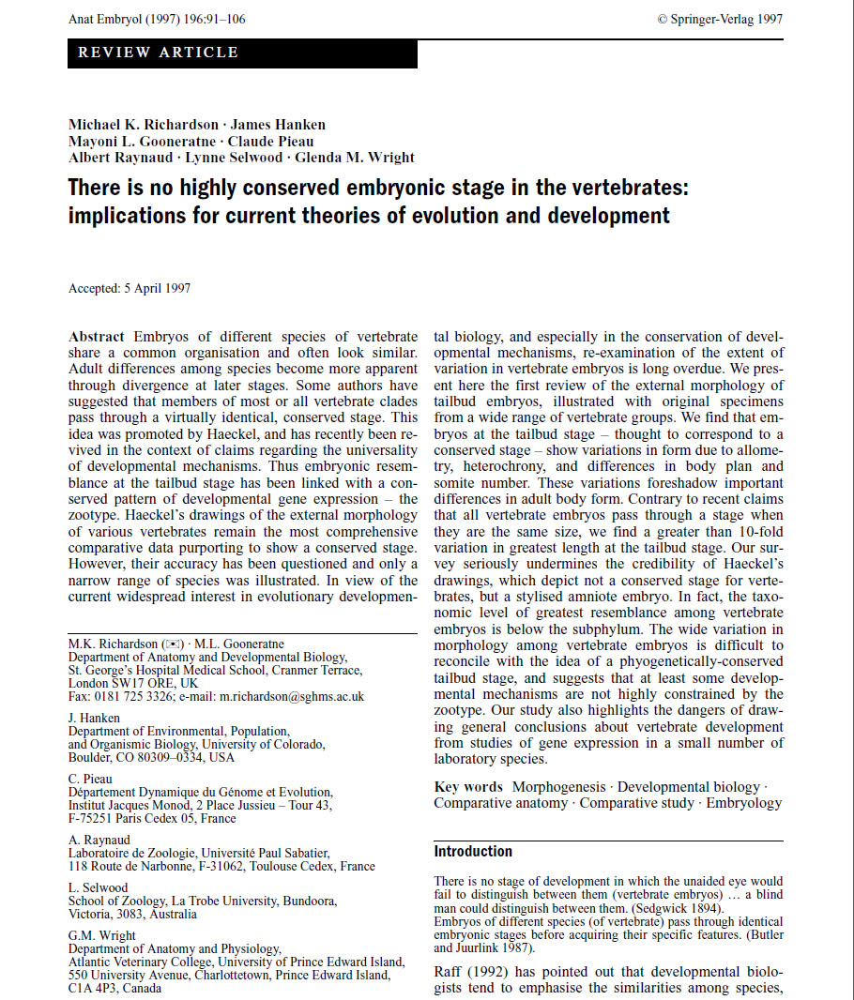
No Conserved Embryonic Stage
Michael K. Richardson, et al. There is no highly conserved embryonic stage in the vertebrates:
implications for current theories of evolution and development. Anat Embryol (1997) 196:91–106.
Notes:
Despite criticisms, no scientists really looked closely at the idea  until this paper was published in 1997. The following slides look at embryonic development of different classes of vertebrates as shown in this paper. 

Slide 34







Comparison of Fish Embryos
Sea lamprey
Electric ray
Sterlet
Flying fish
Salmon
African Lungfish
Queensland lungfish
Michael K. Richardson, et al. Anat Embryol (1997) 196:91–106.
Notes:
 These are comparisons of different fish embryos, all photographed at the same scale at the tailbud stage of development. As you can see, there is quite a bit of variability even within different species of fish. 

Slide 35










Comparison of Amphibian Embryos
Blind worm
Mudpuppy
Hellbender
Mexican
axolotl
PR treefrog
Frog
Alpine
newt
Sharp-ribbed
salamander
Striped
chorus frog
Toad
Michael K. Richardson, et al. Anat Embryol (1997) 196:91–106.
Notes:
 And these are different species of amphibia. 

Slide 36





Comparison of Reptile Embryos
Alligator
European
pond terrapin
African
skink
Australian
skink
Green
lizard
Michael K. Richardson, et al. Anat Embryol (1997) 196:91–106.
Notes:
 And here we have different species of reptiles. 

Slide 37





Comparison of Bird Embryos
Duck
Sparrow
Moorhen
Quail
Chicken
Michael K. Richardson, et al. Anat Embryol (1997) 196:91–106.
Notes:
 And here are bird embryos. 

Slide 38









Comparison of Mammal Embryos
Dog
Rabbit
Anteater
Human
Possum
Rat
Sheep
Cat
Hedgehog
Michael K. Richardson, et al. Anat Embryol (1997) 196:91–106.
Notes:
 And finally, we have different species of mammalian embryos. 

Slide 39






Haeckel’s Embryos vs. Reality
Fish
Salamander
Chicken
Rabbit
Human
Notes:
 And this is a comparison of Haeckel’s drawings to photographs of what the respective species really look like. Do you think Ernst Haeckel fudged his drawings just a little? 

Slide 40
Ontogeny Recapitulates Phylogeny Conclusions
There is no common phylotypic stage for vertebrate embryos
Ernst Haeckel “Photoshopped” his drawings
Epic Fail!
Notes:
So, in conclusion,  there is no common phylotypic stage for vertebrate embryos and  Ernst Haeckel “Photoshopped” his drawings. Ontogeny recapitulates phylogeny is an  evolutionary epic fail! 

Slide 41
Fail #4: Peppered moths
Not?
^
Is the peppered moth a bad example of natural selection/evolution?
Notes:
How many of you have read Icons of Evolution or heard that the peppered moth is a bad example of natural selection? It turns out that some of the details you have heard are true, but the conclusion that peppered moths are not a good example of natural selection  is false. We will also look at the question of whether or not peppered moths are a good example of evolution in action. 

Slide 42


Peppered Moth and Camouflage
Edleston RS. 1864. Entomologist 2:150.
Notes:
Prior to 1848 in Britain, virtually all peppered moths were speckled with both black and white scales. In that year, and subsequently, a darker form, called carbonaria, of the moth appeared.  Here we can see the carbonaria moth on a lichen-covered tree branch,  where it is pretty easily detected. However,  the peppered typica variety is quite well camouflaged on these branches. 

Slide 43
Peppered Moth and Camouflage
Notes:
In the mid-1800’s the Industrial revolution took off and industrial cities of Britain produced lots of pollution that killed the lichen and darkened tree branches with soot. Here you can see carbonaria on a dark branch,  compared to typica, which is quite readily seen. By the turn of the 20th century, carbonaria replaced typica by up to 98% in polluted forests. Clean air legislation passed in the 1950s resulted in a restoration of British woodlands and the frequency of carbonaria declined from about 90% in 1970 to less than 20% in 1995. 

Slide 44
Theories on Industrial Melanism
Industrial pollutants changed moth development to produce dark color
Natural selection favored survival of better camouflaged moths
Tutt, J. W. 1896. British Moths. Routledge, London.
Notes:
Two main theories were proposed to explain the rise of industrial melanism in peppered moths.  Initially, most scientists believed industrial pollutants had changed moth development to produce dark color. However, experiments designed to test this hypothesis had conflicting results.  James Tutt proposed in 1896 that natural selection favored survival of better camouflaged moths and that birds were the selective agents. John Haldane calculated that carbonaria had a higher fitness by 30-50% over typica. 

Slide 45
Human Observation of Moths
Kettlewell, H. B. D. 1955 Selection experiments on industrial melanism in the Lepidoptera. Heredity 9: 323–342.
Notes:
Bernard Kettlewell was the first scientist to attempt to prove Tutt’s natural selection hypothesis. First, he compared the visibility of typica and carbonaria on dark and light trees to human observers. Who sees better, humans or birds? Why? So, the results show that  typica is much more visible on dark wood and  carbonaria is much more visible on light wood. 

Slide 46

Moths on Lichen
Kettlewell, H. B. D. 1956. Further selection experiments on industrial melanism in the Lepidoptera. Heredity 10: 287–301.
Notes:
These are Kettlewell’s photos of typica and carbonaria on lichen. 

Slide 47

Moths on Darkened Wood
Kettlewell, H. B. D. 1956. Further selection experiments on industrial melanism in the Lepidoptera. Heredity 10: 287–301.
Notes:
Here are the two forms on darkened wood. 

Slide 48
Moth Recapture Frequencies
Kettlewell, H. B. D. 1956. Further selection experiments on industrial melanism in the Lepidoptera. Heredity 10: 287–301.
Notes:
 This graph shows the frequency of typica and carbonaria in polluted and unpolluted forests. Carbonaria had a much higher frequency in polluted woods whereas typica had a much higher frequency in unpolluted woods. The other experiments Kettlewell marked and released the two forms of moths in these two forests and measured their recapture frequency.  The second graph shows the recapture frequency for the two moths forms in polluted and unpolluted forests. Carbonaria was recaptured more frequently than typica in polluted woods, whereas typica was recaptured more frequently in unpolluted woods. These were the results one would expect if bird predation was the selective agent. These kinds of experiments were verified independently by other researchers. 

Slide 49
Decline of carbonaria (Leeds, UK)
Cook LM, et al. 2005. Melanic moth frequencies in Yorkshire, an old English industrial hot spot. J. Hered. 96: 522–528.
Notes:
Laurence Cook had kept nearly 40 years records of carbonaria frequencies in Leeds, showing that the anti-pollution laws of the 1950’s had resulted in the  gradual replacement of carbonaria by typica as lichens returned to the trees and soot disappeared. 

Slide 50
Problems with Kettlewell Experiments
Too many moths and too few release sites
Moths were released onto tree trunks, instead of under lateral branches
Moths were released during the day, and so might not have selected good sites to hide
Kettlewell used mixtures of caught and lab bred moths, which might behave differently
Kettlewell used translocated moths
Bats as predators?
Notes:
Kettlewell’s experiments were not without problems.  He released too many moths at too few sites, resulting in what has been called the “birds dinner table” effect.  Moths were released onto tree trunks instead of lateral branches, probably because the researchers didn’t want to climb or use ladders.  Moths were released during the day, probably because the researchers didn’t want to get up before dawn, when the moths usually selected their landing sites.  Kettlewell used mixtures of caught and lab bred moths, which might behave differently,  and he used translocated moths that might have had different behaviors as a result of local adaptation.  Finally, some people objected that bats might be primary predators of peppered moths. 

Slide 51

Predation of Peppered Moths by Bats
Majerus, M. Non-morph specific predation of peppered moths ( Biston betularia ) by bats. Ecological Entomology (2008), 33, 679–683.
Notes:
Let’s look at the bat question first. How do bats hunt?  Here is a picture of a bat. You’ve heard the expression “Blind as a bat.” Do you see its eyes? What about those ears? This is a graph of predation of typica vs. carbonaria by bats over a 3-year period. As expected, bats have no preference of one moth form over another. 

Slide 52
Michael Majerus 6-Year Study (4864 released moths)
Low density (1 moth) at 16 of 103 release sites per night
Moths were released where they normally rested
Moths were released at night when they are normally active
Binocular observation showed 26% of moths were eaten by birds
Notes:
Michael Majerus performed a 6-year study using nearly 5,000 moths to correct deficits in Ketterwell’s methods.  He released moths at low density (1 moth) at 16 of 103 release sites per night.  Moths were released where they normally rested.  And they were released at night when they are normally active.  Binocular observation showed 26% of moths were eaten by birds. 

Slide 53

Peppered Moth Predation Results
L. M. Cook, et a. 2012. Selective bird predation on the peppered moth. Biol. Lett. doi:10.1098/rsbl.2011.1136.
Notes:
Here are the results of his study, showing that typica had better survival than carbonaria in an era when pollution was minimal. So, these results show that the peppered moth is an excellent example of natural selection in action.

Slide 54

Peppered Moth Evolution?
How much “evolution?”
Carbonaria is a natural variation?
Not due to mutations in melanin genes
Notes:
What has been missing from the peppered moth story is  how much “evolution” has actually occurred. Many creationist website will say that carbonaria are a  natural variation found within all populations of peppered moths. An initial examination of peppered moth genetics focused on the melanin genes–obvious target genes. However, that study showed that the  melanin genes were not responsible for industrial melanism.  However, this genome wide study published in 2011 has definitely answered the question. 

Slide 55

Carbonaria Mutation
Arjen E. van’t Hof. 2011. Industrial Melanism in British Peppered Moths Has a Singular and Recent Mutational Origin. Science 332:958-960.
Notes:
The GWAS study in this paper showed that the carbonaria was a single base pair mutation found on chromosome 17 in a region that determined wing patterning. The mutant allele was dominant, which partially explained why it spread so rapidly throughout Britain. So, it is likely the carbonaria mutation was a one-time event that occurred in the recent past-just in time for the industrial revolution. Like most evolutionary changes, the carbonaria mutation broke the wing patterning gene so that it did not work to produce the intricate peppered appearance. 

Slide 56
Peppered Moth Conclusions
Peppered moths represent an excellent example of natural selection
The peppered moth mutation was not the result of massive evolutionary change–just one base pair change
Epic Fail!
Notes:
 So, peppered moths represent an excellent example of natural selection.  However, the peppered moth mutation was not the result of some massive evolutionary change–just one base pair change that broke the wing patterning gene. In fact, from an evolutionary viewpoint, the peppered moth  is an epic fail! 

Slide 57
What Does it All Mean?
?
Notes:
So, what does this all mean? Does all of this prove evolution is false?

