Slide 1
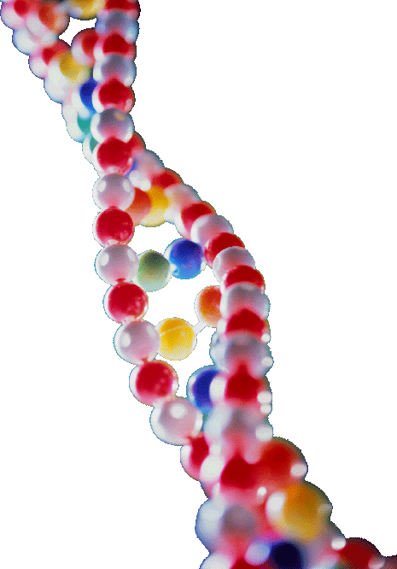
Designs in DNA
Richard Deem,
Paradoxes Class, March 16, 2014
Notes:
Today, we are going to do an experiment and you are the guinea pigs. What I am going to attempt is to show how DNA is designed for optimal efficiency and functionality.

Slide 2
The problem with biology…
…is you need to know things
Notes:
The problem with biology… …is you need to know things to understand any apologetic argument for design. So, we are going to spend some time learning the basics about biology. I would like a show of hands to determine how much background you all have in biology. So, anybody who has taken high school biology, raise your hand. Anybody who has taken a biology course in college? Biochemistry or molecular biology? If you are listening online, you must download the PowerPoint slides or you are guaranteed to get lost. Or you can watch the YouTube video at some point in the future. There are only 33 slides in this presentation, which is well under my usual 50 slides, so I want you to understand the biology and ask questions, if you don’t get it.

Slide 3
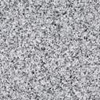
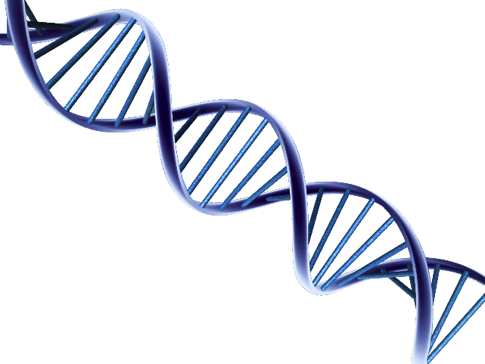

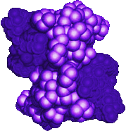
Central Dogma of Biology
Nucleus
Mitochondrion
Chloroplast
DNA
T
T
T
C
T
C
A
C
A
C
A
A
G
A
A
G
A
G
G
G
G
T
C
T
C
T
C
C
A
A
G
C
T
C
T
T
A
G
T
A
T
A
T
G
G
A
Transcription
mRNA
G
A
A
U
U
G
A
U
C
G
A
C
G
U
A
A
U
G
U
G
A
U
C
A
A
A
C
A
G
G
C
A
C
U
U
U
G
G
A
A
A
A
C
C
U
U
ER
G
A
A
U
U
G
A
U
C
G
A
C
U
G
A
A
G
A
A
C
C
U
U
Translation
Protein
Notes:
Who knows what, according to Francis Crick, is the central dogma of biology?

Slide 4
DNA Bases
Purines
Pyrimidines
NH₂
O
C
C
N
C
N
C
CH₃
HN
CH
HC
C
C
CH
N
N
O
N
H
H
Adenine (A)
Thymine (T)
O
NH₂
C
C
HN
C
N
N
CH
CH
C
C
C
CH
H₂N
N
N
O
N
H
H
Guanine (G)
Cytosine (C)
Notes:
I am going to show you the structure of some of the molecules that make up DNA so you can see how everything fits together. DNA consists of four bases: adenine (A), thymine (T), guanine (G), and cytosine (C). DNA is a four letter alphabet. Much simpler than English!

Slide 5
Structure of Deoxyadenosine
Nucleoside
Adenine (base)
NH₂
C
N
C
N
HC
C
CH
N
N
O⁻
5’
O⁻
P
OCH₂
O
O
Glycosidic Bond
3’
OH
Sugar (Deoxyribose)
Nucleotide
Notes:
The bases, in this case,  adenine, are linked to a  deoxyribose sugar through a  glycosidic bond, with the structure being called a  nucleoside. When the deoxyribose sugar is  phosphorylated, the structure is a  nucleotide. Phosphorylation occurs on the  5’ carbon and the  3’ carbon. 

Slide 6
DNA Structure
Hydrogen
Bond
OH
O
3’
H
O
H₂C
O
P
O⁻
O
N
O
Thymine
Adenine
NH
C
CH
N
C
CH₃
C
N
HN
C
HC
C
O
O⁻
N
C
CH
O
O
H₂C
O
P
O⁻
N
O⁻
P
O
CH₂
O
H
O
N
CH
O
Guanine
NH
C
C
5’
O
C
HN
C
N
HC
N
C
N
O
O
HC
C
HN
O⁻
P
O
CH₂
N
O
H
O
H₂C
O
P
O⁻
O
H
NH
O
N
CH
Cytosine
5’
O
C
O
Cytosine
N
C
C
NH
N
CH
N
C
O
O
C
C
HN
HC
N
O
H
O
H₂C
O
P
O⁻
O⁻
P
O
CH₂
O
O
N
N
HC
C
O⁻
Adenine
O
C
CH
Guanine
H₃C
C
NH
N
C
N
C
3’
HC
C
HN
O
N
O
H
O⁻
P
O
H₂C
O
O
Thymine
OH
Notes:
So, how are these nucleotides put together in DNA? Here are our four nucleotide bases bound to each other through the phosphate bounds:  Adenine,  cytosine,  guanine, and  thymine. As you all know, DNA is a double helix, which means that there is a second strand bound to the first. So, adenine binds to its complementary base,  thymine. Cytosine binds to guanine. Guanine binds to cytosine. And thymine binds to adenine. So, what we have are sugars bound to each other 5’ to 3’. Here going down. On the complementary strand, the sugars are bound 5’ to 3’ in the opposite direction. So, the strands are said to be anti-parallel.

Slide 7
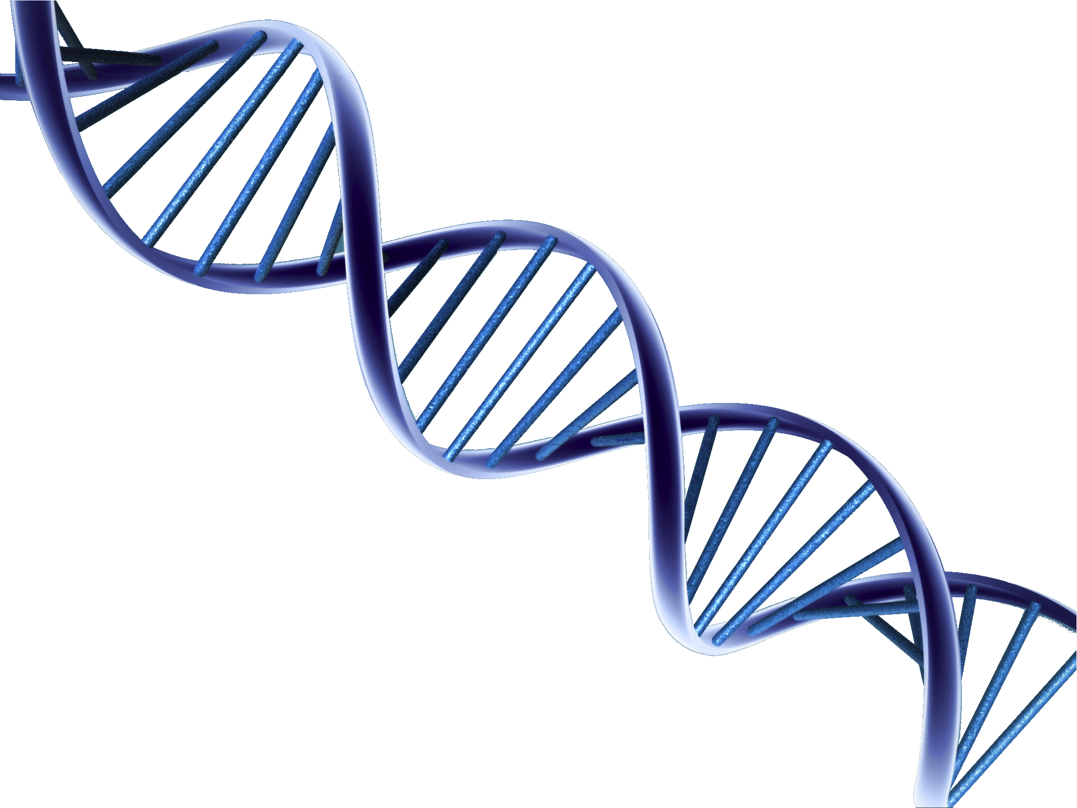
DNA Double Helix
C
G
G
A
C
T
C
T
A
A
G
T
T
G
A
C
T
C
T
A
A
G
G
T
T
C
G
A
A
C
T
C
T
A
A
G
G
T
C
A
A
T
T
C
A
G
Notes:
This shows a stylized DNA double helix showing the  base pair bonding. As you can see, the base pairs are on the inside of the helix, something scientists did not expect at first. Since the base pairs specified the code, scientists racing to discover the structure of DNA assumed the base pairs would be on the outside of any structure. Watson and Crick put together all the pieces of the puzzle to figure out how DNA was put together.

Slide 8
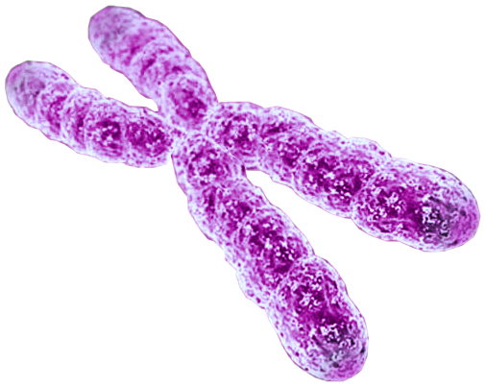
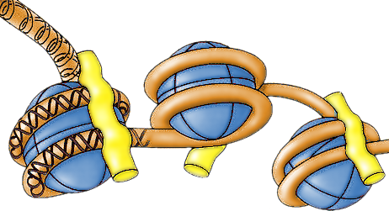





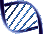

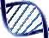






DNA Structure
Nucleosome
4 Histone protein pairs
Histone H1
Chromosome
DNA
Notes:
 The DNA is actually wrapped around proteins, called histones to form what are called  nucleosomes, shown here.  It is further wound around to form a chromosome. 

Slide 9
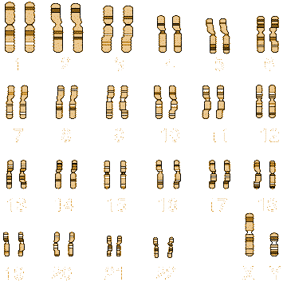
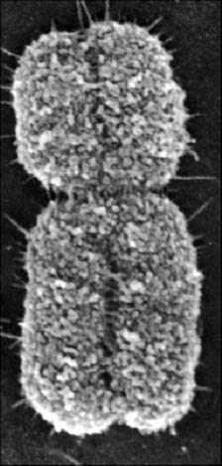
Human Chromosomes
Electron Micrograph
Karyotype
Centromere
Telomere
Notes:
In humans,  there are 23 pairs of chromosome, shown here.  And here is an electron micrograph of a typical chromosome.

Slide 10
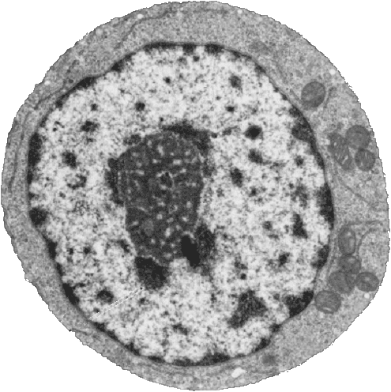
DNA Structure: Chromatin
Nucleus
Heterochromatin
(condensed DNA)
Euchromatin
(actively transcribed DNA)
Notes:
This is a typical immune cell called a lymphocyte. It has a  large nucleus, which houses the DNA. You will notice that the DNA does not appear as distinct chromosomes. Chromosomes are only organized during cell division, when they are to be duplicated. At other times, the DNA looks more like an amorphous blob. You will notice there are light and dark areas of DNA in this nucleus.  The dark areas are composed of condensed DNA, which is not used by the cell.  The light areas are the euchromatin, which is the DNA that is actively transcribed by the cell. Every cell has a full complement of all 3.2 billion DNA based pairs, but only uses a fraction of that DNA in its day to day function. However, different kinds of cells use different parts of DNA molecules, so different parts of the DNA will make up the heterochromatin vs. euchromatin in different cell types. So, that’s a quick survey of DNA.

Slide 11
Bases Found in DNA vs. RNA
DNA | RNA
Adenine | Adenine
Cytosine | Cytosine
Guanine | Guanine
Thymine | Uracil
O
O
CH₃
H
C
C
C
C
H
C
N
H
H
C
N
H
N
C
N
C
Deoxyribose
O
Ribose
O
Notes:
If you recall the central dogma of biology, DNA is transcribed into RNA. The bases of DNA and RNA are similar, but not exactly the same.  Adenine, cytosine, and guanine are the same in both molecules. However, uracil is substituted for thymine in RNA.  This is a comparison of the two molecules. They are quite similar, other than  the methyl group in thymine. And, of course, DNA is bound to a  deoxyribose sugar whereas RNA is bound to ribose. 

Slide 12
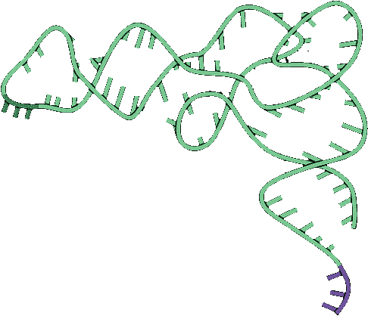
Transfer RNA (tRNA)
A
A
U
G
A
A
G
G
C
C
A
C
U
G
Transfer RNA
U
A
C
U
C
G
U
G
C
G
C
C
C
G
C
G
C
A
U
U
U
G
U
C
A
G
A
A
C
A
U
U
U
U
A
Anti-codon
C
G
A
A
C
G
G
U
A
U
U
A
A
C
U
G
U
U
C
G
A
A
G
A
C
U
Codon
A
G
A
A
G
G
A
A
A
C
G
C
C
U
U
C
G
G
C
G
G
C
C
C
Mesenger RNA (mRNA)
G
A
U
C
Methionine
Notes:
The other thing you need to know is how the RNA is read to specify a protein. This is our messenger RNA (or mRNA) molecule. It turns out that three nucleotide bases,  called a codon, specify one amino acid, which is the building block of proteins.  Here is a transfer RNA or tRNA molecule. On one end is celled the  anti-codon, which is complementary to the codon, allowing it to bind to the mRNA. The other end of the molecule in bound to a  specific amino acid, in this case methionine. A complex set of biochemical machines acts like a factory to assemble the protein product. We aren’t going to go into this, but…

Slide 13
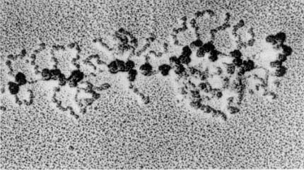
Electron Micrograph of Translation Process
+
Ribosomes
mRNA
Protein chains
Notes:
here is a neat electron micrograph of protein translation in process.  The dark objects are ribosomes, which make up part of the molecular machines involved in translation.  The mRNA is running through the middle of all these ribosomes. Coming off the ribosomes are the  growing protein chains. I thought this was a cool picture, which is why I shared it.

Slide 14
The Genetic Code
Codon |  | AA | Codon |  | AA | Codon |  | AA | Codon |  | AA
UUU |  | Phe | UCU |  | Ser | UAU |  | Tyr | UGU |  | Cys
UUC |  |  | UCC |  |  | UAC |  |  | UGC
UUA |  | Leu | UCA |  |  | UAA |  | Stop | UGA |  | Stop
UUG |  |  | UCG |  |  | UAG |  |  | UGG |  | Trp
CUU |  | Leu | CCU |  | Pro | CAU |  | His | CGU |  | Arg
CUC |  |  | CCC |  |  | CAC |  |  | CGC
CUA |  |  | CCA |  |  | CAA |  | Gln | CGA
CUG |  |  | CCG |  |  | CAG |  |  | CGG
AUU |  | Ile | ACU |  | Thr | AAU |  | Asn | AGU |  | Ser
AUC |  |  | ACC |  |  | AAC |  |  | AGC
AUA |  | Met | ACA |  |  | AAA |  | Lys | AGA |  | Arg
AUG |  |  | ACG |  |  | AAG |  |  | AGG
GUU |  | Val | GCU |  | Ala | GAU |  | Asp | GGU |  | Gly
GUC |  |  | GCC |  |  | GAC |  |  | GGC
GUA |  |  | GCA |  |  | GAA |  | Glu | GGA
GUG |  |  | GCG |  |  | GAG |  |  | GGG
Notes:
I need a show of hands. Who thinks that the genetic code of a chimpanzee is identical to the genetic code of a human being? This is the almost universal genetic code. The phrase “genetic code” refers to how codons are translated into amino acids. All living forms (with a few exceptions) use the exact same translation system, the genetic code. Do not use the phrase “genetic code” when referring to a genetic sequence. There are several special codons in this list, highlight in yellow.  AUG codes for methionine, but more importantly always designates the start of a protein sequence.  Three codons do not code for any amino acid, but cause the termination of the translation process. These are called stop codons. 

Slide 15
DNA as a Language
Four “letters” ( bases A, U, G, C)
64 three letter “words” (codons)
“Redundant” – Many “words” have the identical “meaning”
20 unique “words” (amino acids)
Unlimited “sentences” (proteins)
Notes:
So, let’s summarize what we have learned. DNA consists of 4 letters that form 64 three letter words or codons. Many of those words are redundant, in that they have identical meaning. So, there are only 20 unique words or amino acids. However, these words can be organized into unlimited number of sentences or proteins.

Slide 16
Transcription/Translation
Nucleus
DNA
T
T
T
C
T
C
A
C
A
C
A
A
G
A
A
G
A
G
G
G
G
T
C
T
C
T
C
C
A
A
G
C
T
C
T
T
A
G
T
A
T
A
T
G
G
A
Transcription
mRNA
G
A
A
U
U
G
A
U
C
G
A
C
G
U
A
A
U
G
U
G
A
U
C
A
A
A
C
A
G
G
C
A
C
U
U
U
G
G
A
A
A
A
C
C
U
U
ER
G
A
A
U
U
G
A
U
C
G
A
C
U
G
A
A
G
A
A
C
C
U
U
Translation
Protein
Notes:
So, here is our central dogma again. DNA is transcribed into RNA, then translated into protein. 

Slide 17
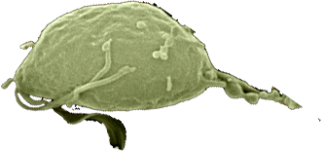
DNA Design: Alternative Splicing of RNA
Multiple proteins from one gene
Notes:
The single-celled protozoan  Trichomonas vaginalis is about the size of a blood cell, but has about 60,000 genes in its genome. Does anybody know how many genes are in the human genome? It’s about 22,000. How can such a much more complicated organism have only a third the number of genes as a single-celled protozoan?

Slide 18
Genes to Proteins: DNA→mRNA
Exons
DNA
UTR
introns (between exons)
UTR
Pre-mRNA
Transcribed region
mRNA
5’
3’
Protein
Translated region
Notes:
This is a schematic of a typical gene. A gene consists of  exons, which are the coding regions and introns, which control how the gene is transcribed. On the ends of the gene are  untranslated regions, which are transcribed, but not translated. The gene is  transcribed into pre-mRNA. The intronic sequences are spliced out,  forming the final message.  The exonic regions of the message are translated into protein. So, why would God create a system in which there are introns in between the code that is eventually translated, even though those sequences are eventually removed? 

Slide 19
Alternative Splicing of RNA
Exon2
Exon2
Exon2
Exon4
Exon4
Exon1
Exon4
Exon5
Exon1
Exon1
Exon3
Exon3
Exon5
Int1
Int2
Int3
Int4
Exon5
Pre-mRNA
mRNA
Protein isoform A
Protein isoform B
Notes:
It turns out that this “simple” means of producing proteins does not follow for all genes. In nearly all genes that contain multiple exons, the pre-mRNA is spliced in alternative ways.  Sometimes, all the exons are included in the final mRNA transcript.  At other times, only a select set of exons are included in the mRNA and the other exons are spliced out. In this way,  two different proteins can be produced from the same gene. 

Slide 20
Types of Alternative Splicing
AS Pattern Type | Acronym
Cassette exon (skipped exon) | CE
Intron retention | IR
Mutually exclusive exons | MXE
Alternative 3' sites | A3SS
Alternative 5' sites | A5SS
Alternative first exon | AFE
Alternative last exon | ALE
Notes:
The alternative splicing of RNA can occur in a number of ways, producing many different varieties of proteins. This is a list of the many ways in which multiple exonic regions can be alternatively spliced. Since there are an average of 5-6 splice variants per gene, the human genome can produce about 100,000 different proteins.

Slide 21
DNA Design: Duons
Overlapping regulatory and protein codes
Notes:
This next section on the design of DNA is based upon research that was first published in December, 2013. 

Slide 22
Transcription Factors
Promoter
region
Exons
DNA
-6800
-800
-300
-250
-200
-150
-100
NFκB
NFAT
NFAT
Y2 Y1
NFAT
AP-1
AP-2
AP-1
Notes:
This is a schematic of the interferon-gamma gene, which is one of the targets of my research. The gene produces a powerful cytokine that is involved in immunity to infections, but is also dis-regulated in certain inflammatory conditions, such as inflammatory bowel disease. The structure of the gene is somewhat typical. The gene body consists of  3 exons and a  promoter region, which controls the expression of the gene. The promoter region,  shown here expanded, contains several sequences that bind what are called transcription factors. Transcription factors are proteins that have affinity to certain specific DNA sequences. When transcription factors bind to a sequence in the promoter region of a gene, they either turn off or on the transcription of that gene. Scientists have known about how transcription factors control gene expression for many years. 

Slide 23
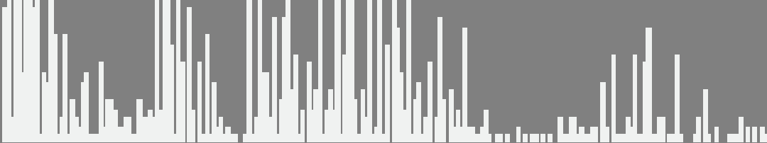
Genome-Wide Transcription Factor Binding Sites
Used enzyme DNase I
Digested DNA from 81 different cell lines
Sequenced and mapped the location of all TF binding sites
DNase I cleavage
per nucleotide
(PLBD2 gene)
«
«
«
«
«
«
«
«
«
»
»
»
SP1
SP1
USF
NRSF
Notes:
Scientists wanted to map all the transcription factor binding sites throughout the entire human genome. So, they used a kind of trick to find all those sites.  There is an enzyme called DNase I that digests DNA into its component bases. It turns out that if a transcription factor protein is bound to a section of DNA, DNase I will not digest that DNA.  Scientists examined 81 different cells lines for their study, since different cell types have different genes that are turned on or off, which would be bound to transcription factors.  The remaining undigested fragments of DNA were sequenced and mapped.  This is an example from one gene, showing that the DNA was protected from digestion when  bound to various transcription factors. Here you can see the areas of transcription binding are protected from DNase digestion. 

Slide 24
Duon Sequences
86% of genes expressed at least one duon sequence
Duons comprise 14% of all exonic coding
Over 12 million base pairs
Andrew B. Stergachis et al. 2013. Exonic Transcription Factor Binding Directs Codon Choice
and Affects Protein Evolution. Science 342, 1367.
Notes:
What surprised the scientists was that many of these transcription factor binding sites were not in the promoter regions, but were actually within the exons themselves. So, these regions of DNA coded for both protein sequence and transcription factor binding simultaneously. These dual coding sequences were called “duons.”  It turned out that 86% of all genes expressed at least one duon sequence.  Duons comprise 14% of all exonic coding for a  total of over 12 million base pairs.

Slide 25
Example of Duon in DNA
CELSR2 Gene: Chr1:109806358-109806387
Protein Sequence
Leu
Gln
Gln
Ile
Thr
Arg
Gly
Arg
Ser
Thr
DNA Sequence
C
T
G
C
A
G
G
C
C
A
T
C
A
C
C
A
G
G
G
G
G
C
G
C
A
G
C
A
C
C
CTCF Binding Sequence
A
C
C
A
C
C
A
G
G
G
G
G
C
G
C
Andrew B. Stergachis et al. 2013. Exonic Transcription Factor Binding Directs Codon Choice
and Affects Protein Evolution. Science 342, 1367.
Notes:
We are going to look at a specific gene example of a duon. The gene is Cadherin, EGF LAG Seven-Pass G-Type Receptor 2 (CELSR2). This is  part of the DNA sequence and the  corresponding amino acid sequence in the protein,  showing the codons.  And here is the transcription factor binding sequence, which almost exactly matches the DNA sequence. In this sequence,  there are two arginine amino acids, which use completely different codon sequences, in order to match the needed transcription factor binding sequence. This is likely one reason why the genetic code is redundant. 

Slide 26
Duons are Functional
Andrew B. Stergachis et al. 2013. Exonic Transcription Factor Binding Directs Codon Choice
and Affects Protein Evolution. Science 342, 1367.
Notes:
How do we know the duon sequences are really functional? This is a graph of the number of duon sequences as a function of location. If these sequences were functional, we would expect them to be found mostly in the first exon, which they are. Why weren’t these duon sequences discovered before a few months ago? It is because evolution would never predict that dual coding regions would exist. 

Slide 27
DNA Design: Dual Coding Genes
Multiple proteins from alternative reading frames
Notes:
Now, we are going to look at our third example of designs in DNA – dual coding genes. 

Slide 28
Reading Frames
Ala
Gly
His
His
Gln
Gly
Ala
Gln
His
Cys
Arg
Pro
Ser
Pro
Gly
Gly
Ala
Ala
Leu
Gln
Gln
Ile
Thr
Arg
Gly
Arg
Ser
Thr
C
T
G
C
A
G
G
C
C
A
T
C
A
C
C
A
G
G
G
G
G
C
G
C
A
G
C
A
C
C
G
A
C
G
T
C
C
G
G
T
A
G
T
G
G
T
C
C
C
C
C
G
C
G
T
C
G
T
G
G
Gln
Leu
Gly
Asp
Ala
Pro
Gly
Arg
Arg
Gly
Ala
Ala
Met
Val
Leu
Pro
Arg
Leu
Val
Ala
Pro
Trp
Stop
Trp
Pro
Ala
Cys
Cys
Notes:
We know that three DNA bases make up a codon and that codons follow sequentially. However, in theory DNA has six reading frames – three on each strand. Shown here is one reading frame and its corresponding amino acid sequence.  If we shift the reading frame to the right by one base, we get a completely different amino acid sequence.  Shift it again, and there is yet another different amino acid sequence. Now, as we know,  the opposite strand of DNA has a complementary sequence, shown here. Whereas one strand is read in one direction, the complementary strand is read in the opposite direction, producing a fourth different amino acid sequence. And, this reading frame  can be shifted by one to produce a 5th amino acids sequence.  Shift again and we get a 6th. Some of these reading frames lead to interesting results.  The 5th one introduces a methionine start sequence.  And the sixth one introduces a stop codon, which would terminate the protein prematurely. So, if we had a mutation that shifted the reading frame, would we expect that mutation to be good or bad?

Slide 29
Dual-Coding Genes
Coding of multiple proteins by overlapping reading frames is not a feature one would associate with eukaryotic genes. Indeed, codependency between codons of overlapping protein-coding regions imposes a unique set of evolutionary constraints, making it a costly arrangement. Yet in cases of tightly coexpressed interacting proteins, dual coding may be advantageous. Here we show that although dual coding is nearly impossible by chance, a number of human transcripts contain overlapping coding regions.
Wen-Yu Chung, et al. A First Look at ARFome: Dual-Coding Genes in Mammalian Genomes. PLoS Computational Biology 3 (5) e91.

Slide 30
Finding Dual Coding Genes
Evolutionary assumptions underestimate true numbers of dual coding genes
9% of human and 7% of mouse
Less than 30% shared: mouse:human
90% of genes on opposite strands
1259 human alternative proteins detected by mass spectrometry
Chaitanya R Sanna, et al. Overlapping genes in the human and mouse genomes. BMC Genomics 2008, 9:169.
Benoıt Vanderperre, et al. 2013. Direct Detection of Alternative Open Reading Frames Translation… PLoS ONE 8(8): e70698.
Notes:
 The evolutionary assumption is that true dual coding genes are conserved among related species, which underestimates true numbers of genes.  A study by Sanna et al found that 9% of human genes and 7% of mouse genes were dual coding. By chance, one would expect 0.07% of genes to be dual coding.  However, less than 30% of dual coding genes are shared between mouse and human.  The study also found that 90% of the genes have overlapping coding sequences on opposite strands. In bacteria, 84% of overlapping genes are on the same strand.  A study from last year analyzed human open reading frame proteins by mass spectrometry and detected a total of 1259, which is much higher than expected.

Slide 31
“Sentences” from Two Directions
A man, a plan, a canal: Panama
Live not on evil
Was it a car or a cat I saw?
Notes:
To give you an idea about how unlikely these sequences would be I would like to show you an analogy. Here are three sentences, which actually are palindromes, which can be read either forward or backward. Needless to say, these are not random sentences, but were designed by intelligent agents. So, the magnitude of the dual coding problem would be the equivalent of writing a novel that could be read either forward or reverse and make two different stories that made sense.

Slide 32
Dual Coding Gene: EIF6 (ITGB4BP)
285
Frame 1
108 aa
107
134
182
66
86
43
5
312
275
Frame 2
226 aa
177
182
66
10
5
G
A
C
A
G
A
A
G
A
A
A
T
T
C
T
G
G
C
A
G
A
T
G
T
G
C
T
C
A
A
G
G
T
G
G
A
A
G
T
C
T
T
C
A
G
A
C
A
G
A
C
A
G
T
G
G
C
C
G
A
C
C
A
G
G
T
G
C
T
A
G
T
A
G
G
A
A
G
C
T
A
C
T
G
T
G
T
C
T
T
C
A
G
C
A
A
T
C
A
Asp
Arg
Arg
Asn
Ser
Gly
Arg
Cys
Ala
Gln
Gly
Gly
Ser
Leu
Gln
Thr
Asp
Ser
Gly
Arg
Pro
Gly
Ala
Ser
Arg
Lys
Leu
Leu
Cys
Leu
Gln
Gln
Ser
Thr
Glu
Glu
Ile
Leu
Ala
Asp
Val
Leu
Gln
Val
Glu
Val
Phe
Arg
Gln
Thr
Val
Ala
Asp
Gln
Val
Leu
Val
Gly
Ser
Tyr
Cys
Val
Phe
Ser
Asn
Gln
Han Liang and Laura F. Landweber. 2006. A genome-wide study of dual coding regions in human alternatively spliced genes. Genome Research 16:190–196.
Notes:
Here is an example of dual coding gene EIF6.  Here is reading frame 1 showing the exons.  And here is reading frame 2. Both proteins  start at the same codon. However,  the second sequence is twice as long as the first. The second reading frame  reads through the intron, producing a frameshift in the  overlapping exons, shown here.  This is the DNA sequence of the overlapping region.  The first reading frame produces  this amino acid sequence  and the second, this amino acid sequence. As you can see, the two sequences are quite different. 

Slide 33
Dual Coding Gene: Ncaph2
Long
Intermediate
Alternative Transcripts
Exon 1
Exon 2
Met
Glu
Short
Leu
Asp
Gln
Ile
Asp
Val
Glu
Val
Arg
Phe
Ala
His
Leu
Leu
Gln
Pro
Ile
Arg
Asp
Leu
Thr
Lys
Asn
Trp
Glu
Val
Asp
Val
Ala
Ala
Gln
Leu
Gly
Glu
Glu
Exon 2
Met
Glu
Asp
Val
Glu
Leu
Asp
Gln
Ile
Exon 2
Met
Trp
Arg
Cys
Ala
Leu
Leu
Thr
Ser
Cys
Ser
Pro
Ser
Gly
Ile
Leu
Arg
Thr
Gly
Arg
Thr
Gly
Arg
Trp
Thr
Trp
Arg
His
Ser
Trp
Leu
Asp
Gln
Ile
Alternative Reading Frame
Angelo Theodoratos, et al. Splice variants of the condensin II gene Ncaph2 include alternative reading frame... FEBS Journal 279 (2012) 1422–1432.

Slide 34
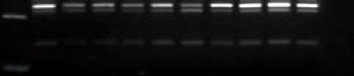
Protein Products of Ncaph2
Bone Marrow
Thymus
Ladder
Muscle
Kidney
Spleen
Brain
Lung
Testis
Heart
Liver
Long 232 bp
200 bp
Int 215 bp
Short 140 bp
50 bp

Slide 35
Conclusions
At least three independent examples of design in DNA
Alternative splicing producing multiple proteins from one gene
Duons–overlapping sequences of coding and transcription factor binding
Dual coding genes

