Slide 1
Churchless
Ross Hoagland

Slide 2
All graphics in this presentation have been shamelessly stolen from BARNA.ORG.

Slide 3
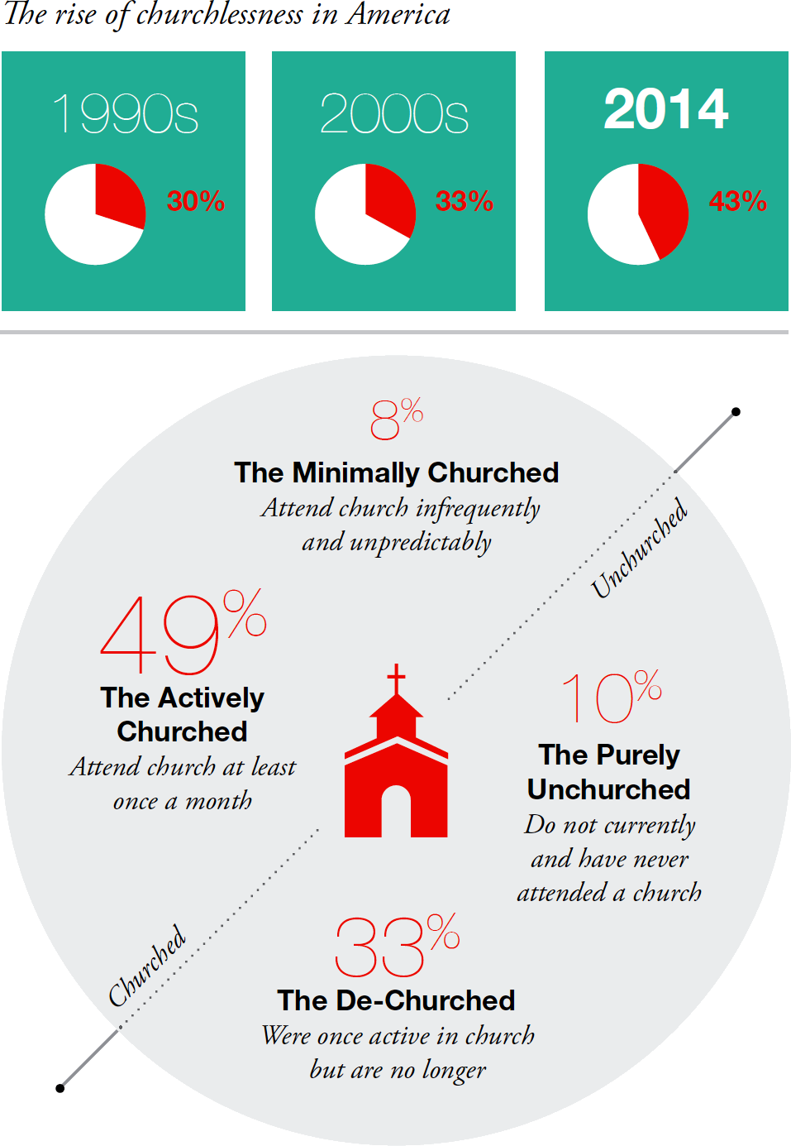
© Barna Group www.barna.org/churchless

Slide 4
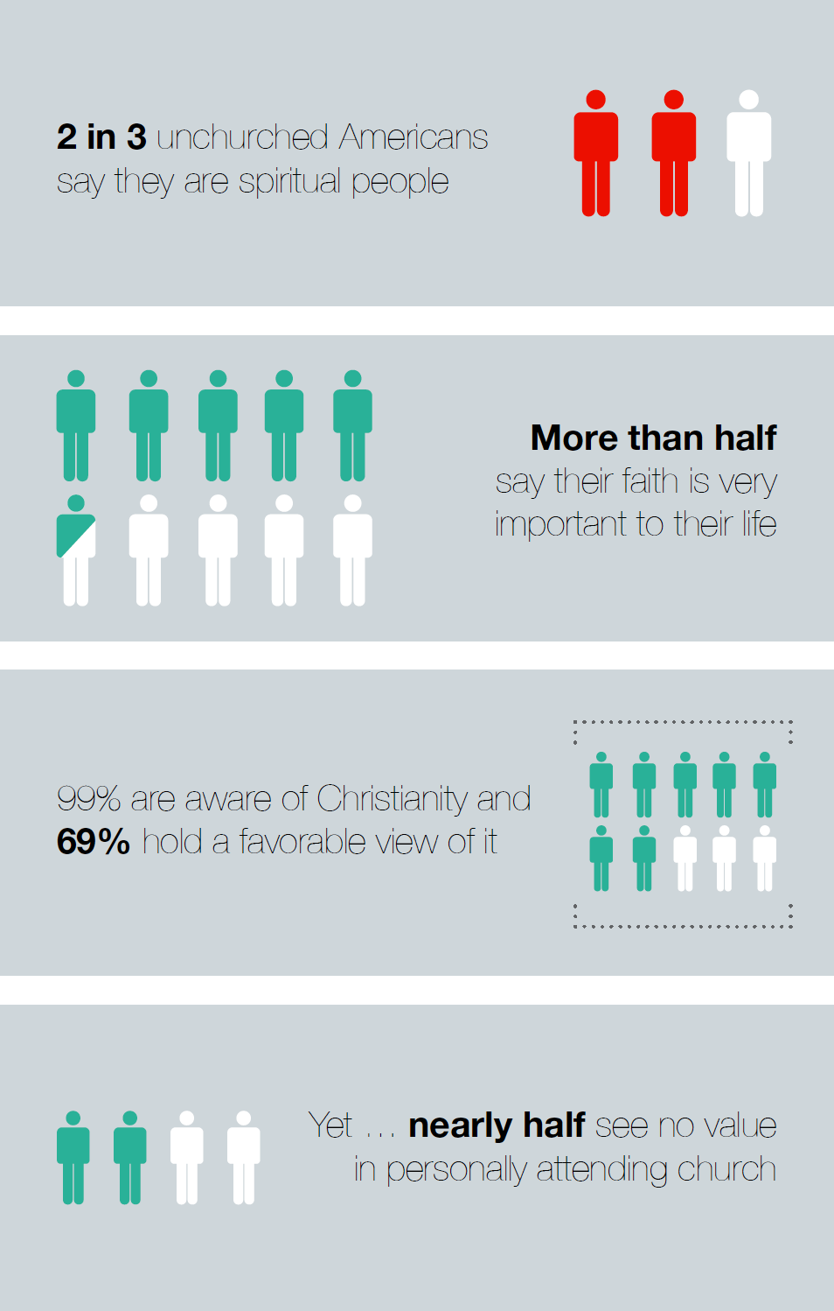
© Barna Group www.barna.org/churchless

Slide 5
What is the Bible?
View of the Bible | Churched | Unchurched
The actual Word of God; it should be taken literally, word for word | 33% | 12%
The inspired Word of God; it has no errors, although some verses are meant to be symbolic rather than literal | 39% | 17%
The Inspired Word of God; it has some factual or historical errors | 14% | 17%
Not inspired by God, but tells how the writers of the Bible understood the ways and principles of God | 5% | 13%
Just another book of teachings written by men that contains stories and advice | 4% | 32%
Some other view of the Bible | 1% | 2%
Not sure | 3% | 8%

Slide 6
To many unchurched people, attending a church looks like becoming an active participant in a club or organization whose central purpose is to celebrate and promote a leader who has never visited the group and is not alive; that is based on a life philosophy that was written thousands of years ago in a very different culture; and whose core values are often misunderstood or even ignored by other members. How difficult, with these assumptions, to see how belonging to a local church is desirable or even reasonable.

Slide 7
In the research…..our team discovered that 84% of young non-Christians say they know a Christian personally, yet only 15% say the lifestyles of those believers are noticeably different in a good way.

