Slide 1
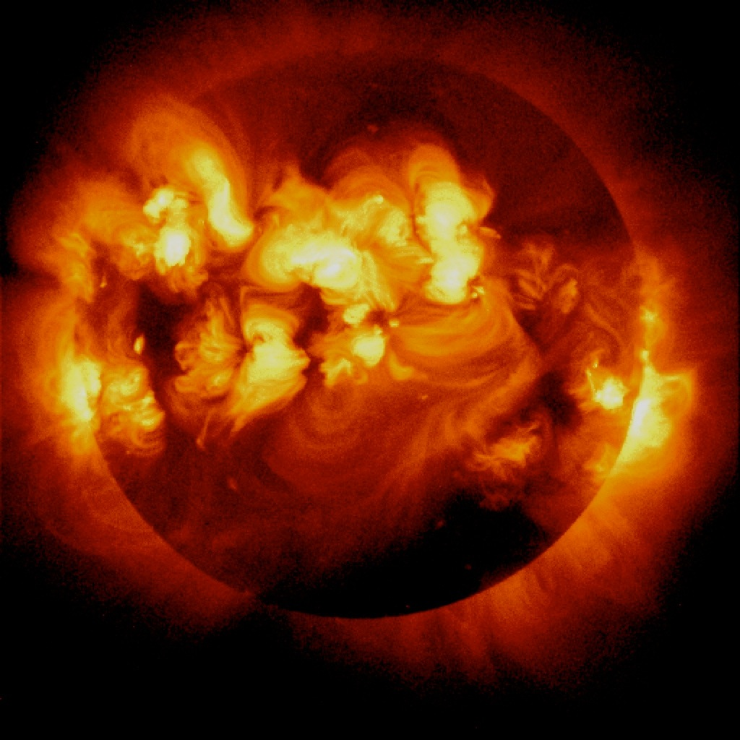
Solar Flare Activity
activity level
0 1 2 3 4 5 6 7 8
age of Sun (billions of years)
NASA/JPL-Caltech
Notes:
Various life forms respond differently to solar radiation.

Slide 2
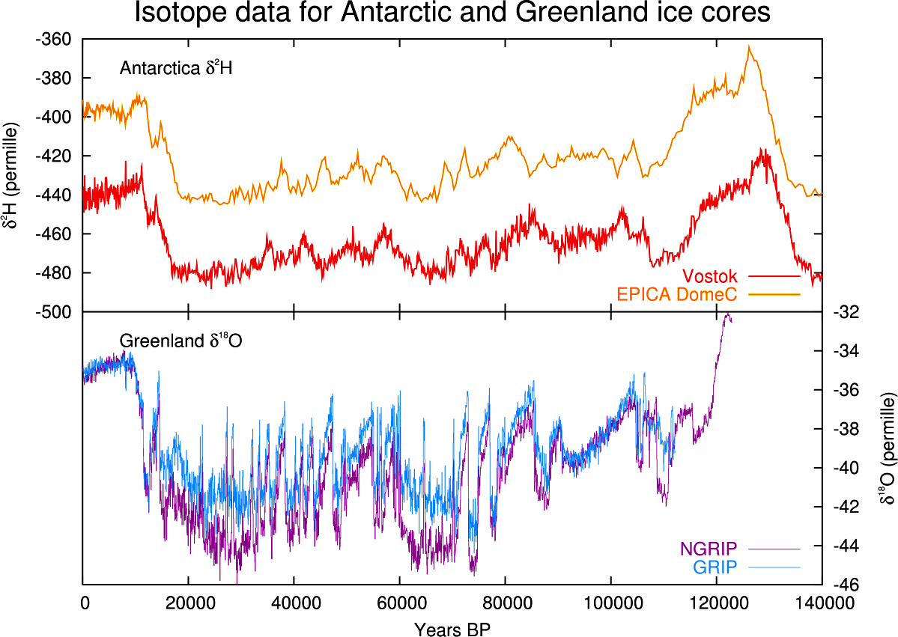

Slide 3
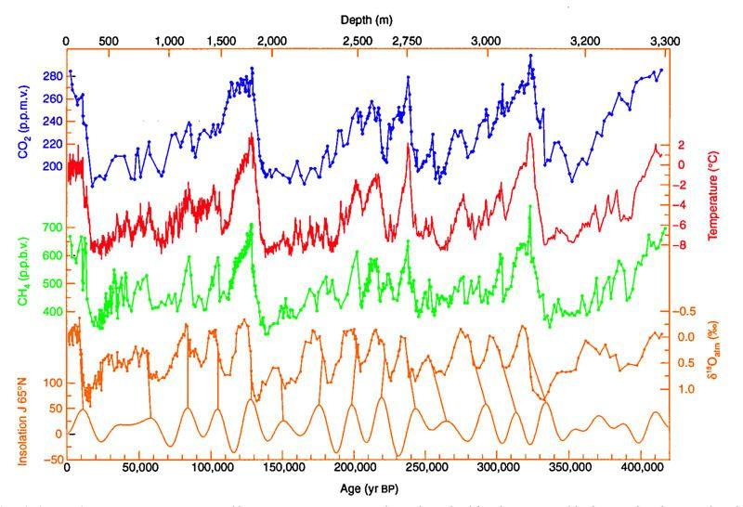
Notes:
Vostok (720,000 years)
red line is temperature

Slide 4
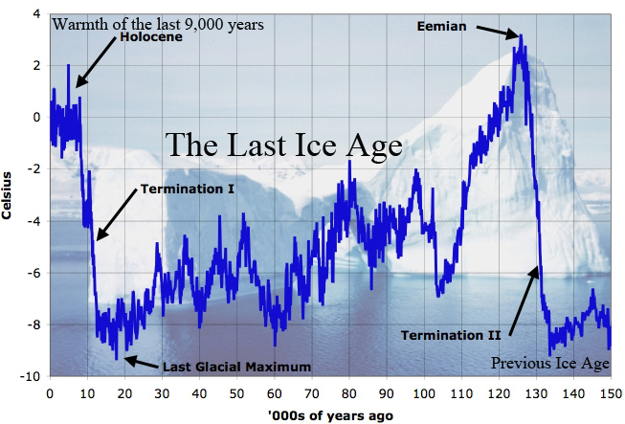
Notes:
NEEM (150,000 years)

Slide 5
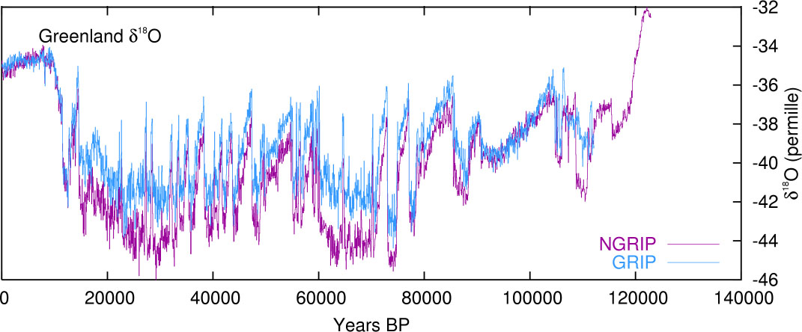
The Long Summer
The Long Summer

Slide 6
Recent Supernovae
date (years)
distance (lyrs)
44,000 360
37,000 590
32,000 520
22,000 820
Notes:
R. B. Firestone, “Observation of 23 Supernovae That Exploded <300 pc from Earth During the Past 300 kyr,”Astrophysical Journal 789 (July 1, 2014): id. 29.

Slide 7
Historical Supernovae
date (years)
distance (lyrs)
1006 AD 1,560
1054 AD 2,000
1181 AD 3,200
1572 AD 2,300
1604 AD 2,900
1671 AD 3,400
Notes:
R. B. Firestone, “Observation of 23 Supernovae That Exploded <300 pc from Earth During the Past 300 kyr,”Astrophysical Journal 789 (July 1, 2014): id. 29.

Slide 8
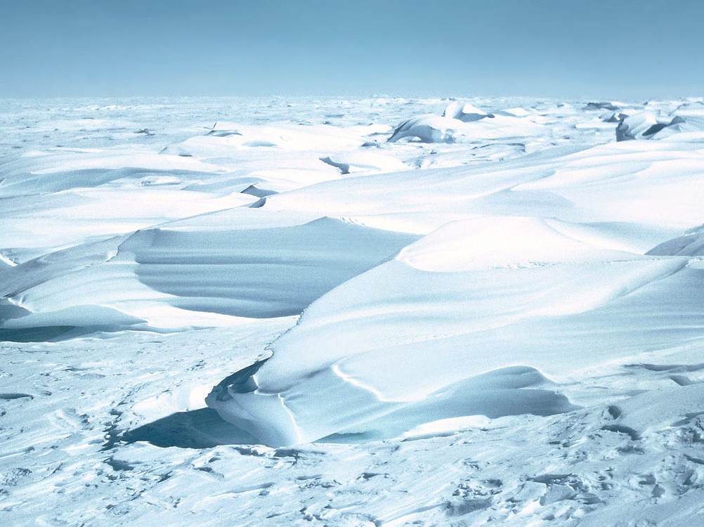
Ice Age Cycle Benefits
melting glaciers water the plains

Slide 9
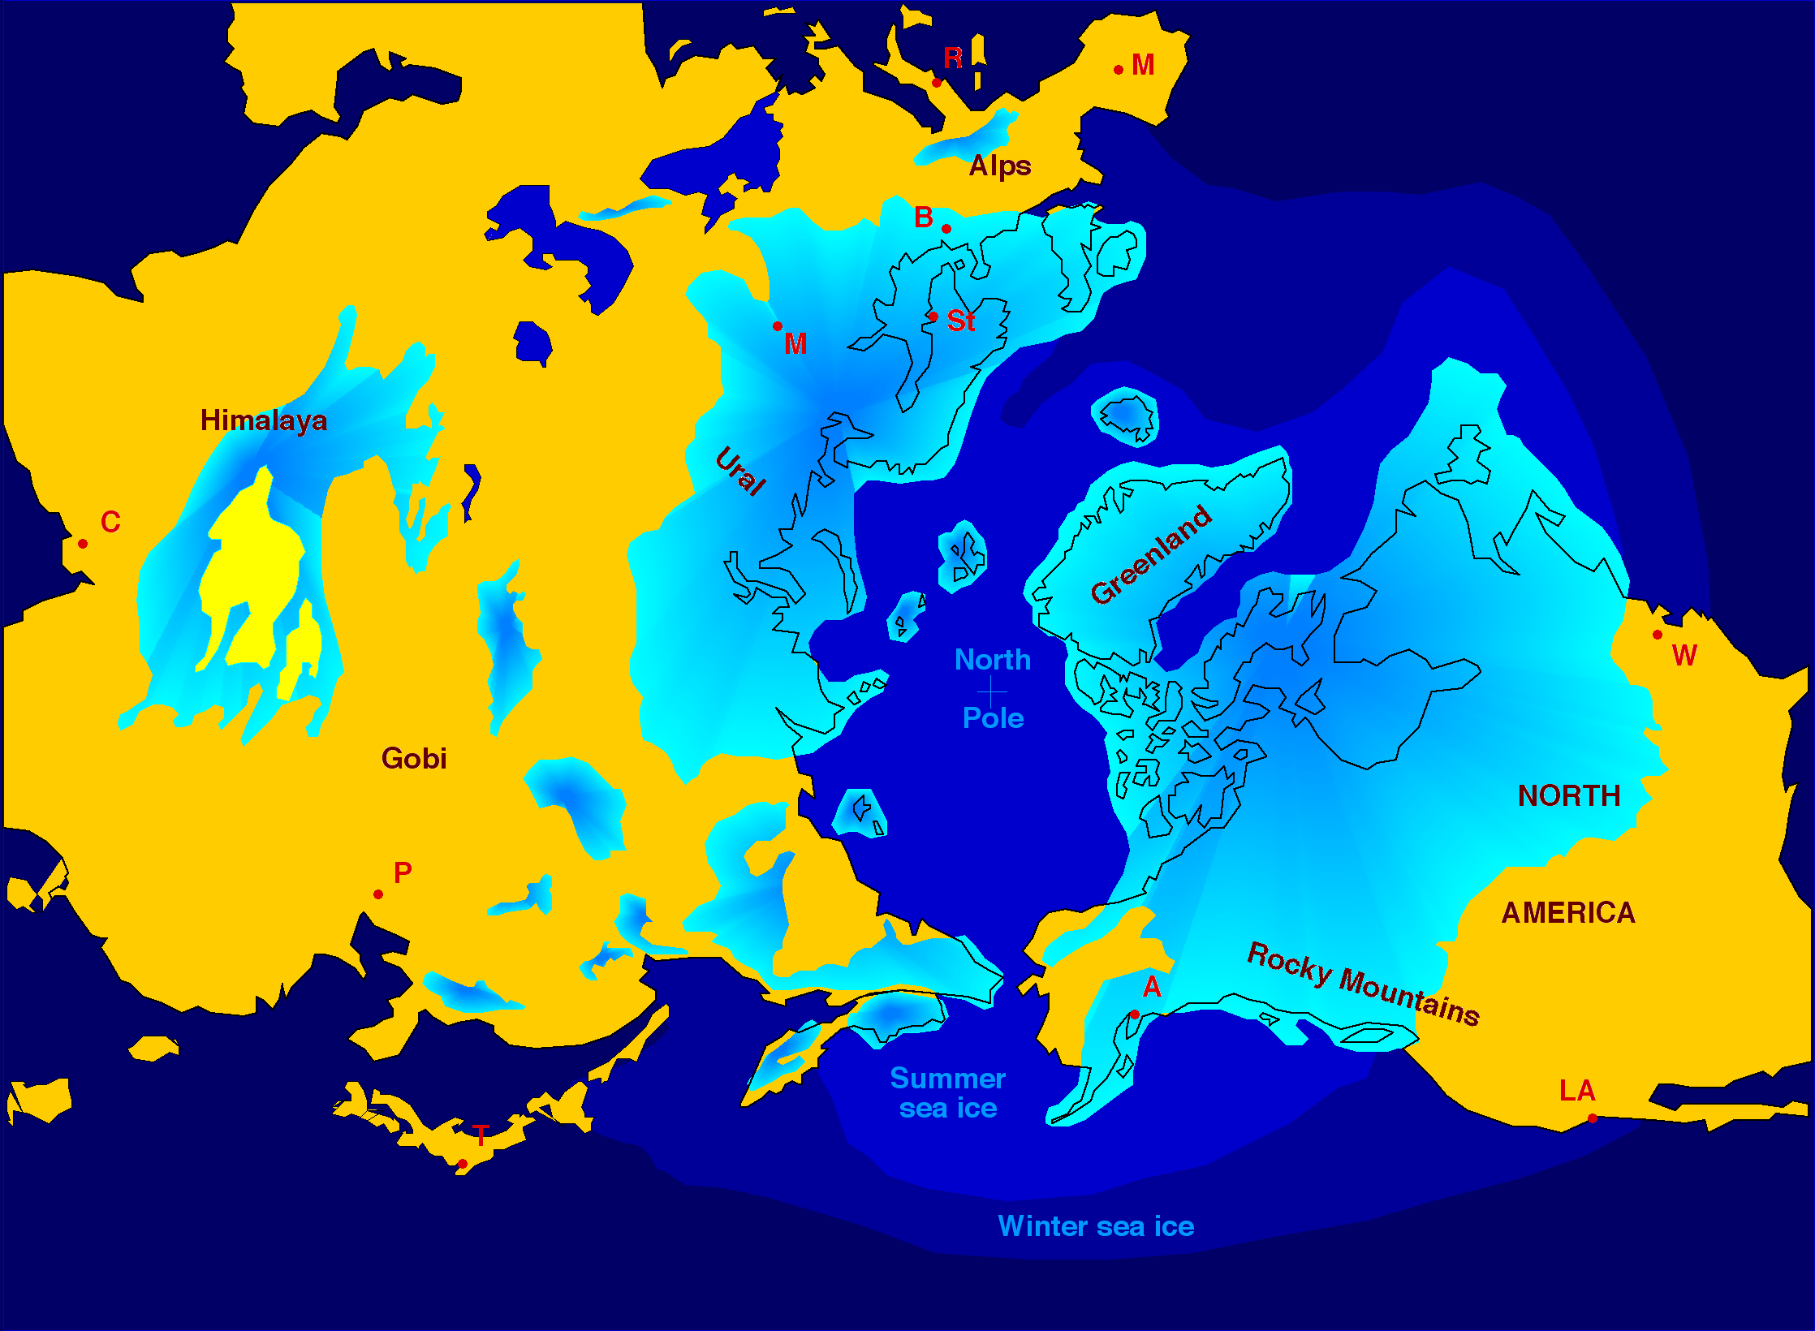

Slide 10
Ice Age Cycle Benefits
melting glaciers water the plains
wind-blown dust enriches the plains

Slide 12
Ice Age Cycle Benefits
melting glaciers water the plains
wind-blown dust enriches the plains
glacier retreat create millions of lakes
created lakes transform deserts
created relief yields hydropower

Slide 13
Ice Age Cycle Benefits
formed warm land bridges
glacier retreat forms safe harbors
formed rich ore deposits
formed large alluvial plains
created spectacular scenery

