Slide 1
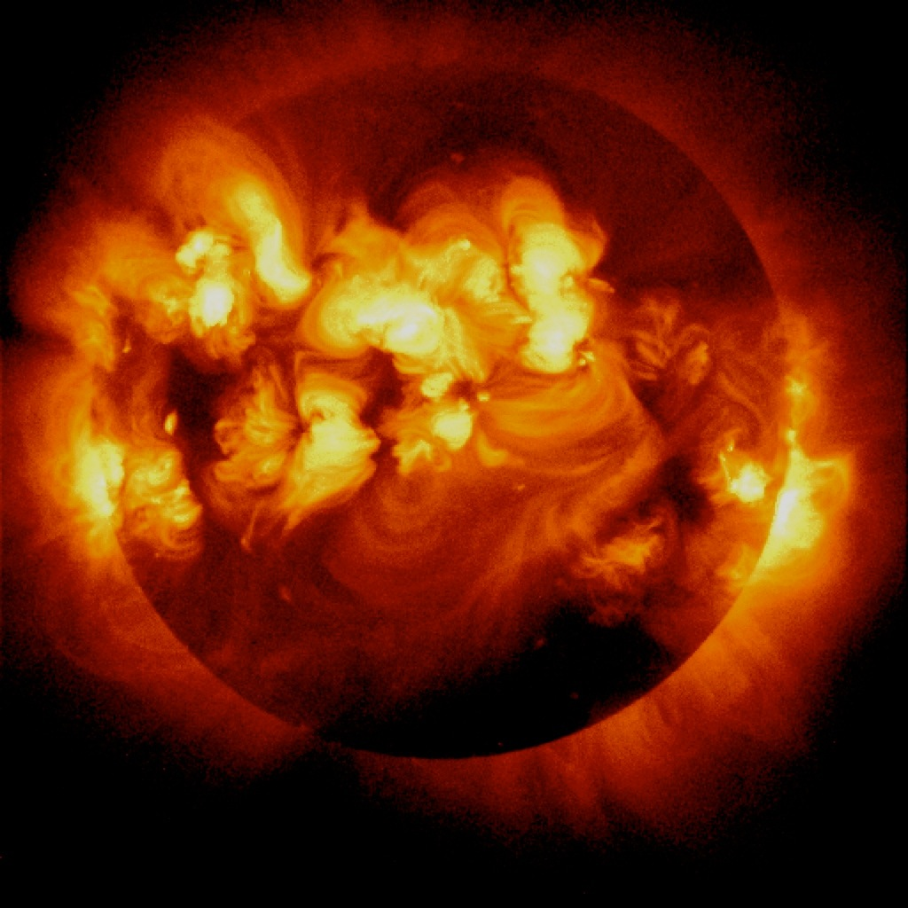
Solar Flare Activity
activity level
0 1 2 3 4 5 6 7 8
age of Sun (billions of years)
NASA/JPL-Caltech
Notes:
Various life forms respond differently to solar radiation.

Slide 2
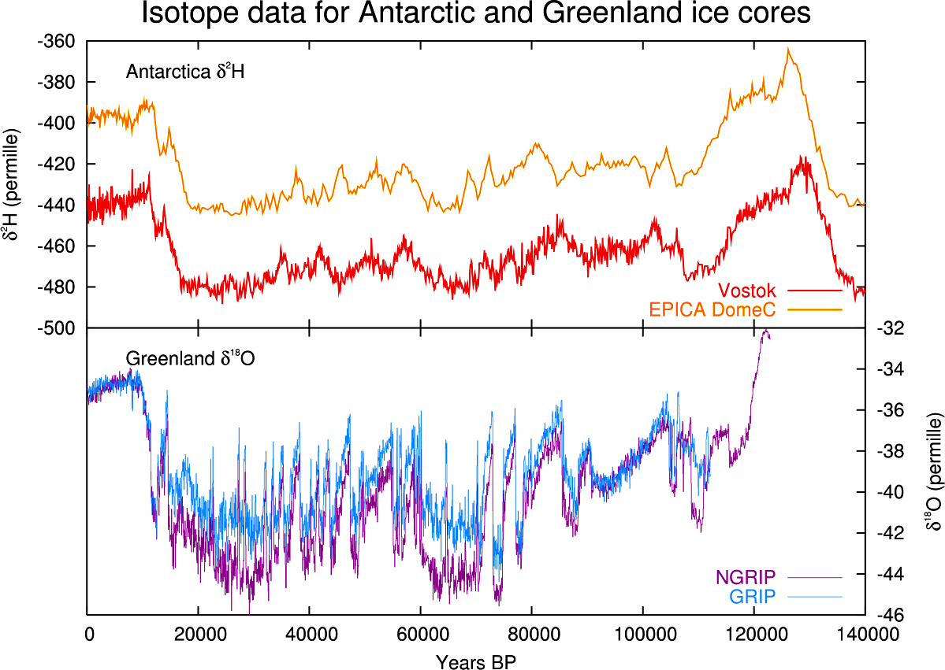

Slide 3
Marine sediment cores reveal rapid climate changes during the last interglacial, unlike the present interglacial. http://bit.ly/1thbQ9K
Notes:
Lars Max et al., “Rapid Shifts in Subarctic Pacific Climate Between 138 and 70 ka,” Geology 42 (October 2014): 899-902.

Slide 4
Lars Max et al., “Rapid Shifts in Subarctic Pacific Climate Between 138 and 70 ka,” Geology 42 (October 2014): 899-902.
Notes:
Lars Max et al., “Rapid Shifts in Subarctic Pacific Between 138 and 70 ka,” Climate Geology 42 (October 2014): 899-902.

Slide 5
R. B. Firestone, “Observation of 23 Supernovae That Exploded <300 pc from Earth During the Past 300 kyr,”Astrophysical Journal 789 (July 1, 2014): id. 29.

Slide 6
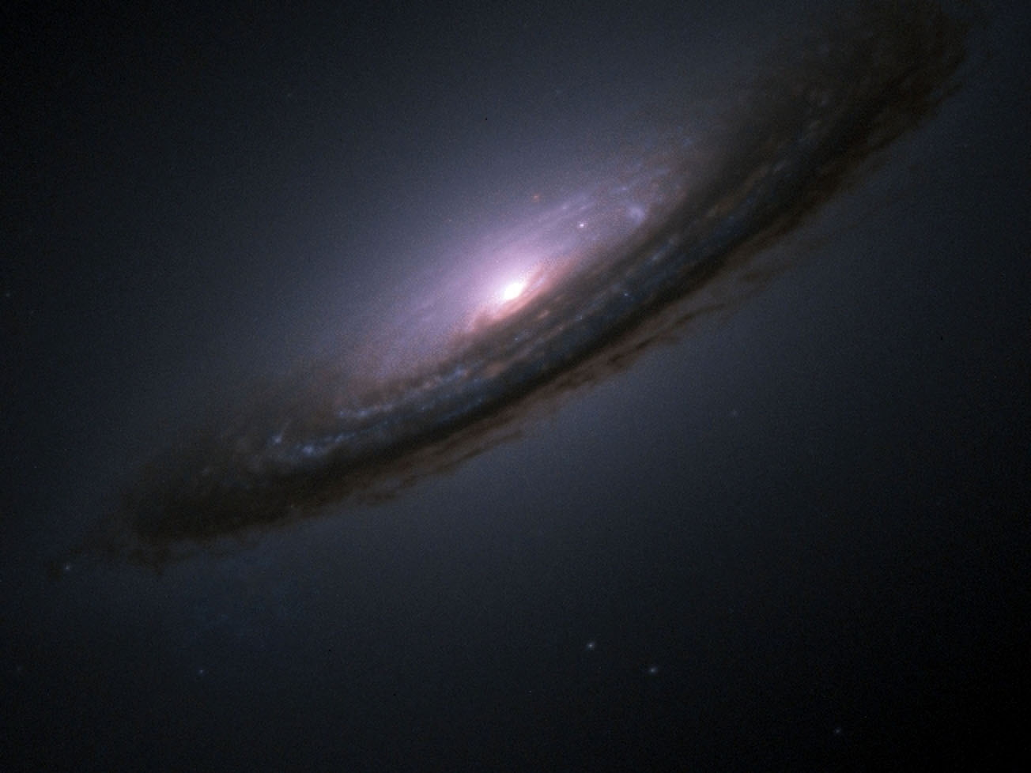
NASA/Hubble Space Telescope/High-Z Supernova Search Team
Notes:
Supernova 1994D in NGC 4526

Slide 7
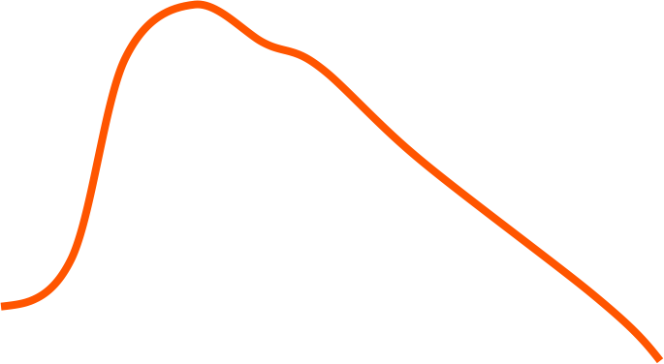
Supernova Light Curve
luminosity
0 1 2 3 4 5 6 7 8 months
Notes:
Supernova 1994D in NGC 4526

Slide 8
Recent Supernovae
date (years)
distance (lyrs)
44,000 360
37,000 590
32,000 520
22,000 820
Notes:
R. B. Firestone, “Observation of 23 Supernovae That Exploded <300 pc from Earth During the Past 300 kyr,”Astrophysical Journal 789 (July 1, 2014): id. 29.

Slide 9
Historical Supernovae
date (years)
distance (lyrs)
1006 AD 1,560
1054 AD 2,000
1181 AD 3,200
1572 AD 2,300
1604 AD 2,900
1671 AD 3,400
Notes:
R. B. Firestone, “Observation of 23 Supernovae That Exploded <300 pc from Earth During the Past 300 kyr,”Astrophysical Journal 789 (July 1, 2014): id. 29.

