Slide 1
Born Gay?
Hint: Always use slideshow mode to view slides
Is Homosexuality Genetic/Biological?
By Rich Deem
Notes:
A couple months ago, Katie Galloway examined the question of whether or not our genes solely determine who we are. For those listening online, I am Rich Deem and today I am going to examine a specific example: Do our genes determine our sexual orientation. In other words, are people born gay? For those of you in class today, I would like to keep the subject on topic. 

Slide 2
Sexual Orientation or Sexual Preference?
Born this way?
Orientation: something we can’t control
Preference: conscious choices we make
Notes:
So, one of the main questions we will attempt to answer is are we talking about sexual orientation or sexual preference? The implication is that sexual orientation is something that we can’t control, whereas sexual preference is the result of conscious choices that we make. 

Slide 3
Scientific Evidence on Sexual Orientation
Brain structure
Hormonal influences
Concordance of homosexuality in twins/siblings
Genetic markers in siblings
Real genetic studies (GWAS)
Other factors
Notes:
The talk will be divided into five separate lines of evidence:  brain structure,  prenatal hormonal influences,  concordance of homosexuality in twins, concordance of genetic markers in siblings, and genome wide association studies.  If we have time, we will look at other factors, including behavioral and epigenetic factors. 

Slide 4
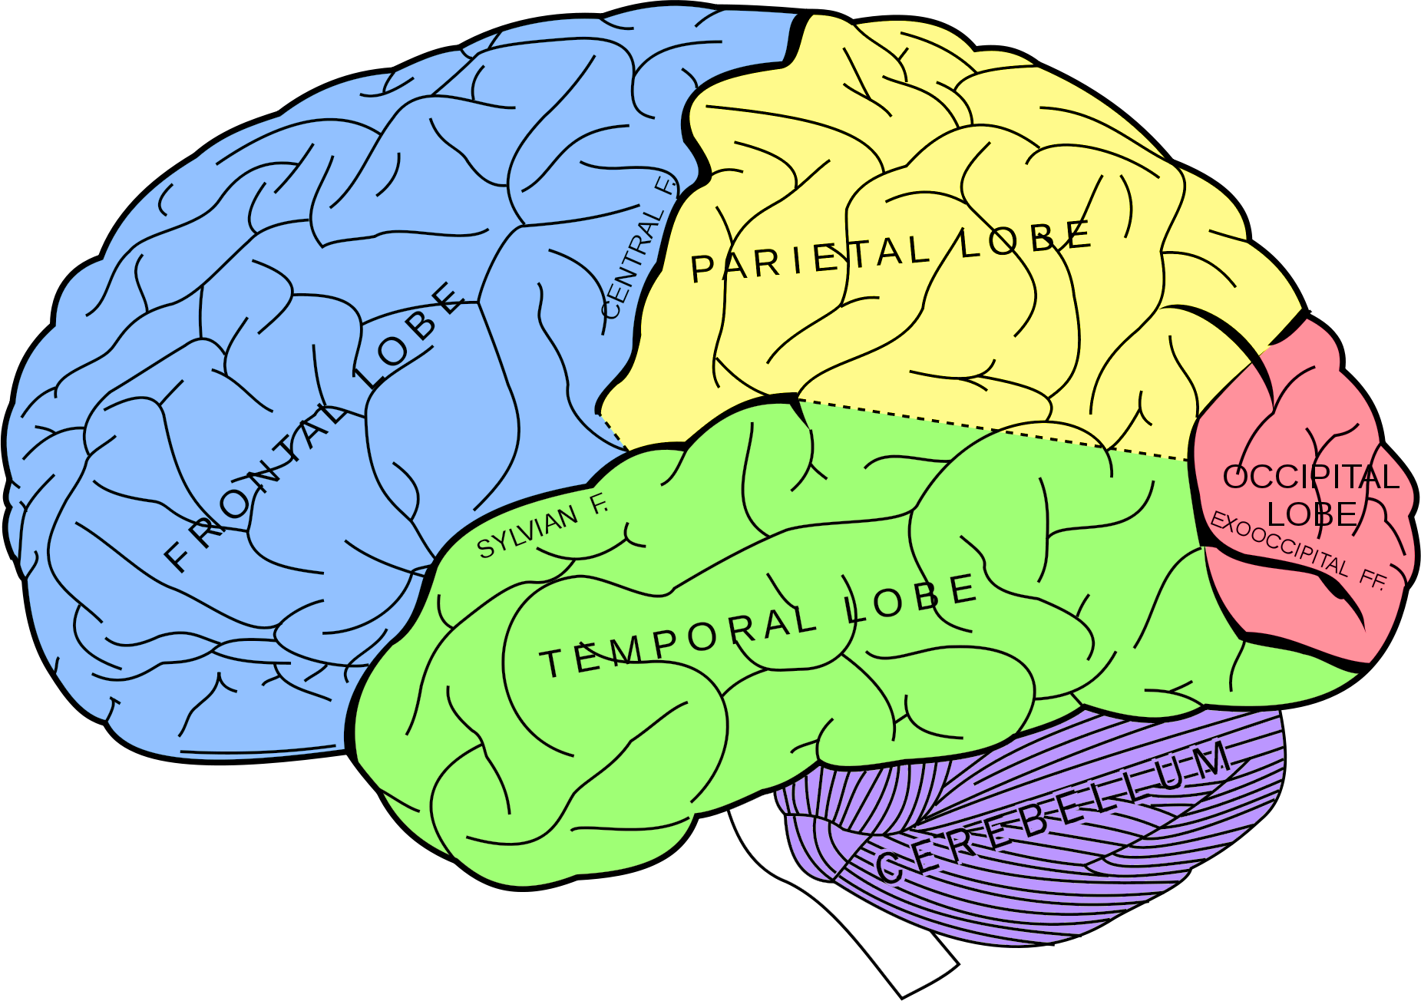
Brain Structure
The seat of sexual attraction
Notes:
Since sexual attraction begins in the brain, researchers first examined the question of sexual orientation by comparing the anatomy of brains from males and females. 

Slide 5
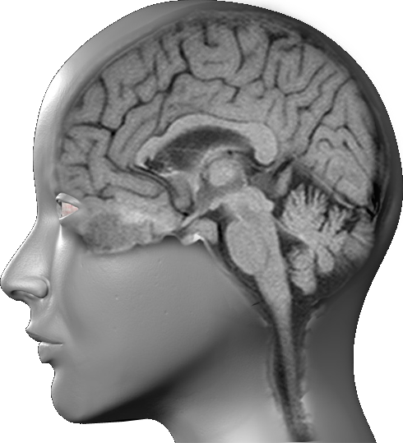
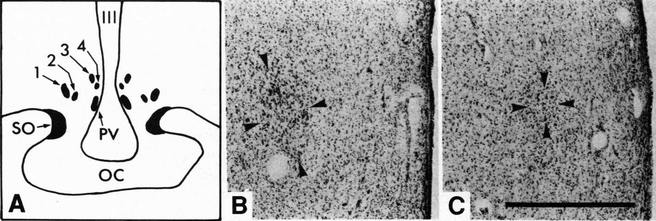
Hypothalamic Structure
INAH
Heterosexual Male
Homosexual Male
LeVay, S. 1991. A difference in hypothalamic structure between heterosexual and homosexual men. Science 253:1034-1037.
Notes:
Simon LeVay studied the brains of 19 homosexuals who had died of AIDS and compared the hypothalamus of those individuals to heterosexual men and women.  Here you can see the location of the hypothalamus in a sagittal MRI image. Specific structures, called “Interstitial Nuclei of the Anterior Hypothalamus” (INAH) were measured.  There are 4 such INAH in the hypothalamus,  numbered from 1 to 4. Previous studies had shown that the INAH3 of men were much larger than those found in women. LeVay hypothesized that homosexual men might have INAH3’s that were similar to women, somehow accounting for their attraction to other men. The figure on the right shows the INAH3 of a  heterosexual male compared to that of a  homosexual male. 

Slide 6
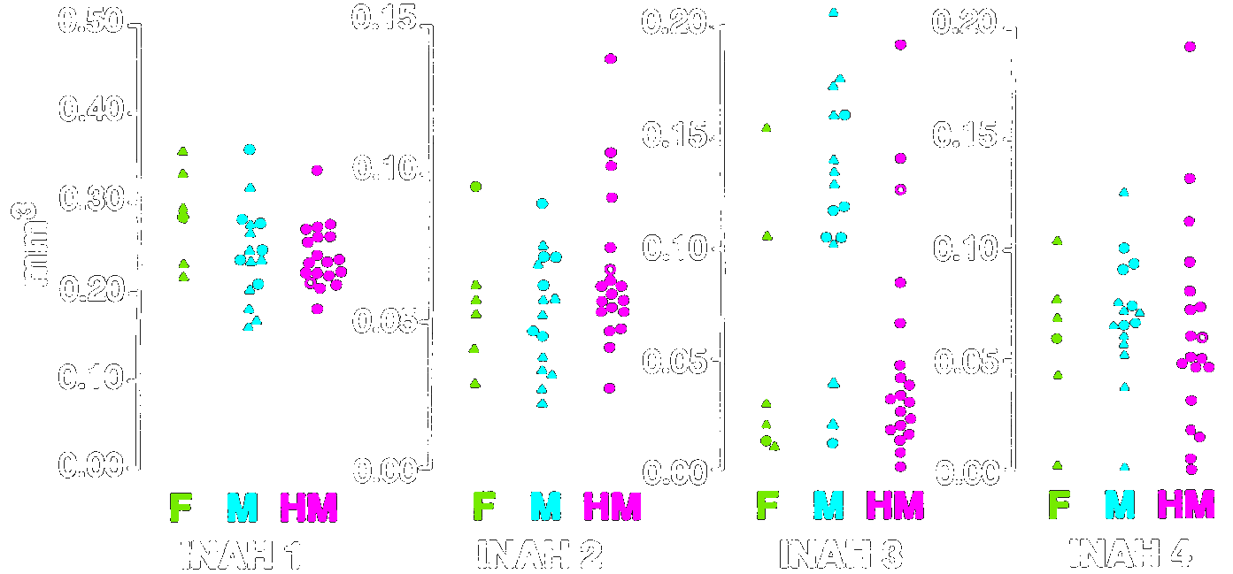
Hypothalamic Structure
LeVay, S. 1991. A difference in hypothalamic structure between heterosexual and homosexual men. Science 253:1034-1037.
Notes:
 This is a colorized version of figure 2 from LeVay’s article.  The y-axis is the measurement of volume in cubic millimeters. A millimeter is really small, being about the width of a sesame seed.  The four graphs here show the measurements of the 4 INAH’s. Individual measurements, represented by the small symbols, are shown for  Female heterosexuals,  Male heterosexuals, and  Homosexual Males. So, the volumes of  INAH1,  INAH2, and  INAH4 are roughly equal among the three groups. However, the volume of the INAH3 for  heterosexual males is about twice as much as that of  homosexual males, which is about equivalent to that of  heterosexual females. 

Slide 7
Hypothalamic Structure (INAH3)
Byne W., et al. 2001. The interstitial nuclei of the human anterior hypothalamus... Horm. Behav. 40:86-92.
Notes:
William Byne attempted to replicate LeVay’s results, but wanted to see if there was an effect of HIV infection on the size of the interstitial nuclei. So, he used much larger sample sizes and included HIV-infected heterosexuals in addition to HIV-infected male homosexuals.  As can be seen from this figure, individuals with HIV infection (both  males and  females) have a slightly lower volume INAH3. The INAH3 volume of  HIV+ heterosexuals and homosexuals are not statistically different, contradicting LeVay’s data. 

Slide 8
Hypothalamic Structure (INAH3)
Byne W., et al. 2001. The interstitial nuclei of the human anterior hypothalamus... Horm. Behav. 40:86-92.
Notes:
Even though the volume of INAH3 is slightly less in HIV+ homosexual compared with heterosexual males,  the actual number of neurons contained within the INAH3s are identical. Here you can see the number of neurons for  HIV+ heterosexual males and  HIV+ homosexual males, which are statistically identical to each other, and  quite similar to those of females. So, this study, done with larger sample numbers and accounting for HIV infection, shows that the hypothalamus of homosexual and heterosexual males do not account for differences in sexual behavior. 

Slide 9
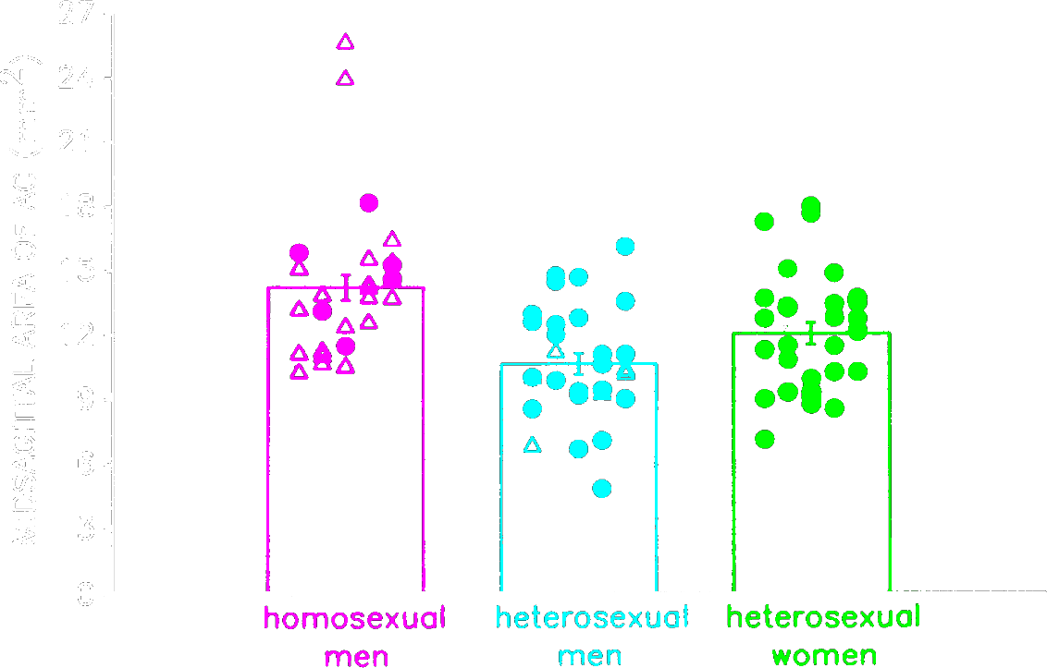
Anterior commissure
Allen, L. S. and R. A. Gorski. 1992. PNAS 89: 7199-7202.
Notes:
In 1991, Laura Allen published a study showing there was sexual dimorphism in the anterior commissure of the human brain.  Here we see a sagittal section of the brain showing the  location of the anterior commissure. Like LeVay, Allen hypothesized that homosexual men might be different from heterosexual men in this part of the brain. Sure enough, her 1992 study showed that the  anterior commissure of homosexual men was larger than that of  heterosexual men, and even larger than that of  heterosexual women. Was this the answer to sexual orientation? 

Slide 10
Anterior commissure
150
HIV⁺ homosxl men
HIV⁺ hetsxl men
140
HIV⁻ hetsxl men
HIV⁻ women
130
HIV⁺ women
120
(Brain Weight)^{2/3} (grams)
110
100
90
2
4
6
8
10
12
14
16
18
20
22
24
AC Measurement (mm²)
M. S. Lasco, et al. A lack of dimorphism of sex or sexual orientation in the human anterior commissure. Brain Research 936 (2002) 95–98.
Notes:
However, a later study by Mitchel Lasco showed that the anterior commissure had identical sizes in gay men and heterosexual men and women. Here, we are plotting  brain weight on the y-axis and the  area of the anterior commissure on the x-axis.  The orange diamonds represent the anterior commissures of HIV+ homosexual men, compared to that of  HIV+ heterosexual men in the red squares. Likewise, the areas of  HIV- heterosexual men and HIV- and  HIV+ women are all about the same size. So, the idea that the anterior commissure is involved in sexual selection seems unlikely. 

Slide 11
Left Handedness
91%
34%
Lalumière ML, Blanchard R, Zucker KJ. Sexual orientation and handedness in men and women: a meta-analysis. Psychol Bull. 2000 Jul; 126(4):575-92.
Notes:
Another indicator of brain function is handedness. About 70-90% of individuals are right handed the remaining 10-30% are mixed or left handed. There is some genetic predisposition for handedness, although two left-handed individuals will produce a left handed child only 25% of the time, which is only marginally greater than average.  It turns out that homosexuality is more common in left or mixed handed individuals. If you are a  male, you are 34% more likely to be gay. And if you are  female, you are 91% more likely to be gay. Since handedness is a function of the brain, it is hypothesized that the brains of homosexuals are different from those of heterosexuals. 

Slide 12
Older Brothers and Handedness
R. Blanchard, et al. 2006. Interaction of fraternal birth order and handedness in the development of male homosexuality. Hormones and Behavior 49:405–414.
Notes:
Several studies have shown there is an about 30% increased odds of being homosexual with each older brother you have. However, this study by Blanchard, et al  shows that the presence of older brothers only increases the odds of being homosexual in those who are  right handed. Those who are  non-right handed actually have reduced odds of being homosexual with one or more older brothers. 

Slide 13
Hormonal Influences
Testosterone
Estrogen
Progesterone
Notes:
Researchers have attempted to explain sexual preference on the basis of hormonal influences during development in utero. The usual suspects are  testosterone,  estrogen or estradiol, and  progesterone. These hormones produce the sexual dimorphism we observe between males and females. I need some couples to volunteer to observe some of these differences…

Slide 14
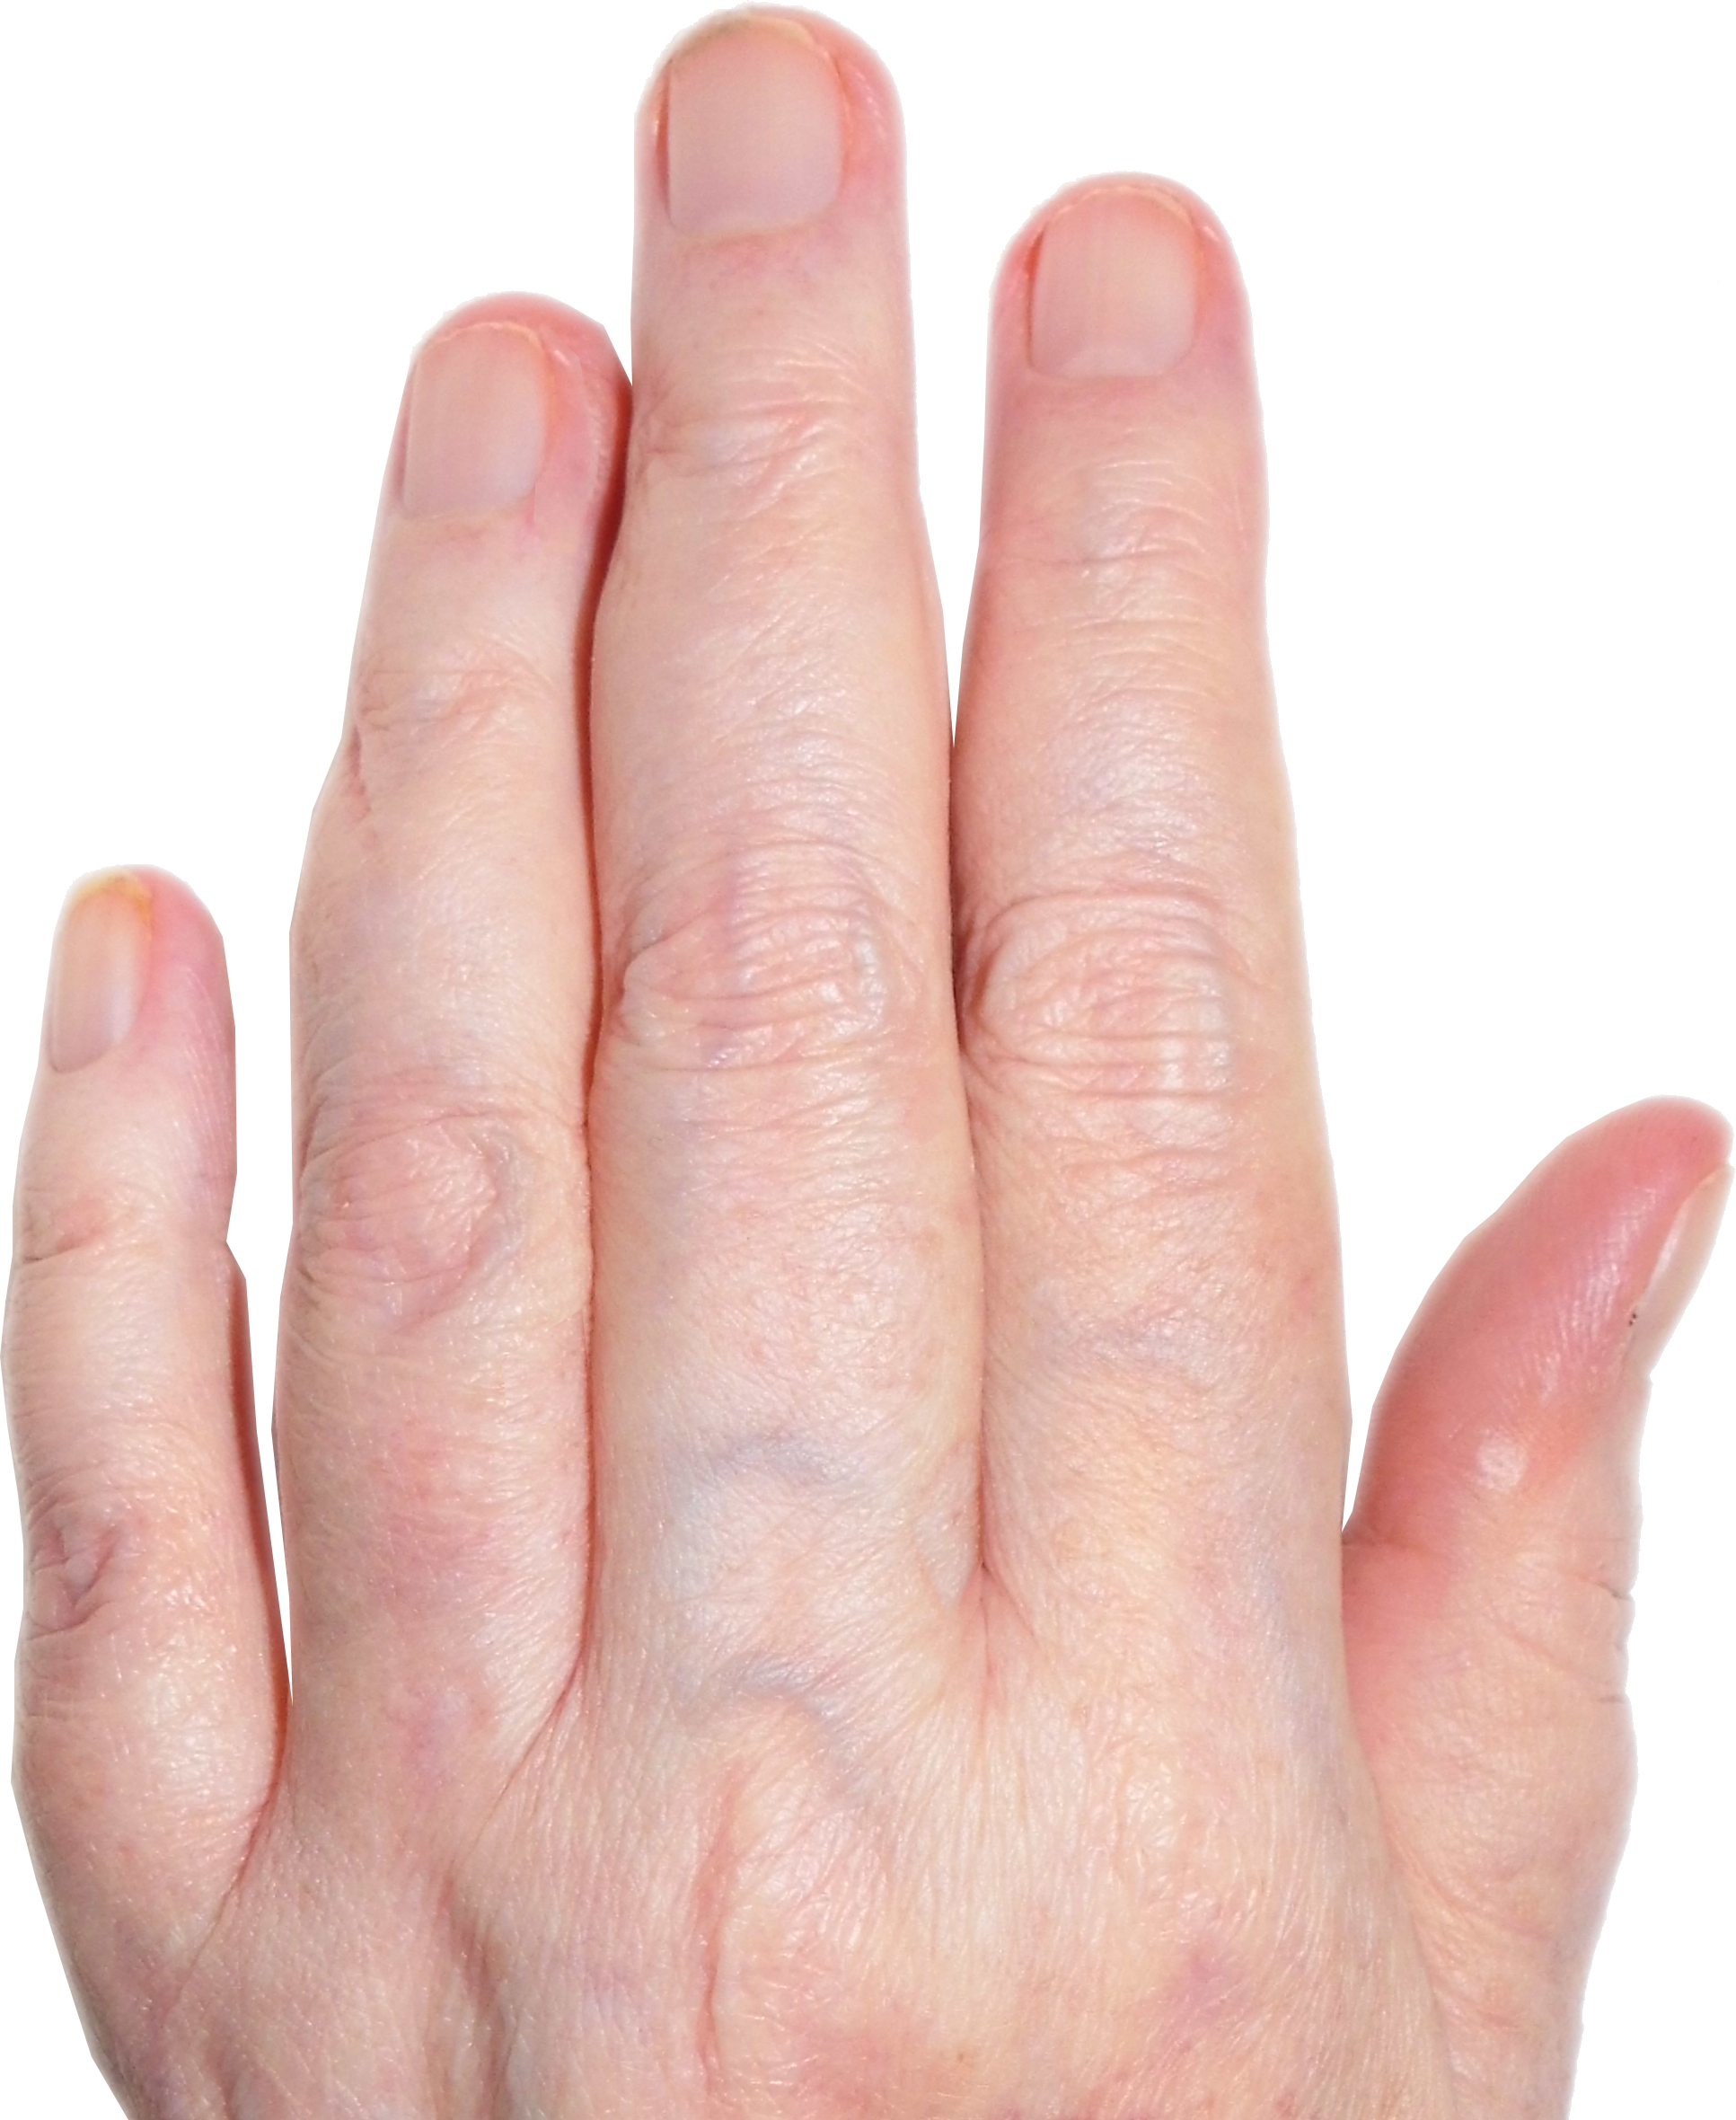
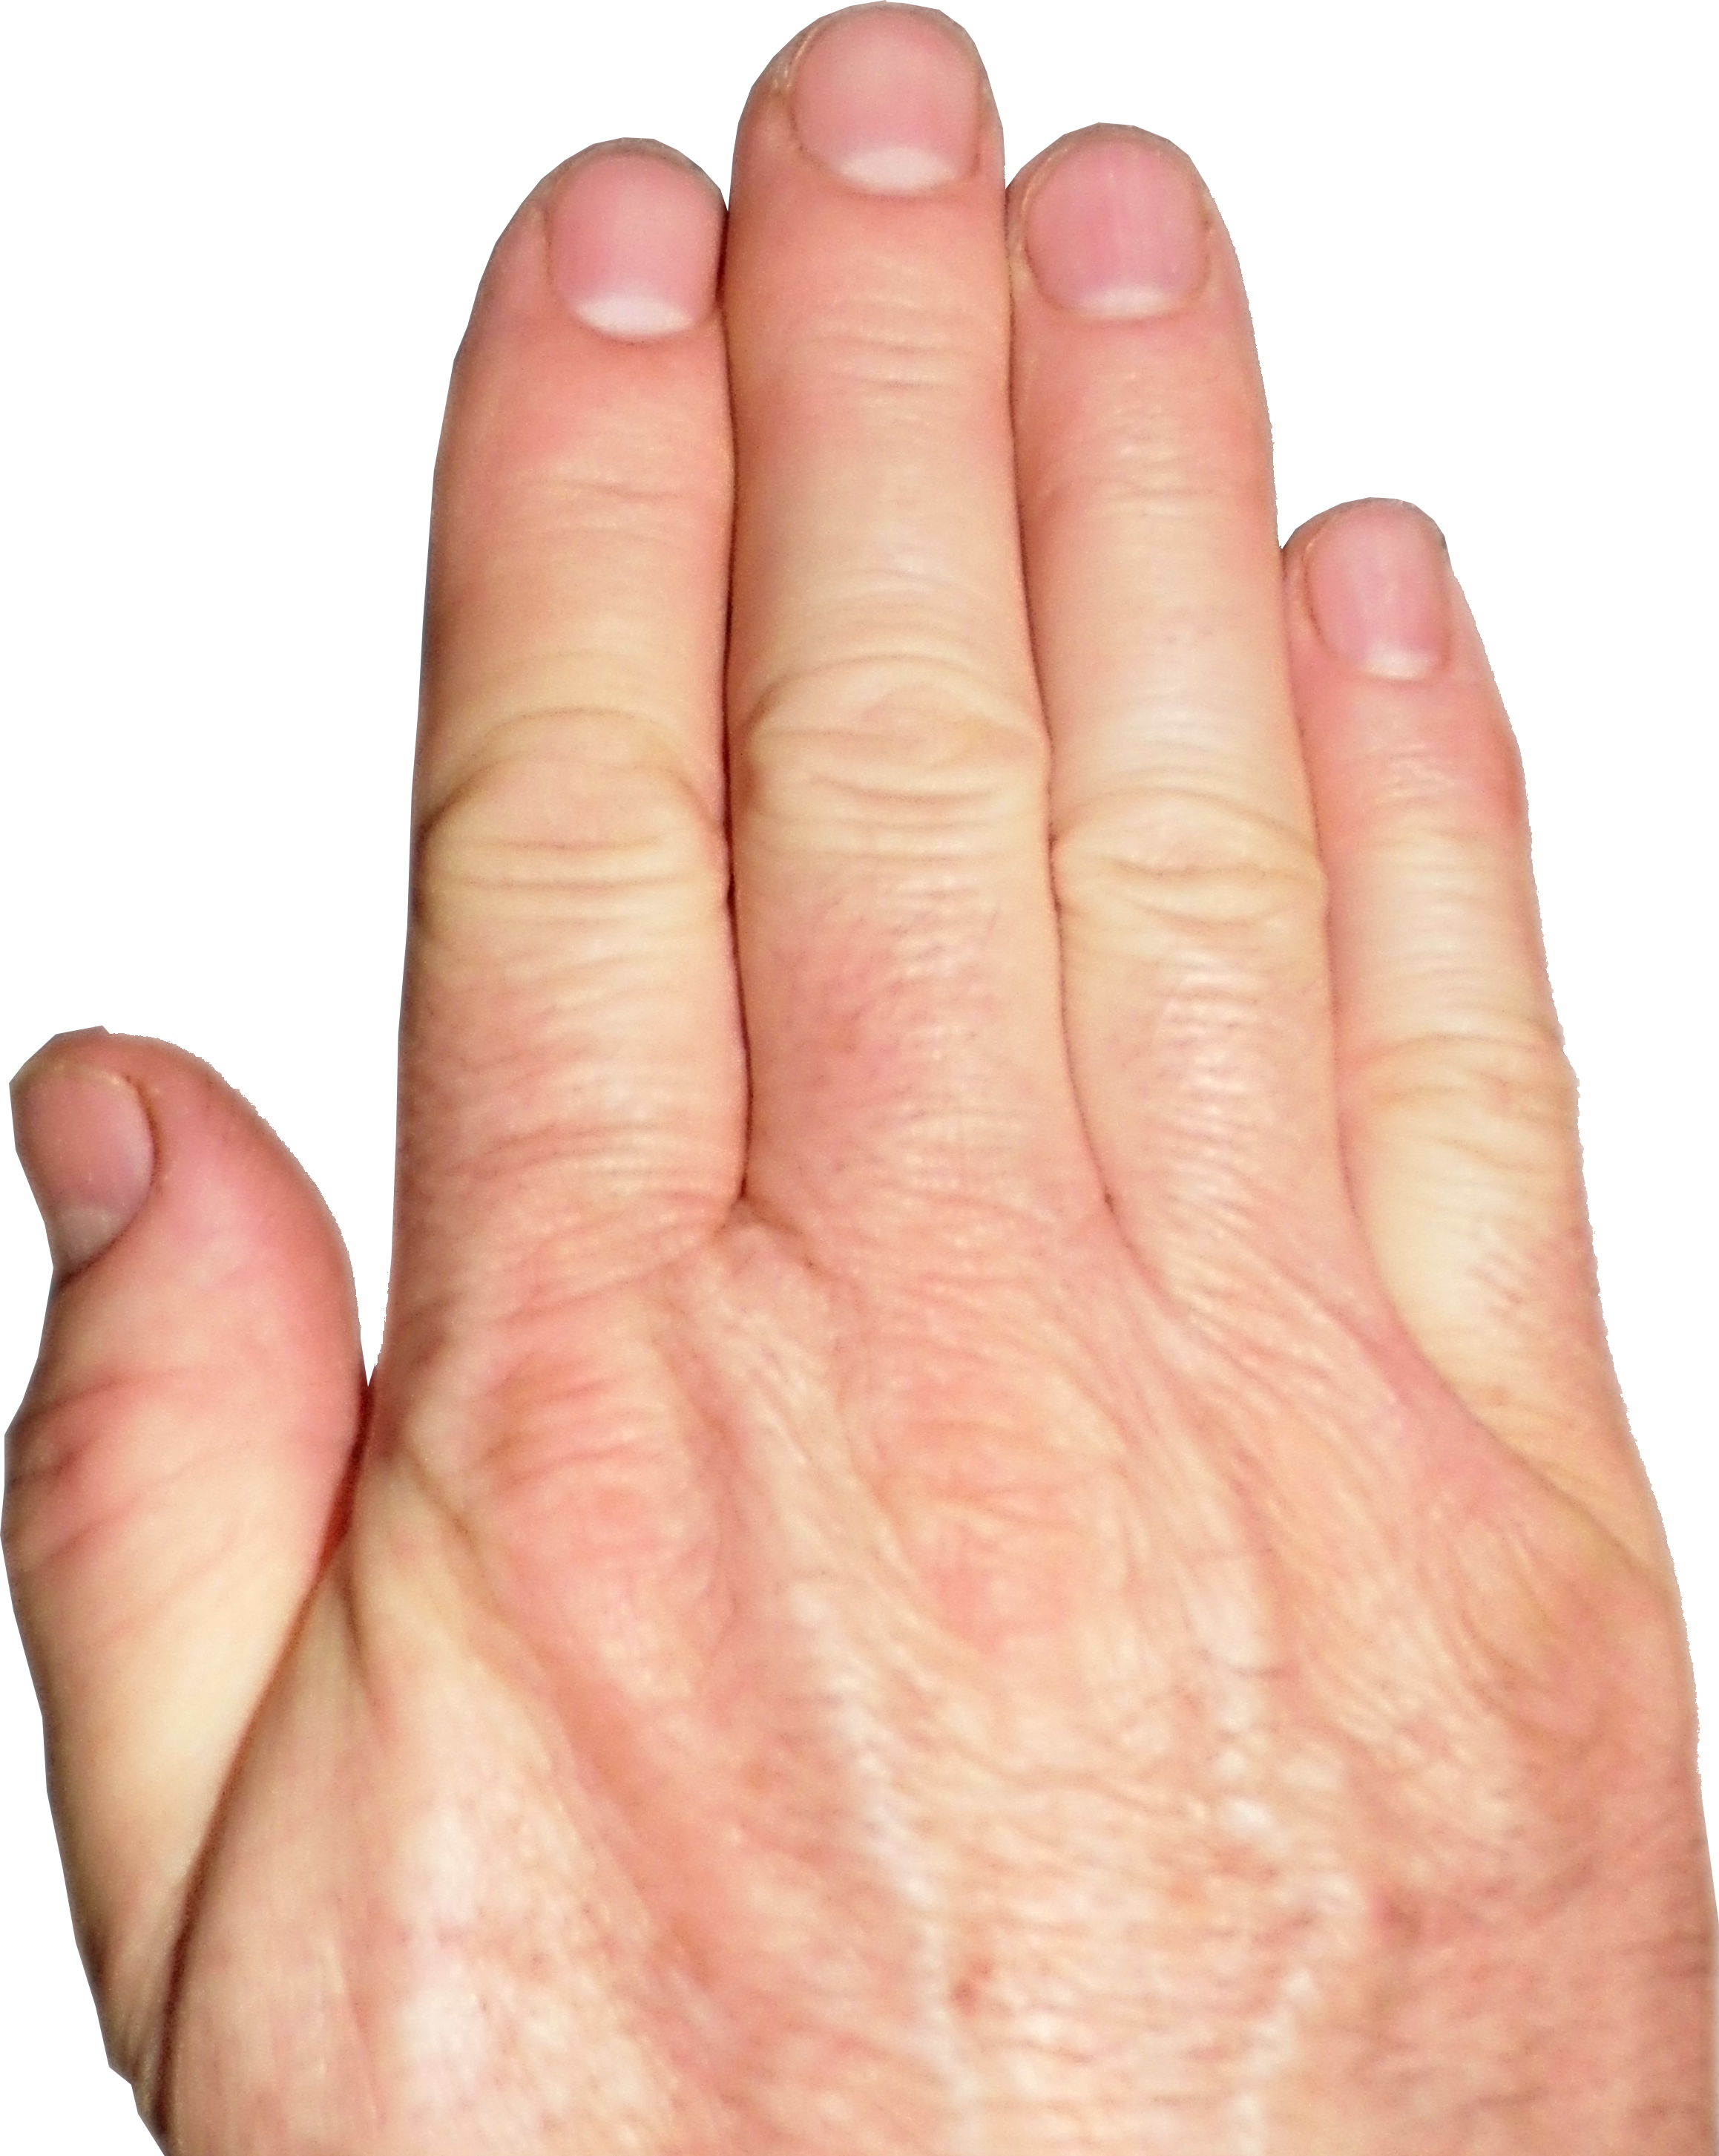
Male vs. Female Hands
Female Hand
Male Hand
4
2
2
4
Notes:
These are photos of  female and  male hands, showing the differences between the lengths of  digits 2  and 4. 

Slide 15
Effect of Testosterone on Digit Lengths
.0025
.0020
.0015
Fetal Testosterone:Estradiol Ratio
.0010
.0005
0
.84
.86
.88
.90
.92
.94
.96
.98
1.00
1.02
1.04
Right 2D:4D Ratio
S. Lutchmaya, et al. 2003. 2nd to 4th digit ratios, fetal testosterone and estradiol. Early Human Development 77: 23-28.
Notes:
 This is a scatterplot looking at the effect of testosterone and estrogen on finger lengths in the fetus during development.  On the y-axis is plotted the ratio of testosterone to estradiol and on the  x-axis is plotted the second digit to fourth digit ratio.  The line shown here is the best-fit regression line among all the points. The data shows that increasing testosterone to estradiol is associated with lower 2D:4D ratios. So, testosterone makes more male-like hands and estrogen makes more female-like hands. Some researchers hypothesize that homosexuality is due to hormone imbalances present during development and have used 2D:4D ratios as a proxy for fetal hormonal differences. 

Slide 16
Finger Lengths
Left Hand
Right Hand
p < 0.025
Williams, T. J., et al. 2000. Finger-length ratios and sexual orientation. Nature 404: 455-456.
Notes:
If sexual orientation were the result of fetal hormone imbalances, one would expect gay men to have hands more similar to female hands and gay women to have hands more like those of males. In fact, this study by Williams et al. shows this result, where  gay men have higher 2D:4D ratios, similar to heterosexual women and  gay women have lower 2D:4D ratios, similar to heterosexual men. However, for the right hand, there were  no differences between homosexual and heterosexual men, although the trend  held up for homosexual women. 

Slide 17
Finger Lengths
p =0.02
S.J. Robinson, J.T. Manning. The ratio of 2nd to 4th digit length and male homosexuality. Evolution and Human Behavior 21 (2000) 333-345.
Notes:
However, a study by Robinson and Manning showed that homosexual males had lower 2D:4D ratios compared to heterosexual men with a  p value of 0.02.  Here is a comparison of the results of the two studies side by side. As you can see, the results are  going in opposite directions. It turns out that ethnicity has a big effect on these ratios and that results done in Europe vs. the U.S. show opposite trends. A meta-analysis of all the finger-length studies by Grimbos et al. in 2010 showed that there was no influence of sexual orientation on finger lengths for males, although the trend for females was consistent.  Grimbos T, Dawood K, Burriss RP, Zucker KJ, Puts DA. Sexual orientation and the second to fourth finger length ratio: a meta-analysis in men and women. Behav Neurosci. 2010 Apr;124(2):278-87. doi: 10.1037/a0018764.

Slide 18
Sexual Preference and Hand Size
p < 0.0001
Martin, J. T. and D. H. Nguyen. 2004. Anthropometric analysis of homosexuals and heterosexuals. Hormones and Behavior 45: 31-39.
Notes:
Now, we are going to look at some anthropometric measurements related to gender and sexual preference.  Here is a graph of hand length vs. gender and partner preference. Males, of course have larger and longer hands than females,  with a p value of less than 0.0001.  Homosexual men have slightly shorter hands compared with heterosexual men and  homosexual women have slightly longer hands compared to heterosexual women. So, overall, those whose preferred partners are female have larger hands than those whose preferred partners are males, with a p value of 0.03, which is barely significant.  On the right is a graph of hand width to length. As most of you probably recognize,  men have “fatter” hands than women.  Homosexual men have hand width:length ratios less than heterosexual men.  And homosexual women have hand width:length ratios greater than heterosexual women. So, this data fits with the hypothesis that there might be some hormonal imbalances during development. 

Slide 19
Sexual Preference and Leg/Trunk Length
p < 0.04
p < 0.0001
Martin, J. T. and D. H. Nguyen. 2004. Anthropometric analysis of homosexuals and heterosexuals. Hormones and Behavior 45: 31-39.
Notes:
From the same study,  although trunk length is dependent upon gender with  males having longer trunk length than females, partner preference was not related to trunk length. Likewise,  leg length is gender dependent, and there was a barely significant correlation (p<0.04) of partner preference with leg length. 

Slide 20
Sexual Preference and Shoulders/Arms
p < 0.0001
p < 0.0001
Martin, J. T. and D. H. Nguyen. 2004. Anthropometric analysis of homosexuals and heterosexuals. Hormones and Behavior 45: 31-39.
Notes:
 The shoulder width to stature ratio is also  sexually dimorphic as shown here. However, this ratio was not correlated with partner preference.  Likewise, men have  longer arms than women, and partner preference was correlated with the arm:stature ratio. So, overall, there is some evidence for possible hormonal influences on sexual orientation, although the data are not all consistent. 

Slide 21
Older Brothers?
p = n.s.
p < 0.04
p < 0.025
p = n.s.
Williams, T. J., et al. 2000. Finger-length ratios and sexual orientation. Nature 404: 455-456.
Notes:
This is a graph of finger length ratios based upon sexual orientation and number of older brothers one has. Early studies indicated that each older brother a male had increased the probability of him being gay by about 30%. Williams et al. found that the second to fourth digit ratio of  second and third brothers decreased compared to the oldest brother. This trend occurred for both  homosexual and  heterosexual men, although the trend was not significant in heterosexual men because of larger error bars. However, the difference between homosexual and heterosexual men who had more than one brother was not significant, bringing into question whether any potential hormonal effects really affected sexual orientation. 

Slide 22
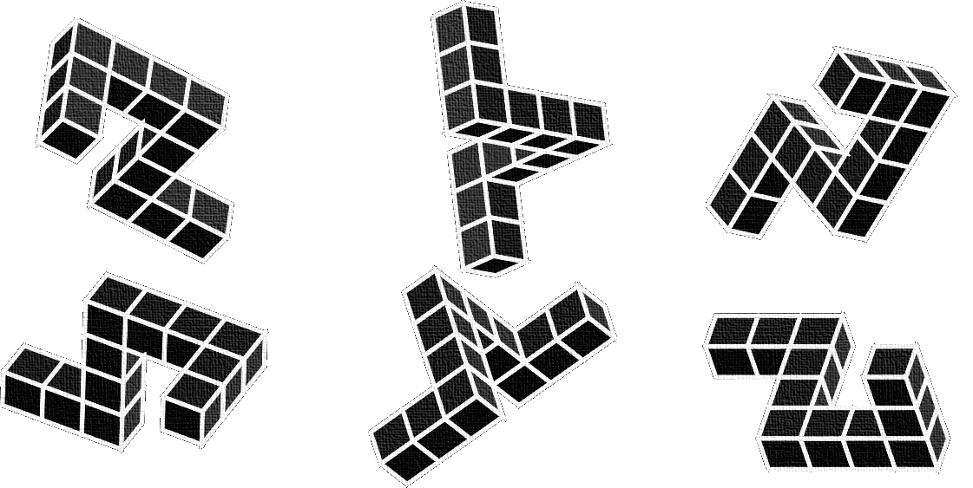
Mental Rotation Tasks (MRT) and Sexual Orientation
A
B
C
Michael Peters, et al. The Effects of Sex, Sexual Orientation, and Digit Ratio (2D:4D) on Mental Rotation Performance. Arch Sex Behav (2007) 36:251–260.
Notes:
 Anybody ever done one of these mental rotation tests? The object is to rotate the images in your mind to pick out the pair of shapes that are identical. So, what’s the answer for this one?  It turns out that men are much better at mental rotation tasks than women and your ability to perform these tasks decreases with age. Studies have shown that gender differences in mental rotation tasks can be detected even in infants, suggesting that early hormonal influences might be involved. So, the authors of this study thought that homosexuals might perform differently than heterosexuals, based upon differences in early hormonal exposure. These are the results, showing that  homosexual men performed worse than heterosexual men and  homosexual women performed better than heterosexual women. 

Slide 23
Congenital adrenal hyperplasia (CAH)
O
OH
21-hydroxylase
HO
H
OH
H
H
H
H
H
H
HO
O
Cholesterol
Cortisol
Testosterone
Progesterone
Estrogen
Notes:
Congenital adrenal hyperplasia is an autosomal recessive disease that results from mutations in the genes that code for enzymes that mediate cholesterol metabolism. So, genes that  convert cholesterol to cortisol  are defective, resulting in  altered synthesis of sex hormones, beginning in utero. Usually, CAH results in increased production of testosterone. In a male fetus, excess testosterone has minimal effect, but in XX females, excess male hormones often result in virulization of the fetus. 

Slide 24
Finger Lengths CAH
Left Hand
Right Hand
p < 0.03
p < 0.05
p = 0.10
p = 0.13
Brown, W.M., et al. Masculinized Finger Length Patterns in Human Males and Females with Congenital Adrenal Hyperplasia. Hormones and Behavior 42: 380–386.
Notes:
How serious are these hormonal effects?  These are the results of Brown et al, which show that those suffering from congenital adrenal hyperplasia have extremely altered 2D:4D ratios compared with controls. These hormonal effects occur in  both males  and females, such that the 2D:4D ratio of  females with CAH are actually have lower ratios than those of normal males. Here are the results for the right hand, though not quite as dramatic are still substantial. Since CAH represents a severe hormonal imbalance, what influence does this extreme case have on sexual orientation? A meta analysis of 18 CAH studies shows that 91.5% of those women suffering from CAH end up with a heterosexual orientation, despite a severe imbalance of testosterone during fetal development. The percentage that are gay is higher than the average population statistic, but these studies show that hormonal influences in utero are not the major reason for homosexual sexual orientation. 

Slide 25

Twin Studies
Notes:
Twins and siblings are a proxy for genetic studies, since identical twins share 100% of genes and siblings share an average of 50% of genes. Early twin studies on sexual orientation suffered from serious flaws, such as obtaining their twin pairs by advertising in gay publications, resulting in populations that were almost certainly biased toward homosexual twin pairs. 

Slide 26
Twins and Their Siblings
K. S. Kendler, et al. Sexual Orientation in a U.S. National Sample of Twin and Nontwin Sibling Pairs. Am J Psychiatry 2000; 157:1843–1846.
Notes:
The largest study of sexual orientation in familial groups was done by  Kenneth Kendler et al. in 2000. Kendler screened 50,000 households at random, obtaining 1,380 twin pairs and their siblings. Even with such a large population, the statistical power of the study was low, since only ~3% of the population was non-heterosexual. Six out of 19 or  32% of monozygotic (identical) twins were concordant for non-heterosexual orientation. If sexual orientation were simply a matter of genes, one would have expected 100% concordance. The study also examined dizygotic (or non-identical) twins and their siblings. On average, siblings (including those who are dizygotic twins) will share 50% of their genes in common. Groups of dizygotic twins and their siblings all shared higher non-heterosexual orientation than what would be expected in a randomly selected population of individuals, demonstrating the existence of genetic and/or environmental factors.  The line here represents the average of all sibling pairs. The fact that  same sex dizygotic and siblings pairs exhibit higher non-heterosexual orientation compared to  opposite-sex pairs shows that familial or environmental effects on sexual orientation exist, since by chance the genetic inheritance of all these pairs should be identical. In fact, the rate of concordance among non-heterosexual opposite-sex siblings was only 5%, which is only marginally higher than that observed in the general population. So, clearly, environmental or familial factord affect sexual orientation.

Slide 27
Homophobia is Partially Genetic
Verweij, K. J. H., et al. Genetic and Environmental Influences on Individual Differences in Attitudes Toward Homosexuality. Behav. Genet. 2008 May; 38(3): 257-265.
Notes:
On a twist of the possible genetic basis of homosexuality, Australian researchers examined twin and sibling pairs to examine the basis of homophobia.  Their data showed that over a third of homophobia was due to genetic factors, with only 18% due to shared environmental factors (such as familial influences). So, even homophobes can claim they were “born that way.” 

Slide 28
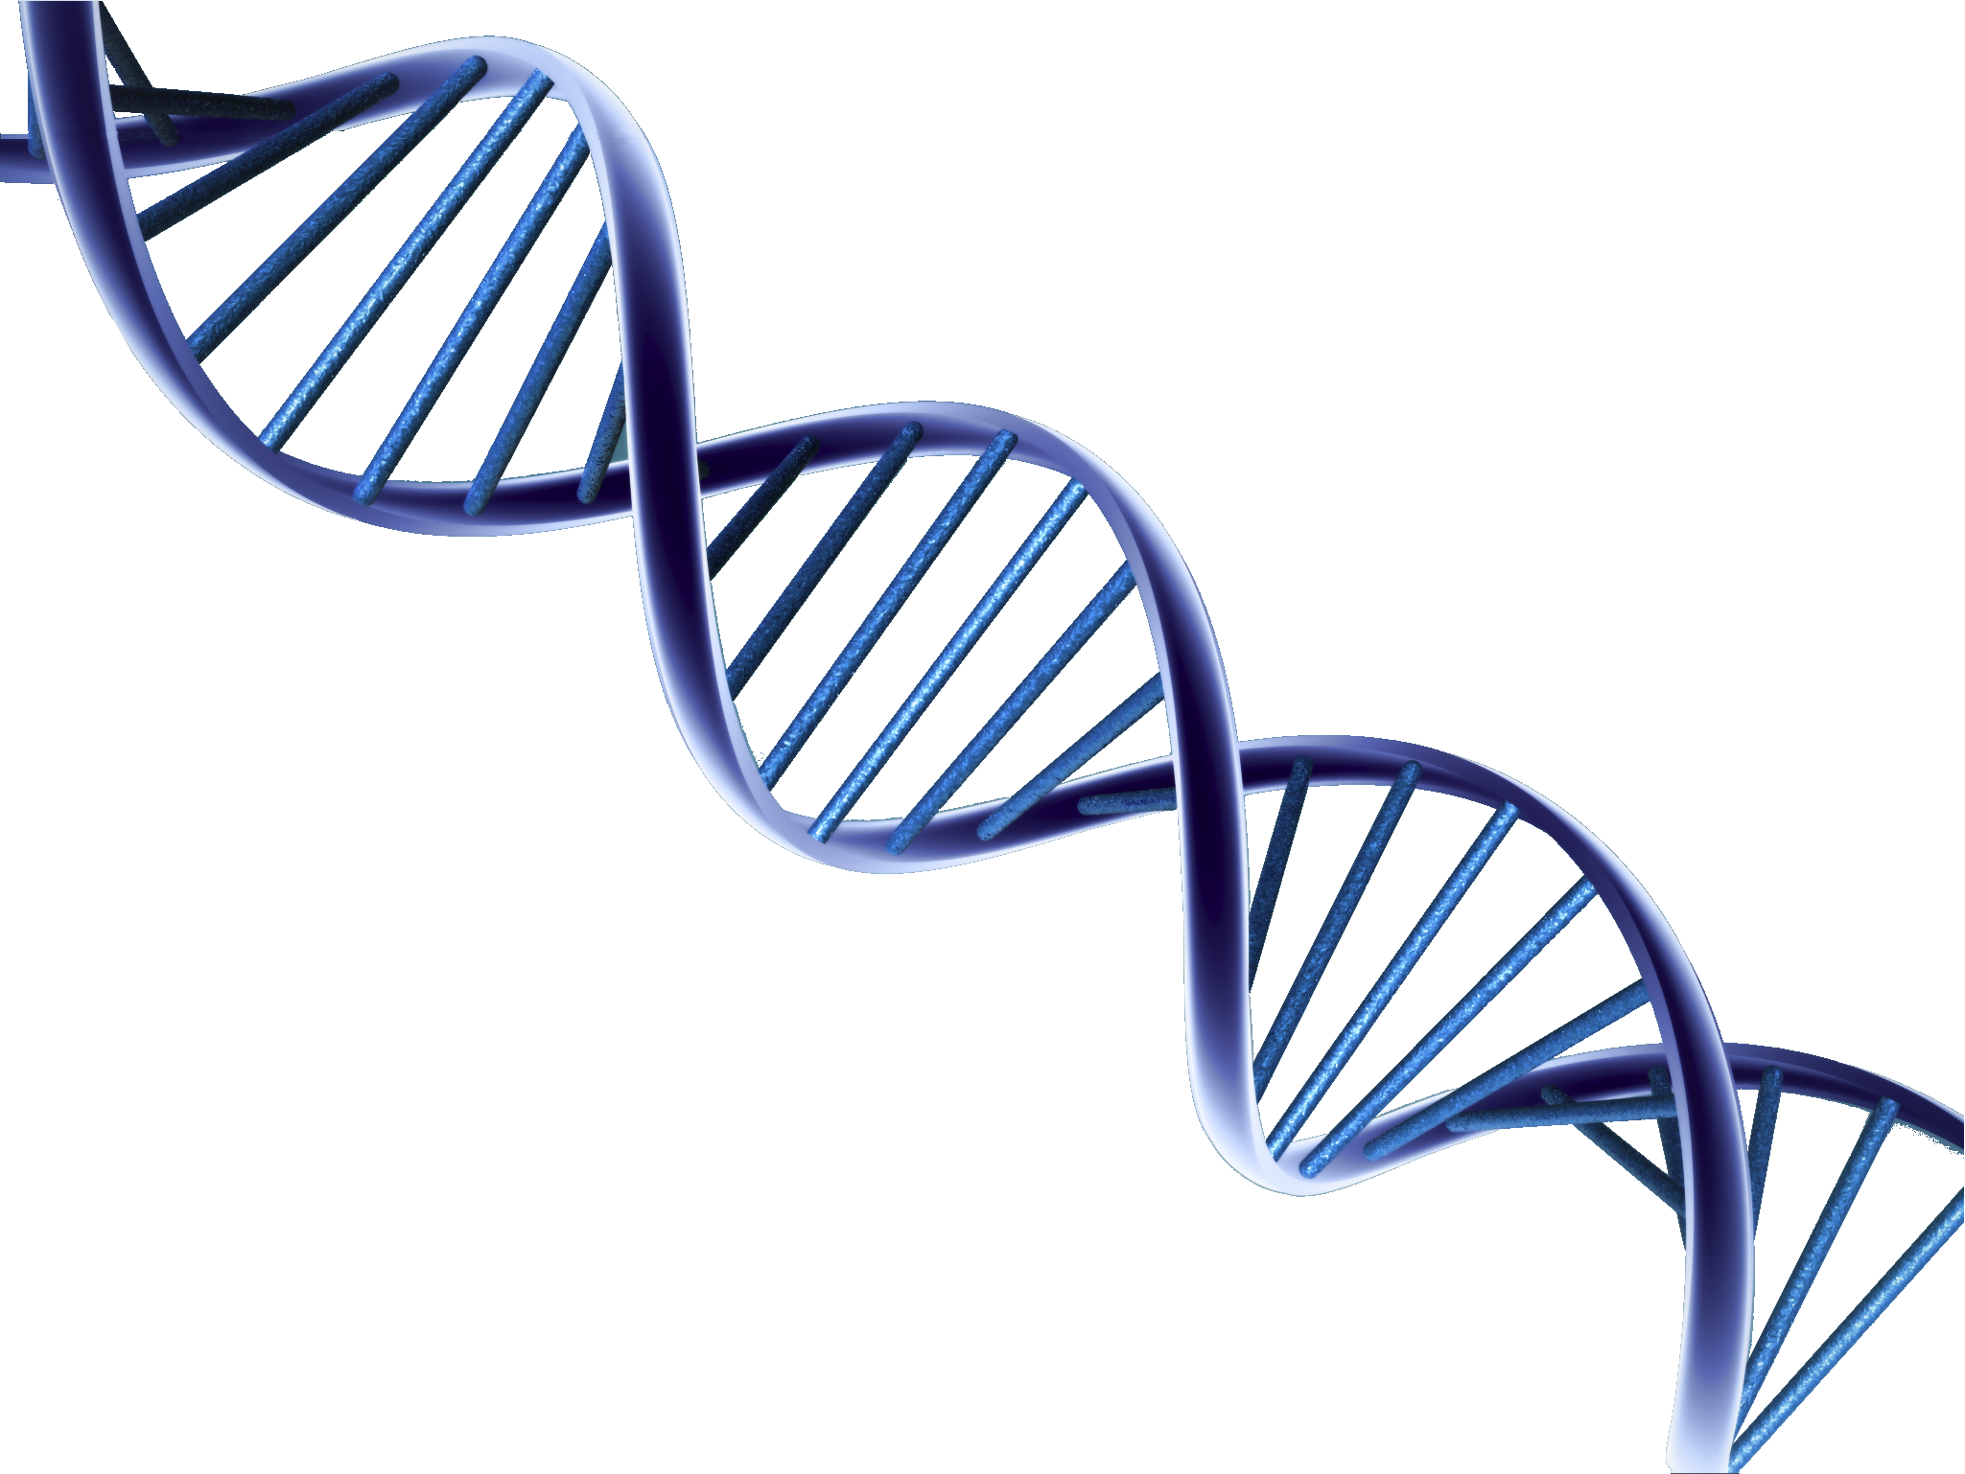
Genetic Studies
Notes:
Genetic studies on sexual orientation have not been extensive, probably because of low percentage of homosexuals in the general population. However, some initial genetic studies suggested an association between sexual orientation and the X-chromosome. Let’s take a look at those studies. 

Slide 29
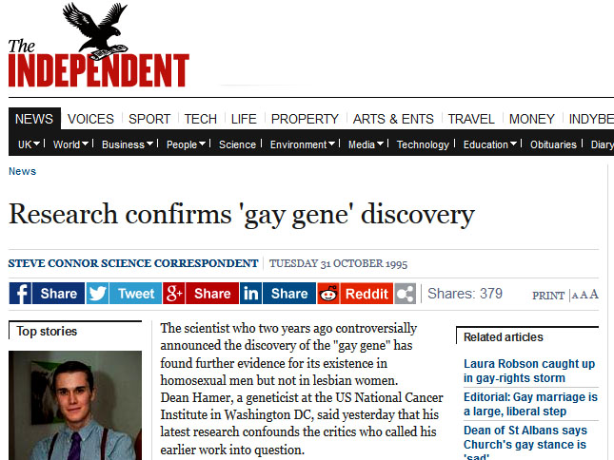
Gay Gene: Xq28 Region
X
q28
FMR
F8C
G6PD
GABRA3
DX552
DXS1108
DXY5154
Notes:
An examination of family pedigrees revealed that gay men had more homosexual male relatives through maternal than through paternal lineages, suggesting a linkage to the X chromosome. So, Dean Hammer examined the X-Chromosome of 40 families that had homosexual brothers. As you all know, we inherit half our genes from our mother and half from our father. But for males, we get only one copy of the X-chromosome, only from either allele from one of the two X-chromosomes carried by our mother. So, by chance, these brothers should share an average of 50% of their alleles. If sharing exceeds 50% for a particular set of genes, it is likely that homosexuality is associated those genes.  This is a schematic of the X-chromosome showing the q28 region on the end for which an association was found.  News headlines proclaimed that homosexuality was genetic – end of story. Let’s look at the data. 

Slide 30
Gay Gene: Xq28 Region
q28 Region
Hamer, D. H., et al. 1993. A linkage between DNA markers on the X chromosome and male sexual orientation. Science 261: 321.
Notes:
 The is a graphic of Hammer’s 1993 data. On the x-axis we can see the list of genes and regions  associated with the q28 region.  The dashed line represents the allele sharing frequency expected by chance. As you can see, allele sharing in the q28 region is much higher than expected by chance–upwards of 82%. Hammer repeated the result two years later, showing that the effect only occurred in gay males and not lesbian females. However, in his second set of experiments, allele sharing went down to 67%, instead of 82% - being much closer to that expected by chance. 

Slide 31
Gay Gene: Xq28 Region?
Rice, G., et al. 1999. Male Homosexuality: Absence of Linkage to Microsatellite Markers at Xq28. Science 284: 665-667.
Notes:
George Rice attempted to replicate Hammer’s data using a larger sample of 52 male homosexual brothers.  Contrary to Hammer’s data, Rice found no excess of allele sharing in the q28 region of the X-chromosome.,  with the expected and observed allele frequencies being statistically identical. You all saw this study reported by the news media. Right? 

Slide 32
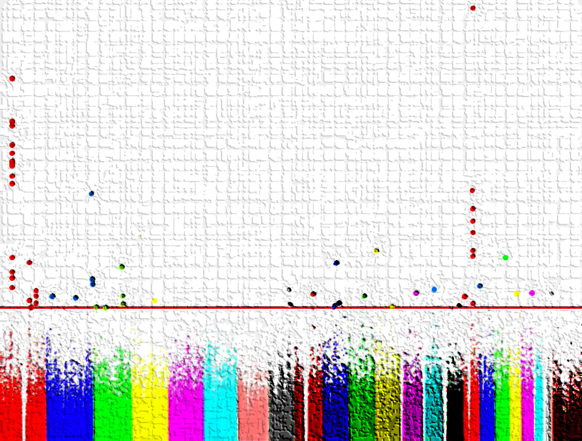
Real genetic studies (GWAS)
Genome Wide Association Studies
Notes:
The current technology most often used in genetic studies is referred to as genome wide association studies (or GWAS). Let’s look at how this technology works. 

Slide 33
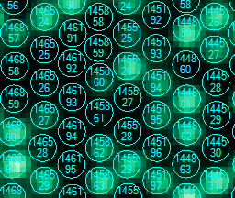
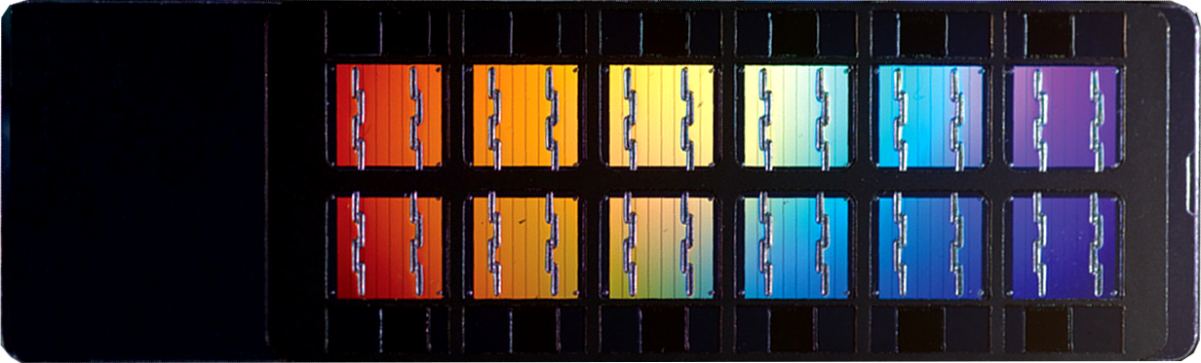
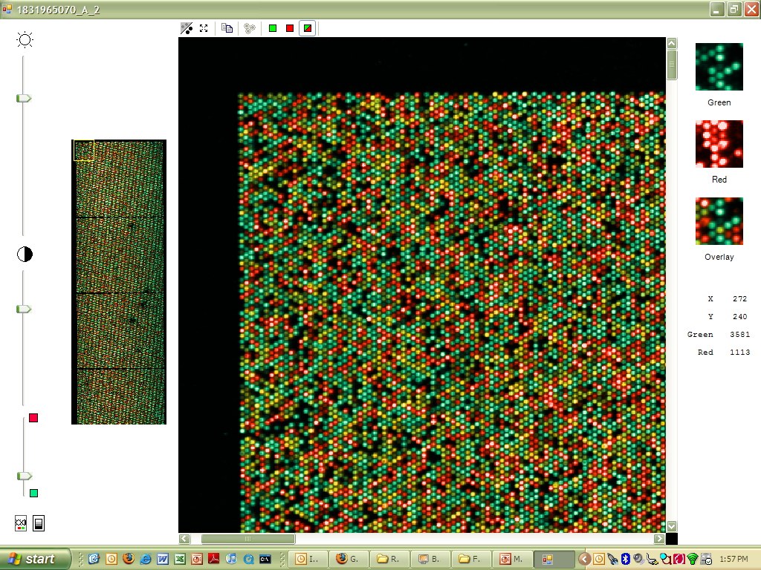
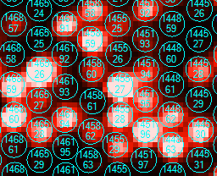
How GWAS Works
Amplified fragmented DNA hybridized to locus-specific 50mers covalently linked to bead type
Laser excites the fluorophore and scanner records light emitted from fluorophore
Each bead pre-identified by factory using 25 mer “zipcode”
High-throughput technology
Determine single nucleotide polymorphism (SNP) frequencies
T
T
G
G
G
T
SNP1
SNP2
SNP3
Y
Y
x
x
x
Y
C-Bio
ɑ-DNP
ɑ-DNP
C-Bio
C-Bio
Notes:
 Genome wide scanning is a high throughput bead-chip technology that allows scientists to  determine the allele frequency of specific single nucleotide polymorphisms (or SNPs). A SNP is a single base pair mutation. In the human population there are about 10 million SNPs among the 3 billion base pairs. Genome wide technology  uses a chip on which hundreds of thousands to millions of complementary SNP sequences are bound.  Addition of amplified patient DNA is detected by a scanner following laser excitation of bound fluorophores. 

Slide 34
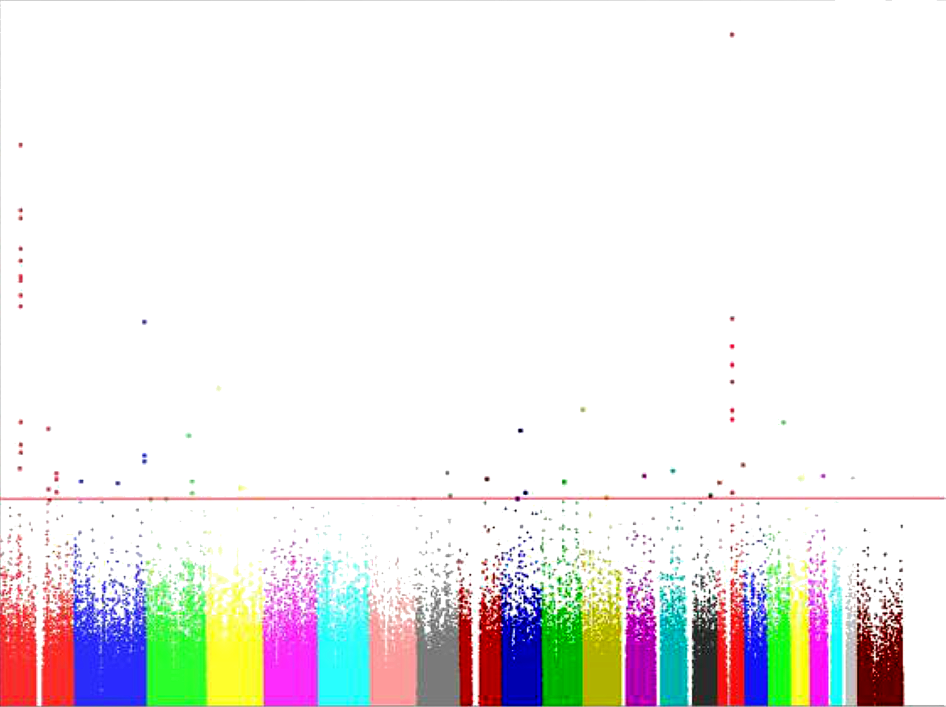



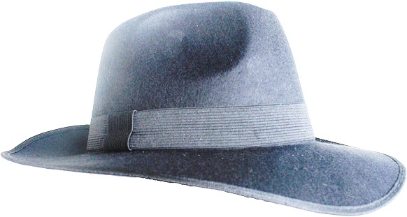


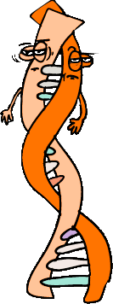



Manhattan Plot of IBD Genes
14
13
12
11
10
9
8
7
-Log₁₀ P Value
6
5
4
3
2
1
0
1
2
3
4
5
6
7
8
9
10
11
12
13
14
15
16
18
20
22
X
Chromosome Number
17
19
21
Notes:
 This is a line-up of the usual gene suspects.  Actually, this Manhattan plot is a sort of line-up of SNPs related to IBD.  The x-axis is chromosome number from 1 to 22 and X.  The y-axis is the p value of significance for each SNP.  The red line represents the value of significance for these number of SNPs analyzed, with SNPs falling above the line being statistically significant for association with IBD. So, in this Manhattan plot, we are looking for skyscrapers among the usual skyline. 

Slide 35

Crohn’s Disease Associated Genes
1q24
8q24
1q32
TAGAP
6q21
BACH2
7p12
6p25
8q24
CPEB4
10p11
NDFIP1
13q14
ERAP2
ICAM1/3
19p13
5q13
CCL2/7
21q21
3p24
EIF3C/CD19
ITLN1
SP140
YDJC
PTPN22
PLCL1
SMAD3
IL12B
VAMP3
GALC
CDKAL1
C2orf74
ZFP36L1
CCR6
THADA
TNFSF11
NKX2-3
JAK2
MAP3K7IP1
GCKR
MTMR3
PTPN2
C11orf30
19q13
DNMT3A
TNFRSF6B
ZNF365
LRRK2/MUC19
IL27
IL10
PRDX5/ESRRA
NOD2
IRGM
ORMDL3
ZMIZ1
DENND1B
UBE2D1
5q31
IL23R
PTGER4
STAT3
CARD9
SCAMP3/MUC1
IL2RA
MHC
TNFSF15
ATG16L1
MST1
ICOSLG
IL18RAP
FUT2
FADS1
Prior
2005
2006
2007
2008
2009
2010
Notes:
This is the list of genes that have been found to be associated with Crohn’s Disease, and these are the ones that were  identified by scientists at Cedars-Sinai. In total, we have found 163 genes that are associated with IBD. 

Slide 36

Immune Cells/Pathways Involved in IBD
Luminal bacteria
TLR
NLR
Epithelial cells
Lamina
propria
Dendritic
cell
IL-10
IL-12
IL-23
IL-18
IL-12R
T_{H}1
IFN-γ
Crohn’s
disease
IL-2R
IL-17
IL-22
CD80
CD86
IL-12, TL1A
T_{H}17
IL-6
IL-23
IL-1β
TNF
TH0
cell
IL-23, TGF-β, IL-6,
TL1A
CD28
CTLA4
T_{H}2
IL-10
IL-4
IL-23
Ulcerative
colitis
IL-13, TL1A
NKT
IL-13
IL-22
ILC₁₋₃
IL-2
T_{REG}
Endothelial cells
IL-10, TGF-β
ICAM1
VCAM1
α4β7
CCR9
Leukocytes
Blood
vessel
α4β1
MAdCAM1
CCL25
Melmed, G and S. Targan. 2010. Nature Reviews Gastroenterology and Hepatology 7, 110-117.
Notes:
Not only are these genes statistically associated with IBD, but these genes are known to be involved in cellular immune responses within the gut as shown in this schematic. So, many of the 163 genes play a known role in the immunopathology of IBD. 

Slide 37
Genes Shared Among
Immune-mediated Diseases
MULTIPLE SCLEROSIS
SYSTEMIC LUPUS ERYTHEMATOSUS
PTGER4;STAT3; IL2RA; IL7R; FCGR2A
IL10
PTN22
FCG2A
IRF5
RHEUMATOID ARTHITIS
ANKYLOSING SPONDYLITIS
PRDM1
REL
PTPN22
CCR6
IL2RA
FCGR2A
IL2 / IL21
TNFRSF14
IRF5
IL23R
ERAP2
IL23R
IL12B
CDKAL1
PTPN22
PSORIASIS
ATOPIC DERMATITIS
C11ORF30
BEHҪET’S
LEPROSY
IL23R; IL10
IBD
NOD2
LRRK2
TNFSF15
ALOPECIA
IL2RA
PTPN22
CCR6
ZMIZ1
PRDX5; IL2RA; IL2 / IL21
ZMIZ1
ICOSLG
REL
KIF21B
YDJC
TNFRSF14
IL2 / IL21
PTPN2
IL18RAP
VAMP3
BACH2
TAGAP
ZFP36L1
SMAD3
ORMDL3
5q31 (IBD5)
DENND1B
VITILIGO
ASTHMA
PTPN2
ORMDL3
IL10
TYK2
FCGR2A
IL18RAP
PTPN22
IL27
BACH2
IL2RA
COELIAC DISEASE
CDKAL1
GCKR CAPN10
THADA HNF4A (MODY)
Type I DIABETES MELLITUS
Type II DIABETES MELLITUS
Lees et al Gut 2011
Notes:
Other researchers have performed genome wide studies on other immune-mediated diseases, such as diabetes, SLE, and arthritis, among others. Many of the IBD-related genes shown here are also involved in the pathology of these other immune-mediated diseases. So, the evidence for the involvement of these genes in autoimmune disease is overwhelming. Let’s look at a GWAS related to some previous data I have shown you. 

Slide 38
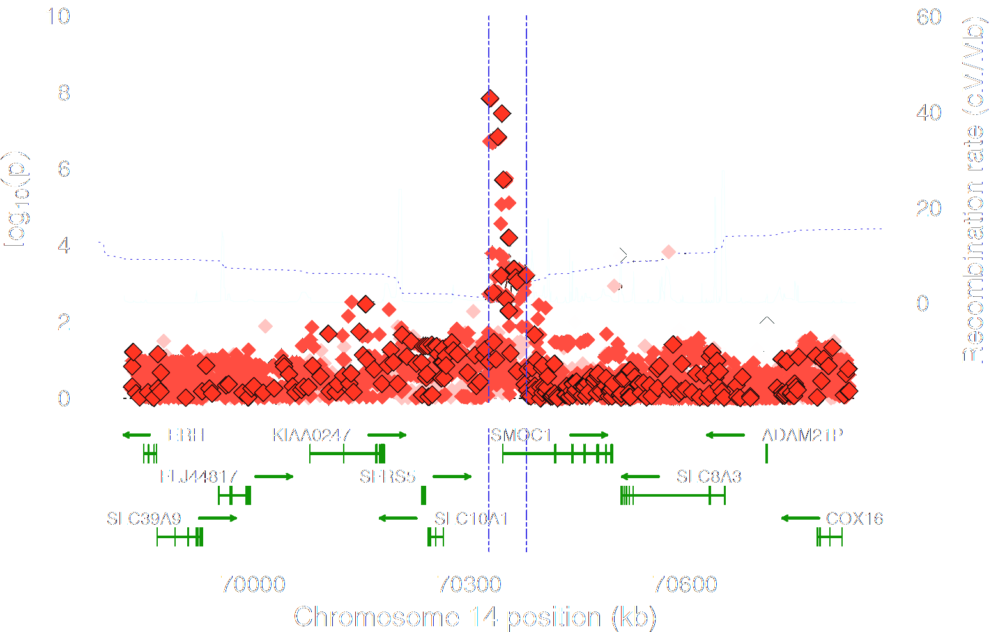
GWAS Related to 2D:4D Digit Ratios
A.J. Lawrance-Owen et al. Genetic association suggests that SMOC1 mediates between prenatal sex hormones and digit ratio Hum Genet (2013) 132:415–421.
Notes:
This is a Manhattan plot of genes related to 2D:4D ratios.  Numerous SNPs are associated with a gene called SMOC1. The gene SMOC1 is involved in eye and limb development and regulates osteoblast differentiation. Of course, osteoblasts are the cells that produce bone and bone matrix. So, it makes perfect sense that the SMOC1 gene would affect digit ratios. So, when we do a genome wide study, we expect to see changes in genes that are functionally related to the subject of study. 

Slide 39
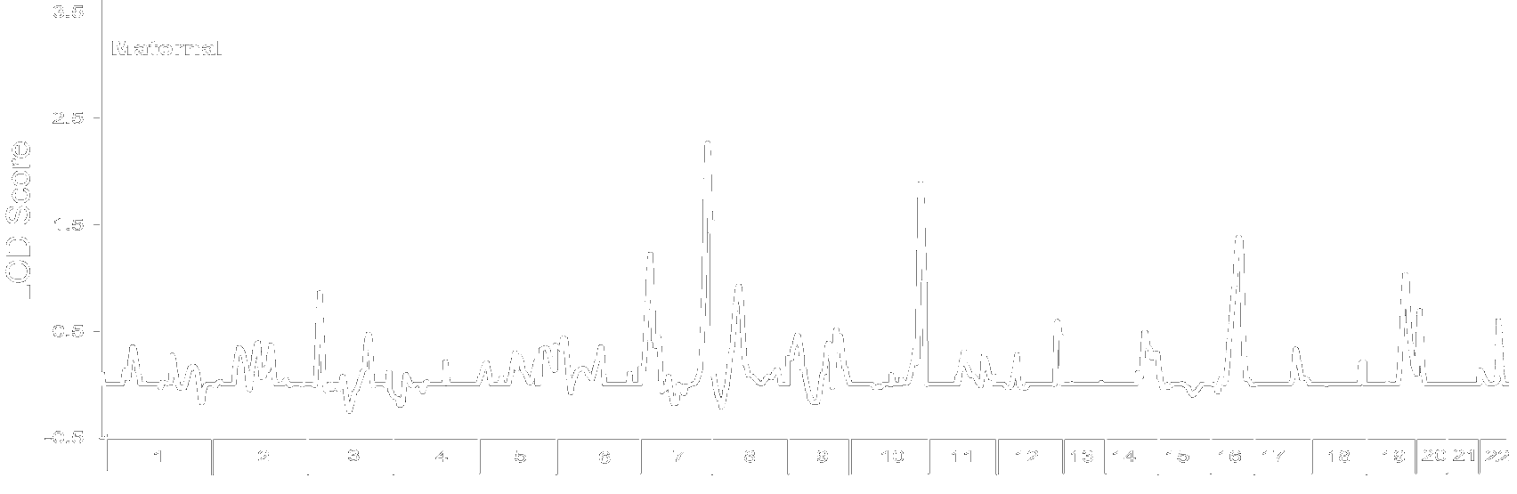
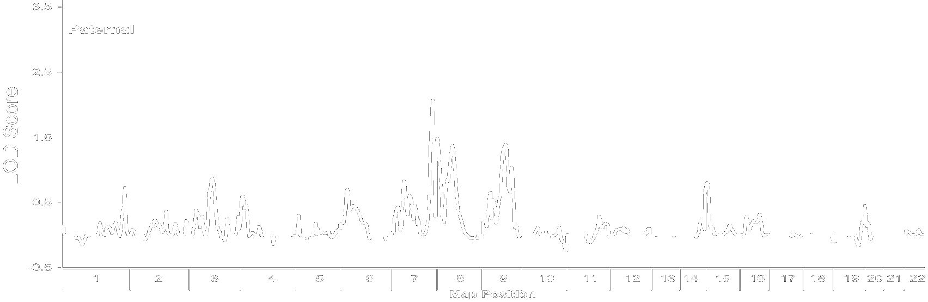
Sexual Orientation GWAS
B. S. Mustanski, et al. A genomewide scan of male sexual orientation. Hum Genet (2005) 116: 272–278.
Notes:
The first genome wide scan of sexual orientation was done by the Dean Hamer group in 2005.  These are plots of the LOD scores (logarithm of the odds), which is similar to a p value. In order to be  significant a LOD score would have to exceed a value of 3. So, none of the peaks were statistically significant, although the authors found the peak in  7q36, to be “interesting.” 

Slide 40
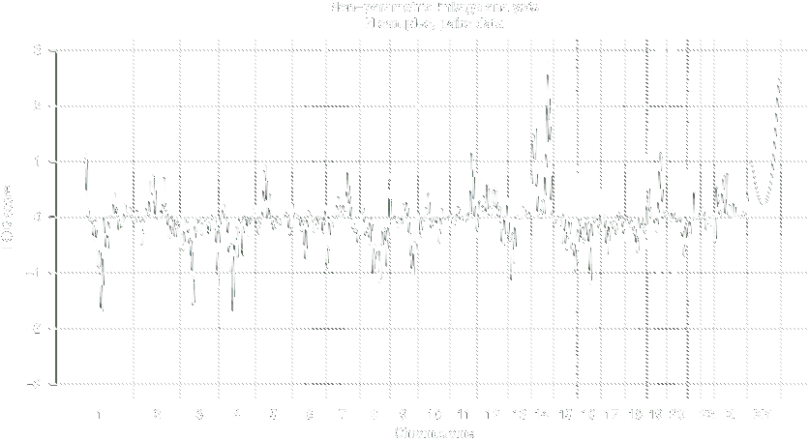
Sexual Orientation GWAS 2
Ramagopalan, S. V., et al. 2010. A genome-wide scan of male sexual orientation. J. Hum. Genet. 55: 131–132.
Notes:
The second genome wide scan of sexual orientation done by Ramagopalan et al. in 2010.  This is a plot of the LOD scores. As in the Hamer scan,  none of the peaks were statistically significant. Most notably, the  peak in 7q36 was completely absent in this GWAS.

Slide 41
Sexual Orientation GWAS 3
7887 unrelated men and 5570 unrelated women analyzed by GWAS
No loci associated with sexual orientation
No associations in Xq28 region of the X chromosome
E. M. Drabant, et al. 2012 Genome Wide Association Study of Sexual Orientation in a Large, Web-based Cohort. American Society of Human Genetics.
Notes:
The largest genome wide scan was conducted by the company 23andMe, which markets genome scans for consumers.  7887 unrelated men and 5570 unrelated women of European ancestry were analyzed by GWAS. Although the data has not been published, it was presented at the American Society of Human Genetics annual meeting in San Francisco in 2012.  The results showed no loci were associated with sexual orientation,  including Xq28 on the X chromosome. So, the preliminary studies on possible genetic causes of homosexual orientation tends to rule out any specific genetic component to sexual orientation. 

Slide 42






The Evolution of Homosexuality)
Natural Selection and “Gay Genes”
Notes:
Next, we are going to look at the evolution of homosexuality. Is it possible, even in theory, for “gay genes” to exist? 

Slide 43
Problems With Gay Genes
Homosexuals do not pass on their genes
Natural selection rapidly removes genes that are not passed down
A mechanism for passing “gay genes?”
Notes:
There is a major problem with the idea that homosexuality is due to genetics. Anybody know what it is?  Homosexuals do not pass on their genes. A gene or genes that prevents an individual from passing on his genes is rapidly removed from a population. So, those who wish to support the idea that genetics plays a role in homosexuality need to provide  a mechanism by which gay genes can be passed from one generation to the next. 

Slide 44
Balancing Selection
Ciani AC, Pellizzari E (2012) Fecundity of Paternal and Maternal Non-Parental Female Relatives of Homosexual and Heterosexual Men. PLoS ONE 7(12): e51088.
Notes:
The idea that has the most support is called “balancing selection.” An essentially lethal gay gene or genes could theoretically persist in a population if the reproductive loss from homosexuals were balanced with a reproductive gain by other related family members. The hypothesis is that a gene or genes on the X-chromosome could cause male homosexuals to be attracted to males and make their female relatives more attracted to males so as to produce more offspring.  In this study, it can be seen that maternal aunts and  maternal grandmothers produce more children than their paternal relations (which have a different X-chromosome). Although statistically significant, the difference is small and for the latest generation is even below replacement levels. 

Slide 45
Balancing Selection?
Blanchard R. Fertility in the mothers of firstborn homosexual and heterosexual men. Arch Sex Behav. 2012 Jun;41(3):551-6.
Notes:
A more obvious approach is to examine the fertility of the mothers of homosexuals. If balancing selection is true, those mothers should produce more children to make up for the ones who don’t reproduce themselves.  However, this graph shows that the mothers of homosexual sons on average produce fewer children than those who produce heterosexual sons. So, balancing selection probably does not explain how non-existent gay genes on the X-chromosome genes can be passed from one generation to the next. 

Slide 46
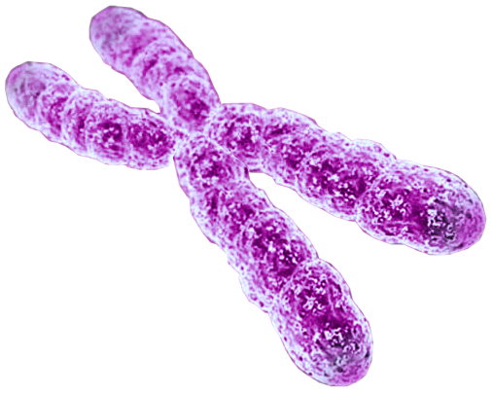
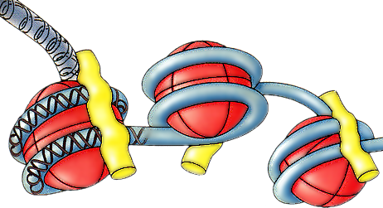
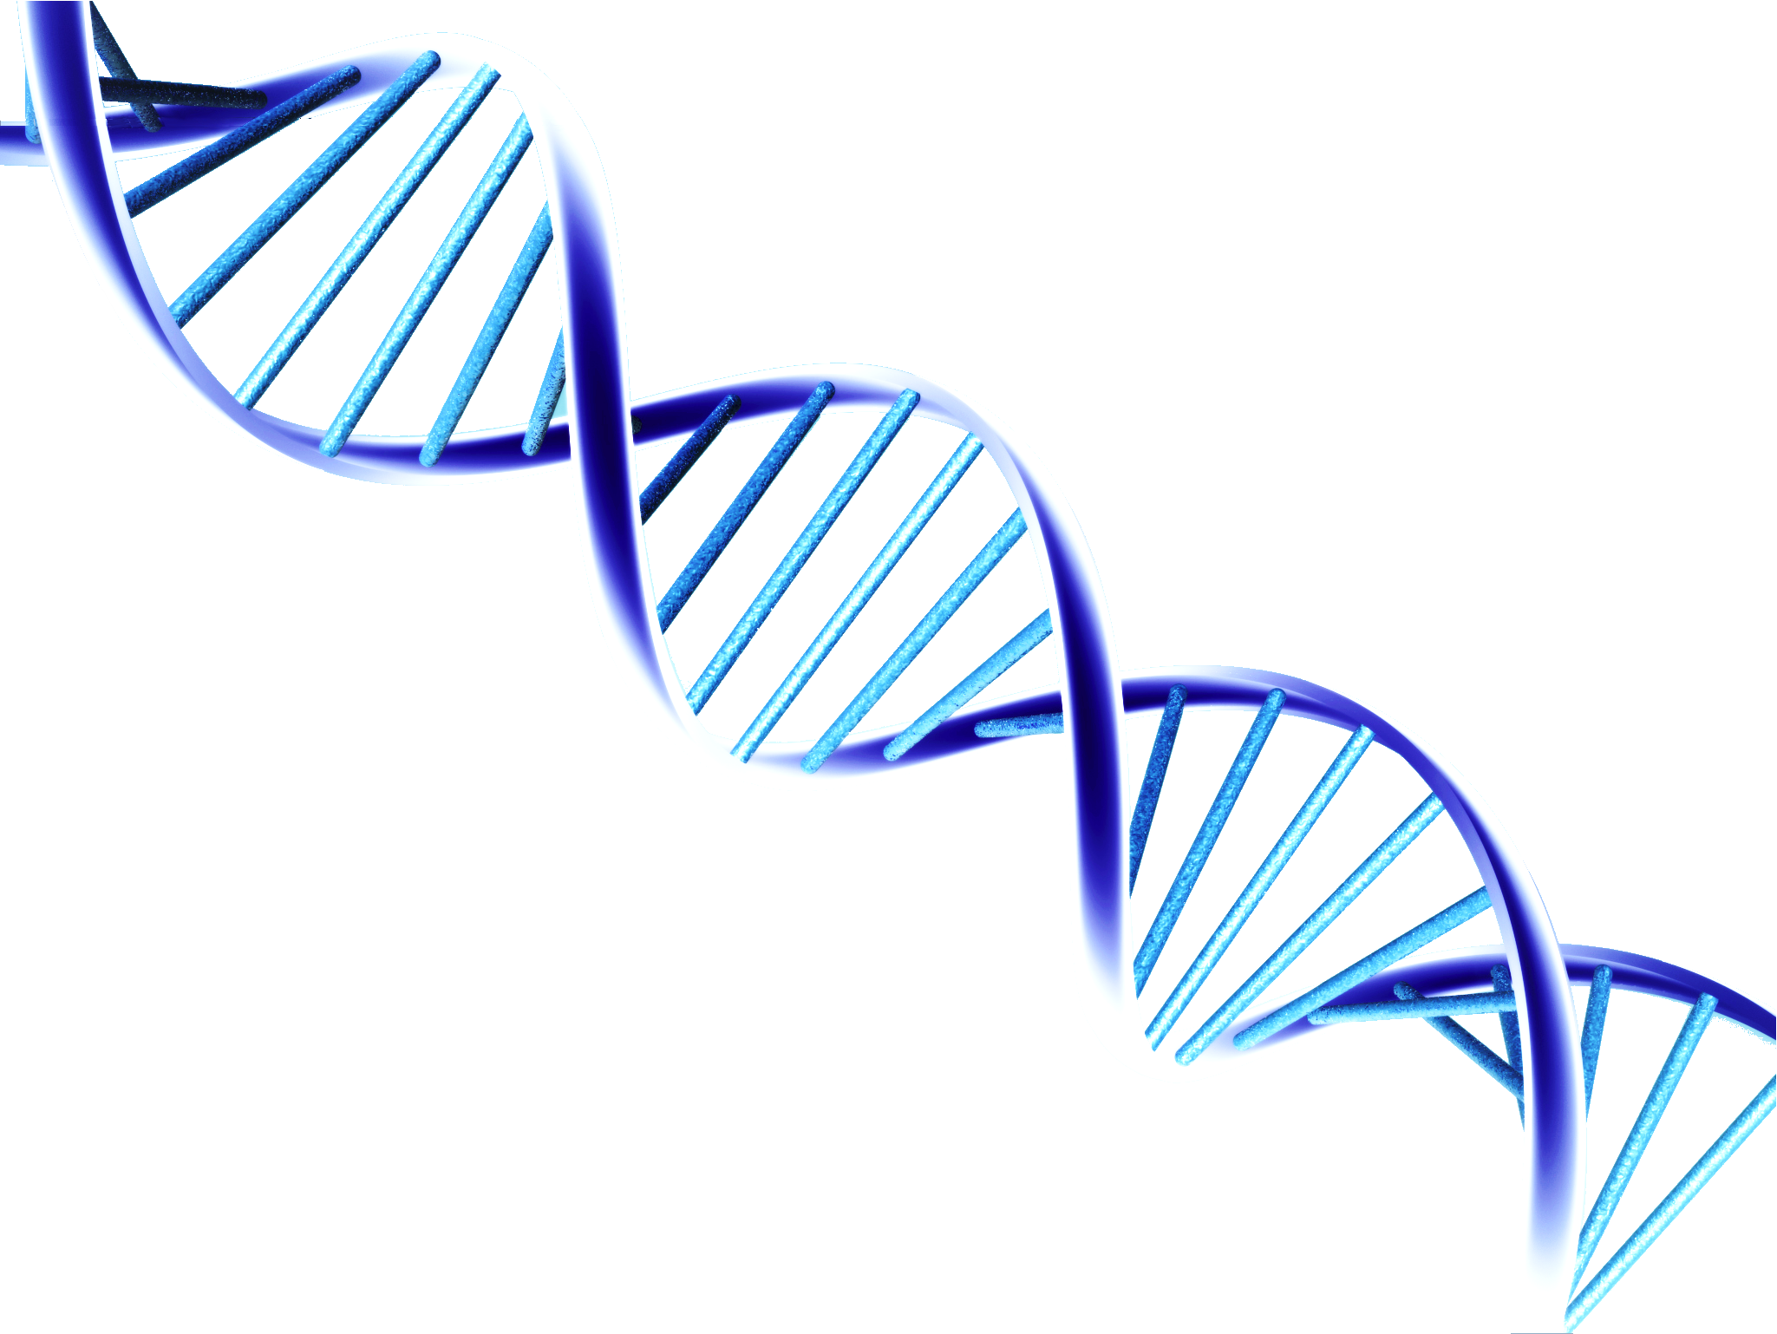
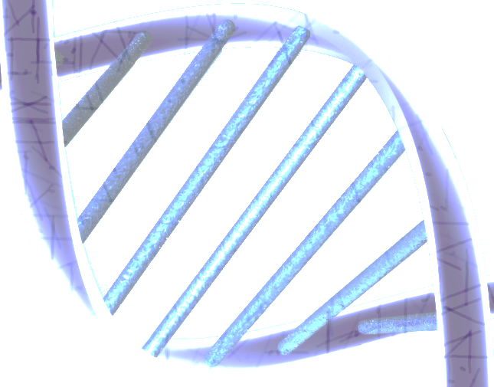
Epigenetics
Nucleosome
4 Histone protein pairs
Histone H1
Me
Me
Methyl group
Gene
Chromosome
DNA sequence
ATTAATCTAACGCTTAGA
CG sites can be methylated
Me
DNA
Notes:
Another means of affecting gene expression is through epigenetic modification.  This is a chromosome and  this is DNA. However, what you learned in your high school biology class was not quite complete.  It turns out that the DNA in chromosomes is highly organized around proteins, with the complex being called a nucleosome.  Each nucleosome consists of 147 base pairs of DNA wrapped around a core of 4 pairs of histone proteins, along with histone H1. Normally, these histone proteins are acetylated, which allows access to the DNA portion. Deacetylation of histones causes the gene associated with such histones to be turned off, which is one form of epigenetic modification.  Here is a length of DNA uncoiled from its histones.  A gene can have as part of its sequence what are called  CpG sites, which can be methylated.  Here is a sequence of base pairs with the cytosine of the cytosine-guanine sequence having a methyl group added. Why is this important? 

Slide 47
DNA Methylation Alters Gene Expression
Unmethylated
Methylated
Gene expression on
Gene expression off
Me
Me
Me
Me
Me
CpG Island
Gene
Promoter
Notes:
It turns out that many of these CpG sites are located in the promoter part of a gene. If the CpG site are  unmethylated, the gene is expressed. However, if the promoter CpG sites are  methylated, the gene is not expressed. So, methylation of CpG sites is an important epigenetic regulator of gene expression. 

Slide 48
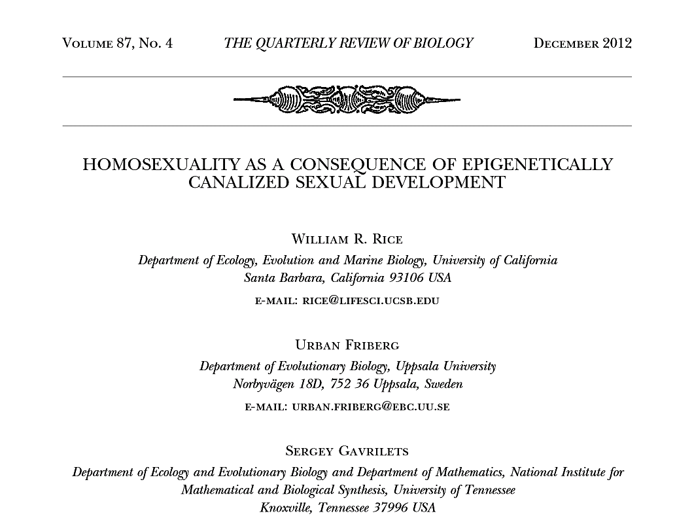
EPIGENETICs Underlies SEXUAL Orientation?
0
Notes:
This study came out in December of last year, claiming that homosexuality might be due to some of these epigenetic changes.. A Science News article said “Epigenetics… appears to be a critical and overlooked factor contributing to the long-standing puzzle of why homosexuality occurs.” The title of a Medical News Today article was, “Epigenetics Is A Critical Factor In Homosexuality.” A National Institute for Mathematical and Biological Synthesis article was entitled, “Study Finds Epigenetics, Not Genetics, Underlies Homosexuality.” So, how much data was presented showing a link between epigenetics and homosexuality?  Zero! The study actually presented no data showing any relationship between epigenetics and sexual orientation. The authors only showed that it is theoretically possible that epigenetics might play a role. It is a completely data-free paper! It will be difficult, in fact to examine epigenetics, since one would have to choose a specific cell type to analyze. If it were something like brain cells, we would need to wait for individuals to die before sample could be obtained. So, such experiments would be technically challenging, if not impossible. 

Slide 49
Neuroplasticity: Behavior Affects Brain Function
Neural improvement in brain function following behavioral therapy for autism
Neuron function varies with complex vs. simple environments in rats
So, behavior and environment influence brain function rather than the other way around
Voos, et al, 2013, Kolb, et al, 2003,
Notes:
It was originally thought that brains controlled behavior as opposed to the other way around. However, numerous studies have shown that the brain demonstrates neuroplasticity, being affected by behavior and environment.  A study by Voos et al showed neural improvement in brain function following behavioral therapy for autism.  Experiments in rats showed that neuron function was affected by complex vs. simple environments.  So, behavior and environment influence brain function rather than the other way around. 
Voos AC, Pelphrey KA, Tirrell J, Bolling DZ, Vander Wyk B, Kaiser MD, McPartland JC, Volkmar FR, Ventola P. Neural mechanisms of improvements in social motivation after pivotal response treatment: two case studies. J Autism Dev Disord. 2013 43:1-10.
Kolb, B., Gibb, R., & Gorny, G. (2003). Experience-dependent changes in dendritic arbor and spine density in neocortex vary with age and sex. Neurobiology of Learning and Memory, 79:1-10.

Slide 50
Effects of Adverse Childhood Experiences on Sexual Orientation
J. Elisabeth Wells, et al. Multiple Aspects of Sexual Orientation: Prevalence and Sociodemographic Correlates in a New Zealand National Survey. Arch Sex Behav. 2011 February; 40(1): 155–168.
Notes:
A study of nearly 13,000 New Zealanders aged 16 years or older examined, as part of its study, the effects of adverse childhood experiences on sexual orientation.  Here on the left, we see the baseline for this population, which is around 1% homosexual and 1% bisexual. However,  those who had experienced beatings, violence, rape or other sexual assault were 2-3 times more likely to express a non-heterosexual orientation. There was also a  cumulative effect of the number of such adverse experiences, such that those who had more of those experiences expressed up to a 4-6 times higher likelihood of being gay or bisexual. However, the rates for such adverse childhood events were such that it explained, at most, maybe 10% of homosexuality. 

Slide 51
Children of Homosexual Parents
Sexual orientation of children of gay parents
16-57% of children with gay parents adopted a homosexual lifestyle
33-57% of daughters of lesbian mothers became lesbians themselves
Schumm, W. R. 2010. J. Biosoc. Sci. 42:721-742.
Notes:
 If environment has no effect on sexual orientation, children of gay parents should have sexual orientation the same as the general population. A meta-study by Walter Schumm examined 262 children raised by homosexual parents.  16-57% of children with gay parents adopted a homosexual lifestyle.  An even higher percentage of daughters of lesbian mothers adopted a lesbian lifestyle. These data show that parenting has a substantial influence on sexual orientation. 

Slide 52
Fluctuating Sexual Preference
¼ lesbians gave up their homosexual identities over 5 year period
5% of lesbians became heterosexual over a one year period
Notes:
A 5-year study of lesbians by Lisa Diamond found that  over a quarter of these women relinquished their lesbian/bisexual identities during this period: half reclaimed heterosexual identities and half gave up all identity labels.  Another study by Diamond in New York City, the percentage that changed from a lesbian/gay/bisexual orientation to a heterosexual orientation was 5% over the period of just 12 months. So, especially among female homosexuals it seems that some can change their sexual orientation.  Diamond, L. M. 2003. Was it a phase? Young women's relinquishment of lesbian/bisexual identities over a 5-year period. J. Pers. Soc. Psychol. 84: 352-64. Diamond, L. M. 2000. Sexual identity, attractions, and behavior among young sexual-minority women over a 2-year period. Dev. Psychol. 36: 241-50.

Slide 53
Conclusions
Factor | Contribution to Homosexuality
Genes | Probably none
Hormonal influences | Some?
Brain structure | Probably none
Childhood abuse | Some
Familial environment | Some
Epigenetics | Unknown
Choice/preference | Some

Slide 54
I already wrote the paper, which is why it’s so hard to get the right data.
Future Studies?
Notes:
Yes, there will be future studies on sexual orientation, which may or may not be publicized in the news media, depending upon whether or not the results are politically correct.

