Slide 1
MODELLING MODELS
Ross Hoagland
August 18, 2013

Slide 2
A model is: a simplified representation of a
system or phenomenon

Slide 3
Synonyms
Copy, simulation, imitation, facsimile, representation, replica, example, standard, prototype, sample

Slide 4
Types of Models
DESCRIPTIVE MODEL
  describes
  example: toy truck
PREDICTIVE MODEL
  can make predictions from
  example: weather model
EXPLANATORY MODEL
  attempts to explain how a system functions
  example: plate tectonics

Slide 5
Qualities of a good model
COHERENCE logical connection
CORRESPONDENCE similarity
SIMPLICITY

Slide 6
E=MC²

Slide 7
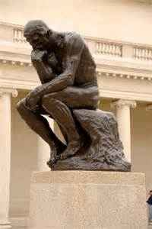

Slide 8
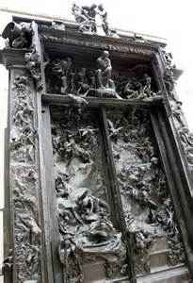

Slide 9


Slide 10
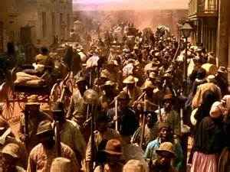

Slide 11
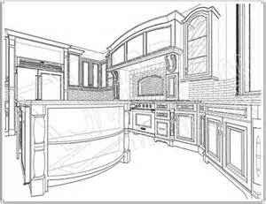

Slide 12
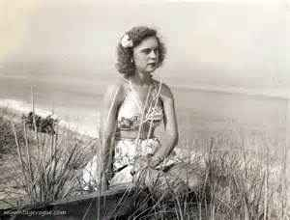

Slide 13
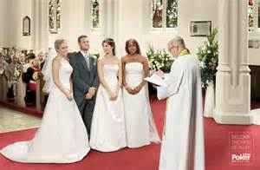

Slide 14
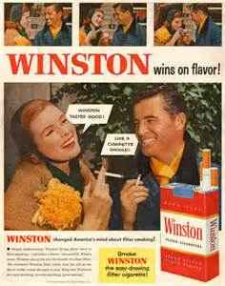

Slide 15
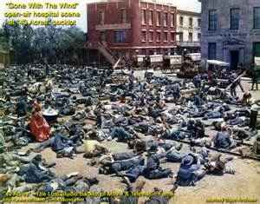

Slide 16
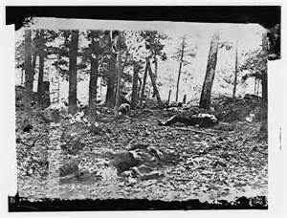

Slide 17
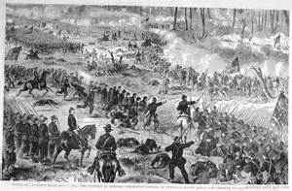

Slide 18
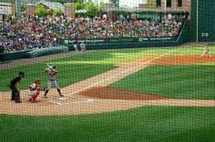

Slide 19
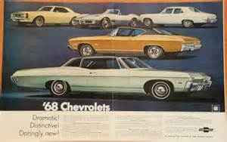

Slide 20
