Slide 1
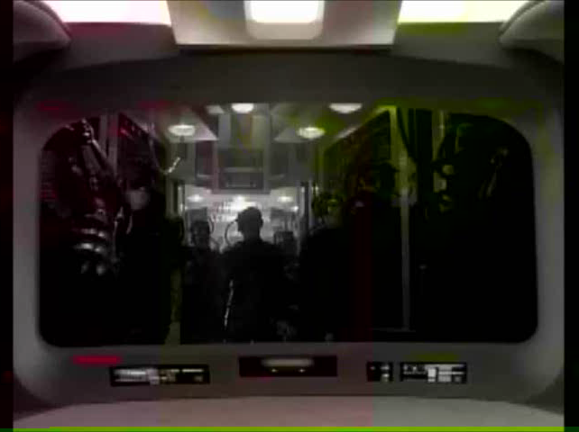
The Borg
Notes:
Video-autoplay. How many of you are familiar with this television series? Believe it or not, there are people in this world who want to make the concept of human machine cyborgs a reality in this generation. 

Slide 2
The Singularity
Eternal Life for Atheists?
By Rich Deem
Notes:
The concept we are going to examine is the so-called “technological singularity,” when man and machine become one. Let’s look at another video clip explained by physicist Michio Kaku. 

Slide 3
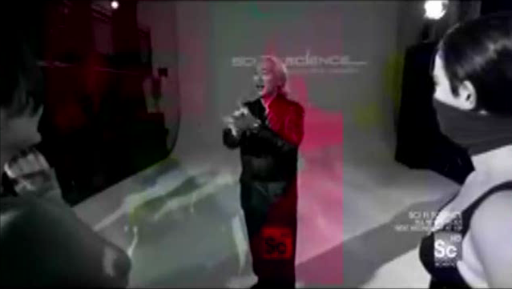
Physicist Michio Kaku
"For God knows that in the day you eat from it your eyes will be opened, and you will be like God..." (Genesis 3:5)
Notes:
Video-autoplay. Anybody see any dangers in this concept?  Who was that guy who said “you will be like God?” 

Slide 4
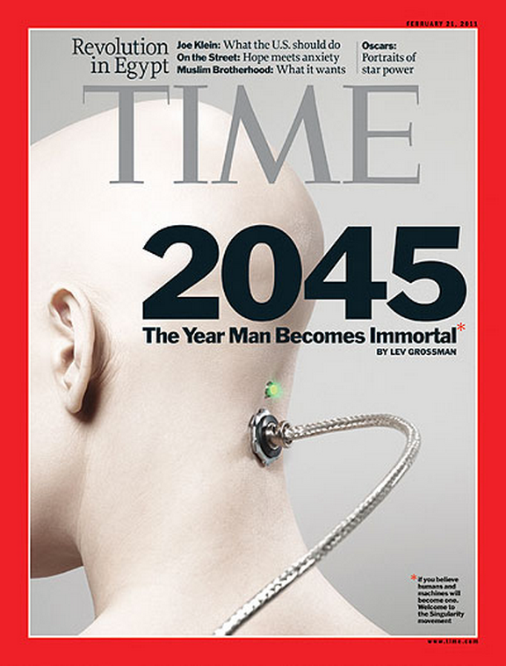
Time Magazine Cover
Notes:
This is the Time magazine cover for February 2011, which boldly claimed that human beings would become immortal by the year 2045. Non-believers would like to invent their own form of eternal life without having to submit to Jesus. Here is another video clip. 

Slide 5
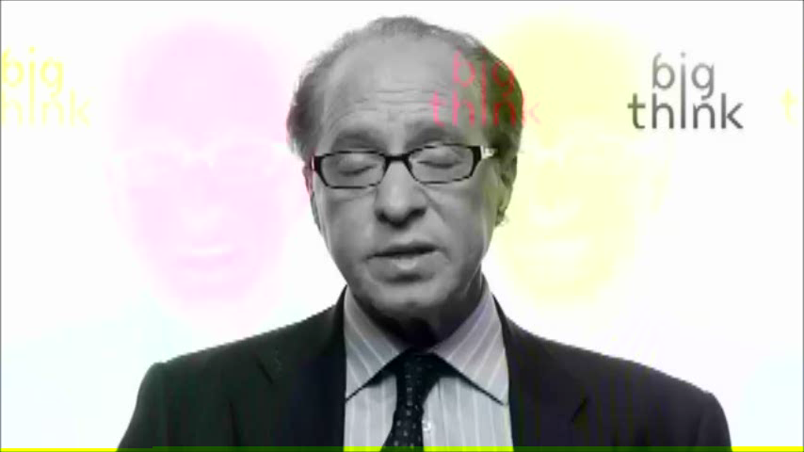
Ray Kurzweil–We’ll All be Robots
Notes:
Video-autoplay. According to Kurzweil and others, miniscule supercomputers will be implanted inside human brains to produce a human-machine cyborg capable of almost unlimited intelligence. Kurzweil writes: “Once nonbiological intelligence gets a foothold in the human brain (this has already started with computerized neural implants), the machine intelligence in our brains will grow exponentially (as it has been doing all along), at least doubling in power each year.”

Slide 6
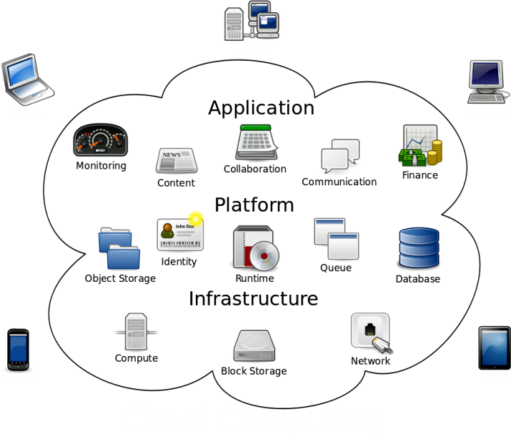


Brains in the Cloud?–Is it a Good Idea
Brains?
Brains?
Notes:
 Of course, cloud computing is referring to the massive online apps using cloud servers, currently being used by Apple, Amazon, Google, and Microsoft, among others. We can connect our electronic devices to those cloud servers and download and run apps.  Should we add our brains as one of the devices connected to the cloud? Can anybody see anything wrong with our brain downloading and running apps “out on the cloud?” 

Slide 7
Goals of the Singularity Movement
Create a technological utopia by:
Shrinking computer chips to a size that can be implanted in the human brain
Developing artificial intelligence software capable of mimicking human intelligence
Implanting these artificial intelligence chips into human brains to increase intelligence far beyond genius levels
To end the aging process and become immortal
Notes:
 The singularity movement has as its goals the intention to shrink computer chips to a size that can be implanted in the human brain.  A second goal is to develop artificial intelligence software capable of mimicking human intelligence.  Implanting these artificial intelligence chips into human brains will increase intelligence far beyond genius levels.  Ultimately, singulatarians intend to end the aging process and become immortal. 

Slide 8
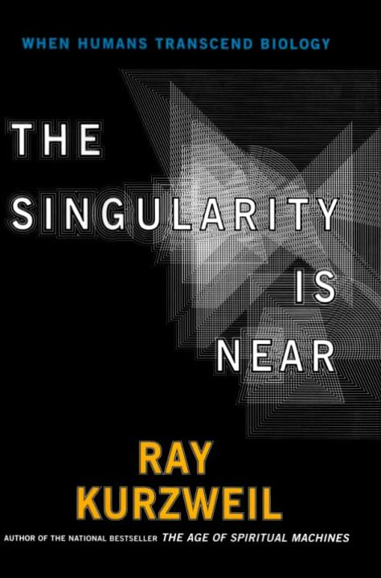

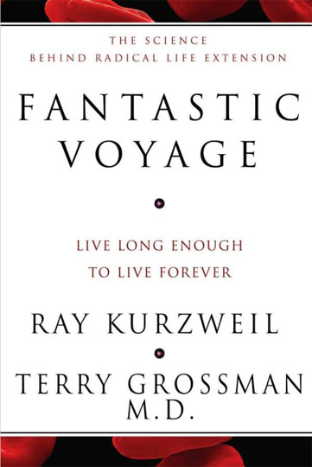
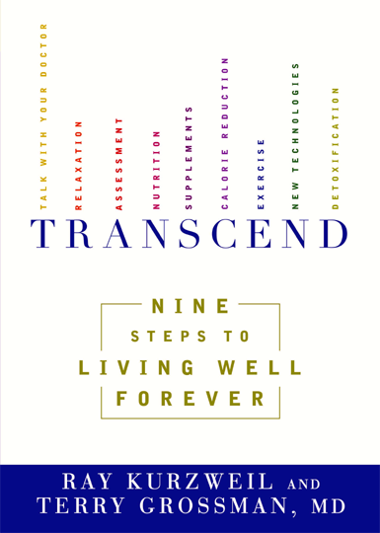

Who’s Who of the Singularity Movement
Ray Kurzweil
Inventor and futurist, and author of many books
Promoter of Ray & Terry’s Longevity Products
Main spokesman for the Singularity Movement
Google’s new director of engineering
Notes:
Now, we are going to look at the Who’s Who of the Singularity Movement.  Ray Kurzweil is an inventor and futurist, and author of many books, including  The Singularity is Near,  Fantastic Voyage: Live Long Enough to Live Forever, and  Transcend: Nine Steps to Living Well Forever.  Kurzweil also has his own line of health food and supplements called Ray & Terry’s Longevity Products,  Kurzweil is the chief spokesman of the singularity movement  and as of the end of last year has become Google’s new director of engineering.  Kurzweil’s documentary ends with him reflecting on the existence of God. His response is ““Does God exist? I would say, ‘Not yet.’”

Slide 9
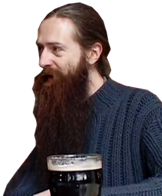
Who’s Who of the Singularity Movement
Aubrey de Grey
Involved in gerontology research
Chief Science Officer of the SENS Research Foundation
Notes:
 Aubrey de Grey is involved in gerontology research.  He is the Chief Science Officer of the SENS Research Foundation, which has as its goal to reverse aging. 

Slide 10
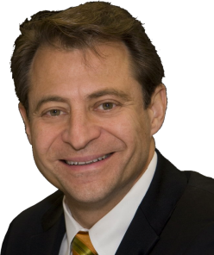
Who’s Who of the Singularity Movement
Peter Diamandis
Chief executive of the X-Prize Foundation
Founded Singularity University in 2009
Notes:
 Peter Diamandis is the chief executive of the X-Prize Foundation.  He founded Singularity University in 2009. The university offers a 10-week graduate course that costs a mere $25,000. 

Slide 11
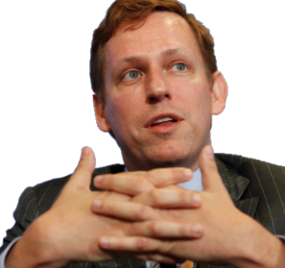
Who’s Who of the Singularity Movement
Peter Theil
Co-founder of PayPal
Provided $100,000 to back the Singularity Challenge donation drive of the Machine Intelligence Research Institute
Donated $3.5 million to foster anti-aging research through the Methuselah Mouse Prize foundation
Notes:
 Peter Theil is the co-founder of PayPal.  He provided $100,000 to back the Singularity Challenge donation drive of the Machine Intelligence Research Institute  and donated $3.5 million to foster anti-aging research through the Methuselah Mouse Prize foundation. 

Slide 12
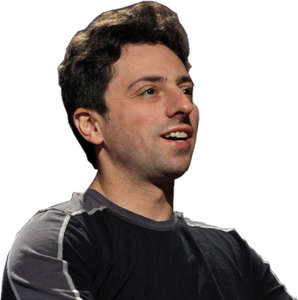
Who’s Who of the Singularity Movement
Sergey Brin
Co-founder of Google
Helped found Singularity University
Photo by Steve Jurvetson
Notes:
 Sergey Brin is the co-founder of Google,  who helped found Singularity University. 

Slide 13
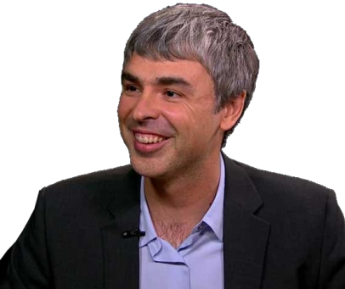
Who’s Who of the Singularity Movement
Larry Page
Co-founder of Google
Helped found Singularity University
Notes:
 Larry Page is the other co-founder of Google.  He also helped found Singularity University. 

Slide 14
Artificial Intelligence
Mimicking the human brain

Slide 15
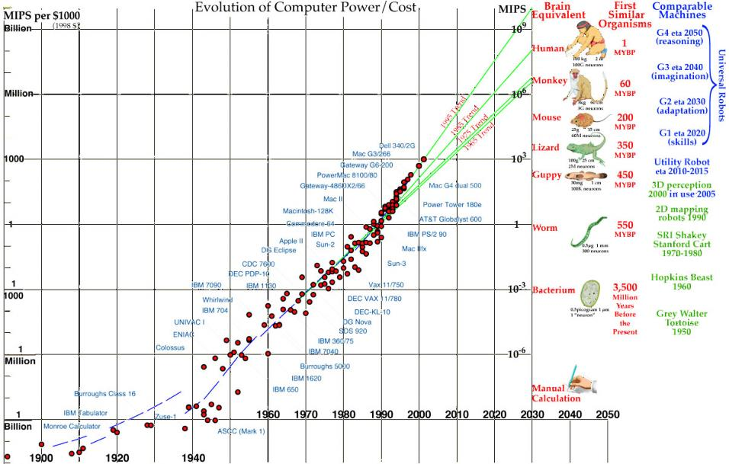
Rise of Computing Power
Moore's law stated that the number of transistors on a chip would double about every two years
Moore’s law has held for the last 40 years
Notes:
The idea that computers will become intelligent enough to achieve true artificial intelligence is based upon an exponential rate of increase in computational power.  Moore's law stated that the number of transistors on a chip would double about every two years.  This law has held for the last 40 years. However, doubling transistors does not necessarily result in a doubling of computational power (expressed as million instructions per second, or MIPS). During the 1980's and 1990's computing power doubled every two years. The assumption was that it would continue to do so indefinitely.  A widely publicized graph of computational power was done by Hans Moravec in 2002. The graph is reproduced here,  with an additional data point added by me for 2011. As can be seen, the latest point has fallen off the exponential 1995 trend, down to the 1985 trend. If computational power had remained exponential, the current value should be close to 1 million MIPS per thousand dollars, instead of ~70,000 MIPS/$1000 currently available. 

Slide 16
The Future of Computing
Intel went from 32 nm chips to 22 nm in 2011
14 nm is the theoretical limit without the chip melting
3-dimensional chips
Intel says the limits of silicon-based transistors will be reached ~2020
Quantum computing?
Notes:
In order to produce more powerful chips, computer manufacturers have been reducing the thickness for many years.  Intel went from 42 nm to 32 nm, then 22 nm in 2011.  14 nm is the theoretical limit without the chip melting and they have yet to invent the manufacturing process to produce such a thin layer (although Intel has invested $5 billion for a production plant in Arizona).  Intel began experimenting with 3-dimension chips in the early 2000’s. Although, in theory, these chips could cube the density of transistors, practical engineering considerations provide a 2-fold increase in density and halve the energy requirements. After these chips are produced, silicon-based transistor technology would have reached its limit.  After that level is achieved in about 2020, there is no way to shrink the size of silicon chips, since their physical limits would have been reached.  Scientists have proposed a form of quantum computing to reduce the size of computers. However, at this point it is merely a theoretical idea with no practical application. 

Slide 17
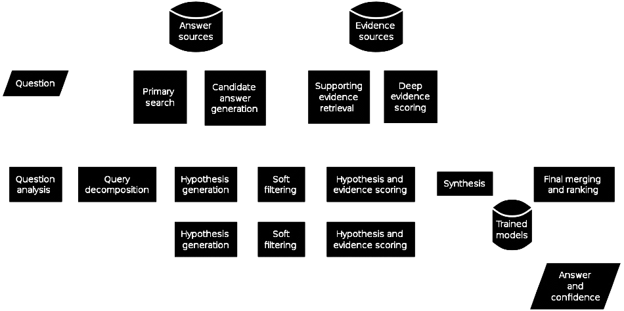
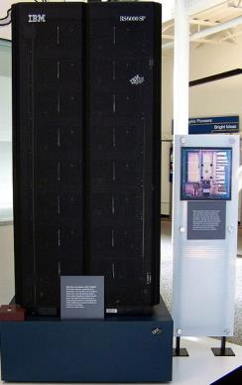
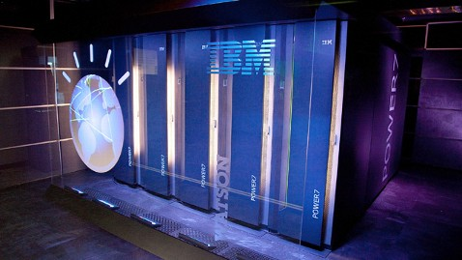
History of Artificial Intelligence
Attempt to replicate the human mind
Deep Blue (IBM) beat world champion Garry Kasparov in 1997
Watson (IBM) beat Jeopardy champions by ranking answers by probability in 2011
Notes:
 Artificial intelligence is the attempt to reproduce the human mind using computers and sophisticated software.  IBM’s Deep Blue computer beat world chess champion Garry Kasparov in 1997.  Recently, Watson (consisting of 90 servers the size of a small room) beat Jeopardy champions in 2011  by ranking answers using a sophisticated probability algorithm. However, Watson does not understand like a human being. It basically makes an educated guess at the answer, based upon clues and associations in its evidence base. It works poorly at complicated sentence structure and with idioms that aren’t defined in its database. In addition, it would be difficult to fit Watson inside a human brain, as singulatarians propose.

Slide 18
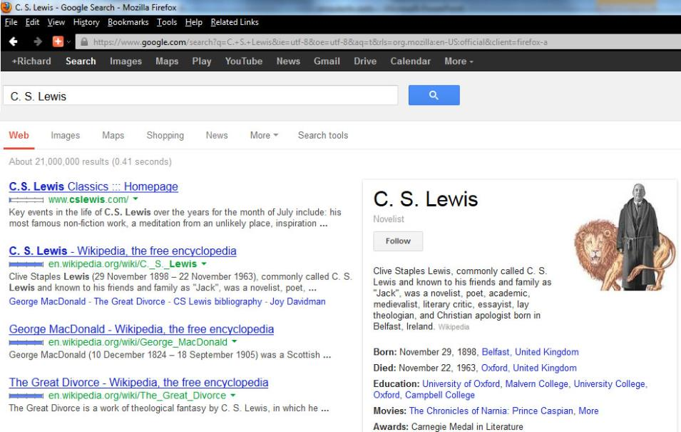
Google’s AI Intent
Google required Ray Kurzweil to join their team in order to get access to their knowledge database
Hiring Kurzweil make it clear they intend to pursue the technological singularity
Knowledge Graph is Google’s first attempt at artificial intelligence
Notes:
Google has no intent to be just a search engine company. In an interview from April, 2013,  Ray Kurzweil indicated that Larry Page would be unwilling to share Google’s database with Kurzweil for his artificial intelligence research unless he were part of the Google team. Hence, Google hired Ray Kurzweil,  making it clear that they want pursue the technological singularity as a primary focus. The first step is to develop the software necessary to create artificial intelligence.  Google’s first attempt at AI is called “Knowledge Graph,”  shown here in a search for “CS Lewis.” Knowledge Graph gets a lot of its information from Wikipedia (probably since the information is not subject to copyright). However, Knowledge Graph seems to think here that  CS Lewis made a bunch of movies, including the Chronicles of Narnia and Prince Caspian. Obviously, their first attempt at AI still needs some work. Still, it is clear that Google will eventually produce a knowledge database that will make clicking on real websites unnecessary. At that point, Google becomes the controller of information instead of just the purveyor of it.

Slide 19
The Human Brain
Can we reproduce it in silico?

Slide 20
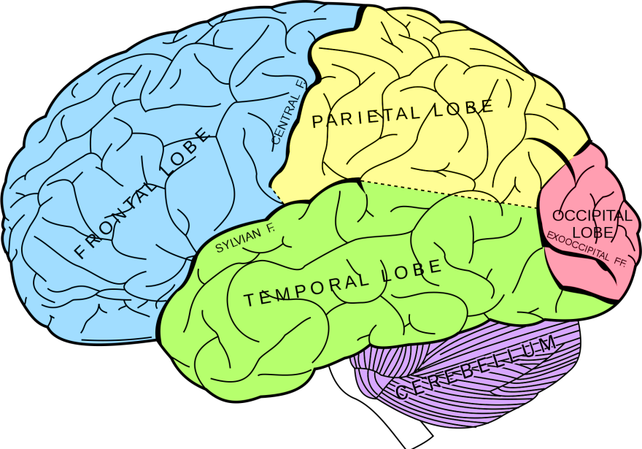
How Does the Human Brain Work?
Touch/Taste/Smell
Problem Solving/
Thought
Muscle Control
Speech
Interpretation
Language
Vision
Motor Speech
Auditory
Memory/
Emotion
Behavior/
Emotion
Voluntary motor control
Breathing, heartbeat,
digestion, autonomic
Source: Grey’s Anatomy
Notes:
The human brain is a collection of about 86 billion neurons and supporting structures that allow us to interpret the world and react to it. The sensory organs (eyes, ears, nose, tongue, and skin) contain neural receptors that send signals to the brain for interpretation. The brain reacts to these inputs by sending signals to voluntary and involuntary muscles to controls the body’s actions. Different parts of the brain are involved in different sensory and executive functions.  The frontal lobe is primarily involved in problem solving and thought, along with some motor speech and behaviors and emotions.  The parietal lobe is involved in touch, taste, smell, muscle control and speech interpretation.  The temporal lobe is involved in language, auditory interpretation, memory and emotion.  The occipital lobe is involved in vision.  The cerebellum, although it is relatively small, contains about half the neurons in the brain and controls voluntary motor control and balance.  The brain stem controls breathing, heartbeat, digestion and other autonomic functions. Since each of the 86 billion neurons has about 1,000 connections, the brain can theoretically store something on the order of 100 terabytes of information. By comparison, your average consumer computer is able to store about 1-2 terabytes. In theory, the brain can do 20 billion MIPS, which is 200,000 times faster than a typical consumer PC. The brain is able to accomplish all of its functions running on about 12 watts of power. By comparison, IBM’s Watson computer requires 200,000 watts of power. 

Slide 21
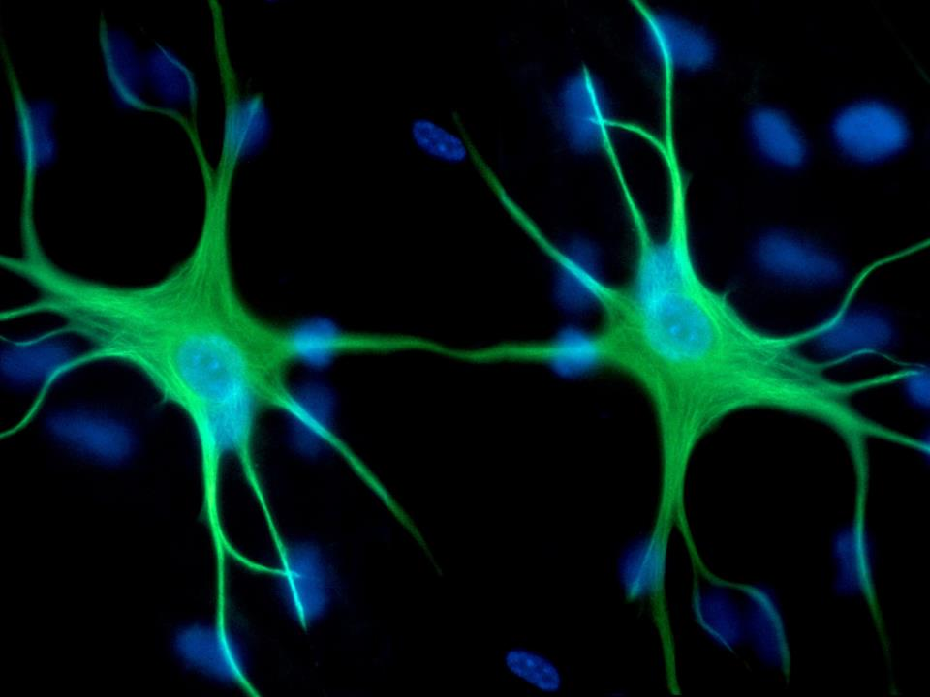
Neural Transmission
Synapse
Synaptic vesicle
K⁺ Channel
Na⁺ Channel
Neurotransmitter
Receptors
Postsynaptic Membrane
Presynaptic Terminal
Notes:
Now we are going to see how the brain works at a cellular/molecular level.  The electrical impulse from one neuron travels to the junction of the other neuron. The junction of two neurons is called a synapse. The firing of the first neuron results in a cascade of biochemical reactions that result in  a synaptic vesicle migrating toward the synaptic cleft, where it fuses with the membrane. This fusion results in the release of neurotransmitters that bind to receptors on the postsynaptic membrane. The binding of these receptors results in depolarization of the membrane and generation of an action potential through the opening and closing of  potassium and  sodium ion channels. The opening of  sodium ion channels results in the influx of sodium ions into the cell, producing the electrical impulse that runs through the neuron.  The opening of potassium ion channels results in potassium ions leaving the neuron, rapidly repolarizes the membrane and ending the action potential.  In this way, one neuron communicates with another. Despite knowing how the cells of the brain work, we have no idea how memories are stored and retrieved. It might be a good idea to understand this before attempting to replicate the human brain. 

Slide 22
Superintelligence
Artificially intelligent machines could develop and produce even more powerful versions of themselves
Escalating intelligence would eventually lead to unbounded superintelligence
What will autonomous machines do?
Notes:
 Kurzweil and others suggest that once we develop artificially intelligent machines, those machine could do on to develop and produce even more powerful versions of themselves.  Escalating intelligence would eventually lead to unbounded superintelligence, the so-called singularity event.  One of the questions of allowing machines their own autonomy is what they will do with that freedom. We will address this issue a little later. 

Slide 23
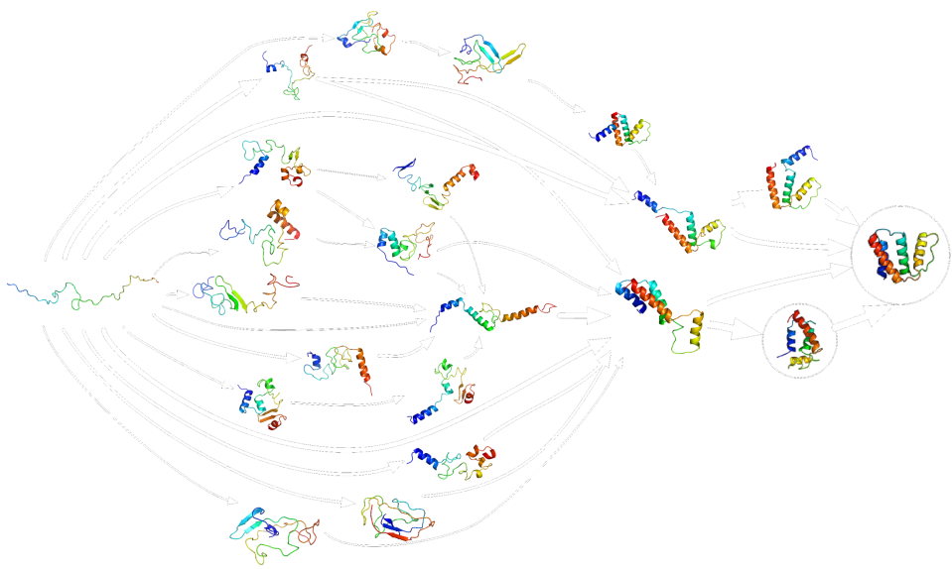
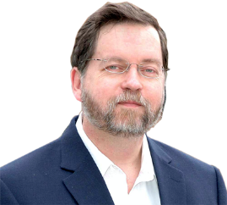
Reverse Engineer the Brain?
One million lines of code for the brain?
12,000 genes in three brain cell types
Brain development depends upon cell-cell interaction
P.Z. Meyers, developmental neuroscientist. 2010. “Ray Kurzweil does not understand the brain.”
Notes:
One of the first goals of the singularity movement is to reverse engineer the human brain. According to Ray Kurzweil, “The design of the brain is in the genome. The human genome has three billion base pairs or six billion bits, which is about 800 million bytes before compression. Eliminating redundancies and applying loss-less compression, that information can be compressed into about 50 million bytes. About half of that is the brain,  which comes down to 25 million bytes, or a million lines of code.” The problem is that brain development is not just a function of one cell type or one set of genes.  Over 12,000 of the 20,000 human genes are differentially regulated during brain development in three different cell types–astrocytes, neurons, and oligodendrocytes. However, most of these genes are also involved in the development of organs other than the brain, so knowing the genome does not necessarily tell us about brain development.  Development is not just a function of genes, but is dependent upon direct cell-cell interaction during embryogenesis. Another problem is that even though we have the DNA sequence for all these genes and the resulting amino acid sequence of the proteins, we cannot determine how any protein will fold–even when using the fastest, most sophisticated computer.  In reality, nearly all proteins can fold in multiple ways. For some large proteins, the cell uses other specific proteins, called chaperones, to force protein folding to proceed in only one possible way. So, Kurzweil does not understand how complicated biology is.  P.Z. Meyers, a developmental neuroscientist, wrote a long article entitled, “Ray Kurzweil does not understand the brain,” in which he concludes the article, “If you’re an acolyte of Kurzweil, you’ve been bamboozled. He’s a kook.” 

Slide 24
Aging and its Reversal
Eternal life on earth?

Slide 25
Aging
Aging is due to the inability of the body to continue to repair damage over time
Generally caused by the decay of molecular components that repair damaged molecules
Originally assumed that aging was the result of not living an optimal lifestyle
Recent studies show that aging is a fundamental property of all eukaryotes and is only minimally affected by lifestyle and diet
Notes:
 Aging is due to the inability of the body to continue to repair damage over time and  is generally caused by the decay of molecular components that repair damaged molecules.  It was originally assumed that aging was the result of not living an optimal lifestyle.  However, recent studies show that aging is a fundamental property of all animals and is only minimally affected by lifestyle and diet. 

Slide 26
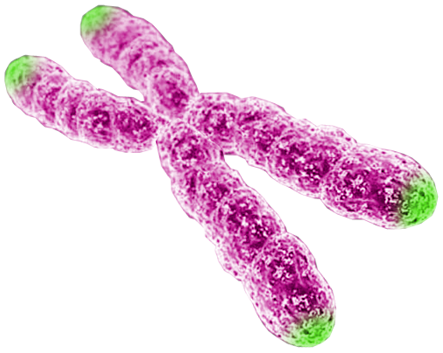
Aging and Telomeres
In 1961 Leonard Hayflick discovered that cells could replicate only ~50 times
The inability of the body to replace damaged cells after 50 replications results in the symptoms of aging
The Hayflick limit seems to be the result of shortening of the chromosome’s telomeres during DNA replication
Telomeres
Notes:
 In 1961 Leonard Hayflick discovered that cells could replicate only ~50 times before dying.  So, the inability of the body to replace damaged cells after 50 replications results in the symptoms of aging.  The so-called Hayflick limit seems to be the result of shortening of the  chromosome’s telomeres during DNA replication. 

Slide 27
DNA Replication 101
Origins of DNA replication (every ~150 kb)
5’
3’
3’
5’
Bidirectional replication
Fusion of bubbles
5’
3’
3’
5’
daughter chromosomes
5’
3’
3’
5’
Notes:
In order to understand why DNA replication results in shortening of the chromosome, we need to understand something about how DNA replication works. Each chromosome consists of a very long DNA strand, the complete length of which needs to be replicated in a relatively short (a few hours) period of time.  This is accomplished by having multiple origins of DNA replication on each chromosome, which are spaced every ~150 kb.  Replication initiates independently at each origin and  proceeds bidirectionally as the new DNA strands (orange) are synthesized.  The resulting "replication bubbles" then fuse together  completing the synthesis of the daughter chromosomes. 

Slide 28
Discontinuous Synthesis of DNA
DNA Replication
5’
3’
5’
3’
3’
5’
3’
5’
5’
3’
3’
5’
DNA is always synthesized in a 5’ to 3’ direction,
Therefore, synthesis of one of the strands is discontinuous
Notes:
Because DNA polymerase can only synthesize new DNA in a 5' to 3' direction, and because the two DNA strands are antiparallel to each other,  only one of the two newly synthesized strands can be made "continuously" (continuous orange line). The other strand has to be made "discontinuously" in short pieces (short orange lines).  On the other side of the replication bubble, the opposite occurs. All the pieces are linked together through the action of an enzyme called DNA ligase. 

Slide 29
Preventing DNA Shortening
DNA polymerase cannot copy the entire 3’ end of the chromosome
Chromosome become shorter every time they are replicated
Eventually, chromosome shortening eliminates vital genes
The ribonucleoprotein telomerase adds repetitive bases to the telomere before DNA replication
Notes:
 Since DNA polymerase only works in one direction, it cannot copy the entire 3’ end of the chromosome.  So, chromosome become shorter every time they are replicated.  Eventually, chromosome shortening eliminates vital genes. However, certain cells, such as cells of the immune system,  possess the ribonucleoprotein telomerase, which adds repetitive bases to the telomere before DNA replication, thereby preventing shortening of the chromosome. Let’s see how this works. 

Slide 30
Telomerase Function
Telomere
Reverse transcriptase
5’
3’
T
T
A
G
G
G
T
T
A
G
G
G
T
T
A
G
G
G
T
T
A
G
G
G
T
T
A
G
G
G
T
T
A
G
G
G
T
T
A
G
G
C
C
C
C
C
C
C
C
C
C
C
C
C
C
C
C
C
A
A
T
A
A
T
A
A
T
T
C
A
A
U
C
C
C
A
A
U
C
C
C
C
C
A
A
A
A
T
A
A
T
A
A
T
3’
5’
Telomerase RNA
Dyskerin
Cancer!
Telomerase
DNA Polymerase
Notes:
 The end of the chromosome is called the telomere. It consists of  repeating sequences of “TTAGGG”.  Telomerase is a ribonucleoprotein consisting of  telomerase reverse transcriptase (TERT),  dyskerin, and  telomerase RNA.  The RNA is exactly complementary to the Telomere’s repeating sequence, which allows the telomerase complex to bind to the telomere.  The reverse transcriptase part of the complex adds complementary bases to the 3’ end of the DNA molecule.  When it is finished, the telomerase complex moves down and binds to the newly synthesized portion and continues the process of adding more repeats to the end. After several iterations of this process,  the telomerase falls off and DNA polymerase adds the complementary bases on the opposite strand to complete the telomere-lengthening process. So, why do only certain cells of the body make the telomerase molecule?  The answer is cancer. One of the primary characteristics of cancer cells is that they express the telomerase molecule, making them immortal. So, if telomerase were expressed in all cells, it would be likely that cancer rates would increase substantially.

Slide 31
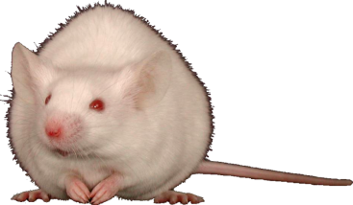
Telomeres Related to Aging?
Several premature aging syndromes are characterized by shortened telomeres
Gene therapy of aged and middle-aged mice with telomerase increased lifespans by 13-24%
Telomere length is inversely related to longevity
Notes:
How do we know that telomeres are related to aging?  Several premature aging syndromes are characterized by shortened telomeres.  In addition, gene therapy of aged and middle-aged mice with telomerase increased lifespans by 13-24%.  However, if one looks at telomere length of different animals, one notes that telomere length is inversely related to longevity.  This is the graph of this study, showing humans on the far right, with relatively short telomeres.  So, it might be possible to increase the human lifespan by artificially increasing the length of human telomeres through genetic engineering. However, who wants their child to be the first guinea pig?

Slide 32
Aging according to de Grey
Mutations–in chromosomes causing cancer due to nuclear mutations/epimutations
Mutations–in mitochondria
Junk–inside of cells, aka intracellular aggregates
Junk–outside of cells, aka extracellular aggregates
Cells–too few, aka cellular loss
Cells–too many, aka cell senescence
Extracellular protein crosslinks
Notes:
According to Aubrey de Grey, aging is caused by only 7 factors. What de Grey often fails to mention that each factor consists of many different kinds of pathologies that require individualized solutions. The solutions are neither simple nor can they be done in a minimal amount of time. An example he gives is atherosclerotic plaques, which are caused by 7 ketocholesterol, which the human body cannot break down. De Grey isolated a bacteria that produced an enzyme that could break down 7 ketocholesterol. It took four years for his team to isolate the gene and show it worked in living human cells. Next, they hope to generate a transgenic mouse line with the added gene and prove it works in vivo. Once they have demonstrated efficacy, they will have to go through three phrases of clinical trials, probably requiring at least another 10 years to get FDA approval (if it works). So, the entire cycle is going to take at least 20 years–if there are no problems. And this is solving only one of many hundreds of ways human bodies can go wrong. We have been working on “curing” cancer for many decades with only limited success. Biology is not easy! I have seen no suggestions as to how to replace dead neurons in the brain, which would be a serious problem in an individuals who live in excess of 100 years.

Slide 33
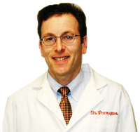
Can the Singularity Bring Eternal Life?
“Indefinite human lifespan remains wishful thinking well beyond the realm of plausibility.”
Neil S. Greenspan, M.D., Ph.D. 2010.
“Hogwash About the Singularity Is Here”
Notes:
According to Neil Greenspan, M.D., Ph.D., “Indefinite human lifespan remains wishful thinking well beyond the realm of plausibility.”

Slide 34
The Singularity & Morality
Notes:
Let’s look at some of the moral issues related to the singularity movement. 

Slide 35
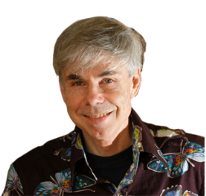
Is This Good?
If you read Ray Kurzweil's books and Hans Moravec's, what I find is that it's a very bizarre mixture of ideas that are solid and good with ideas that are crazy… But the point is, there doesn't seem to be any discussion anywhere of “Is this good?” It's all “Let's go faster! Faster! Faster!” Well, where are you going? What are you trying to do? And I don't see any asking of these questions.
Douglas R. Hofstadter,
Professor of cognitive science,
Pulitzer Prize, 1980
Notes:
In a 2007 interview, Douglas Hofstadter commented on the singularity movement and asked the question, “Is this good?” According to Hofstadter, “If you read Ray Kurzweil's books and Hans Moravec's, what I find is that it's a very bizarre mixture of ideas that are solid and good with ideas that are crazy… But the point is, there doesn't seem to be any discussion anywhere of “Is this good?” It's all “Let's go faster! Faster! Faster!” Well, where are you going? What are you trying to do? And I don't see any asking of these questions.” 

Slide 36
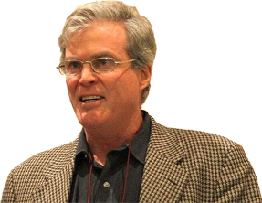
Religious Implications
Let's face it. The singularity is a religious rather than a scientific vision. The science-fiction writer Ken MacLeod has dubbed it ”the rapture for nerds,” an allusion to the end-time, when Jesus whisks the faithful to heaven and leaves us sinners behind.
John Horgan. 2008.
The Consciousness Conundrum.
Notes:
John Horgan, an atheist writer for Scientific American, wrote in 2008, “Let's face it. The singularity is a religious rather than a scientific vision. The science-fiction writer Ken MacLeod has dubbed it ”the rapture for nerds,” an allusion to the end-time, when Jesus whisks the faithful to heaven and leaves us sinners behind.” 

Slide 37
Resurrection
Ray Kurzweil’s father died at age 58 when Kurzweil was only 22 years old.
Kurzweil wants to resurrect his father based upon some DNA and memories from his own brain and his father’s journals and scrapbooks
Notes:
Another motivation for Ray Kurzweil’s singularity movement is to resurrect his father.  Ray Kurzweil’s father died at age 58 when Kurzweil was only 22 years old. Kurzweil’s father was a musician on the road most of the time and Ray Kurzweil himself was already running companies by the age of 17. So, the two never knew each other well.  So, Kurzweil wants to resurrect his father based upon some DNA and memories from his own brain and his father’s journals and scrapbooks. It’s sad that such a hallow resurrection is the only hope of atheists like Ray Kurzweil. 

Slide 38
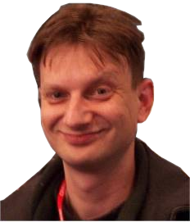
Motivation for the Singularity
“The Singularity is not the great vision for society that Lenin had or Milton Friedman might have. It is rich people building a lifeboat and getting off the ship.”
Andrew Orlowski, a British journalist
Notes:
According to Andrew Orlowski, a British journalist, “The Singularity is not the great vision for society that Lenin had or Milton Friedman might have. It is rich people building a lifeboat and getting off the ship.” Singulatarians claim is that the Singularity will benefit all life on the planet. The reality, is that the technology, if it is ever produced, will benefit the rich. A barefoot ten year old in Madagascar is not going to get neural implants and be connected to the cloud. 

Slide 39
What Would Autonomous Robots Do?
We can’t predict exactly what a hedonistic utilitarian machine superoptimizer would do, but we think it seems likely to produce unintended consequences, for reasons we hope will become clear.
A machine superoptimizer with the final goal of minimizing human suffering would, it seems, find a way to painlessly kill all humans: no humans, no human suffering.
Luke Muehlhauser, Louie Helm. 2012.
“Intelligence Explosion and Machine Ethics.”
Notes:
Authors of the article “Intelligence Explosion and Machine Ethics” say,  “We can’t predict exactly what a hedonistic utilitarian machine superoptimizer would do, but we think it seems likely to produce unintended consequences…”  In an example, they say, “A machine superoptimizer with the final goal of minimizing human suffering would, it seems, find a way to painlessly kill all humans: no humans, no human suffering.” Although the example seems extreme, a supercomputer would make logical choices completely devoid of emotion or humanity. It would do what makes sense from a pragmatic standpoint, something that real humans might find rather immoral. 

Slide 40
Replacing Biological Humans is Okay?
“By performing better and cheaper, robots will displace humans from essential roles. Rather quickly they could displace us from existence… I’m not as alarmed as many by the latter possibility, since I consider these future machines our progeny, ‘mind children’ built in our image and likeness… It behooves us… to bow out when we can no longer contribute.”
Hans Moravec. 1999.
Robot: Mere Machine to Transcendent Mind
Notes:
According to Hans Moravec in his book Robot: Mere Machine to Transcendent Mind humans will be replaced by robots. He says, “I’m not as alarmed as many by the latter possibility, since I consider these future machines our progeny, ‘mind children’ built in our image and likeness… It behooves us… to bow out when we can no longer contribute.” 

Slide 41
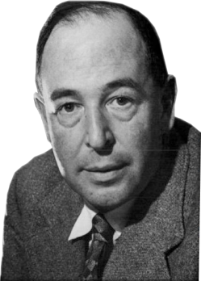
Will the Technological Singularity Solve the World’s Problems?
“Education without values, as useful as it is, seems rather to make man a more clever devil.”
C. S. Lewis

Slide 42
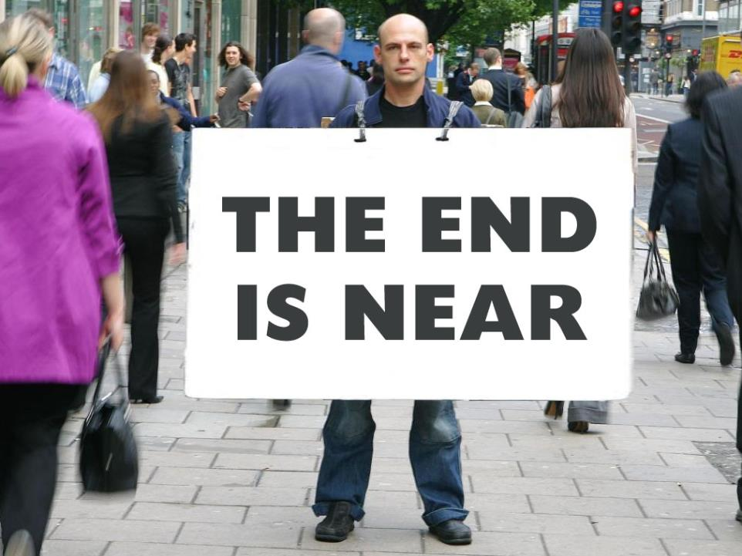
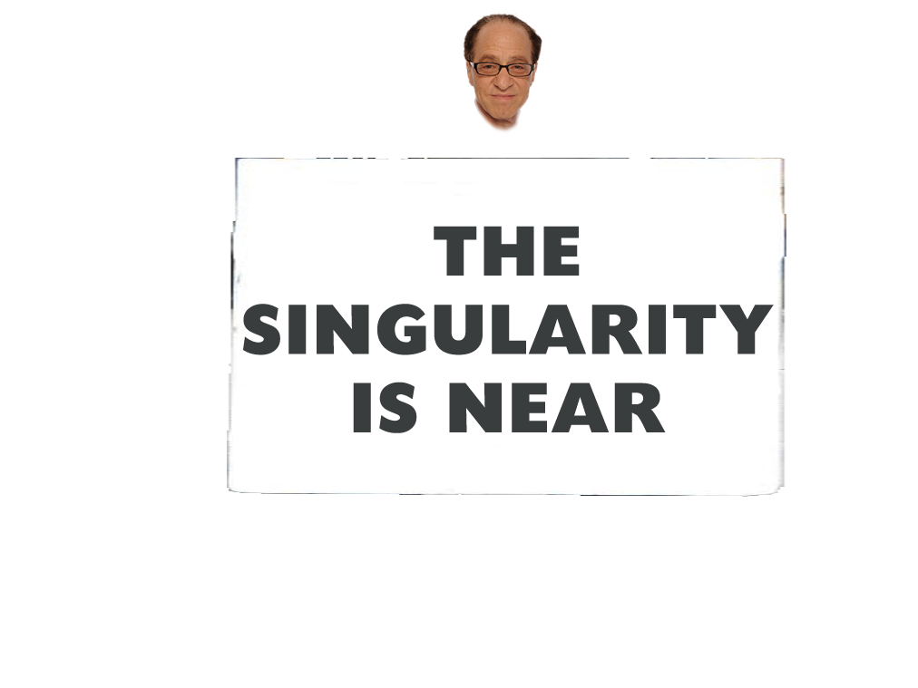
The Singularity is Near–Not!
Notes:
Yes, the end is near (at least for this talk), but the singularity is not. However, at the point that something like the singularity does appear immanent, we should oppose it with as much determination as we can muster. Thank you.

