Slide 1
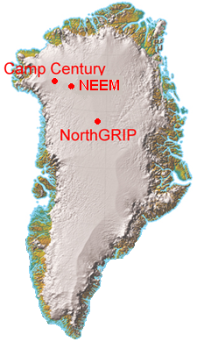

Slide 2
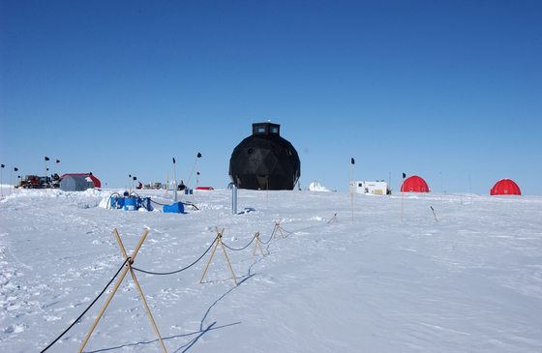

Slide 3
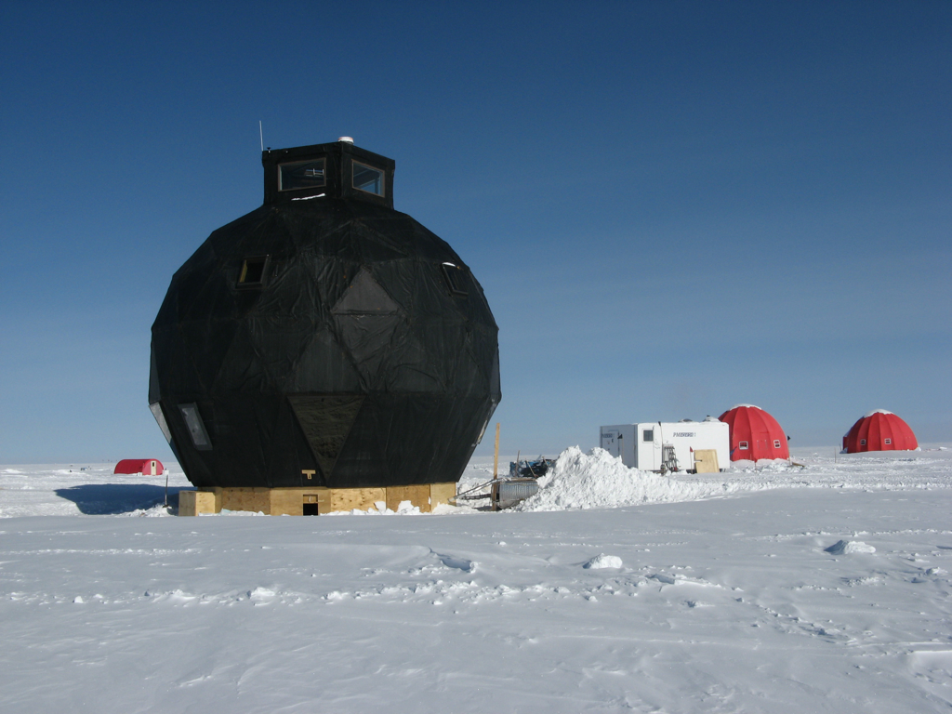

Slide 4
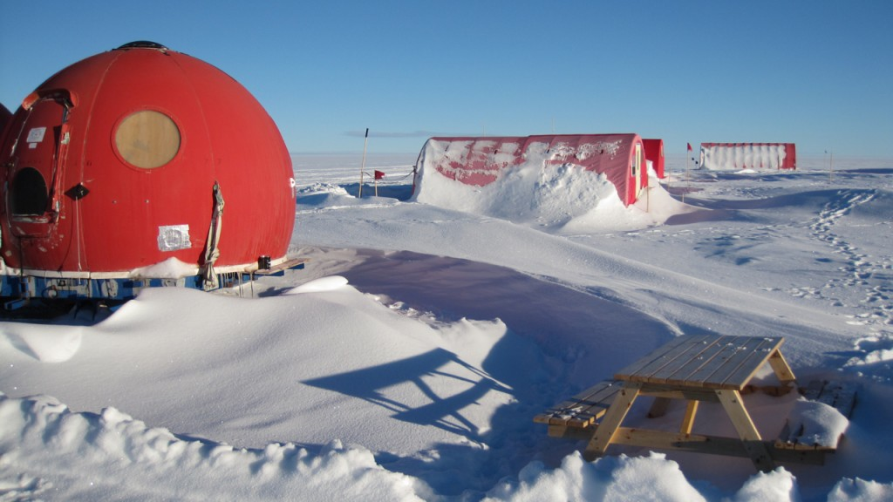

Slide 5
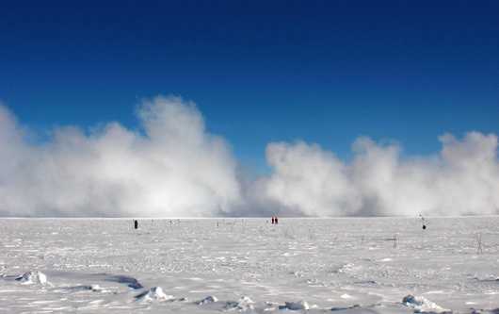

Slide 6
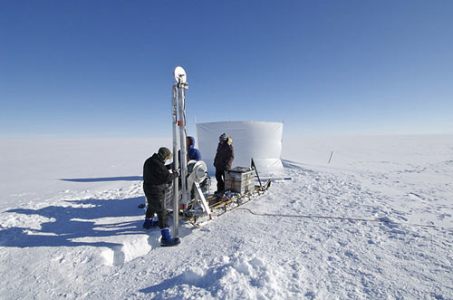

Slide 7
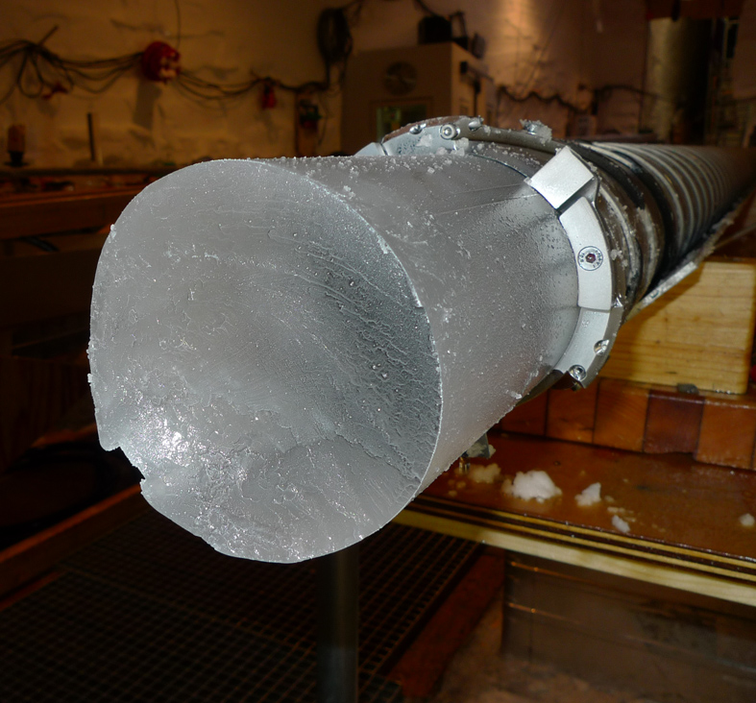

Slide 8
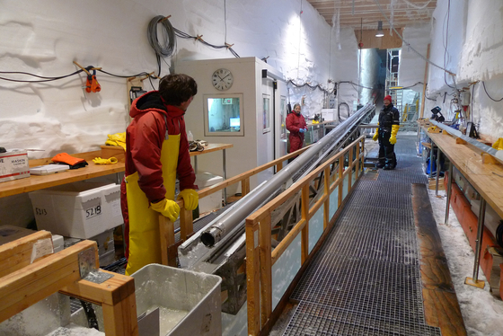

Slide 9
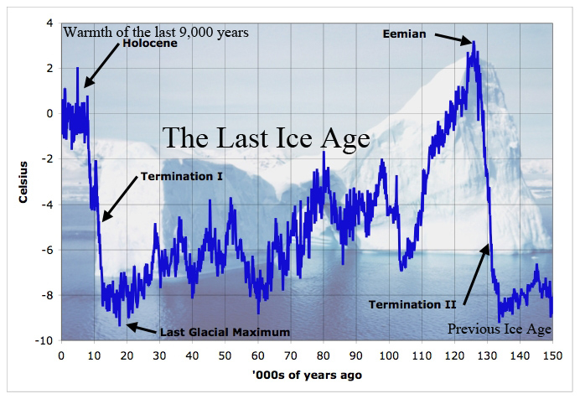
Notes:
NEEM (150,000 years)

Slide 10
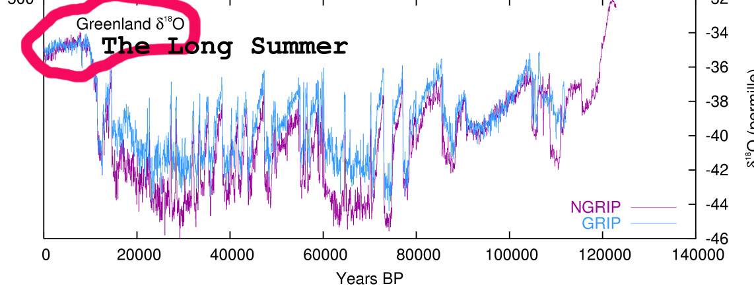

Slide 11
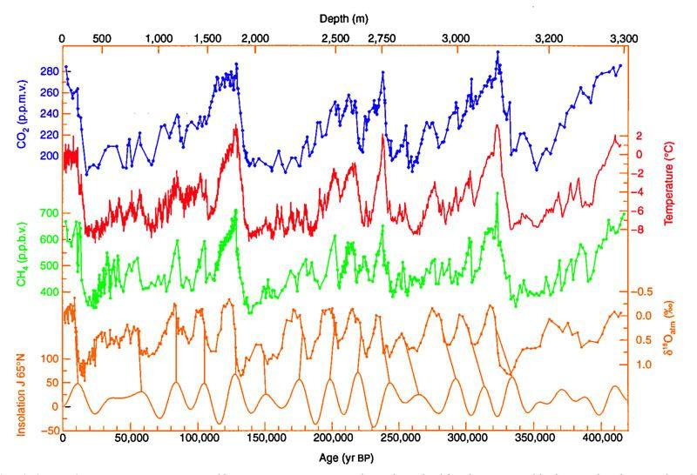
Notes:
Vostok (720,000 years)

Slide 13
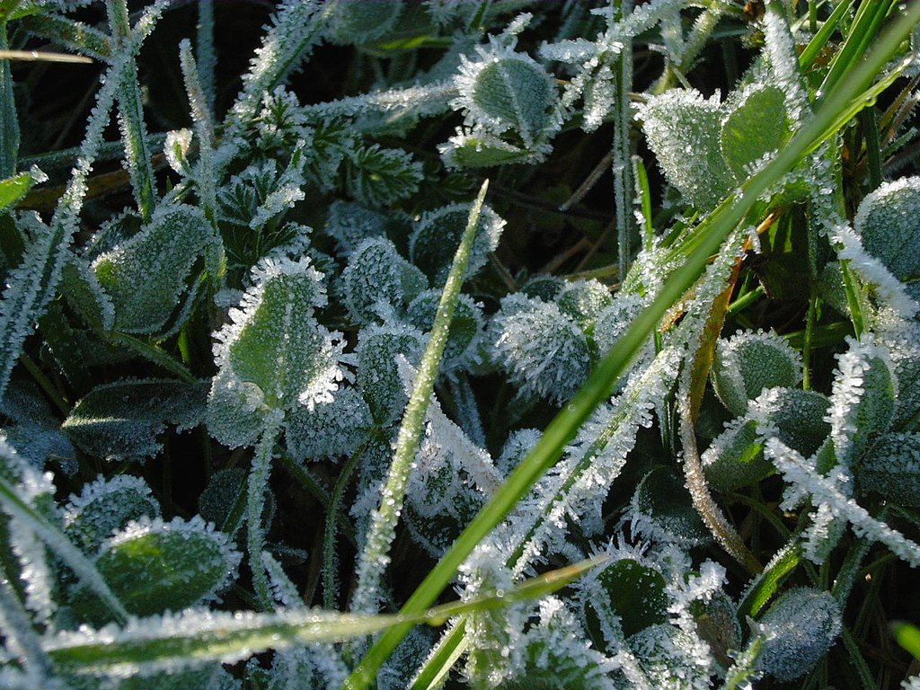
Notes:
Frost will form on a solid surface if the surface is chilled below the dew point of the surrounding air and the surface itself is colder than freezing.

Slide 14
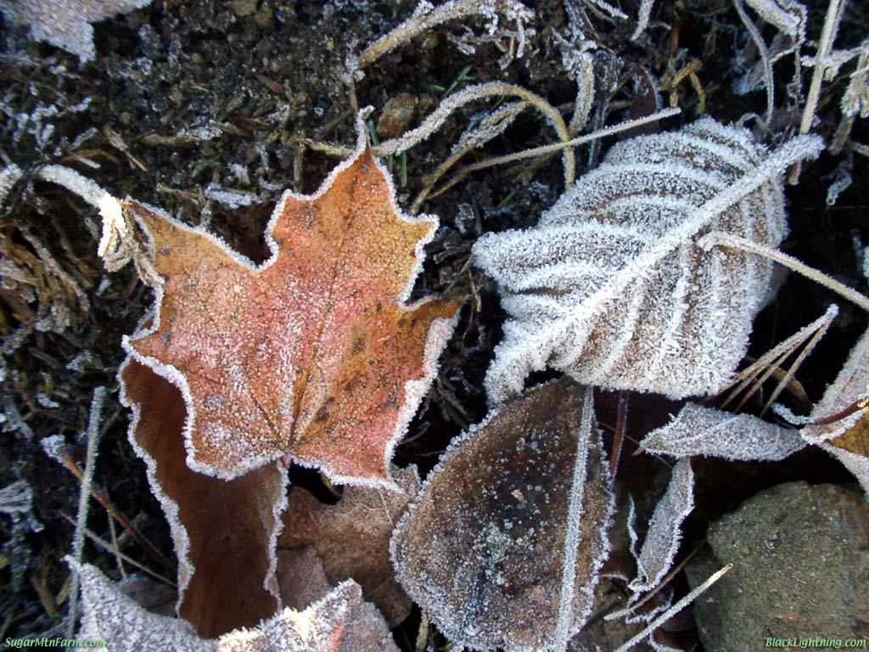
Notes:
Frost can form when there are not the clouds or the cold temperatures for snow to form and fall.

Slide 15
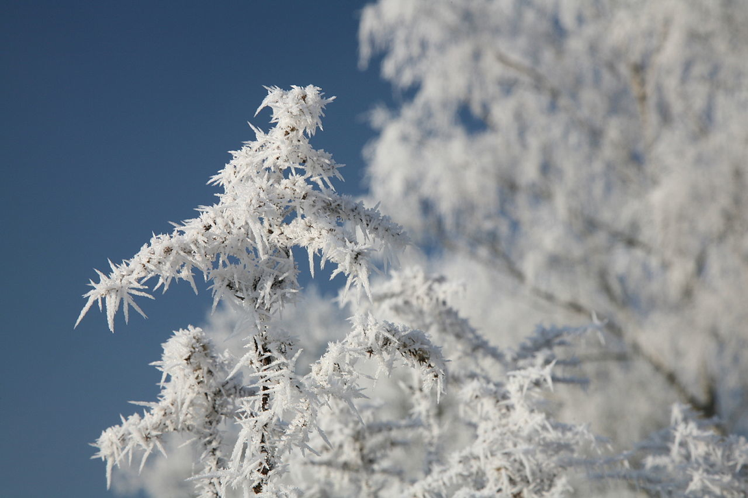
Notes:
hoar frost (radiation frost)
white ice crystals loosely deposited on the ground and on exposed objects
formed when heat is lost into the open sky causing objects to become colder than the surrounding air
can form when the air temperature is well above freezing

Slide 16
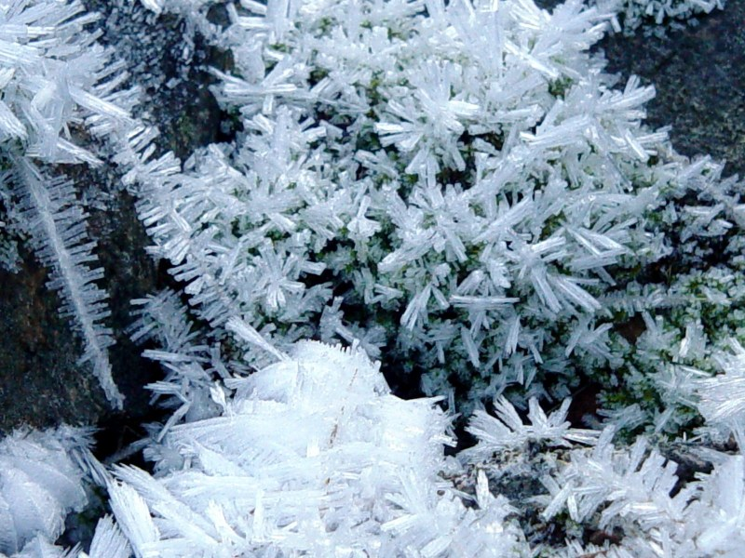
Notes:
hoar frost

Slide 17

Notes:
Hoar frost

Slide 18
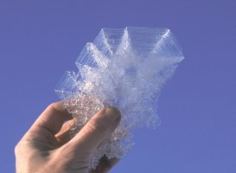
Notes:
Hoar frost crystal

Slide 19
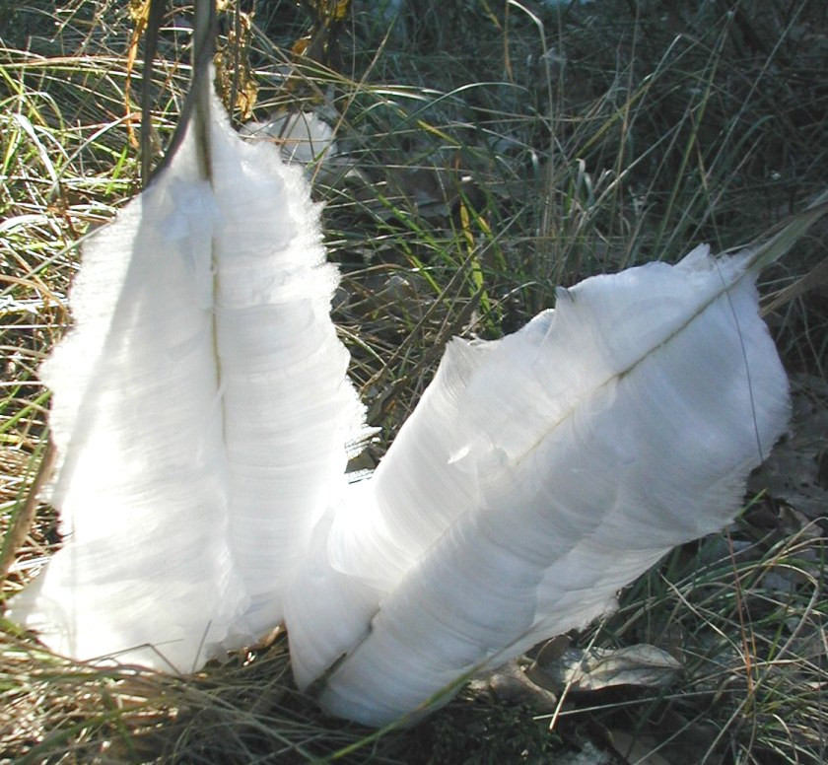
Notes:
frost flower
The bigger the frost flowers the longer they take to melt.

Slide 20
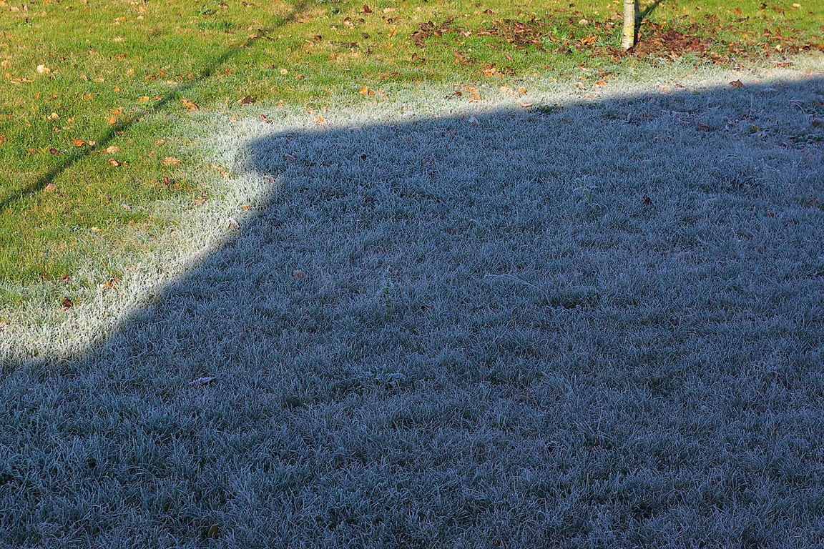
Notes:
hoar frost melting on grass

Slide 21
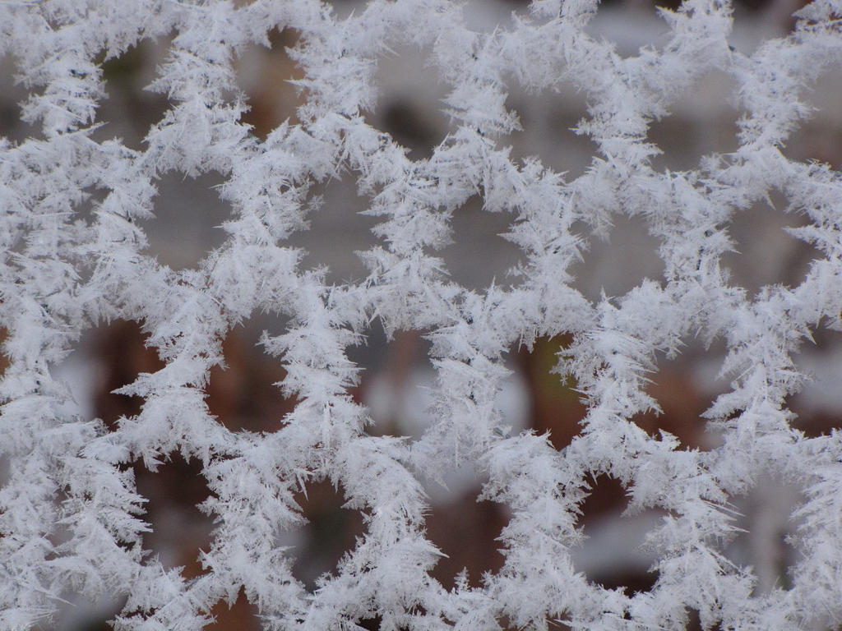
Notes:
hoar frost on fence

Slide 22
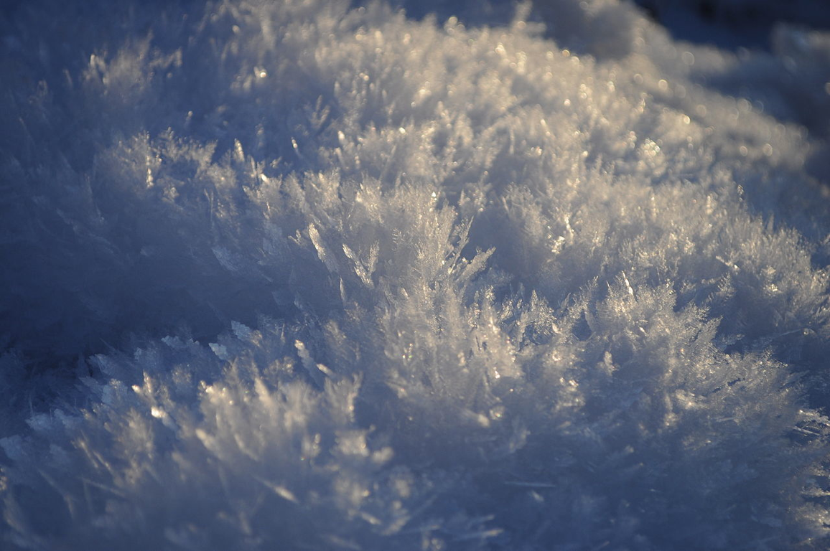
Notes:
surface frost

Slide 23
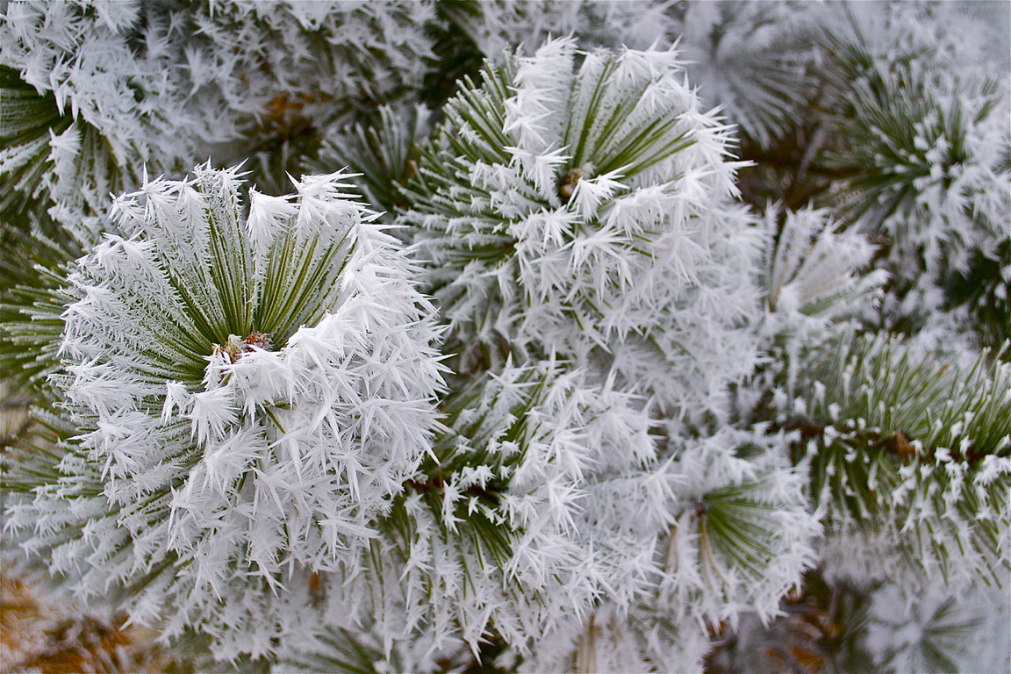
Notes:
air hoar; advection frost; wind frost
tiny ice spikes that form when a cold wind blows over the branches of trees, wires, poles, etc.

Slide 24
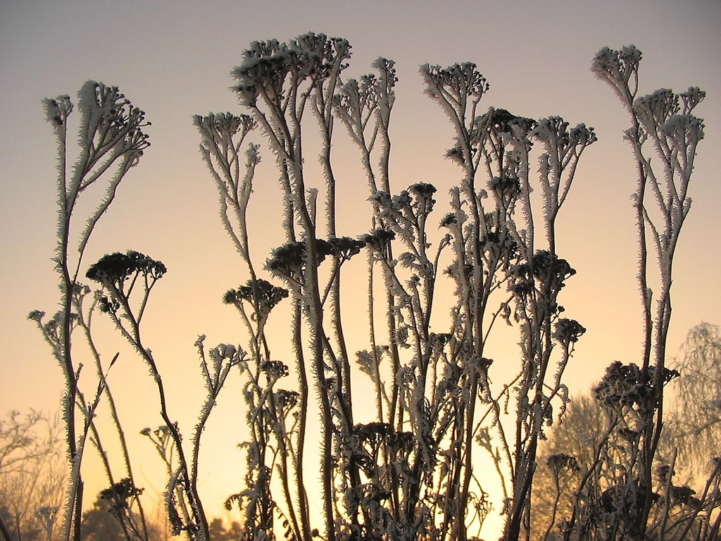
Notes:
rime frost
deposits quickly under windy conditions where there is heavily saturated air
has an icy solid appearance and takes a long time to melt

Slide 25
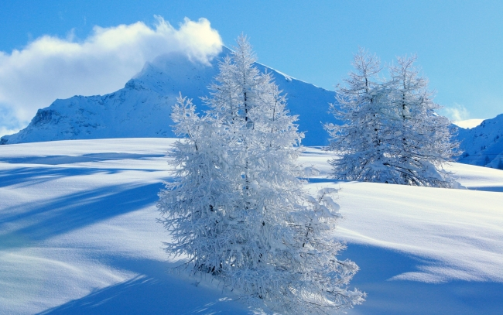
Notes:
air hoar (on tree branches) and surface hoar
Surface hoar can cause avalanches when surface hoar forms on snowy slopes.

Slide 26
