Slide 1
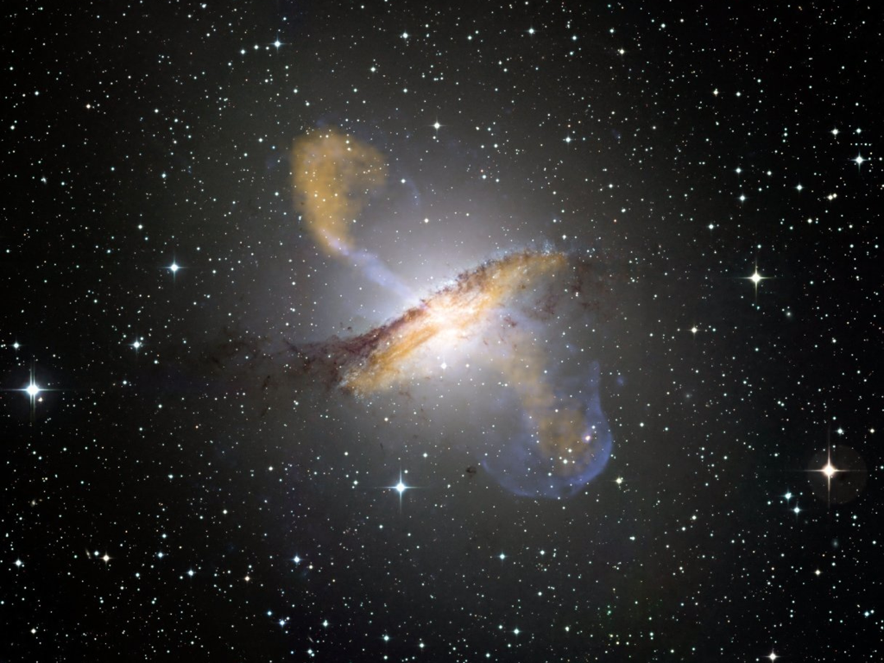
ESO
Notes:
The following giant galaxies contain over one trillion stars.
This is Centaurus A.

Slide 2
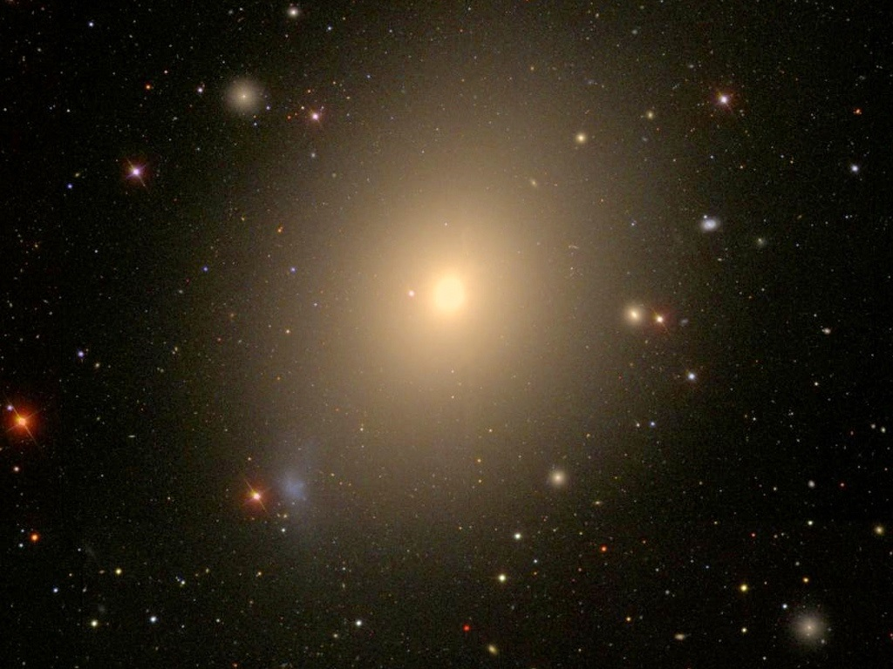
WikiSky/SDSS
Notes:
This is M 49, the biggest galaxy in the Virgo supercluster.
In addition to its trillion plus stars it contains 6,300 globular clusters.
It all adds up to 50 billion trillion stars
CUT

Slide 3

Notes:
To visualize 50 billion trillion, stack up a pile of dimes …
(use a stack of dimes as a demo)

Slide 4

NASA/ESA/Hubble Heritage (STScI/AURA)
Notes:
… twice as high as the tallest skyscrapers.
Now, duplicate those stacks and pack them as closely together as possible.
50 billion trillion dimes stacked that high and packed that close together would cover the entire continent of South America.

Slide 5
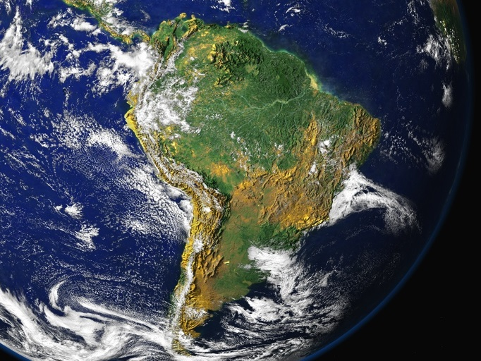
NASA
NASA/ESA/Hubble Heritage (STScI/AURA)
Notes:
50 billion trillion dimes stacked that high and packed that close together would cover the entire continent of South America.
CUT
Now, how big is a typical star? How much bigger than the Earth is the Sun?

Slide 6
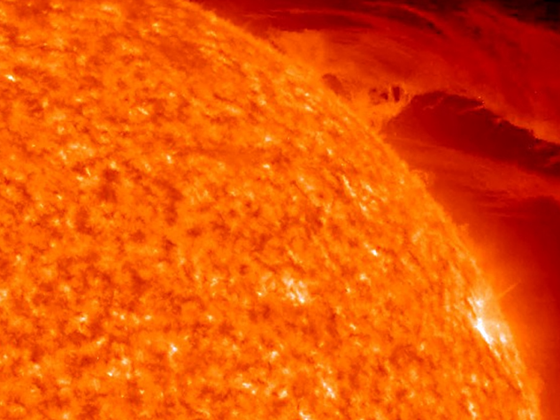
Earth
NASA
: STEREO Project, NASA
Notes:
Each star is about a million miles in diameter. It would take 1.3 million Earths to fill up the volume of the Sun.
If you were to model a typical star down to the size of a grapefruit, how far away would you need to go to reach the next nearest star/grapefruit?

Slide 7
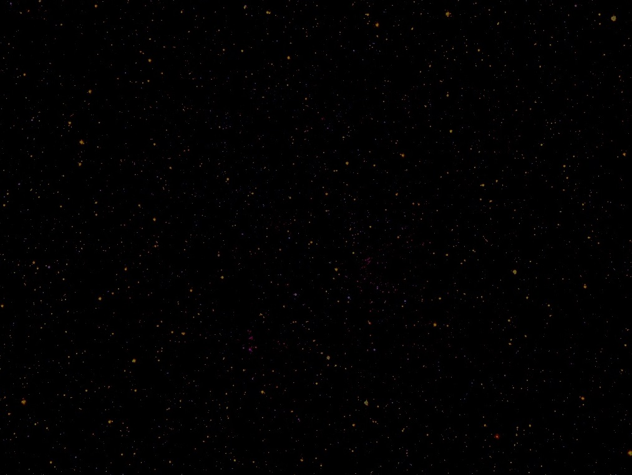
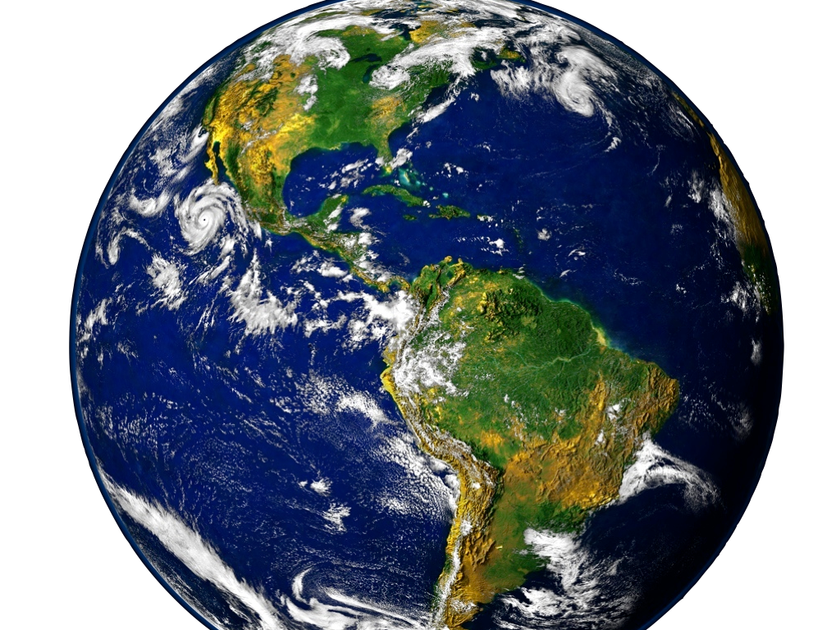
NASA
Notes:
WAIT
You would need to go to Peru.
Now multiply all that out by 50 billion trillion. That’s how big the observable universe is.
The universe of today is at least a thousand times bigger.

Slide 8
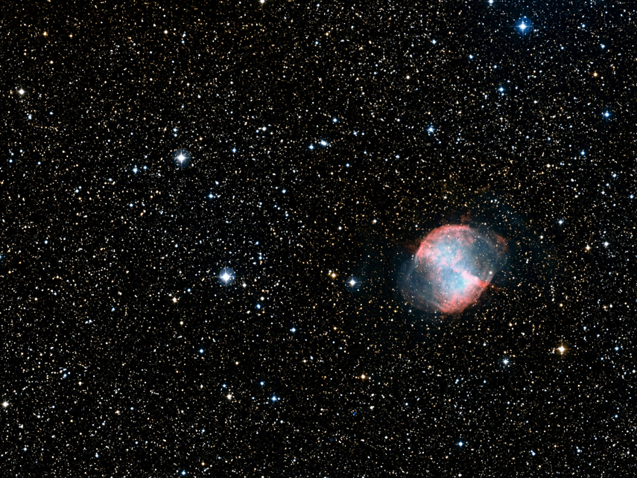
How much mass is in the universe?
NASA/ESA/Digitized Sky Survey 2
Notes:
Mass is not the same as size. Size measures volume. Mass measures the amount of matter.

Slide 9
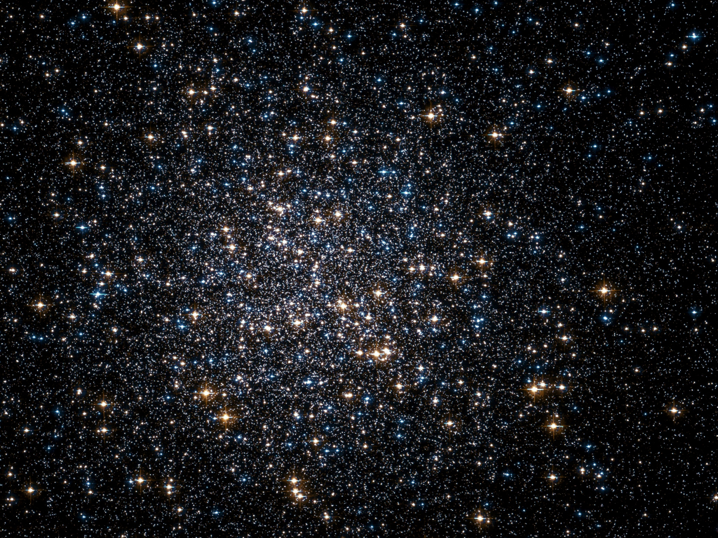
How much mass is in the universe?
Notes:
All the stars, planets, moon, rocks, dust, and gas make up just 1% of the universe’s mass.

Slide 10
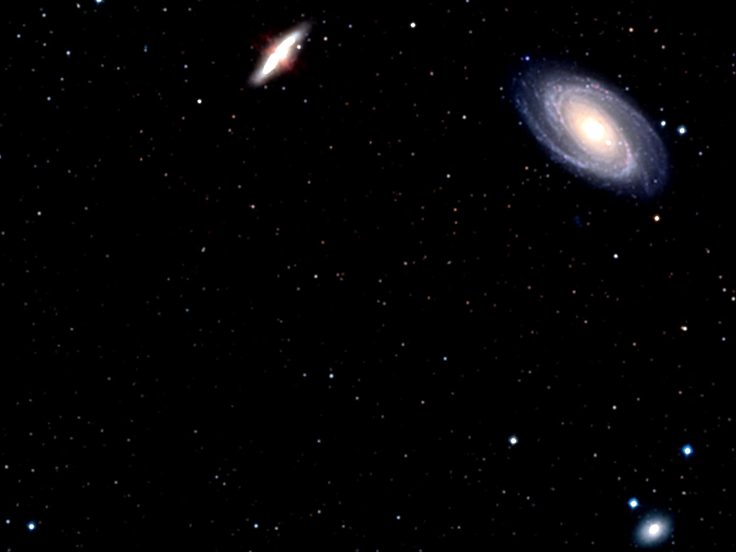
Why is the universe so very massive?
The universe’s mass determines its makeup of elements.
ESA/Hubble and Digitized Sky Survey 2

