Slide 1
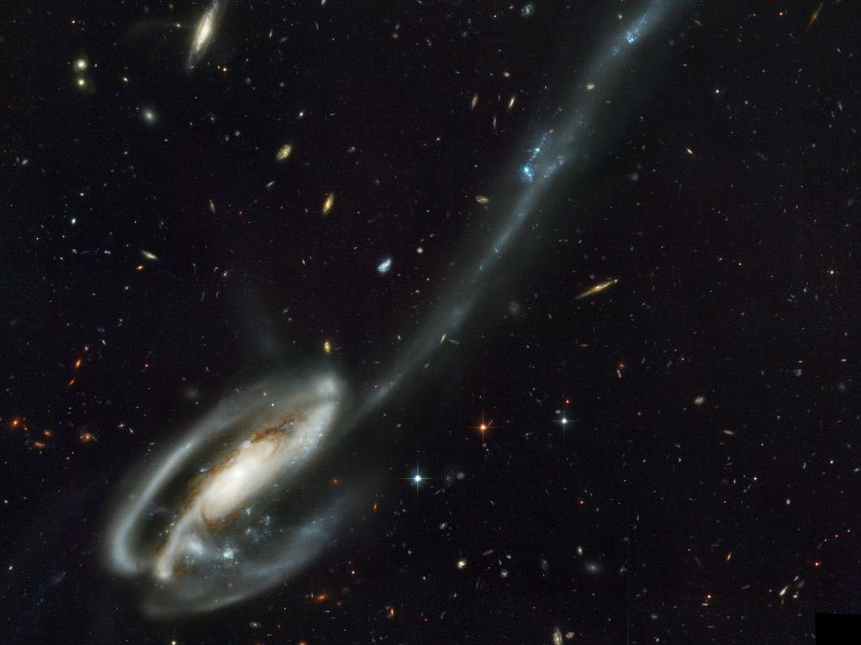
Why is the universe so vast?
NASA
Notes:
If God made the universe …
First, how enormous is the universe?

Slide 2
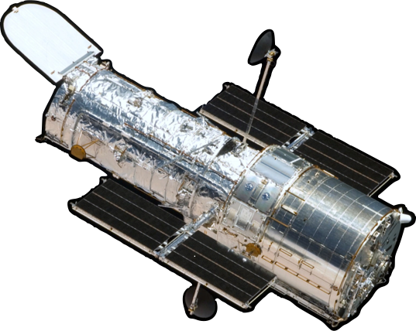
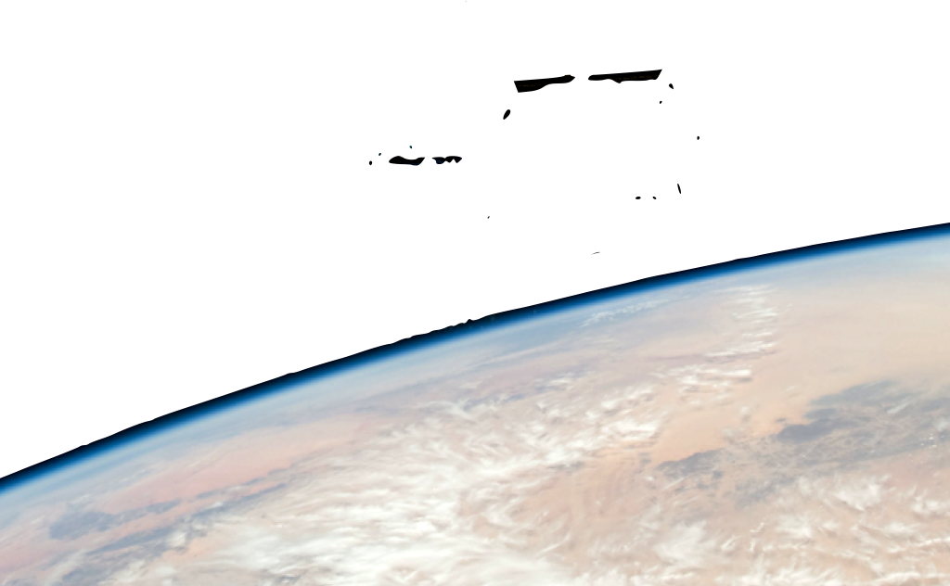
NASA/crew of STS-125
Notes:
The Hubble Space Telescope here is like a giant digital camera.
use a digital camera as a demo

Slide 3
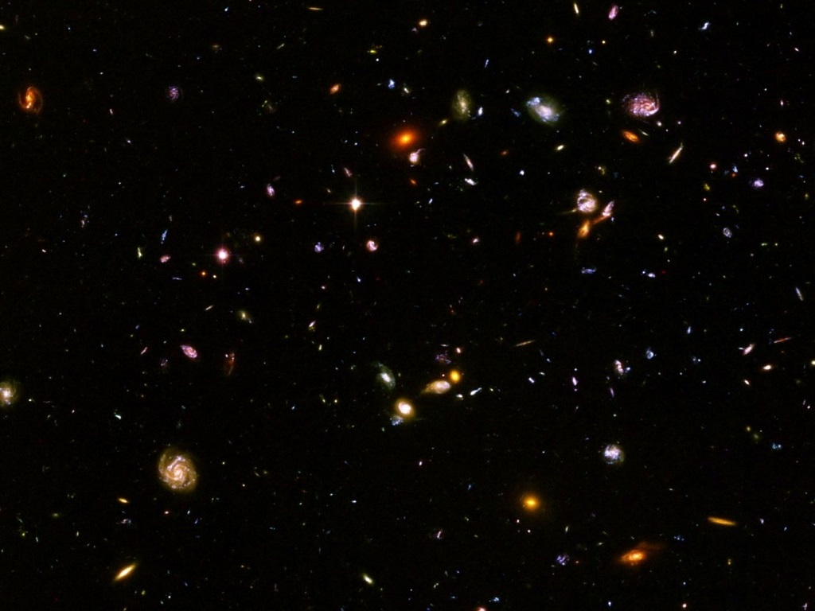
NASA/Hubble Heritage Team STScI/AURA
NASA/ESA/Hubble Heritage (STScI/AURA)
Notes:
use a digital camera as a demo
a million second exposure (278 hours, nearly two weeks) on a portion of the sky just one tenth of a moon diameter across

Slide 4
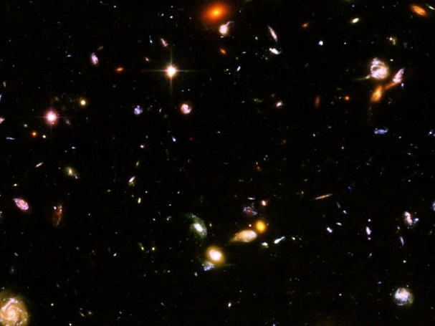
NASA/Hubble Heritage Team STScI/AURA
NASA/ESA/Hubble Heritage (STScI/AURA)
Notes:
The Hubble Ultra Deep Field images all the large and medium-sized galaxies that exist in this part of the universe.

Slide 5
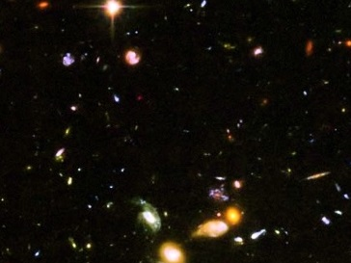
NASA/Hubble Heritage Team STScI/AURA
NASA/ESA/Hubble Heritage (STScI/AURA)
Notes:
Over 10,000 galaxies are visible in the HUDF.
That works out to over 200 billion medium- and large-sized galaxies in the observable universe.
Dwarf galaxies are a hundred times as numerous.

Slide 6
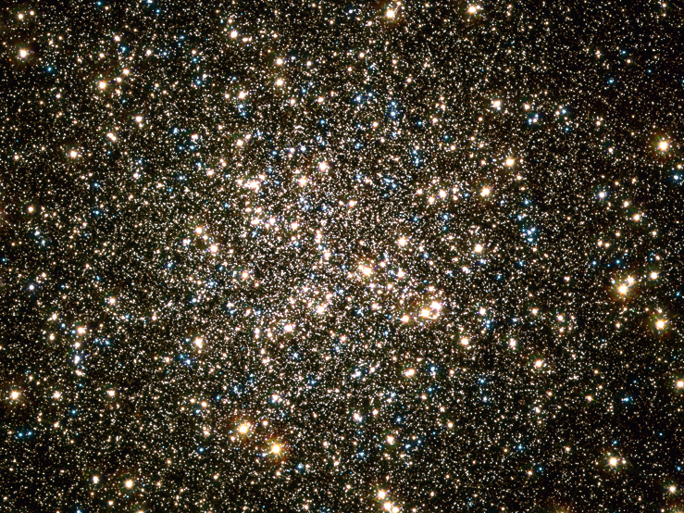
credit: NASA, ESA, /Hubble Heritage (STScI/AURA)
acknowledgment: C. Bally and W. van Altena (Yale), W. Lewin (MIT), A. Sarajedini (U. of Florida)
NASA/ESA/Hubble Heritage (STScI/AURA)
Notes:
This is 1 of 151 globular clusters in our Milky Way Galaxy. Its on the small side containing just 100,000 stars.

Slide 7
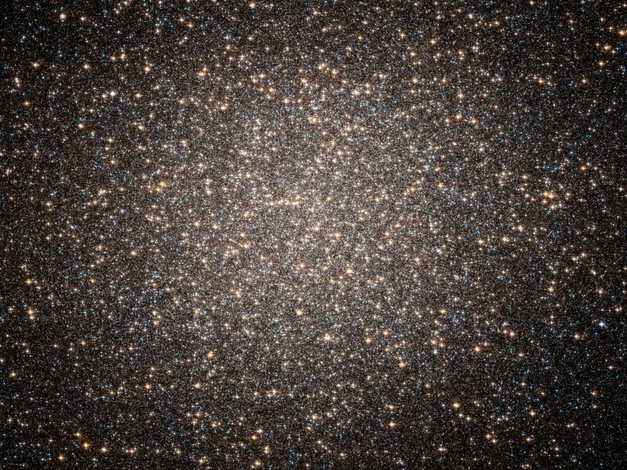
NASA/ESA/Hubble Heritage Team (STSiI/AURA)
NASA/ESA/Hubble Heritage (STScI/AURA)
Notes:
This one is on the large side. It contains 10,000,000 stars.

Slide 8
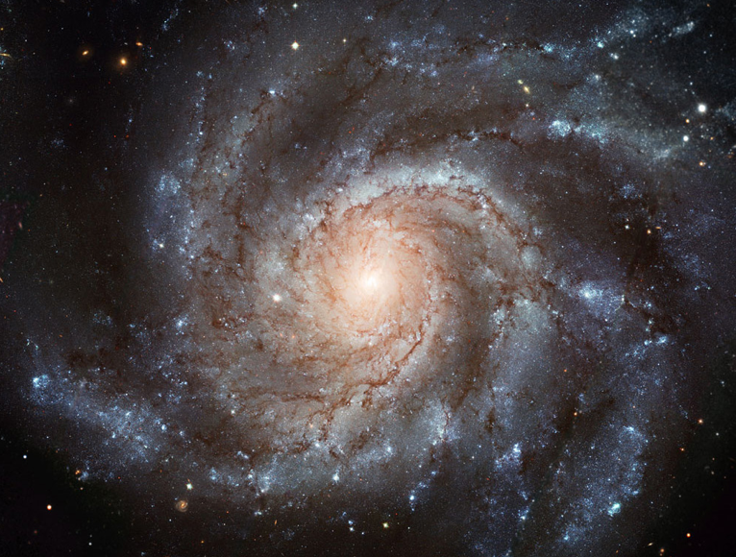
NASA, ESA. CFNT. NOAO
Notes:
The following medium-sized galaxies contain between one hundred and four hundred billion stars each.
M101

Slide 9
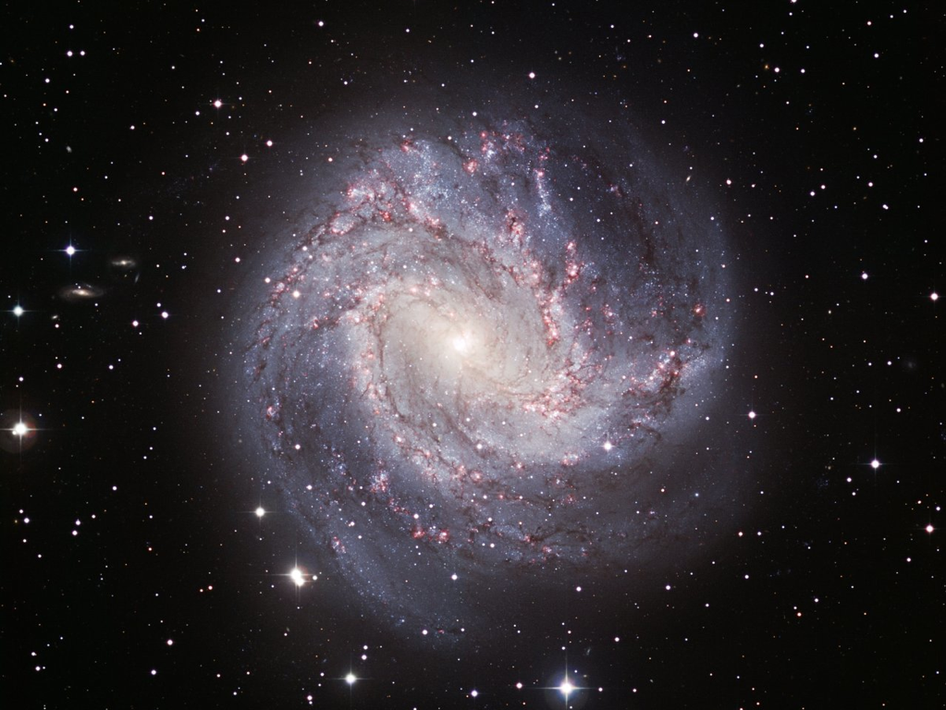
ESO
Notes:
M83

Slide 10
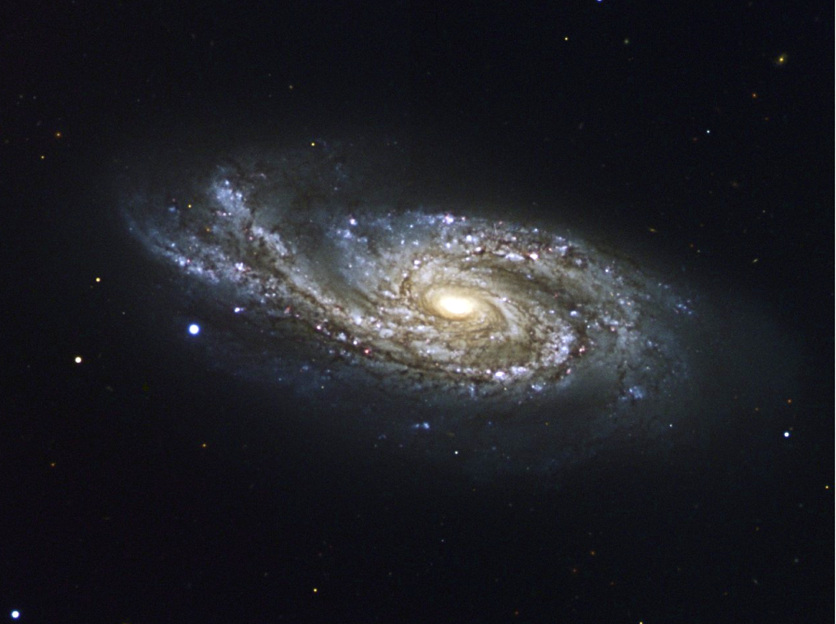
ESO
Notes:
NGC 908

Slide 11
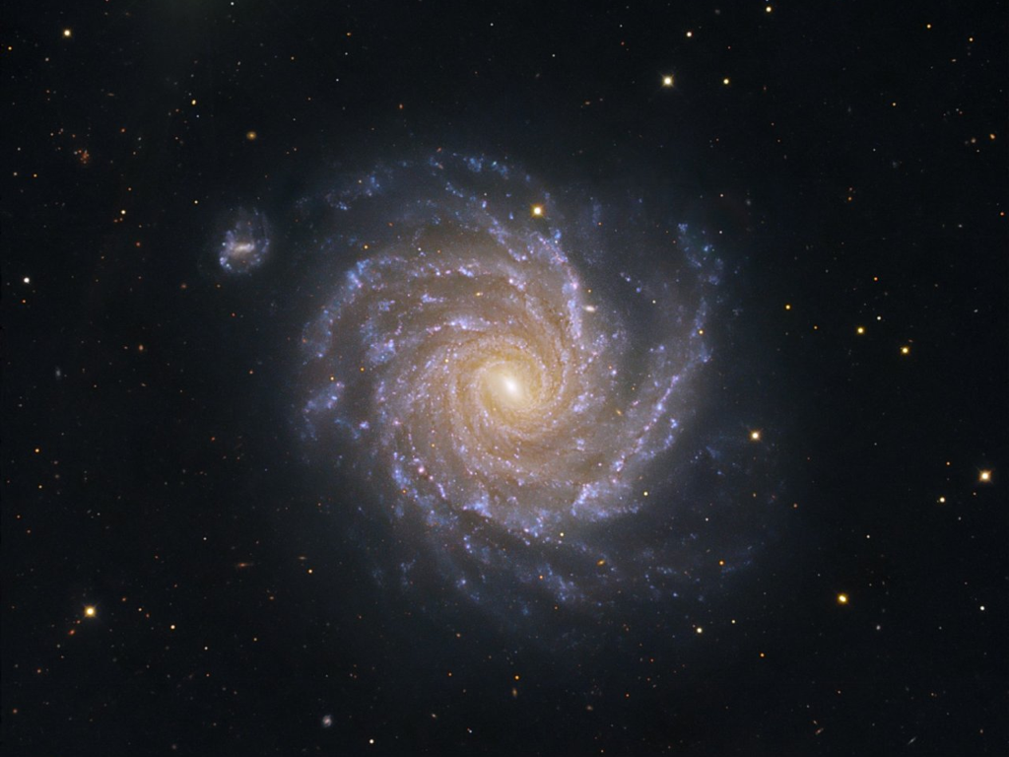
ESO
Notes:
NGC 1232

Slide 12
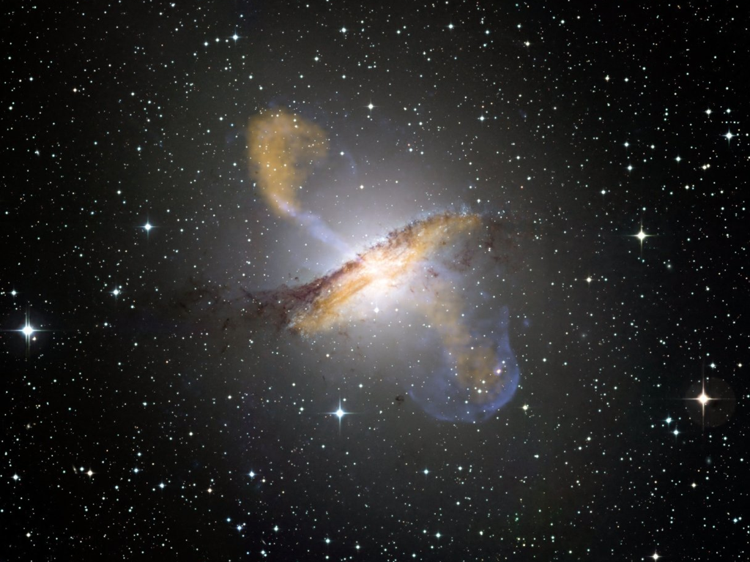
ESO
Notes:
The following giant galaxies contain over one trillion stars.
This is Centaurus A.

Slide 13
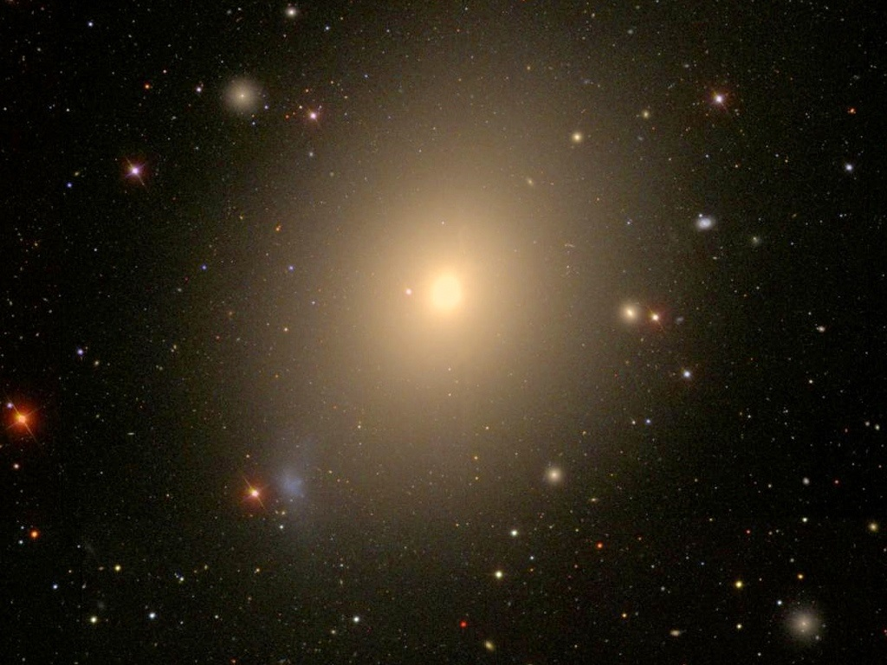
WikiSky/SDSS
Notes:
This is M 49, the biggest galaxy in the Virgo supercluster.
In addition to its trillion plus stars it contains 6,300 globular clusters.
It all adds up to 50 billion trillion stars
CUT

