Slide 1
Will the Real God Please Stand Up?!
A Comparison of
gods of Mormonism
to the God of the Bible
Part A: What Mormonism Teaches
Part B: What the Bible Teaches

Slide 2
Why This Presentation?

Slide 3
Will the Real God Please Stand Up?! Motive Behind this Presentation
It is often said, and correctly so, to have a relationship with someone, you have to have their identity correct.
The most important person/being we can ask this about is the nature of God (don’t want the wrong God!!!).
As we will see, Mormonism teaches a radically different concept from biblical Christianity on who God is.
If Mormonism’s gods are correct, biblical Christianity’s God is wrong, and if biblical Christianity’s God is true, Mormonism’s gods cannot be true.

Slide 4
Will the Real God Please Stand Up?! Motive Behind this Presentation
This presentation contends the God of the Bible is the one true God of the entire universe.
Mormonism clearly does not teach this one true God (Jesus Christ).
Therefore, out of love and concern this presentation wants to reveal the false gods of Mormonism in the hope that some Mormons will come to the true God, and that Christians become more knowledgeable and effective witnesses.

Slide 5
Part A:
What Mormonism Teaches

Slide 6
Will the Real God Please Stand Up?!
Only Mormon sources are used to explain the official Mormon doctrines presented herein; also:
Only well-recognized, authoritative Mormon leaders – such as Presidents and Apostles are used
Authoritative Mormon documentation/books are utilized

Slide 7
Will the Real God Please Stand Up?!
The “Journal of Discourses” is abbreviated “JoD” and the “Doctrines of Salvation” is abbreviated as “DoS” (also in DoS Vol. I = 1, II = 2, and III = 3)
In quoting sources, volume and page nos. are abbreviated; i.e., 2:311 = vol. 2, pg. 311

Slide 8
The Position of Mormon Leaders on Christianity

Slide 9
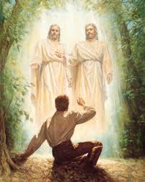
Will the Real God Please Stand Up?! Mormon Founder, Joseph Smith, Jr. , against Christianity
In Mormonism’s “official” version of Joseph Smith’s “first vision” (where he is said to have seen the Father and the Son in two separate bodies), Joseph states: “…then I asked the Personages who stood above me in the light,

Slide 10
Will the Real God Please Stand Up?! Mormon Founder, Joseph Smith, Jr. , against Christianity
which of all the [Christian] sects was right (for at this time it had never entered into my heart that all were wrong)--and which I should join.
"I was answered that I must join none of them, for they were all wrong; and the Personage who addressed me said that all their creeds were an abomination in his sight; that those professors were all corrupt; that: ‘they draw near to me

Slide 11
Will the Real God Please Stand Up?! Mormon Founder, Joseph Smith, Jr. , against Christianity
with their lips, but their hearts are far from me, they teach for doctrines the commandments of men, having a form of godliness, but they deny the power thereof.’ ” (http://www.lds.org/library/display/0,4945,104-1-3-4,00.html)

Slide 12
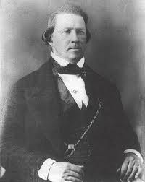
Will the Real God Please Stand Up?! Mormon leaders against Christianity
Brigham Young, Mormonism’s 2nd President, stated that the “…Christian God is the Mormon’s Devil…” (JoD, 5:331).

Slide 13
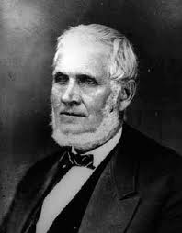
Will the Real God Please Stand Up?! Mormon leaders against Christianity
John Taylor, Mormonism’s 3rd President, said that Christianity was “hatched in hell” (JoD, 6:176), and that Christianity was “a perfect pack of nonsense…the Devil could not invent a better engine to spread his work….(JoD, 6:167)

Slide 14
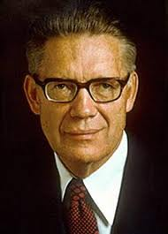
Will the Real God Please Stand Up?! Mormon leaders against Christianity
Bruce R. McConkie, Mormon Apostle (died 1985), said, “What is the church of the devil in our day, and where is the seat of her power?....It is all of the systems, both Christian and non-Christian, that perverted the pure and perfect gospel….It is communism, it is Islam, it is

Slide 15
Will the Real God Please Stand Up?! Mormon leaders against Christianity
Buddhism, it is modern Christianity in all its parts. It is Germany under Hitler, Russia under Stalin, and Italy under Mussolini.” (The Millennial Messiah, pp. 54-55).

Slide 16
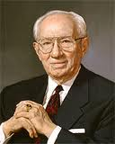
Will the Real God Please Stand Up?! Mormon leaders against Christianity
Mormon President Gordon B. Hinckley, 15th President of the Mormon Church, stated: “The traditional Christ of whom they [Christians] speak is not the Christ of whom I speak. For the Christ of whom I speak has been revealed in this the Dispensation of the

Slide 17
Will the Real God Please Stand Up?! Mormon leaders against Christianity
Fulness of Times. He, together with His Father, appeared to the boy Joseph Smith in the year 1820, and when Joseph left the grove that day, he knew more of the nature of God than all the learned ministers of the gospel of the ages.” (Church News, June 20, 1998)

Slide 18
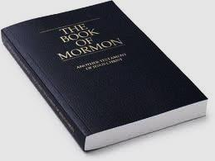
Will the Real God Please Stand Up?! Book of Mormon against Christianity
The angel Nephi in I Nephi 14:10 states, “And he [Nephi] said unto me: Behold there are save two churches only; the one is the church of the Lamb of God, and the other is the church of the devil; wherefore, whoso belongeth not to the church of the Lamb of God belongeth to that great church, which is the mother of abominations; and she is the whore of all the earth.”

Slide 19

Will the Real God Please Stand Up?! Mormon Scripture Statements Against Christianity
The Doctrine and Covenants, Section 1, Verse 30 states: “…the only true and living church upon the face of the whole earth” in reference to the Mormon Church.

Slide 20
Will the Real God Please Stand Up?! Additional Mormon Leader's Statements Against Christianity
“Are Christians ignorant? Yes, as ignorant of the things of God as the brute beast.” (President John Taylor, JoD, 6:25)
“The Christian world, so called, are heathens as to their knowledge of the salvation of God.” (President Brigham Young, JoD 8:171)
“With regard to true theology, a more ignorant people never lived than the present so-called Christian world.” (President Brigham Young, JoD 8:199)

Slide 21
Will the Real God Please Stand Up?! Additional Mormon Leader's Statements Against Christianity
“What does the Christian world know about God? Nothing; yet these very men assume the right and power to tell others what they shall and what they shall not believe in. Why, so far as the things of God are concerned, they are the veriest fools; they know neither God nor the things of God. (President John Taylor, JoD 13:225)

Slide 22
Will the Real God Please Stand Up?!
In light of the previous evidence, isn’t it ironic and contradictory how the Mormon Church sometimes tries to pass itself off as “Christian” in order to gain more public acceptance and converts?
Unfortunately, the “public relations” campaign is working; even 40% of evangelical Christians think the Mormon Church is Christian!!!
However, this presentation will show beyond a shadow of a doubt that Mormonism is not Christian.

Slide 23
Will the Real God Please Stand Up?!
Part A:
What Mormonism Teaches

Slide 24
Are There an Infinite No. of Gods and Goddesses?

Slide 25
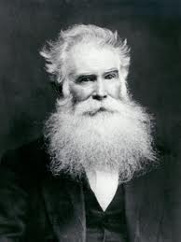
Will the Real God Please Stand Up?! Mormonism teaches an infinite no. of gods
“…If we should take a million of [sic] worlds like this and number their particles, we should find that there are more Gods than there are particles of matter in those worlds. (Orson Pratt, JoD 2:345)

Slide 26
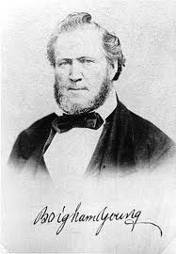
Will the Real God Please Stand Up?! Mormonism teaches an infinite no. of gods
“How many Gods there are, I do not know. But there never was a time when there were no Gods and worlds.” (Mormon President Brigham Young, JoD, 7:333)
NOTE: As we will see, Mormonism teaches each god became a god, like his “god the father” did before him, and so on infinitely in the past. This results in an “infinite” number of gods…

Slide 27
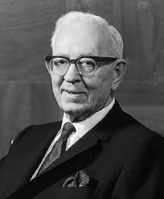
Will the Real God Please Stand Up?! Mormonism teaches an infinite no. of gods
“Further, as the Prophet [Joseph Smith] also taught, there is ‘a God above the Father of our Lord Jesus Christ…If Jesus Christ was the Son of God, and John discovered that God the Father of Jesus Christ had a Father, you may suppose that he [i.e, the father’s father]

Slide 28
Will the Real God Please Stand Up?! Mormonism teaches there are an infinite no. of gods
had a Father also. When was there ever a son without a father?...Hence, if Jesus had a Father, can we not believe that he had a Father also?’ (Teachings, pp. 370, 373.) In this way both the Father and the Son, as also all exalted beings, are now or in due course will become Gods of Gods. (Teachings, pp. 342-376)” --- This whole quote from Mormon Apostle Bruce R. McConkie’s Mormon Doctrine, pp. 322-323.

Slide 29
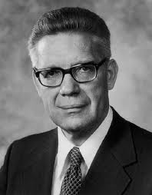
Will the Real God Please Stand Up?! Mormonism teaches there are an infinite no. of gods
“Three separate personages-Father, Son and Holy Ghost-comprise the Godhead. As each of these persons is a God, it is evident, from this standpoint alone, that a plurality of Gods exists. To us, speaking in the proper finite sense, these three are the only Gods we worship. But in

Slide 30
Will the Real God Please Stand Up?! Mormonism teaches there are an infinite no. of gods
addition there is an infinite number of holy personages, drawn from worlds without number, who have passed on to exaltation and are thus gods. (Mormon Apostle Bruce R. McConkie, Mormon Doctrine, pp. 576-577)

Slide 31
Are the Father, Son, and Holy Ghost Three Different Gods?

Slide 32
Will the Real God Please Stand Up?! Mormonism teaches the Father, Son and Holy Ghost are three different gods
“Three separate personages-Father, Son and Holy Ghost-comprise the Godhead. As each of these persons is a God, it is evident, from this standpoint alone, that a plurality of Gods exists. To us, speaking in the proper finite sense, these three are the only Gods we worship. (Apostle Bruce R. McConkie, Mormon Doctrine, pp. 576-577)

Slide 33
Will the Real God Please Stand Up?! Mormonism teaches the Father, Son and Holy Ghost are three different gods
“There are three Gods-the Father, Son and Holy Ghost-who though separate in personality, are united as one in purpose, in plan, and in all the attributes of perfection.
(Apostle Bruce R. McConkie, Mormon Doctrine, p. 317)

Slide 34
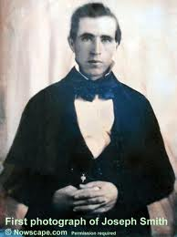
Will the Real God Please Stand Up?! Mormonism teaches the Father, Son and Holy Ghost are three different gods
“I will preach on the plurality of Gods…I have always declared God to be a distinct personage, Jesus Christ a separate and distinct personage from God the Father, and that the Holy Ghost was a distinct personage and a Spirit: and

Slide 35
Will the Real God Please Stand Up?! Mormonism teaches the Father, Son and Holy Ghost are three different gods
these three constitute three distinct personages and three Gods…..we have three Gods anyhow, and they are plural: and who can contradict it?” (Joseph Smith, Jr. , History of the Church 6:474)

Slide 36
Were All the Gods Once Not Gods? (did they become gods?)

Slide 37
Will the Real God Please Stand Up?! Mormonism: All gods were once mortal men/women who later became gods/goddesses
“God himself was once as we are now, and is an exalted man, and sits enthroned in yonder heavens!...I am going to tell you how God came to be God. We have imaged and supposed that God was God from all eternity. I will refute that idea, and take

Slide 38
Will the Real God Please Stand Up?! Mormonism: All gods were once mortal men/women who later became gods/goddesses
away the veil, so that you may see….It is the first principle of the Gospel to know for a certainty the character of God,…He once was a man like us; yea, that God himself, the Father of us all, dwelt on an earth, the same as Jesus Christ himself did;…” (Joseph Smith, Jr. History of the Church, 6:305)

Slide 39
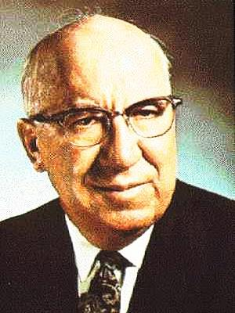
Will the Real God Please Stand Up?! Mormonism: All gods were once mortal men/women who later became gods/goddesses
“Mormon prophets have continuously taught the sublime truth that God the Eternal Father was once a mortal man who passed through a school of earth life similar to that which we are now passing. He became God-an exalted being -

Slide 40
Will the Real God Please Stand Up?! Mormonism: All gods were once mortal men/women who later became gods/goddesses
through obedience to the same eternal Gospel truths that we are given opportunity today to obey. (Milton R. Hunter, The Gospel Through the Ages [1968], pp. 114-115)

Slide 41
Will the Real God Please Stand Up?! Mormonism: All gods were once mortal men/women who later became gods/goddesses
“He is our Father-the Father of our spirits, and was once a man in mortal flesh as we are, and is now an exalted being….God was once a finite being;… (President Brigham Young, JoD, 7:333)

Slide 42
Will the Real God Please Stand Up?! Mormonism: All gods were once mortal men/women who later became gods/goddesses
“Yet, if we accept the great law of eternal progression, we must accept the fact that there was a time when Deity was much less powerful than He is today. Then how did He become glorified and exalted and attain His present status of Godhood?...He became

Slide 43
Will the Real God Please Stand Up?! Mormonism: All gods were once mortal men/women who later became gods/goddesses
God by absolute obedience to all the eternal laws of the Gospel-by conforming His actions to all truth, and thereby became the author of eternal truth. Therefore, the road that the Eternal Father followed to Godhood was one of living at all times a dynamic, industrious and completely righteous life. There is no other way to exaltation [to become a god and be forgiven of all sin].” (Milton R. Hunter, The Gospel Through the Ages [1968], pp. 114-115)

Slide 44
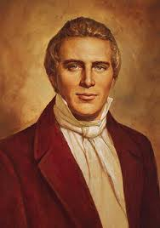
Will the Real God Please Stand Up?! Mormonism: All gods were once mortal men/women who later became gods/goddesses
“…you have got to learn how to be gods yourselves, and to be kings and priests to God, the same as all gods have done before you, …and to sit in glory, as do those who sit enthroned in everlasting power…. (Joseph Smith, Jr., History of the Church 6:305-306).

Slide 45
Will the Real God Please Stand Up?! Mormonism: All gods were once mortal men/women who later became gods/goddesses
“As man now is, our God once was;…(a poem from Lorenzo Snow as quoted in The Gospel Through The Ages, by Milton R. Hunter [1968], p. 113).

Slide 46
Is God the Father a Physical Man with a Body?

Slide 47
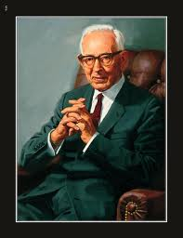
Will the Real God Please Stand Up?! Mormonism: God the Father IS a glorified man (as are all the gods)
“Christ was begotten of God. He was not born without the aid of Man, and that Man was God! (Joseph Fielding Smith, DoS, I:18)

Slide 48
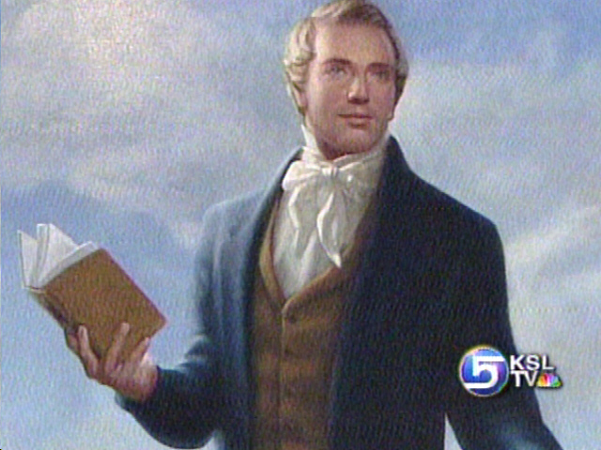
Will the Real God Please Stand Up?! Mormonism: God the Father IS a glorified man (as are all the gods)
“First, God himself, who sits enthroned in yonder heavens, is a man like unto one of yourselves, that is the great secret.” (Joseph Smith, Jr., Times & Seasons, V. 5, Aug. 15, 1844, p. 613)

Slide 49
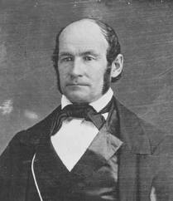
Will the Real God Please Stand Up?! Mormonism: God the Father IS a glorified man (as are all the gods)
“…for our God is a natural man…Where did he get his knowledge from? From his Father, just as we get knowledge from our earthly parents.” (President Heber C. Kimball in JoD, 8:211)

Slide 50
Will the Real God Please Stand Up?! Mormonism: God the Father IS a glorified man (as are all the gods)
“I know that God is a being with body, parts, and passions…the Father was born of woman.” (In a topic called “Man a Child of God” with an article entitled “The Creation of Adam” by President Joseph F. Smith, Dec. 7, 1913, in the newspaper “The Deseret News,” Saturday, Sept. 19, 1936, as reported by Joseph

Slide 51
Will the Real God Please Stand Up?! Mormonism: God the Father IS a glorified man (as are all the gods)
E. Noble, Stake Clerk, Dec. 27, 1913, Sec. III, p. 7

Slide 52
Before Being Born a Mortal Human (on another planet) was Earth's God the Father Once Born a Spirit Baby from His God the Father's Sexual Activity with one of His Goddesses Wives?

Slide 53
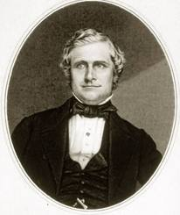
Will the Real God Please Stand Up?! Mormonism: All gods before being born mortal humans are born spirit babies from their respective god the fathers having physical sex with their multiple goddess wives
“…As the horse, the ox, the sheep, and every living creature, including man, propagates its own species and perpetuates its own kind, so does God perpetuate His. (John Taylor,

Slide 54
Will the Real God Please Stand Up?! Mormonism: All gods before being born mortal humans are born spirit babies from their respective god the fathers having physical sex with their multiple goddess wives
Mediation & Atonement, p. 165

Slide 55
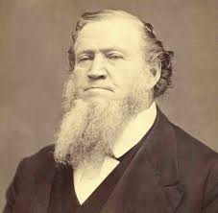
Will the Real God Please Stand Up?! Mormonism: All gods before being born mortal humans are born spirit babies from their respective god the fathers having physical sex with their multiple goddess wives
“…God has made his children like Himself…He (God the Father) created man, as we create our children: for there is no other process of creation in heaven, on earth, in the earth, or under the

Slide 56
Will the Real God Please Stand Up?! Mormonism: All gods before being born mortal humans are born spirit babies from their respective god the fathers having physical sex with their multiple goddess wives
earth, or in all eternities that is, what were, or that ever will be.” (President Brigham Young, JoD, 11:122, June 18, 1965)

Slide 57
Will the Real God Please Stand Up?! Mormonism: All gods before being born mortal humans are born spirit babies from their respective god the fathers having physical sex with their multiple goddess wives
“There is not a person here today but what is a son or daughter of that Being [God the Father]. In the spirit world their spirits were first begotten and brought forth, and they lived there with

Slide 58
Will the Real God Please Stand Up?! Mormonism: All gods before being born mortal humans are born spirit babies from their respective god the fathers having physical sex with their multiple goddess wives
their parents [God the Father & his goddess wives] for ages before they came here. This, perhaps, is hard for many to believe, but it is the greatest nonsense in the world not to believe it. If you do not believe it, cease to call Him Father; and when you pray, pray to some other character. (Brigham Young, JoD, 4:216, Feb. 8, 1857)

Slide 59
Will the Real God Please Stand Up?! Mormonism: All gods before being born mortal humans are born spirit babies from their respective god the fathers having physical sex with their multiple goddess wives
“God is the Father of our spirits, which are [later] clothed upon by fleshly bodies, [which were] be-gotten for us by our earthy fathers. (Pres. Brigham Young, JoD, 10:2, Sept. 28, 1862)

Slide 60
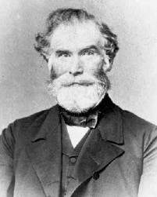
Will the Real God Please Stand Up?! Mormonism: All gods before being born mortal humans are born spirit babies from their respective god the fathers having physical sex with their multiple goddess wives
“The celestial beings who dwell in the Heaven from which we came, having been raised from the grave, in a former world, and having been filled with all the fulness of these eternal attributes, are called Gods,…
In the Heaven where our spirits were born, there are many Gods, each one of them has his

Slide 61
Will the Real God Please Stand Up?! Mormonism: All gods before being born mortal humans are born spirit babies from their respective god the fathers having physical sex with their multiple goddess wives
own wife or wives which were given to him previous to his redemption, while yet in his mortal state. Each God, through his wife or wives, raises up a numerous family of sons and daughters;…As soon as each God has begotten many millions of male and female spirits, he, in connection with his sons, organizes a new world, after a similar order to the one which we now inhabit, where he sends both the male and female spirits to inhabit tabernacles of flesh and bones…. (Apostle Orson Pratt, The Seer, 1853, p. 37-38)

Slide 62
Do Each of the Gods, Including Earth's God the Father, Engage in Polygamous, Sexual Relationships with Goddess Wives?

Slide 63
Will the Real God Please Stand Up?! Mormonism: The gods are in polygamous relationships and have physical sex to conceive spirit children.
“…The purpose of these scriptures is to this effect that God the Eternal Father, whom we designate by this exalted name-title ‘Elohim,’ is the literal Parent of our Lord and Savior Jesus Christ, and of the spirits of the human race.”

Slide 64
Will the Real God Please Stand Up?! Mormonism: The gods are in polygamous relationships and have physical sex to conceive spirit children.
(Joseph F. Smith, Man: His Origin and Destiny [Salt Lake City: Deseret Book Company, 1965], p. 118

Slide 65
Will the Real God Please Stand Up?! Mormonism: The gods are in polygamous relationships and have physical sex to conceive spirit children.
“We have now clearly shown that God the Father had a plurality of wives, one or more being in eternity, by whom he begat our spirits as well as the spirits of Jesus His First Born,…We have also proved that both God the

Slide 66
Will the Real God Please Stand Up?! Mormonism: The gods are in polygamous relationships and have physical sex to conceive spirit children.
Father and our Lord Jesus Christ inherit their wives in eternity as well as in time;…(Apostle Orson Pratt, The Seer, p. 172)

Slide 67
Will the Real God Please Stand Up?! Mormonism: The gods are in polygamous relationships and have physical sex to conceive spirit children.
“Plural marriage, explained the Prophet, is the patriarchal order of marriage lived by God and others [gods] who reign in the Celestial Kingdom; therefore, both the eternity of the marriage covenant and the plurality of wives are contained in the revelation (John J. Stewart, Joseph Smith, the Mormon Prophet [1966], p. 69)

Slide 68
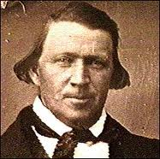
Will the Real God Please Stand Up?! Mormonism: The gods are in polygamous relationships and have physical sex to conceive spirit children.
“Monogamy, or restrictions by law to one wife, is no part of the economy of heaven among men…Why do we believe in and practice polygamy? Because the Lord introduced it to his servants in a revelation given to

Slide 69
Will the Real God Please Stand Up?! Mormonism: The gods are in polygamous relationships and have physical sex to conceive spirit children.
Joseph Smith, …‘And is that religion popular in heaven?’ It is the only popular religion there…” (President Brigham Young in “Deseret News,” Aug. 6, 1862)

Slide 70
Will the Real God Please Stand Up?! Mormonism: The gods are in polygamous relationships and have physical sex to conceive spirit children.
“…The Father of our spirits is at the head of His household, and His wives and children are required to yield the most perfect obedience to their great Head. (Apostle Orson Pratt, The Seer, p. 157)

Slide 71
Did Earth's God the Father Have Sexual Intercourse with Mary to Conceive Jesus on Earth? (Note: Some Mormons are not aware of this common teaching in their church)

Slide 72
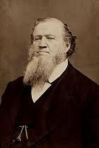
Will the Real God Please Stand Up?! Mormonism: The Father had sexual intercourse with Mary to conceive Jesus' physical body on Earth
“Now, remember from this time forth, and for ever, that Jesus Christ was not begotten by the Holy Ghost.” (President Brigham Young, JoD, 1:51)

Slide 73
Will the Real God Please Stand Up?! Mormonism: The Father had sexual intercourse with Mary to conceive Jesus' physical body on Earth
“They tell us the Book of Mormon states that Jesus was begotten of the Holy Ghost. I challenge the statement. The Book of Mormon teaches no such thing! Neither does the Bible. It is true that there is

Slide 74
Will the Real God Please Stand Up?! Mormonism: The Father had sexual intercourse with Mary to conceive Jesus' physical body on Earth
one passage that states so, but we must consider it in the light of other passages with which it is in conflict. (President Joseph Fielding Smith, DoS, I:19

Slide 75
Will the Real God Please Stand Up?! Mormonism: The Father had sexual intercourse with Mary to conceive Jesus' physical body on Earth
“God the Father is a perfected, glorified, holy Man, an immortal Personage. And Christ was born into the world as the literal Son of this Holy Being; he was born in the same personnel, real, and literal

Slide 76
Will the Real God Please Stand Up?! Mormonism: The Father had sexual intercourse with Mary to conceive Jesus' physical body on Earth
sense that any mortal son is born to a mortal Father: He was begotten, conceived and born in the normal and natural course of events, for he is the Son of God, and that designation means what is says…Christ is the Son of Man, meaning that his Father (the Eternal God!) is a Holy Man.” (Apostle Bruce R. McConkie, Mormon Doctrine, p., 742)

Slide 77
Will the Real God Please Stand Up?! Mormonism: The Father had sexual intercourse with Mary to conceive Jesus' physical body on Earth
“When the time came that His first-born, the Savior, should come into the world and take a tabernacle, the Father came Himself and favoured that spirit with a tabernacle instead of letting any other man do it. The

Slide 78
Will the Real God Please Stand Up?! Mormonism: The Father had sexual intercourse with Mary to conceive Jesus' physical body on Earth
Savior was begotten by the Father of His spirit, by the same Being who is the Father of our
spirits, and that is all the organic difference between Jesus Christ and you and me.” (President Brigham Young, JoD 4:218)

Slide 79
Will the Real God Please Stand Up?! Mormonism: The Father had sexual intercourse with Mary to conceive Jesus' physical body on Earth
“…Christ was begotten of God. He was not born without the aid of Man, and that Man was God!” (President Joseph Fielding Smith, DoS, I:18)

Slide 80
Does the Bible Teach that Elohim = the Father and Yahweh (Jehovah) = Son? (this will prove to be very important in the Bible’s refutation)

Slide 81
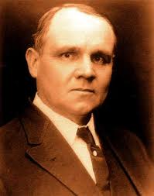
Will the Real God Please Stand Up?! Mormonism: Bible's Elohim (Hebrew for "God") = only the Father; Yahweh (Hebrew for "Jehovah" or "Lord") = only the Son/Jesus Christ
“…The purport of these scriptures is to the effect that God the Eternal Father, whom we designate by the exalted name-title ‘Elohim,” is the literal Parent of our Lord and Savior, Jesus Christ, and of the spirits of the human race. (Apostle James E. Talmage, The Articles of Faith, 1977, ed., p. 466)

Slide 82
Will the Real God Please Stand Up?! Mormonism: Bible's Elohim (Hebrew for "God") = only the Father; Yahweh (Hebrew for "Jehovah" or "Lord") = only the Son/Jesus Christ
“…Christ is Jehovah; they are one and the same Person….That Jesus Christ, whom we also know as Jehovah, was the executive of the Father, Elohim, in the work of creation.” (Apostle

Slide 83
Will the Real God Please Stand Up?! Mormonism: Bible's Elohim (Hebrew for "God") = only the Father; Yahweh (Hebrew for "Jehovah" or "Lord") = only the Son/Jesus Christ
James E. Talmage, The Articles of Faith, 1977, ed., p. 392, 467)

Slide 84
Are Jesus and Lucifer Spirit Brothers?

Slide 85
Will the Real God Please Stand Up?! Mormonism: Jesus Christ and Lucifer are Spirit Brothers (as are all humans on earth)
Previously shown that Mormonism’s Father is the literal Father of all the spirits who have taken on bodies of flesh and bone on this earth
In Mormonism the Father also fathered the spirits of all his spirit children. This includes Jesus, Satan, the Holy Ghost, and us.
Therefore, we are all brothers and sisters; that makes Jesus and Lucifer brothers.

Slide 86
Will the Real God Please Stand Up?! Summary: Mormonism: The Law of Eternal Progression
Spirit Baby
Spirit Baby
Spirit Baby
Male
God
Goddess
Wives
Goddess
Wives
Goddess
Wives
Goddess
Wives
Spirit
Baby
Spirit
Baby
Spirit
Baby
Infinite No. of Polygamous Gods and their Goddess Wives
Each God producing an infinite no. of spirit babies (over time)

Slide 87

Will the Real God Please Stand Up?! Summary: Mormonism: The Law of Eternal Progression
Mortal Father
Mortal Mother
This done on many planets
Physical Babies
Physical Babies
Physical Babies
Who are then physically born on other planets of mortal, physical parents
Grow up, hopefully obey Mormon gospel, physically die

Slide 88
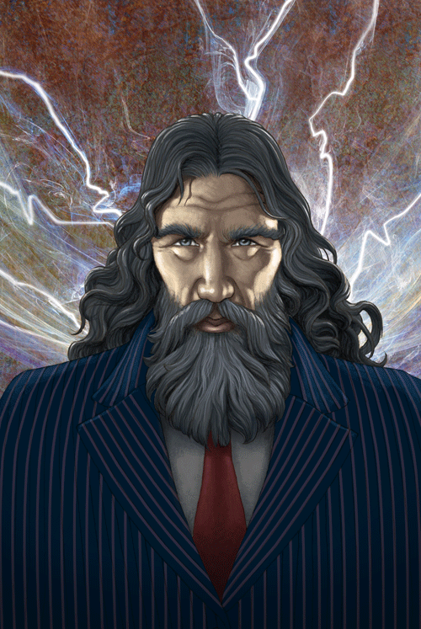
Will the Real God Please Stand Up?! Summary: Mormonism: The Law of Eternal Progression
Male
God
Goddess
Wives
Goddess
Wives
Goddess
Wives
Goddess
Wives
All are resurrected; a few after a long time evolve into becoming gods and goddesses
And then the whole thing starts all over again

Slide 89
What About the Gods and Creation?

Slide 90
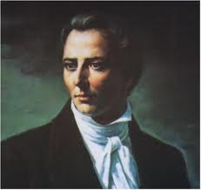
Will the Real God Please Stand Up?! Mormonism: The gods do not create; they reorganize pre-existing matter which has always existed . A Council of Gods organized the earth.
“In the beginning [of earth], the head of the gods called a council of the gods; and they came together and concocted a plan to create [organize] the world and people it.” (Joseph Smith, Jr. JoD VI:5)

Slide 91
Will the Real God Please Stand Up?! Mormonism: The gods do not create; they reorganize pre-existing matter which has always existed . A Council of Gods organized the earth.
“The head God organized the heavens and the earth. I defy all the world to refute me. In the beginning the heads of the Gods organized the heavens and the earth….The heads of the

Slide 92
Will the Real God Please Stand Up?! Mormonism: The gods do not create; they reorganize pre-existing matter which has always existed . A Council of Gods organized the earth.
Gods appointed one God for us; and when you take (that) view of the subject, it sets one free to see all the beauty, holiness and perfection of the Gods. All I want is to get the simple, naked truth, and the whole truth.” (Joseph Smith, Jr., History of the Church, 6:475-76)

Slide 93
Will the Real God Please Stand Up?! Mormonism: The gods do not create; they reorganize pre-existing matter which has always existed . A Council of Gods organized the earth.
“…That he [the Father] was aided in the creation of this earth by ‘many of the noble and great’ spirit children of the Father is evident from Abraham’s writings…. Michael or Adam was one of these. Enoch, Noah,

Slide 94
Will the Real God Please Stand Up?! Mormonism: The gods do not create; they reorganize pre-existing matter which has always existed . A Council of Gods organized the earth.
Abraham, Moses, Peter, James, and John, Joseph Smith,…played a part…. (Doctrines of Salvation, I:74-75.)” (Apostle Bruce R. McConkie, Mormon Doctrine, p. 169)

Slide 95
Will the Real God Please Stand Up?!
Special Note:
Since Mormonism has an infinite no. of gods and goddesses in the universe, and each of these gods organizes new planets and stars in their respective realms, each god in Mormonism can only have a very small piece of the whole cosmic pie, if you will, in which to organize things.

Slide 96
Does God the Father Live on a Planet in the Center of the Milky Way Galaxy Near a Star Called "Kolob?" (Note: While the location is not official Mormon doctrine, the inescapable logic of Mormon leaders’ statements show it is at the center of the Milky Way Galaxy)

Slide 97
Will the Real God Please Stand Up?! Mormonism: God the Father lives in the center of the Milky Way galaxy on a planet near a star called "Kolob"
“And I saw the stars, that they were very great, and that one of them was nearest unto the throne of God; and there were many great ones which were near unto it; And the Lord said unto me: these are the governing ones; and the name of the great one is Kolob, because it is near unto me, for I am the Lord thy God: I have set this one to govern all these which belong to the same order as that upon

Slide 98
Will the Real God Please Stand Up?! Mormonism: God the Father lives in the center of the Milky Way galaxy on a planet near a star called "Kolob"
which thou standest, which Kolob is set nigh unto the throne of God, to govern all those planets which belong to the same order as that upon which thou standest.” (Abraham 3:2-3, 9 in Pearl of Great Price – one of Mormonism’s scriptures)

Slide 99
Will the Real God Please Stand Up?! Mormonism: God the Father lives in the center of the Milky Way galaxy on a planet near a star called "Kolob"
“The Prophet Joseph in his translation says our sun with its planets revolves around Kolob, one of the mightiest stars. (Prof. J. E. Hickman, “The Greatest Seer of the Ages,” Improvement Era [May 1929], Vol. XXXII, No. 7,p. 537)

Slide 100
Will the Real God Please Stand Up?! Mormonism: God the Father lives in the center of the Milky Way galaxy on a planet near a star called "Kolob"
“Thus, the Lord told Abraham, forty centuries ago, that great governing stars, with Kolob as the main one, controlled the rest of the stars of heavens…which this control was exercised over a space of 100,000 light years [our galaxy’s diameter] and 10,000 light-years thick at its center,--a great whirling disc….Each galaxy in this vast universe is a ‘heaven’ in its place to its starry

Slide 101
Will the Real God Please Stand Up?! Mormonism: God the Father lives in the center of the Milky Way galaxy on a planet near a star called "Kolob"
inhabitants. Our galaxy – Milky Way - is our Heaven….It seems uniformly and presently conceeded [sic] there is a hub, and that the entire galaxy revolves around it…stars in the hub are governing stars that control the galaxy;….But this fact seems reasonably clear that this hub or center of a galaxy exists and performs, in broad principle, the functions of Kolob…(J. Reuben

Slide 102
Will the Real God Please Stand Up?! Mormonism: God the Father lives in the center of the Milky Way galaxy on a planet near a star called "Kolob"
Clark, Jr., Kolob – “The Governor” [Sept. 5, 1958], p. 2, 5, 12, 15-17)
Note: We now know there is a black hole at the center of our galaxy (probably true for all galaxies). A black hole! Ummm…..

Slide 103
Will the Real God Please Stand Up?!
Well, if as if that wasn’t enough,
Joseph Smith, Jr., Founder of Mormonism, reached the heights of pride when he said…

Slide 104
Will the Real God Please Stand Up?!
“..I am learned, and know more than all the world put together.” (Joseph Smith, Jr., History of the Church, 6:308)

Slide 105
Will the Real God Please Stand Up?!
“…no man or woman…will ever enter into the Celestial Kingdom of God without the consent of Joseph Smith….every man and woman must have the certificate of Joseph Smith, junior, as a passport to their entrance into the mansion where God and Christ are….I cannot go there without his consent.” (President Brigham Young, JoD, 7:289)

Slide 106
Will the Real God Please Stand Up?!
“God made Aaron to be the mouth piece for the children of Israel, and He will make me be god to you in His stead, and the Elders to be mouth for me; and if you don't like it, you must lump it." (Joseph Smith, Jr., History of the Church, 6:319-320)

Slide 107
Will the Real God Please Stand Up?!
“…I have more to boast of than ever any man had. I am the only man that has ever been able to keep a whole church together since the days of Adam. A large majority of the whole have stood by me [not true!]. Neither Paul, John, Peter nor Jesus ever did it. I boast that no man ever did such as work as I. The followers of Jesus ran away from Him; but the Latter-day Saints never ran away from me yet.” (Joseph Smith, Jr., History of the Church, 6:408-9

Slide 108
Will the Real God Please Stand Up?!
Joseph was murdered June 27, 1844. almost one month to the day after this boast was made.
Proverbs 16:18 tells us "Pride goeth before destruction, ... "

