Slide 1
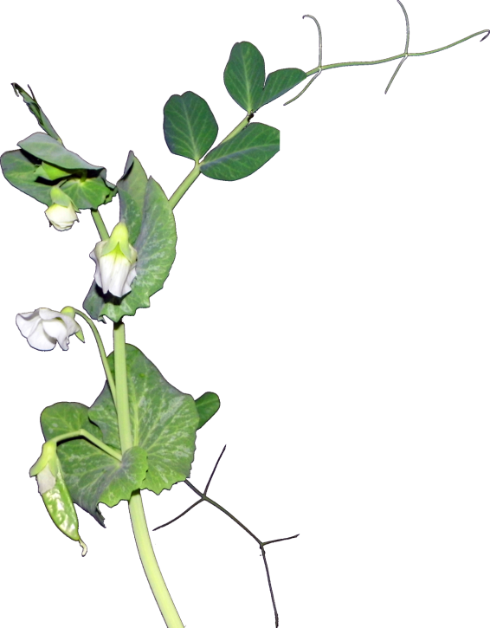
Genetically Modified Food
Safe to eat? Playing God?
By Rich Deem
Notes:
Today, we are going to cover the topic of genetic modification of organisms (GMOs) that are used to produce the food we eat. Is it safe? Why are companies doing this? Are we playing God? Here is a short video clip from an opponent of genetic modification of organisms. 

Slide 2
GMOs are Evil?
Notes:


Slide 3

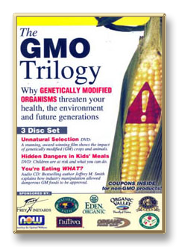

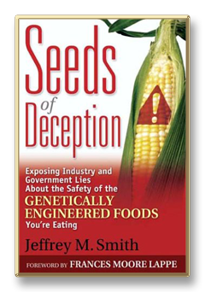
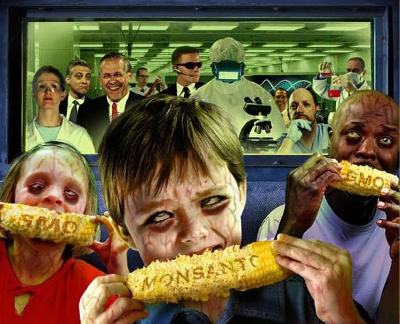
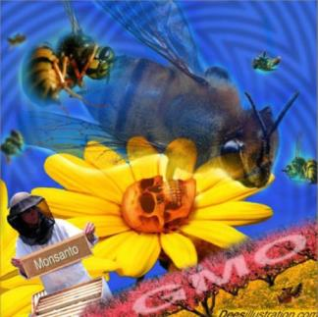



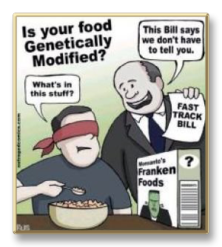
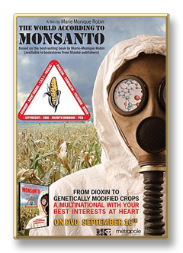


The “Evil” of GM Foods
Notes:
If you search the Internet for the term “genetically modified,” you will find these kinds of pictures and articles in abundance. My favorite is the one showing how your children will become zombies if they eat Monsanto’s GM corn. 

Slide 4

Frankenfish–the GMO Movie
Notes:
There is even a movie that uses  genetic modification of a catfish as the main part of its plot. However, instead of us eating the fish, the fish eats us!

Slide 5
GMO Quiz
NOT
GMO
GENETICALLY
MODIFIED
Notes:
First we are going to have a quiz. As you can see by all these bags, I have gone shopping. I am going to hold up an item and your job is guess whether it contains ingredients from genetically modified organisms. If you think it is genetically modified, just shout out “yes.” If not, then “no.” As a disclaimer, since GMOs do not have to be labeled, we can’t know for certain. Are you ready?

Slide 6
Cultivation of GM Crops (Corn)
Notes:
The reason why I can be almost certain that food products contain or do not contain GMO is because of trends in US and global agriculture.  First, we are going to look at corn production. Here is a plot of percent of  global acreage devoted to GM corn. And, in the  US,  Argentina, and  South Africa. And, in the second graph are acreage, in million hectacres, for planted GM corn. As you can see, most of the global corn comes from the US, and at this point about 90% of it is genetically modified.

Slide 7
Cultivation of GM Crops (Soybean)
Notes:
 Here is the graph for GM soybeans. The big producers are again, the US, and also Argentina and Brazil.  And again is the graph for millions of hectacres planted. The US produces nearly half of the world’s soybeans, and greater than 90% of it is genetically modified.

Slide 8
Cultivation of GM Crops (Cotton)
Notes:
 Here is the graph for GM cotton. The big producers are again, the US, and also China and India.  And again is the graph for millions of hectacres planted. The US produces about a third of the world’s cotton, and about 90% of it is genetically modified.

Slide 9
Cultivation of GM Crops (Canola)
Notes:
 Here is the graph for GM canola. The big producer is Canada. Canada produces over 90% of the world’s canola and over 90% of it is genetically modified. The other major GM crop is sugar beets, with about 90% total production being genetically modified. Since half the sugar comes from sugar beets, about half the U.S. sugar supply is genetically modified. Cane sugar is not genetically modified. So to sum up, in the United States, virtually any product containing corn, soybean, cottonseed or canola oil is almost certainly genetically modified. Anything containing corn, including high fructose corn syrup, or soy is almost certainly genetically modified. It is estimated that about 70% of all US food contains genetically modified ingredients. Can anybody name the top three opponents of Proposition 37, the GMO labeling proposition? Monsanto, DuPont, and Pepsi. Yes, your Pepsi contains high fructose corn syrup from genetically modified corn. 

Slide 10
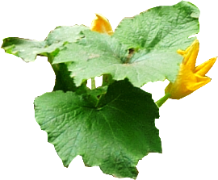












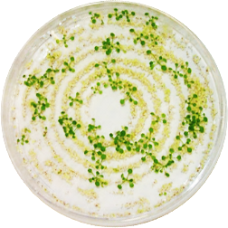

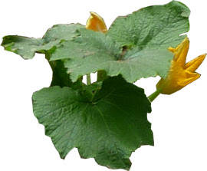
Making a GMO Crop
cry11B
STAB-SD
cyt1A-p
Cm
E.c. Ori
Trans
Gene
Amp
B.t. Ori
Plant
Cells
Tissue
Culture
Antibiotic
Selection
Plant
With GM Trait
Backcross
Notes:
Now, let’s look at how genetically modified plants are made.  First, scientists start with a plant, which is disrupted to produce  individual plant cells, which can be grown in  tissue culture.  The scientist then creates a plasmid, a circular piece of DNA that contains the gene of interest, along with a gene that confers antibiotic resistance.  The plasmid is introduced into the plant cells, and  an antibiotic is added to the tissue culture medium so that only plant cells that have incorporated the trans gene (which confers antibiotic resistance) can grow. The tissue culture medium is changed to encourage the plant cells to  differentiate into whole plants. Unlike animal cells, all plant cells are totipotent, meaning that each cell can form an entire plant. After successful differentiation,  the new transgenic plant is backcrossed with the original to render it as close as possible to the  original breed. To create a transgenic animal, scientists must incorporate the trans gene into a fertilized egg cell. 

Slide 11
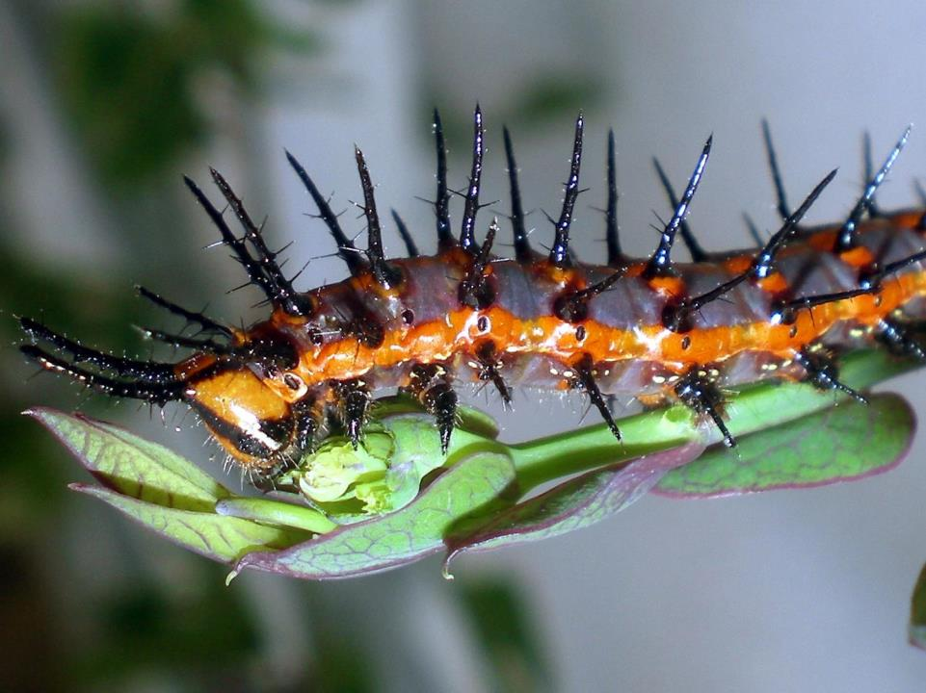
GMO Reason 1: Pests
Notes:
Why would scientist want to incorporate foreign genes into crop plants? One reason are these hungry guys. Pests that eat crops can do a tremendous amount of damage and reduce crop yields significantly. For years, farmers sprayed insecticides on crops to prevent pests from eating them.

Slide 12
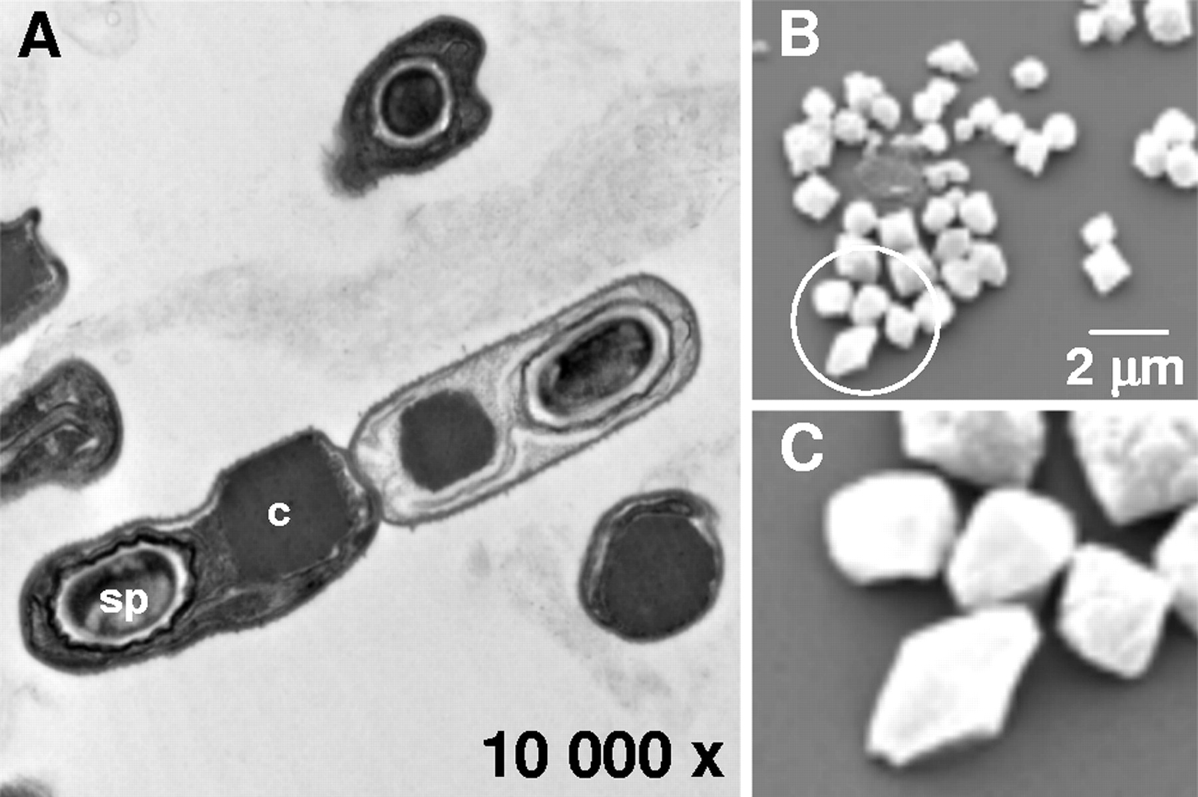
Bacillus thuringiensis Toxin
Toxin
Spore
Notes:
 One of the most popular insecticides comes from the soil bacterium, Bacillus thuringiensis (Bt for short) which produces a toxin when it sporulates. When nutritional conditions become poor, the bacterium encloses its DNA in a hard shell,  called a spore. At the same time, it produces a toxin. Here is a  close-up electron micrograph of the toxin crystals. Scientists discovered early in the 20th century that this toxin kills caterpillars, and farmers have been using it as an insecticide for nearly 100 years. 

Slide 13
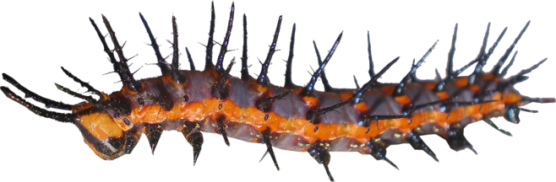



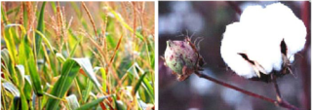

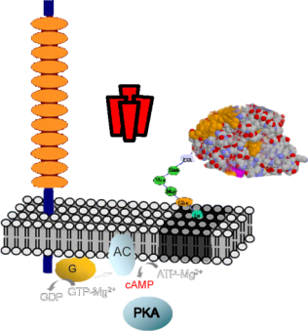



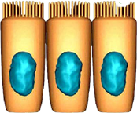
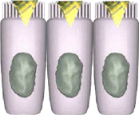
Bacillus thuringiensis Toxin
Bacillus thuringiensis (Bt)
Bt
toxin
Solubilization
Activation
Ingestion
Septicemia
Dead caterpillar
Bt corn
Bt cotton
Cadherin
Binding to
receptor
Toxin
oligomer
Membrane
insertion
Toxin
monomer
GPI-anchored
protein
Caterpillar
midgut cells
membrane
Pores lead to
osmotic cell lysis
Cell death
Activation of cell
death pathway
Notes:
Here is how the Bt toxin works. The toxin, either sprayed on plants or contained within the  leaves of GM crops that produce it,  is ingested by the caterpillar.  The toxin goes down the caterpillar’s digestive tract where it becomes  solubilized and then  activated. The  toxin binds to the midgut cells of the caterpillar, forming an  oligomer. It turns out that the toxin binds to a specific protein found only in the midgut of Lepidoptera (butterflies and moths).  Once the oligomer binds to the membrane, it  activates the gut cells’ death pathway,  which creates pores in the cells, leading to osmotic lysis. When the integrity of the  gut is disrupted, the caterpillar dies of septicemia. 

Slide 14
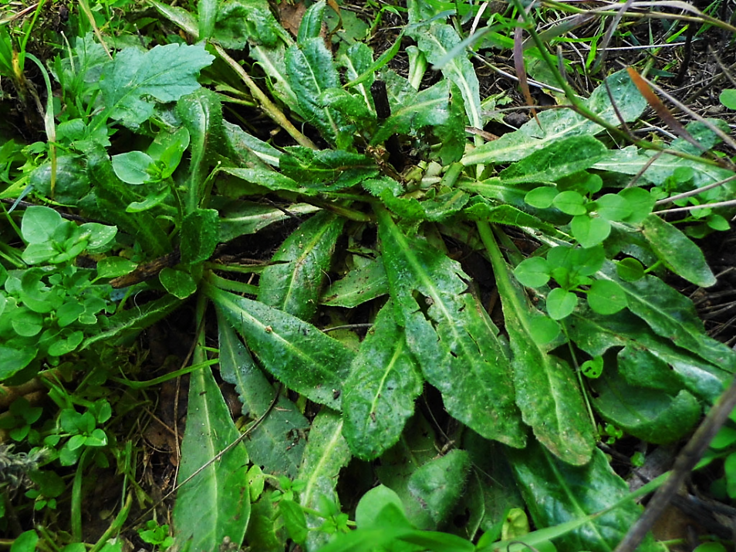
GMO Reason 2: Weeds
Notes:
The second main reason why scientists have created genetically modified crops is to make them resistant to herbicides, which kill weeds. The problem with most herbicides is that their action is not restricted to killing weeds, but will also kill crops and are somewhat toxic to animals. So farmers had to apply herbicides before planting crops and let those herbicides decay before planting seeds. Alternatively, they would plow all of their fields, turning over the weeds and burying them. Both processes cost farmers money, either in additional fuel costs or time lost between plantings. With herbicide resistant GM crops, farmers can apply herbicides while crops are growing, preventing weeds from interfering with the growth or harvest of the crop. 

Slide 15

Mechanism of Herbicide Roundup
Roundup (Glyphosate)
O
H
O
N
P
Shikimate Pathway
HO
OH
OH
CO₂⁻
CO₂⁻
CH₂
²⁻O₃PO
OH
CH₂
²⁻O₃PO
O
CO₂⁻
OH
²⁻O₃PO
CO₂⁻
OH
Shikimate-3-phosphate
P_{i}
5-Enolpyruvylshikimate-
3-phosphate
CO₂⁻
⁻₂OC
CO₂⁻
⁻₂OC
CO₂⁻
CH₂
O
NH₂
O
CO₂⁻
Transamination
OH
OH
OH
Chorismate
Prephenate
Arogenate
O
O
O
OH
OH
OH
NH₂
NH₂
NH₂
HN
HO
Phenylalanine
Tryptophan
Tyrosine
Notes:
Herbicides have varying degrees of toxicity to animals. One of the least toxic to animals is Monsanto’s herbicide Roundup. Roundup acts by inhibiting the plant’s shikimate pathway. The pathway, partially  shown here, produces the aromatic amino acids phenylalanine, tryptophan, and tyrosine.  Roundup, or glyphosate, acts by inhibiting an upstream reaction in the pathway, blocking the production of all three aromatic amino acids. No animals possess the shikimate pathway (but instead get all their aromatic amino acids from their diet, the so-called essential amino acids), so Roundup is much less toxic to animals than other herbicides. 

Slide 16
Transgenic Plants
Notes:
Now we are going to look at some other transgenic or genetically modified plants. 

Slide 17
Genetically Modified Plants
Crop | GM Trait
 | Herbicide resist. | Pest resist. | Virus resist. | Antibiotic resist. | Modified Oil | Delayed ripening | Self-fertilizing | Lysine | Bioethanol | Modified starch | Modified color
alfalfa | ✓
Argentine canola | ✓ |  |  |  | ✓
bean |  |  | ✓
cantaloupe |  |  |  | ✓ |  | ✓
carnation |  |  |  |  |  |  |  |  |  |  | ✓
chicory | ✓ |  |  |  |  |  | ✓
cotton | ✓ | ✓ |  | ✓
creeping bentgrass | ✓
flax | ✓ |  |  | ✓
maize | ✓ | ✓ |  |  |  |  | ✓ | ✓ | ✓
papaya |  |  | ✓ | ✓
petunia |  |  |  |  |  |  |  |  |  |  | ✓
plum |  |  | ✓ | ✓
Polish canola | ✓
poplar |  | ✓ |  | ✓
potato |  | ✓ | ✓ | ✓ |  |  |  |  |  | ✓
rice | ✓ |  |  | ✓
rose |  |  |  |  |  |  |  |  |  |  | ✓
soybean | ✓ | ✓ |  | ✓ | ✓
squash |  |  | ✓ | ✓
sugar beet | ✓ |  |  | ✓
sweet pepper |  |  | ✓
tobacco | ✓ |  |  | ✓
tomato |  |  | ✓ | ✓ |  | ✓
wheat | ✓
Notes:
This is a table of most of the genetically modified plants, to date. Other than the five main crops mentioned previously, most are not yet grown extensively. There are some unusual plants in this group. One is creeping bentgrass, a favorite of golf courses. Now, the grass can be grown and sprayed with Roundup to get rid of all the weeds. Several crops have been developed with resistance to various viral diseases. Scientists have also genetically engineered oils from plants to be healthier and better tasting than oils from non-GM crops.

Slide 18


Genetically Modified Flowers
Blue Rose
“Applause”
“Moonshade”
Carnation
Notes:
Scientists have altered flower pigmentation pathways to create the  Blue Rose and the  Moonshade carnation. 

Slide 19

“Plantimal” Flower
Eduardo Kac
Petunia
Notes:
Artist Eduardo Kac wanted to create a flower that was a combination of a plant and animal. So, he employed Dr. Neil Olszewski University of Minnesota professor of plant biology. Dr. Olszewski attempted to put a transgene from Kac’s blood into a petunia to give it red veins.  However, the idea didn’t work, so Kac selected a Petunia that already had red veins and had Dr. Olszewski add one of his genes that did nothing to change the appearance of the flower. However, it seems that Kac’s sole purpose was to create shock at his “plantimal” creation. 

Slide 20
Transgenic Animals
Notes:
Now we are going to look at some genetically engineered animals. 

Slide 21
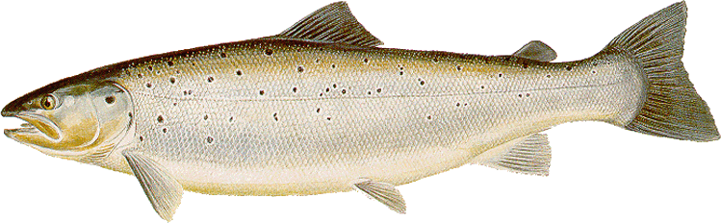

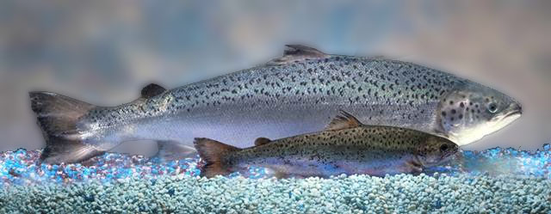
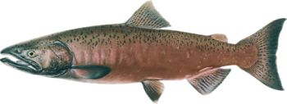

AquAdvantage Salmon “Frankenfish”
Atlantic Salmon
Pacific Chinook Salmon
Ocean Pout
Notes:
A 1989 genetically engineered salmon was the inspiration for the Frankenfish movie, mentioned previously.  AquaBounty took an Atlantic salmon (which are already extensively grown in farms) and added a  growth hormone regulating gene from a Pacific Chinook salmon and a  promoter gene from an ocean pout. So, instead of growing only during warmer months, the AquAdvantage salmon grows all year long, achieving maturity in about half the time as wild Atlantic salmon.  This graph shows the growth rate of the  AquAdvantage salmon compared with  wild salmon. No, the fish does not turn into a giant Frankenfish, but just reaches full size earlier.  Here is a picture of two comparably-aged salmon. Although these genetically modified salmon could probably out-compete wild salmon because of their high growth rate, they are provided by AquaBounty as sterile females, to prevent breeding, should they be inadvertently released into the wild. Despite these precautions, activist groups, along with the Alaska salmon fishing lobby, convinced the FDA not to approve AquaBounty's application in 2010. From a scientific perspective, the genes inserted into the genetically modified salmon are naturally-occurring, and have been eaten in their respective host species without incident. The FDA finally released the environmental report for AquAdvantage salmon immediately before Christmas, 2012, after the November election, although the report itself was dated May, 2012. So, it is likely the AquAdvantage salmon will be the first transgenic animal approved for human consumption in 2013. 

Slide 22
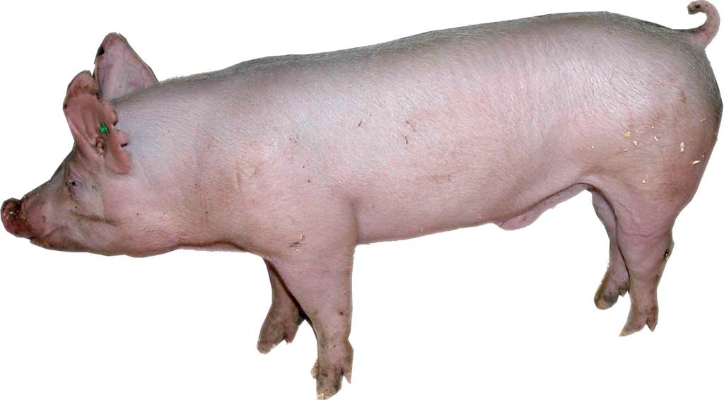

Enviropig
Notes:
 Enviropig is a genetically modified pig that produces the enzyme phytase, which allows the pig to digest phytic acid, which contains a form of phosphorus that is normally indigestible to pigs. This results in reduced phosphorus being excreted into the environment, reducing pollution of waterways. Another novel idea in genetic engineering was the cloning of pigs that were rich in omega-3 fatty acids. With this GM pig, you could get healthy omega-3 fatty acids by eating bacon, instead of smelly fish.  Genetic engineering has been used to alter cows so that they produce milk that is free of β-lactoglobulin (which many people are allergic to) and high in casein protein. Other cows have been genetically modified to produce milk that is nearly identical with human milk, which would allow mothers who cannot nurse the opportunity to give their infants milk that is more "natural" than standard baby formula. Due to intensive lobbying efforts, none of these GM animals have been approved for human consumption.

Slide 23
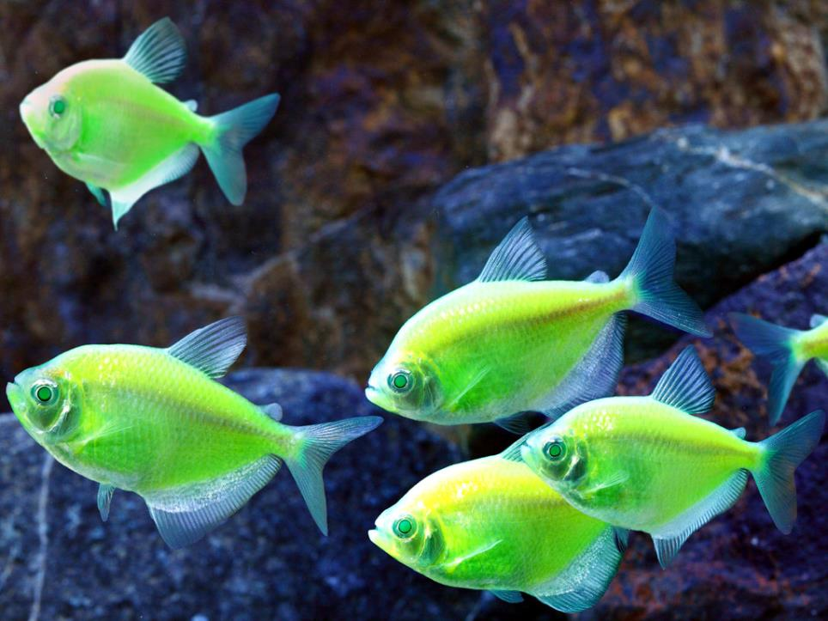
Glofish Electric Green Tetra
Photo credit: http://www.glofish.com/
Notes:
Fluorescent proteins have been used for years in molecular biology research to report expression of genes to which they are attached. When the gene of interest is transcribed, the fluorescent protein is also expressed, which shows up as a fluorescent glow that can be measured. Most of these fluorescent proteins have been isolated from species of jellyfish that naturally glow.  Entrepreneurs have incorporated different fluorescent proteins into tropical fish. Here is shown the Glofish Electric Green Tetra. 

Slide 24
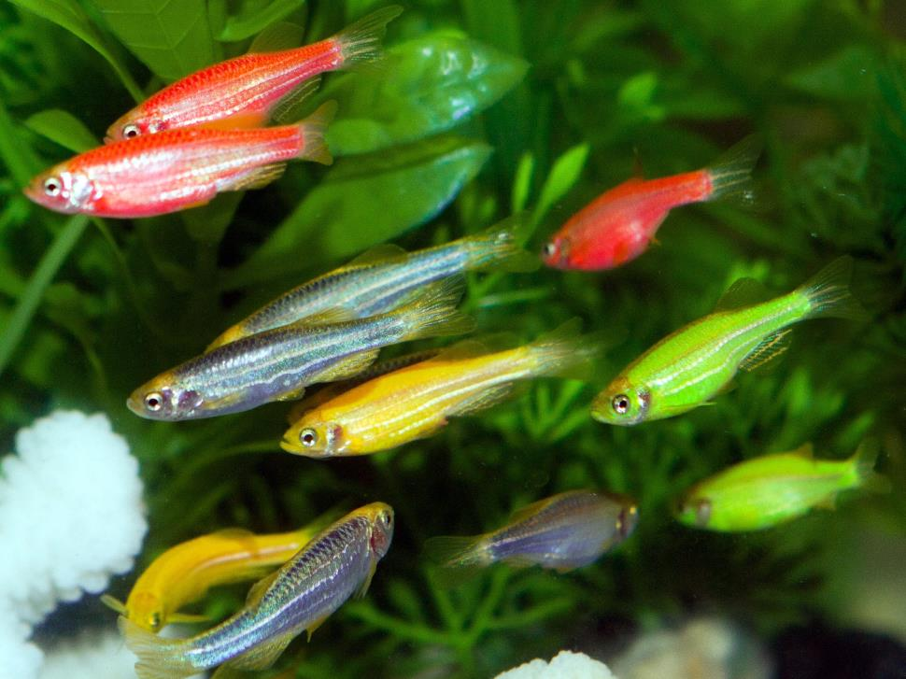
Glofish Zebrafish
Photo credit: http://www.glofish.com/
Notes:
Here are transgenic zebrafish, which have been genetically engineered with different colors of fluorescent proteins. These "Glofish" have been marketed as unique tropical fish, notable for their stunning fluorescent colors. 

Slide 25
GMO Food Studies
Notes:
Now, we are going to examine the studies that have looked at GMO food safety. Here is a short video clip from a GMO opponent. 

Slide 26
Claim: GMO Food is Bad for You
Notes:


Slide 27
Longevity in the United States
Introduction of GMO Crops
Notes:
If genetically modified food were really bad for you, one would expect that life expectancy in the United States would have decreased during the 17 years since their introduction.  However, this graph shows that the life expectancy of both males and females from different races has continued to increase since the  introduction of GMO crops in 1996. In addition, cancer deaths have declined about 20% since that time. 

Slide 28
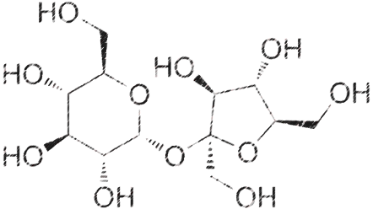
GMO vs. Non-GMO
GMO
Sugar
Non-GMO
Sugar
Notes:
For a number of GM crops, the genes/gene products never enter the food supply, since those parts of the plants are removed during processing. For example,  sugar from GM sugar beets is chemically identical to  non-GM sugar. Likewise, oils purified from GM canola, soybean, cottonseed, and corn are identical to non-GM oils. Much of the corn crop is dedicated to generating ethanol, which, of course, is identical to non-GM ethanol. Genetically modified cotton is worn, rather than ingested, and there have been no reports of adverse effects of wearing GM clothing. For GM crops in which whole plant cells are ingested, the genes and gene products are usually destroyed through digestion in the stomach and small intestine. So, it is unlikely, even in theory, that eating GM crops can harm human beings. Here is another video clip. 

Slide 29
GMO Testing?
Notes:


Slide 30
FDA Testing Requirements
FDA handles approval of new GMO
6% of people have some kind of food allergy
Any artificial gene product is required to be analyzed structurally to determine if it matches any known allergen
Matching sequences must undergo allergy testing
No published evidence of allergic reactions to any GM protein
Notes:
In the United States all applications for the approval of  GMO released for public consumption are handled by the FDA. Development and testing of a new GM crop typically requires 8 to 12 years, including more than 4 years of safety and environmental testing, before regulatory approval and commercial release. The so-called “Frankenfish” has been in the loop for over 20 years.  No particular food is safe to eat for all human beings, since about 6% of the human population has allergies to one or more food groups. FDA testing for food allergies to GM foods is identical to similar testing for non-GM foods.  Any gene products found in GM food that is not found in non-GM food must have its chemical structure analyzed to determine if it matches any known allergen (containing a sequence greater than 35% identical to any 80-amino-acid segment of known allergens, where an average protein contains hundreds of amino acids). In nearly all instances, commonly inserted genes would never be expected to be similar to food allergens.  However, if a match were found, the protein would have to be tested with sera from allergy sufferers to establish allergenicity. A GM product that exhibits "substantial equivalence" to the non-GM variety is declared to be safe.  There is no published evidence of allergic reactions to any GM protein or any adverse human health reactions associated with consumption of foods from GM crops since the introduction of GM products into the food supply in 1996. 

Slide 31
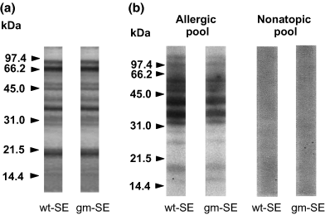
Allergenicity of GM vs. Non-GM Soybean Protein Extract
Non-
GMO
Non-
GMO
Non-
GMO
GMO
GMO
GMO
Clinical & Experimental Allergy
Volume 36, Issue 2, pages 238-248, 20 JAN 2006 DOI: 10.1111/j.1365-2222.2005.02415.x
http://onlinelibrary.wiley.com/doi/10.1111/j.1365-2222.2005.02415.x/full#f1
Notes:
This is a polyacrylamide gel electrophoresis comparison of GMO vs. non-GMO soy proteins. The left two lanes show the protein profile of whole soybean extracts from  non-GMO (left) and  GMO (right) soybeans. As you can see, the bands from each lane look identical, showing that there are equal amounts of each protein. In the second set of gels, soy proteins were blotted, then sera from allergic individuals were added to see what proteins they bound to.  Again, non-GMO (left)  and GMO (right). Sera from allergic individuals bound to both lanes equally, showing that the allergenicity of GM soy is identical to non-GM soy.  The right two set of lanes are controls showing the lack of binding to soy from non-allergic sera. 

Slide 32
Scientific Studies on the Safety of Genetically Modified Crops
Study | GM crop | GM trait | Species | Conclusion
MacKenzie et al. (2007) | Corn | Bt toxin | rats | No differences
Malley et al. (2007) | Corn | Bt toxin | rats | No differences
Healy et al. (2008) | Corn | Bt/Roundup | rats | No differences
(He et al. (2008) | Corn | Bt toxin | rats | Minor differences due to flour diet differences
(He et al. (2009) | Corn | lysine-rich | rats | No differences
Tutel'ian et al. (2008, 2009); Tyshko et al. (2008, 2009) | Corn | Bt/Roundup | rats | No differences
Appenzeller et al. (2009) | Corn | Bt, glufosinate-ammonium herbicide | rats | No differences
Appenzeller et al. (2009) | Corn | Roundup Ready and herbicide resistance | rats | No differences
Juberg et al. (2009) | Corn | Bt toxin | mice | No differences
Buzoianu et al. (2012) | Corn | Bt | pigs | No differences
(Schrøder et al., 2007) | Rice | Bt | rats | No differences
Domon et al. (2009) | Rice | Japanese cedar pollen allergens | macaque | No differences
(McNaughton et al. (2007) | Soybean | Bt toxin | chickens | No differences
Appenzeller et al. (2008) | Soybean | Roundup Ready and other herbicide | rats | No differences
McNaughton et al. (2008) | Soybean | Roundup Ready and other herbicide | chickens | No differences
Delaney et al. (2008) | Soybean | herbicide, monounsaturated oleic acid | rats | No differences
Battistelli et al. (2010) | Soybean | Roundup Ready | mice | No differences in structure or flora, some mucin differences
Notes:
The safety of GM foods has been tested in numerous animal studies (including mice, rats, pigs, chickens, and monkeys). Nearly all the studies have shown no difference between the health of animals fed GM vs. non-GM diets. Some negative studies have come from one laboratory headed by Dr. Gilles-Eric Séralini at the University of Caen, France. However, the conclusions of those studies have been refuted by numerous scientists who have noted flaws in study designs and statistical evaluations. In addition, Séralini is funded by the Committee for Research and Independent Information on Genetic Engineering, in Paris, France, which opposes genetic engineering of crops. 

Slide 33
GMO Environmental concerns
Development of resistance in Bt crop target organisms
Tolerance in weeds to complementary herbicides used in GM crops.
Does Bt in pests adversely affect the pest predators?
Can GM traits be transferred to wild, non-GM relative plants?
Notes:
There are a few realistically possible environmental concerns about GM crops.  First, is development of resistance in Bt crop target organisms. Resistance to Bt toxin by pests was anticipated prior to commercialization of those crops. For this reason, Many crops include multiple variations of the Bt toxin in their products. In addition, all farms growing GM Bt crops must plant a small percentage of corresponding non-GM crop in the vicinity. In theory, these non-GM crops would attract pests, which would reproduce abundantly, overwhelming the gene pool of any potential Bt-resistant mutant pests. So far, the strategy has worked.  A second concern is tolerance in weeds to herbicides used in GM crops. Although herbicide resistance has been described, it has not presented a major problem so far. Some of the newer varieties of GM plants are tolerant to multiple herbicides, reducing the likelihood of weeds developing multiple resistances.  The third concern was whether the eating of pests feeding on GM crops might pose a threat to the predators that eat such pests. Studies have shown few, if any impacts on predator species.  A fourth question is whether GM traits could be transferred to wild, non-GM relative plants. For example, there are wild relatives of Brassica (which includes GM canola) and Beta species (which includes GM sugar beets). Although pollen from some species can fertilize other species in the lab, this has never been demonstrated to have occurred in nature. 

Slide 34
Economic Benefits of GMO
Bt cotton yields up to 50% higher
Pesticide costs 16%-70% less
BT corn yields 5%-25% higher
Gross margins 10%-17% higher
Marginal economic benefit for GM soybeans
Benefits for GM farming are higher in developing countries compared with developed countries
Estimated $7 billion/year benefit to farmers
Notes:
The main benefit of most GM crops at this point is economics. The economics of GM crops was analyzed in a study of 196 publications containing 721 entries for the statistical analysis in 2011.  The meta analysis found that crop yields for GM Bt cotton were up to 50% higher than conventional cotton (in India). However, yields in developed countries were only 1-28% higher, since pest management was aggressive before the introduction of GM cotton.  However, reductions in pesticide costs range from 16% in the USA to about 70% in China.  Yield levels of Bt corn are 5%-25% higher compared to conventional corn, and along with lower pesticide costs,  which results in higher gross margins of 10%-17% higher for farmers.  For GM soybeans, marginally increased yields and reduced pesticide costs did not make up for the higher cost of GM seed.  In general, benefits of GM farming are higher in developing countries compared with industrialized countries.  Overall, it was estimated that GM crops benefit farmers by $7 billion per year, worldwide. 

Slide 35
GMOs and Christianity
Notes:
We are now going to look at some ways GMOs might impact Christianity.

Slide 36
GMOs and the Bible
No dietary restrictions in Christianity
Therefore no one is to act as your judge in regard to food or drink or in respect to a festival or a new moon or a Sabbath day—things which are a mere shadow of what is to come; but the substance belongs to Christ. (Colossians 2:16-17)
Orthodox Judaism does not oppose GMO
Notes:
There are no dietary restrictions in Christianity other then an admonition against gluttony and eating foods sacrificed to idols.  An example would be Colossians 2:16-17, which says, “Therefore no one is to act as your judge in regard to food or drink…”  Although Judaism does adhere to a strict dietary code, Orthodox Rabbis have ruled that genetic modification of food is irrelevant to the Jewish dietary laws. So, obviously there is no restriction on the eating of GMOs by Christians or Jews. 

Slide 37
Are We Playing God?
Scientists are playing God?
Human beings have been breeding plants for thousands of years
Notes:
 Some Christians say that by creating GMOs, scientists are “playing God.“ However, human beings have been breeding plants for thousands of years. Here are two examples. 

Slide 38
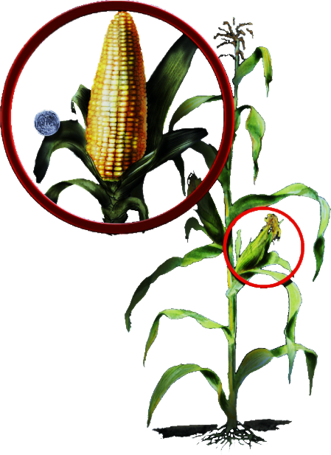
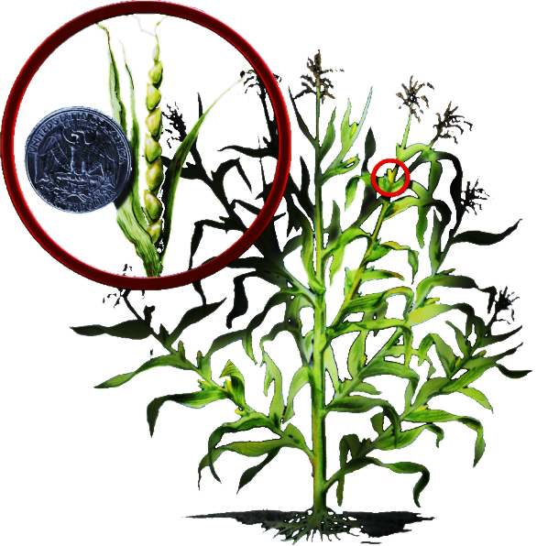
Genetic Modification of Corn
MODERN CORN
TEOSINTE
Notes:
 This is the familiar corn plant with large ears of corn.  However, corn originally comes from the teosinte plant, which produces only a few grains of seed from each ear. 

Slide 39
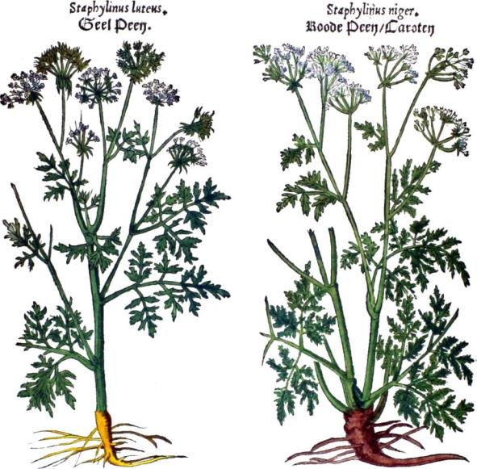
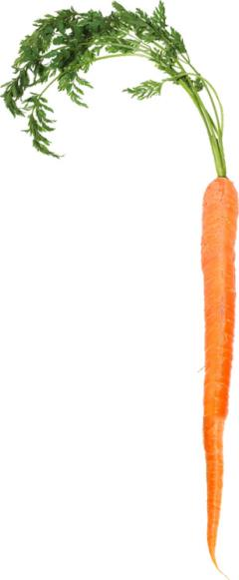
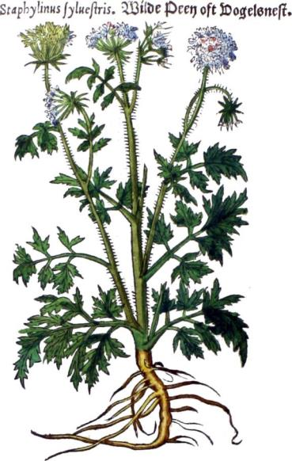
Genetic Modification of Carrots
Yellow and Red Carrots
Wild Carrot
Notes:
 These are drawings of yellow and red carrots done in a Flemish botanical book from 1554.  These carrots came from wild carrots, shown on the right.  Since this time, carrots have been bred to be orange and sweet, vastly different from the wild variety. These examples show that the crops we now grow are quite different from those that God originally created. In essence, we have been “playing God” all along. 

Slide 40
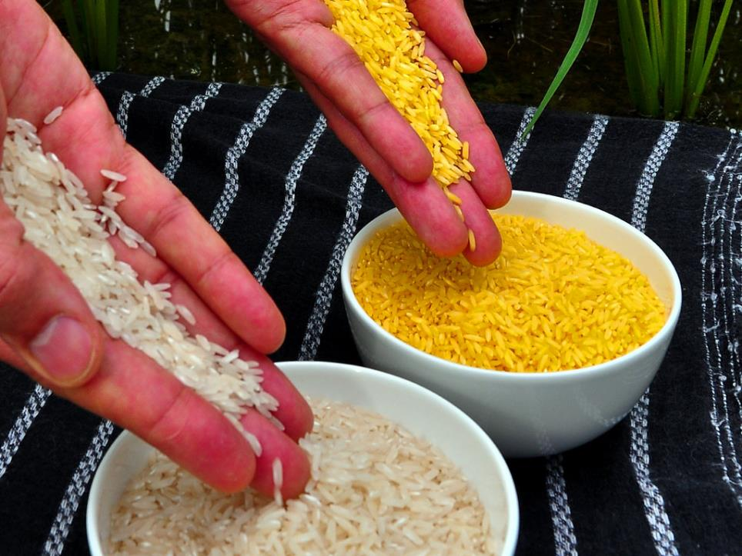
Golden Rice
Vitamin A deficiency kills ~670,000 children under the age of 5 each year
Golden rice contains genetically engineered beta-carotene, a precursor of vitamin A
An average serving supplies about half the daily vitamin A requirements
CH₃
₃HC
CH₃
CH₃
₃HC
CH₃
CH₃
CH₃
CH₃
CH₃
β-carotene
CH₃
CH₃
₃HC
CH₃
COOH
Vitamin A
CH₃
Photo courtesy of International Rice Research Institute
Notes:
Besides providing a financial benefit, GMOs can provide tangible help to people of third world countries.  Vitamin A deficiency kills ~670,000 children under the age of 5 each year. So, scientists  genetically engineered into rice the beta-carotene gene, which is a precursor of vitamin A.  An average serving of this rice supplies more than half the daily vitamin A requirement. Since a large percentage of the world’s children primarily eat rice, this would be a good way for them to get extra vitamin A and prevent childhood deaths. 

Slide 41
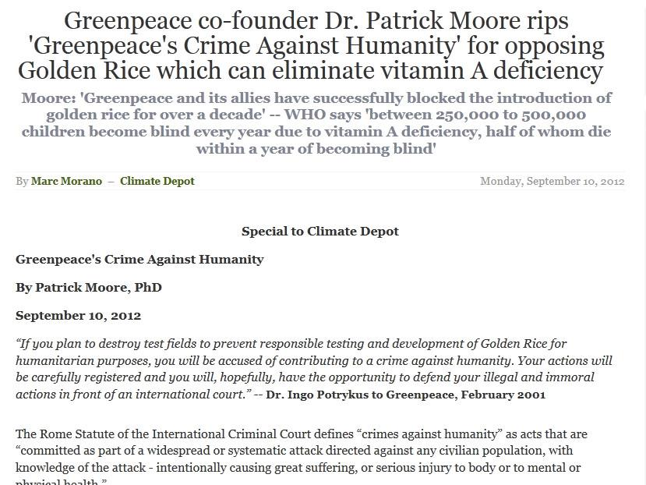
Greenpeace’s Opposition to Golden Rice
Notes:
However, Greenpeace and several other environmental organizations have strongly opposed the introduction of any kind of GMOs, even those that might help third world populations. In this article, Greenpeace co-founder Patrick Moore said that Greenpeace should be charged with  crimes against humanity for opposing the introduction of golden rice, which could save hundreds of thousand of children from blindness and death each year. 

Slide 42
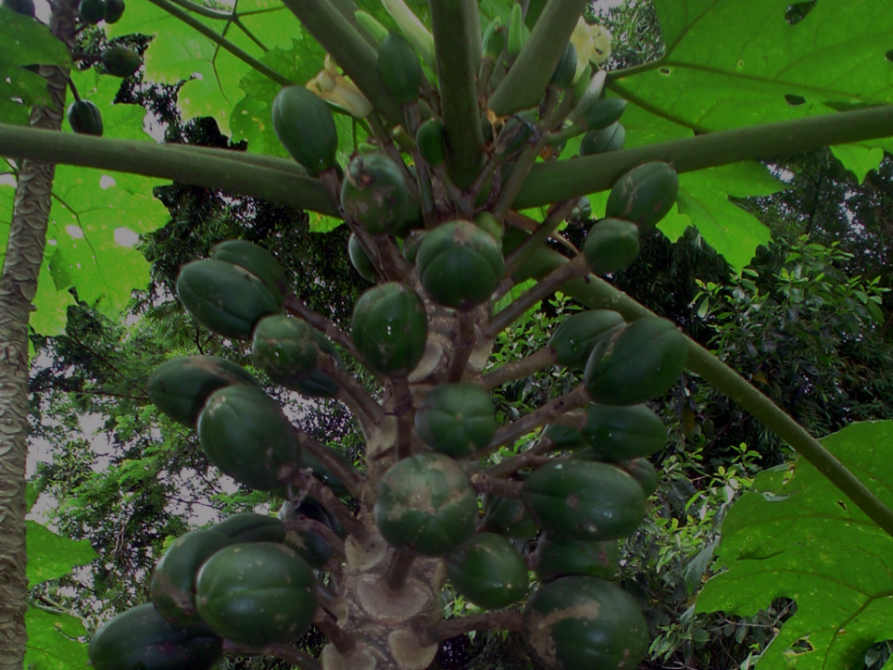
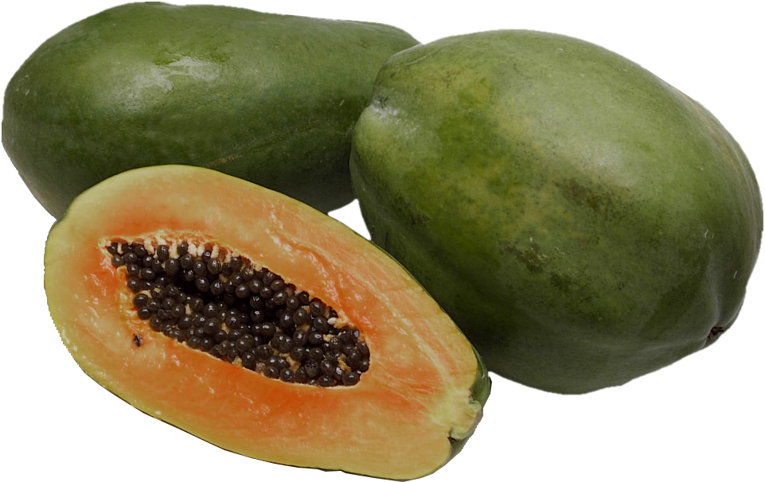
Hawaiian Papaya Industry
Hawaiian papaya was wiped out on Oahu in the 1950’s by PRSV
Production was moved to the big island.
PRSV infection on the big island began in the 1970’s and had destroyed the crops by the early 1990’s
Scientists genetically engineered the plants to produce defective viral coat protein.
The $60,000 project saved the multi-million dollar Hawaiian papaya industry
Notes:
 Hawaiian papaya was wiped out on the island of Oahu in the 1950’s by the papaya ringspot virus (PRSV), so  production was moved to the big island. However,  PRSV infection on the big island began in the 1970’s and by the early 1990’s had destroyed most of the crops. So, in 1996,  scientists genetically engineered a gene that produced defective viral coat protein and put it into the papaya plant. When PRSV infects the genetically-engineered plant, RNA from the defective coat protein gene silences the expression of the real viral coat protein, preventing replication of the virus. However, scientists didn’t discover how their defective gene actually worked until many years later.  The $60,000 U.S. government project saved the multi-million dollar Hawaiian papaya industry and has provided hundreds of jobs for Hawaiians. 

Slide 43
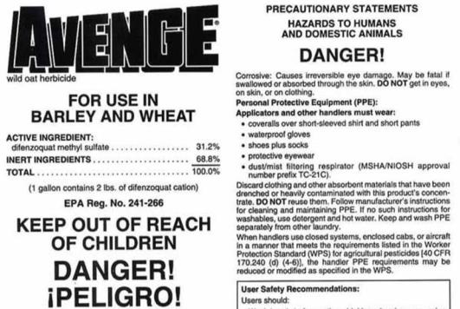
Pesticide Poisonings
300,000 deaths from pesticide poisoning
1,200 poisonings in California
GMOs reduce or eliminate pesticide use
GMOs allow use of less toxic herbicides
Notes:
 Worldwide there are 300,000 deaths from pesticide poisoning each year.  Even in California there are about 1,200 poisonings each year (though not necessarily fatal).  Since pest resistant GMOs can be grown in the absence of pesticides, these deaths and injuries could be eliminated through expanded culture of GMO crops.  Likewise, GMOs can allow farmers to use less toxic herbicides to control weeds. The result is lowered environmental impact by agriculture. 

Slide 44
Food Sustainability
World population to rise from 7 billion to 9 billion by 2050
Limited arable land
Requires increases in productivity
GMOs can dramatically improve agricultural productivity.
Notes:
 The population of the world is expected to rise from the current 7 billion to 9 billion by 2050. This rise will require an increase in global crop production of nearly 50%.  Since most of the arable land is already dedicated to agriculture,  gains in production will require significant increases in productivity. In third world countries, where most of population increases will occur, agricultural production is significantly impacted by pests, disease and weeds.  GMOs can dramatically improve productivity under these conditions. 

Slide 45

Future GMOs
Nitrogen fixing crops
  Less fertilizer
  Less fertilizer pollution
Drought resistant crops
Disease resistant crops
Notes:
Genetic modification of plants hold promise for the future.  Plants cannot use nitrogen directly from the atmosphere, but require it to be in a chemical form that can be absorbed by the roots. Only certain classes of bacteria can fix nitrogen from the air.  Legumes, such as peas and beans, live in symbiosis with these nitrogen-fixing bacteria, providing them high energy carbon molecules in exchange for fixed nitrogen. However, through genetic engineering, it would be possible to insert the genes involved in nitrogen fixation directly into plants, allowing them to produce their own nitrogen.  These crops would require little or no fertilizers, reducing the carbon footprint  and environmental impact of fertilizer runoff from farms. In many parts of the world, climate change has resulted in reduced rainfall, such as in much of northern and eastern Africa.  Drought resistant crops would markedly increase crop yields in these regions, contributing to food sustainability. There are also a number of areas where plant diseases greatly impact yields.  GMOs engineered for resistance to these diseases would contribute to food sustainability. 

Slide 46
GMOs and Politics
Notes:
In general, opponents of GMOs are the same organizations that are environmental advocates or part of the nutritional health community.

Slide 47
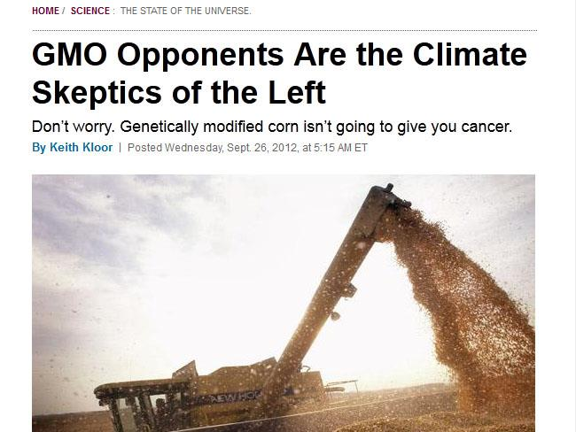
GMO Opponents Are the Climate Skeptics of the Left
Notes:
Since environmentalists tend to be on the left side of the political spectrum. Keith Kloor of Slate wrote an article saying GMO opponents are the climate skeptics of the left, implying that they are ignoring the data and acting irrationally. 

Slide 48
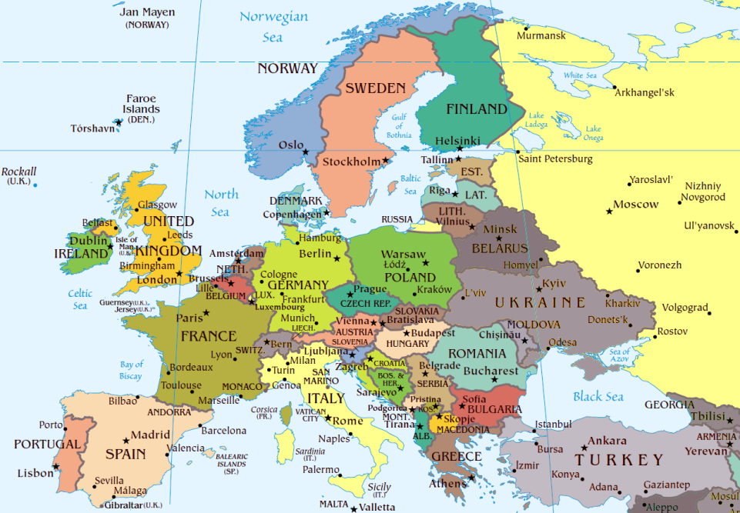












































GMO Labeling Requirements Worldwide
Notes:
42 nations require labeling of food that contains GMO components.  These are countries throughout the world, with  most of the countries belonging to the European Union, which dictates the laws of all those countries. In countries where GMO labeling is required, GMO food products have all but disappeared, because stores will not carry GMO products for fear of being unable to sell them, even though surveys show that consumers do not usually read the labels. 

Slide 49
GMOs and the Law
Notes:
Now, we are going to look at GMOs and the law. 

Slide 50
GMO and Patents
GM crops contain patented DNA technology
Licensing prevents farmers from saving and replanting seed
Restrictions protect company patents
New DNA technology produces seed that cannot be replanted
Patent infringement cases
Notes:
 All genetically modified organisms contain patented DNA technology. The licensing terms require that users of the patent (i.e., farmers) not save any seed from any harvests, but buy licensed seed every year it is planted.  Without such licensing restrictions, patents on genetically engineered seeds would be useless to protect a company's investment in creating the patent.  However, to insure patent protection, some GM seed companies are now producing seed that when grown does not produce viable embryos, preventing the replanting of harvested seed.  Some interesting cases of patent infringement have resulted from farmers planting unlicensed GM seed. The most famous case involved Percy Schmeiser, a canola farmer from Saskatchewan, Canada. The case inspired an extremely biased “documentary” entitled David vs. Monsanto. Let’s look at some excerpts. 

Slide 51
Monsanto Canada v. Schmeiser
Notes:
I first saw this video several years ago and thought at the time that Monsanto was evil and the Canadian Courts insane. However, the truth is…

Slide 52
Monsanto v. Schmeiser: The Truth
In 1997 Schmeiser “found” RoundUp-resistant canola
He sprayed nearby field and found 60% survival
Schmeiser saved the Roundup-resistant seed separately
In 1998 Schmeiser intentionally planted an additional 1,000 acres (out of the 1,400) with the saved seed he knew to be Roundup resistant
Notes:
That the facts are not quite the same as those presented in David vs. Monsanto. Percy Schmeiser was found guilty of patent infringement by three courts (including the Canadian Supreme Court).  According to Schmeiser’s account, in 1997 he sprayed the herbicide RoundUp around telephone poles at the edge of his farm and discovered that the canola plants survived, indicating that they were GM canola plants.  He then sprayed an additional 4 acres of the adjacent field and found that 60% of the plants survived the spraying. The documentary suggested that the 60% came from wind-blown contamination. Does anybody believe that?  At harvest, Schmeiser saved the Roundup-resistant seed separately  and the following year intentionally planted an additional 1,000 acres (out of the 1,400) of land with the saved seed he knew to be Roundup resistant. Fortunately for Schmeiser, he did not use the herbicide Roundup on this crop, so the Canadian Supreme Court voided the lower court financial judgments. Monsanto had dropped the lawsuit for the 1997 crop, even though Schmeiser’s story of “accidental” contamination was almost certainly false. 

Slide 53
Monsanto vs. Vernon Bowman
Bowman planted Monsanto soybeans, then a second crop from commodity soybean
Bowman saved seed from the commodity planting and replanted it next season
Bowman wrote Monsanto, telling them exactly what he had done!
Monsanto sued and won in district court and the US Court of Appeals
The case is currently before the US Supreme court
Notes:
Monsanto's Technology Agreement allows farmers to sell their genetically-modified crops to commodity markets, which are allowed to sell those seeds as a commodity, for anything but planting.  So, Vernon Bowman, after planting Roundup Ready soybean seed from Monsanto, decided to obtain second season crop seed from the commodity market, saving money on seed costs and avoiding the licensing fee. Since 94% of the soybean market in the U.S. uses Roundup Ready soybeans, the seed from the commodity market was probably nearly pure GM seed.  Bowman planted the seed from the commodity market and harvested the seed from that crop and saved it for next season's planting.  Then, amazingly, Bowman wrote Monsanto, telling them exactly what he had done!  Monsanto, of course, sued Bowman, since he had violated the terms of the license agreement, which prevented the planting of patented seed from previous harvests. Monsanto alleged that Bowman, in planting the seed from the commodity market violated the terms of the license agreement. A judge agreed with Monsanto, along with the United States Court of Appeals for the Federal Circuit.  The case is currently before the U.S. Supreme Court. If the Supreme Court rules against Monsanto, patents on GM seed will be basically worthless, since any farmer could buy commodity seed and avoid Monsanto's licensing fee. Here is another video clip. 

Slide 54
Epicyte Gene

Slide 55
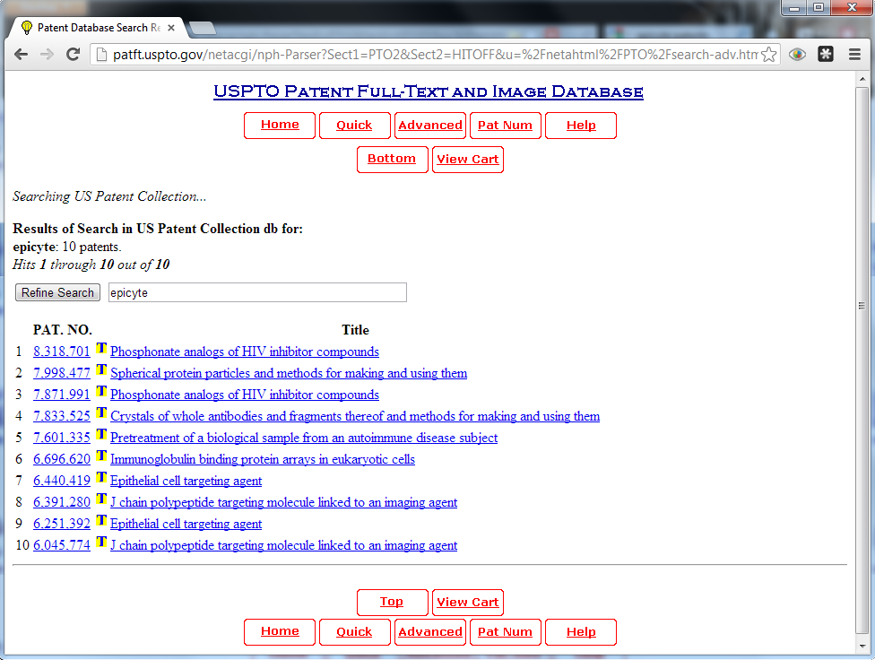


The truth about Epicyte
Epicyte developed 5 patents
None of the patents involved antibodies to sperm
Epicyte was purchased by Biolex Therpeutics in 2004
Biolex sold their plant antibody system to Synthon in April, 2012
Biolex went bankrupt in July, 2012
Five patents for Epicyte
Notes:
The story is immediately suspect, since Monsanto and Dupont are competitors and would be unlikely to do any kind of joint venture.  Epicyte Pharmaceuticals developed 5 patents between 1997 and 2000, related to the ability to produce monoclonal antibodies in plants.  None of the patents involved antibodies to sperm. Neither Monsanto and Dupont ever purchased Epicyte.  In fact, Epicyte was purchased by Biolex Therpeutics in 2004. Biolex attempted to produce monoclonal antibodies in the aquatic plant Duckweed, not corn.  However, they sold their antibody system to Synthon in April, 2012,  and went bankrupt in July, 2012. The Monsanto sterilization gene claim is a ridiculous hoax, but is widely circulated on the Internet. 

Slide 56
Conclusions
GM crops and food are safe to eat
Genetic engineering technology can make our food more nutritious and contribute to sustainable agriculture
GM opponents use false and misleading information to thwart GM technology
Christians should support research into GM technologies to improve living standards in third world countries
Notes:
In conclusion,  GM crops and food are safe to eat.  Genetic engineering technology can make our food more nutritious and contribute to sustainable global agriculture.  GM opponents use false and misleading information to thwart development of GM technology.  I believe Christians should support research into GM technologies to improve living standards in third world countries. 

