Slide 1
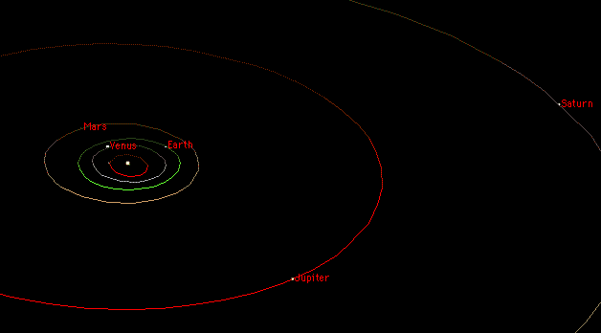

Slide 2
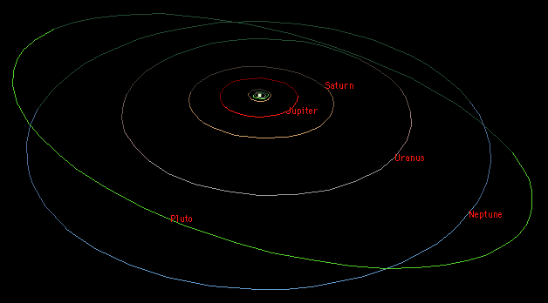

Slide 4
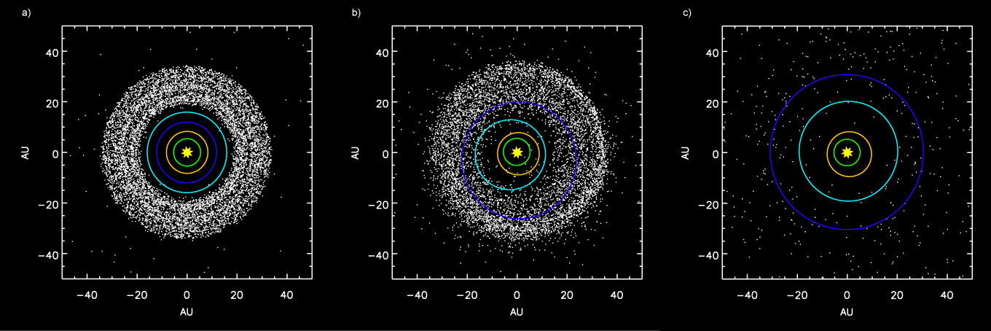
Notes:
outer planets and the Kuiper Belt before the 2:1 Jupiter-Saturn resonance

Slide 5
Notes:
scattering of Kuiper Belt objects into the solar system after the orbital shift of Neptune

Slide 6
Notes:
after ejection of Kuiper Belt bodies by Jupiter

Slide 7
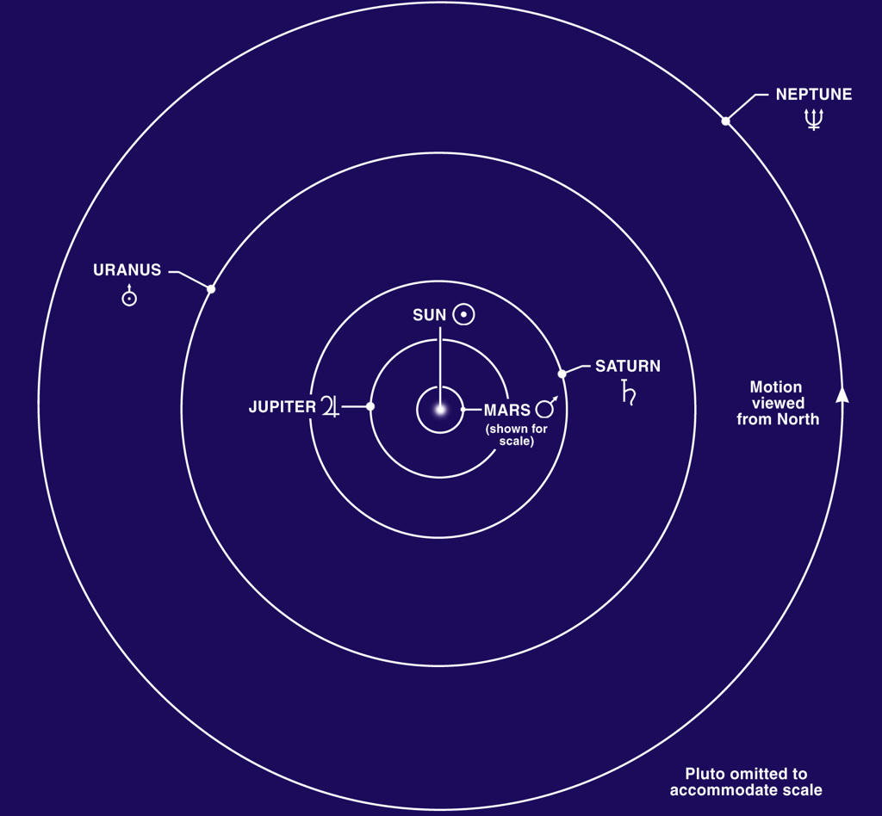

Slide 8
Asteroid/comet belts
Main Belt
Centaurs
Scattered Belt
Kuiper Belt
Oort Cloud
Hugh Ross

