Slide 1

Adam: physical life

Slide 2

Adam: physical life
created outside of Eden
watched Eden’s trees grow
tended the Garden
received pleasure and some satisfaction from the Garden
Notes:
recognizes the difference between a wilderness and a well designed and tended garden
God taught Adam how to relate to the physical part of creation.

Slide 3



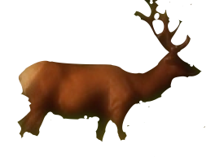
Adam: soulish life
Hugh Ross

Slide 4

Adam: soulish life
examined all the nephesh kinds
determined how God designed each one to serve and please him in a distinct manner
Hugh Ross

Slide 5
Adam: soulish life
received pleasure, service, and much fulfillment from the nepesh
Nevertheless, something was missing. He was still lonely.
Hugh Ross

Slide 6


Adam: spiritual life
God made Eve from a biopsy from Adam’s side.
Of all creatures only Eve could fulfill Adam physically, soulishly, and spiritually.

Slide 7

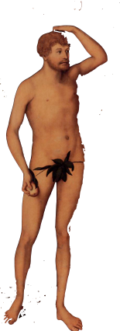
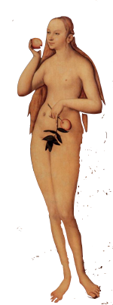
Three Creation Methods
from the dust of the ground
from re-engineering a DNA sample
from an act transcendent to space and time

Slide 8
Ezer
“assistant in the context of a military ally or source of reinforcement for the completion of an assigned task”
—Carl Schultz
Notes:
It takes both men and women to fulfill the Great Commission.

Slide 9

“Put on God’s armor so that you can make a stand against the tricks of the devil. We aren’t fighting against human enemies but against rulers, authorities, forces of cosmic darkness, and spiritual powers of evil in the heavens.” (Eph. 6:11-12 CEB)
Notes:
It takes both men and women to fulfill the Great Commission.

