Slide 1
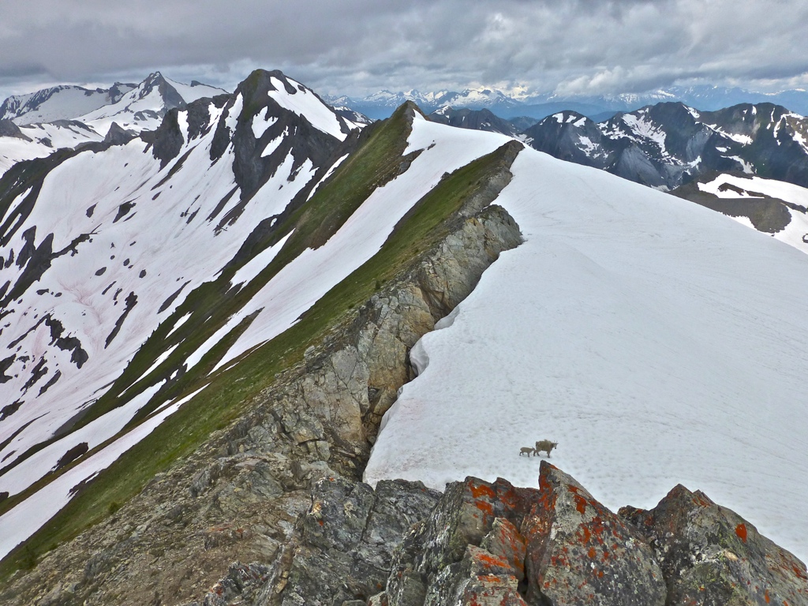

1-855-REASONS
www.reasons.org
Hugh Ross

Slide 2

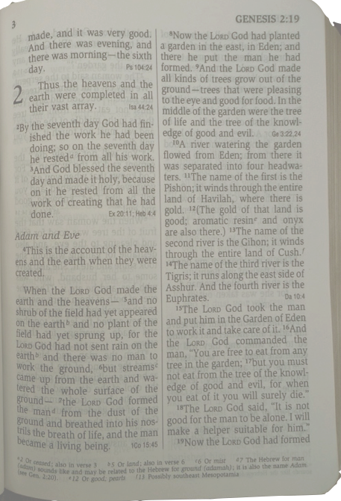


Genesis 2 Humanity’s Mission
Hugh Ross

Slide 3
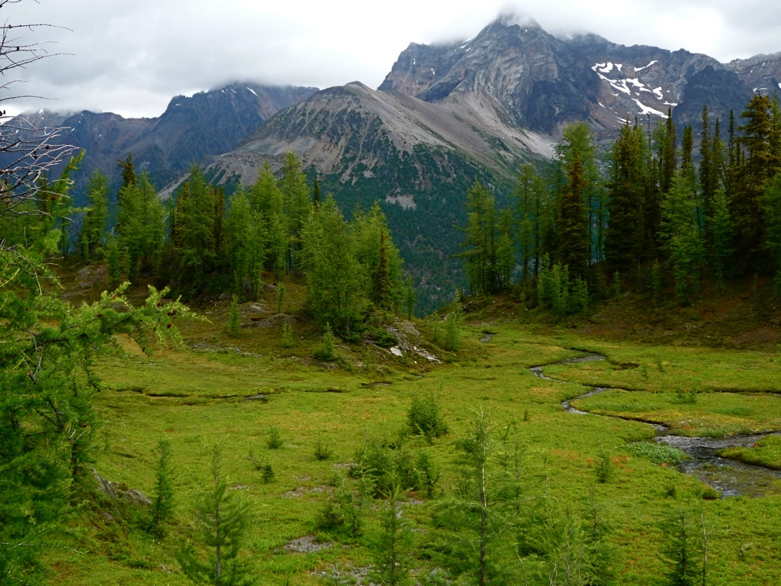
Why Two Accounts?
Genesis 1 has a physical focus: God creates three different kinds of life.
Genesis 2 has a spiritual focus: God introduces Adam to three different kinds of life.

Slide 4
Why Two Accounts?
Genesis 1: Physical events are sequenced but not the relational events.
Genesis 2: Relational events are sequenced but not the physical events.

Slide 5
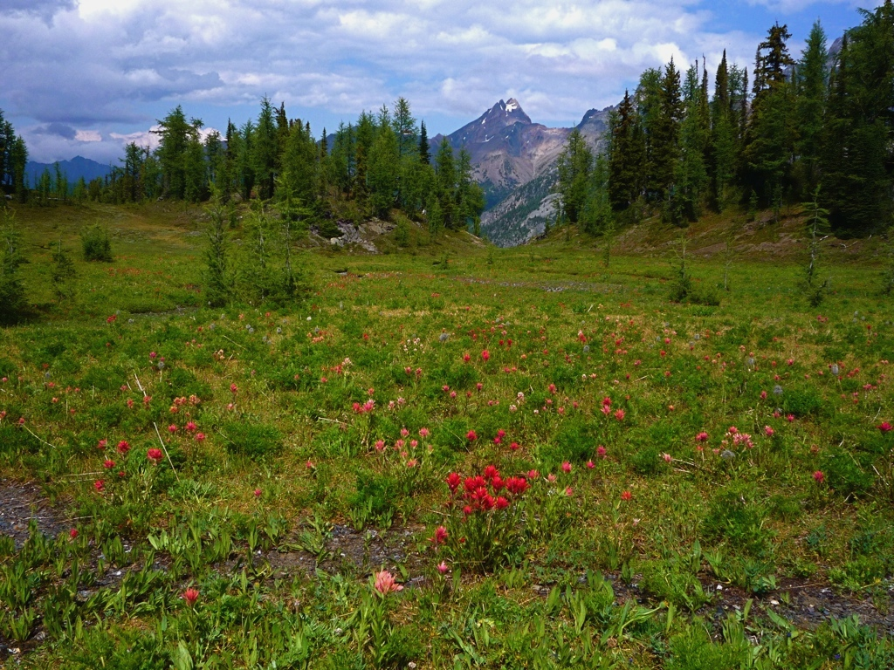
Gen. 2 Physical Events
In the region of Eden before God planted the Garden there were no shrubs, plants, rain, or humans (verse 5).
Verse 19 states that birds and mammals predated Adam.

Slide 6
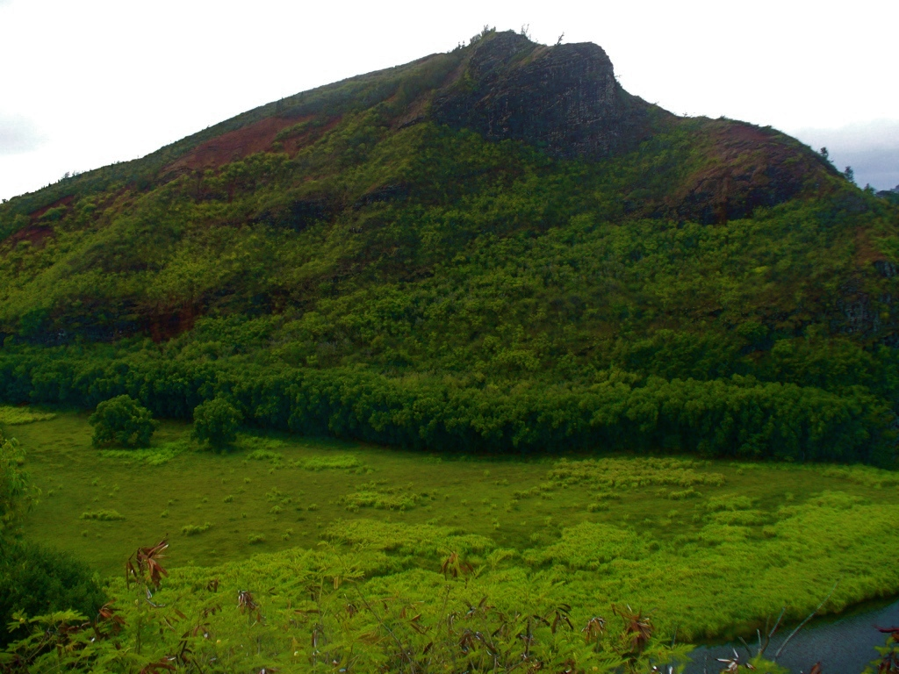
Location of Eden
“in the east” (verse 8)
where four rivers come together: the Pishon from Havilah, the Gihon from Cush, and the Tigris and Euphrates from Asshur (verses 11-14)
Notes:
The land of Nod is “east of Eden.”

Slide 7
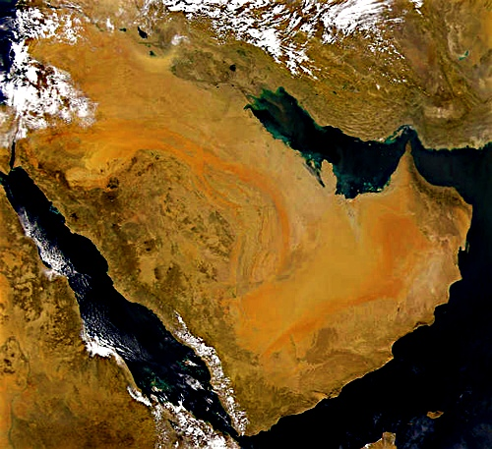
Asshur
¥
Eden?
Havilah
Cush

Slide 8
Asshur
¥
Eden
Havilah
Cush

