Slide 1
WHERE’S THE BEEF?

Slide 2

Notes:
Where’s the beef

Slide 3
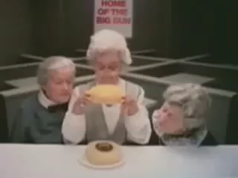

Slide 4
What is the source of the information in the cell?

Slide 5
Definition:
INFORMATION
Not facts, knowledge
I mean:
that which is communicated by verbal, written or electronic symbols

Slide 6
A symbol which by itself or in conjunction with other symbols, and with a shared set of rules, conveys meaning, intent, ideas, or causes an effect

Slide 7
COMPLEXITY
The amount of information that it takes to describe something
OR
The number of instructions it takes

Slide 8
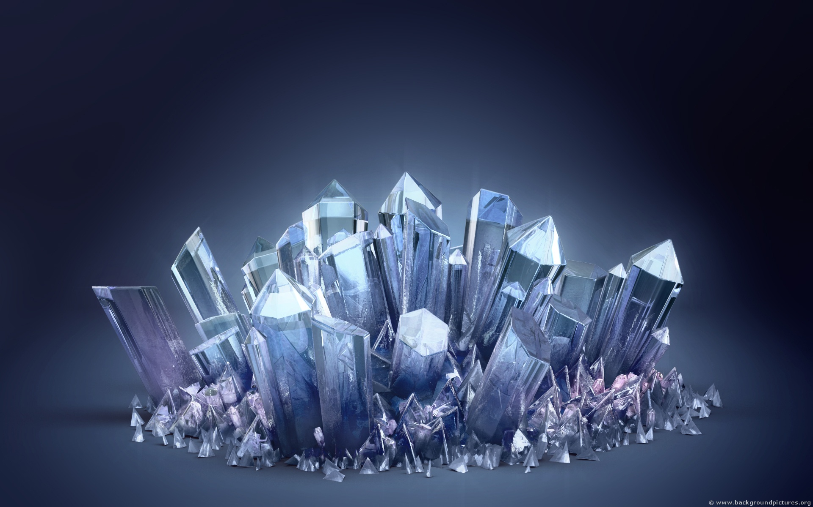

Slide 9


Slide 10


Slide 11

Mandelbrot Set Formula
$z_{n+1}=z_{n}^{2}$+c

Slide 12

Notes:
ikea

Slide 13
Put these things in order of complexity:
Automobile Hydrogen molecule
Human brain Microsoft Word
Toaster Laptop computer
Beethoven's 5th symphony Bacterial cell
Federal tax code Entire universe minus living things
747

Slide 14
Systems can have two kinds of information
DIRECT:
Symbols
Alphabet
Computer code
Language
Skywriting
Etc.

Slide 15
EMBEDDED
Info is part of the structure of the system
Key
Footing of a house
Setting of a table

Slide 16
SPECIFIED COMPLEXITY
Meadow vs. Football field

Slide 17
LESS SPECIFIED
Christmas tree
Front yard
The sentence:
“the black cat drank the white milk”

Slide 18
MORE SPECIFIED:
Bank balance
Legal contract
PIN number
Lock combination

Slide 19
Simple Cake Recipe
1/2 cup butter, slightly softened
1 cup sugar
1 egg, beaten until light
1 cup milk
2 cups flour
1 teaspoon baking powder
1/4 teaspoon salt (optional)
1 1/2 teaspoons vanilla or other flavoring
Preheat oven to 350°F.
Whisk together flour, baking powder and salt. Measure the milk and stir in the vanilla.
Cream together butter and sugar. Add egg and beat for 2 minutes or until light.
Stir in 1 cup of the flour mixture, the milk mixture, then the remaining flour mixture. Beat for 30 seconds, or only until combined. (For a tender cake, do not overbeat the batter once the flour has been added).
Bake in a buttered 9 inch square pan for 30 minutes or until a toothpick inserted in center of cake comes out clean.

Slide 20
INGREDIENTS:
Some greasy stuff Mix them up
Small crystals Put them in a hot place
Any embryo For a while
Some white liquid
Two kinds of powdery stuff
Anything salty
Some brown liquid

Slide 21
Law of conservation of information
No system can output more information than is input in to it
PLUS
What is already programmed in to it
OUTPUT = or < INPUT + PROGRAMMED

Slide 22
A computer can’t make up the Gettysburg Address
A cat can’t talk
A radio can’t play a song without the song being embedded in the radio signal
A computer design program can’t choose the style of the sofa or the color of the carpet without you entering it
A computer program can’t create a new version of itself
A book can’t write it’s own second edition
A cellphone can’t make up your new friends phone number

Slide 23
A security camera system cannot make up a picture of a person committing a crime

Slide 24
Where does information come from? Originally?

Slide 25
Why information cannot come from:
Random source
vneo8ft4ionmmblri3hg3hwwv = random output
A source governed by natural law
wxawxawxawxawxawxawxawxa = repetitive output

Slide 26
Only a conscious mind can create original information

Slide 27
Complexity of a cell
1,000,000,000 atoms
Millions of moving parts
Thousands of systems
Millions of characters in the DNA
(which functions just like an alphabet)

Slide 28
How many instructions would it take to build a cell one atom at a time?
If an IKEA piece of furniture takes 2 minutes per step, times 60 steps
(equals 2 hours) and we take that same rate to build a cell, one
atom at a time,
and we all took it on as a class project,
and we worked on it 24/7
we could finish it in

Slide 29
ONLY 27,777 years!

Slide 30

Notes:
Inside a cell

Slide 31
What is the main feature that distinguishes a designed system from one made by random processes or natural law?
COMPLEXITY

Slide 32
Biological systems are loaded with complexity and specified information on every level

Slide 33
“The problem of the origin of life is clearly basically equivalent to the problem of the origin of biological information”
Bernd-Olaf Kuppers, origin of life researcher

Slide 34
Therefore, using the principle of Abductive logic, it is reasonable to
argue that the only source for the information in biological
systems is an intelligent, reasoning source
AND
The only intelligent, reasoning source with the power and creativity
to actually create living things from the non-living, is a being that fits
the classical description of God

Slide 35
So how can we critique the paradigm?

Slide 36
Confusion between order and complexity
Natural systems can account for some level of order,
But not complexity
In many ways they are OPPOSITE

Slide 37
When addressing an argument for a naturalistic explanation of the
origin of life look for their explanation for the origin of the
information
They will:
ignore the problem
confuse it with order or pattern
invoke a process which is indistinguishable from magic
This is where you ask:

Slide 38


Slide 39
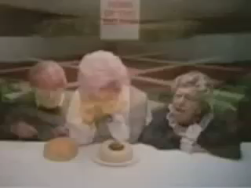

Slide 42
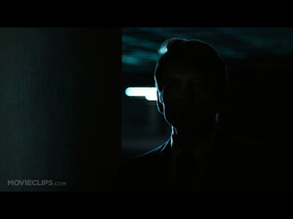

Slide 43
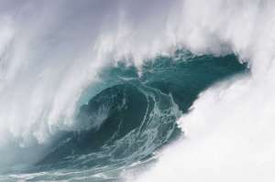

Slide 44
