Slide 1
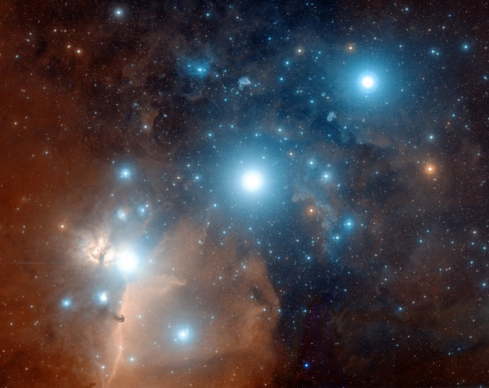
UNIVERSE’S FINE TUNING = DESIGN
So far, we have examined only the universe’s three (the mass-space density ratio replaced by the energy-space density ratio) Initially Fine Tuned parameters, which have a random chance of 1 out of 10²¹⁷ of occurring
(10⁵⁷ + 10¹²º + 10⁴º).
STARS ALMITAK, ANILAM, MINTAKA: Credit-Digitized Sky Survey, ESA, ESO, NASA, FIS Liberator; Color Composite – Davide De Martin (Skyfactory)

Slide 2
1 out of 10²¹⁷ is like saying:
  Take all the atoms in the universe (i.e., 10⁷⁸) and multiple them:
  by one trillion by one trillion
  by one trillion by one trillion
  by one trillion by one trillion
  by one trillion by one trillion
  by one trillion by one trillion
  by one trillion by 10,000,000 times!!!
STARS ALMITAK, ANILAM, MINTAKA: Credit-Digitized Sky Survey, ESA, ESO, NASA, FIS Liberator; Color Composite – Davide De Martin (Skyfactory)

Slide 3
  Mark one atom, mix all of them up and dive down blindfolded and get the marked atom on the first try!!!
  (or…remove one atom and you thereby eliminate any chance of a life-supporting planet anywhere, anytime!!!)
STARS ALMITAK, ANILAM, MINTAKA: Credit-Digitized Sky Survey, ESA, ESO, NASA, FIS Liberator; Color Composite – Davide De Martin (Skyfactory)

Slide 4
GALACTIC CLUSTERS & GALAXIES

Slide 5
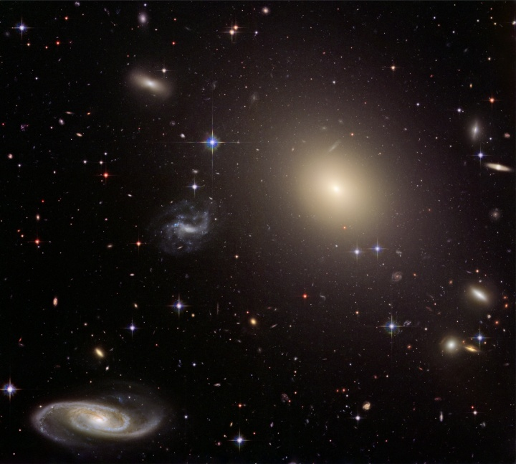
UNIVERSE’S FINE TUNING = DESIGN
FOR POSSIBILITY OF LIFE MUST
HAVE AT LEAST
299 GALACTIC FACTORS JUST RIGHT; JUST A FEW ARE AS FOLLOWS:
(any numbers inside parentheses indicate the limit to which that factor can change without prohibiting life)
GALAXIES: Credit – NASA, ESA, Hubble Heritage Team (STScI, AURA), Acknowledgement: J. Blakeslie (Washington State University)

Slide 6
  UNIVERSE’S FINE TUNING=DESIGN
  Location, location, location!
  Galaxy cluster location (10%)
  Galaxy cluster size (10%)
  Galaxy location (10%)
  Location & variability of local dwarf galaxy absorption rate (<10%)
GALAXIES: Credit – NASA, ESA, Hubble Heritage Team (STScI, AURA), Acknowledgement: J. Blakeslie (Washington State University)

Slide 7
UNIVERSE’S FINE TUNING=DESIGN
Vast majority of galaxies are in
“galactic neighborhoods”
that are too crowded,
causing lethal-to-life
collisions and mergers.
The Milky Way Galaxy is not!
GALAXIES: Credit – NASA, ESA, Hubble Heritage Team (STScI, AURA), Acknowledgement: J. Blakeslie (Washington State University)

Slide 8
UNIVERSE’S FINE TUNING=DESIGN
For example, most galactic clusters have about 10,000 galaxies in them. Our local “cluster” or group has only about 40, with only two medium size galaxies (the Milky Way and Andromeda) and the rest being dwarf galaxies
GALAXIES: Credit – NASA, ESA, Hubble Heritage Team (STScI, AURA), Acknowledgement: J. Blakeslie (Washington State University)

Slide 9
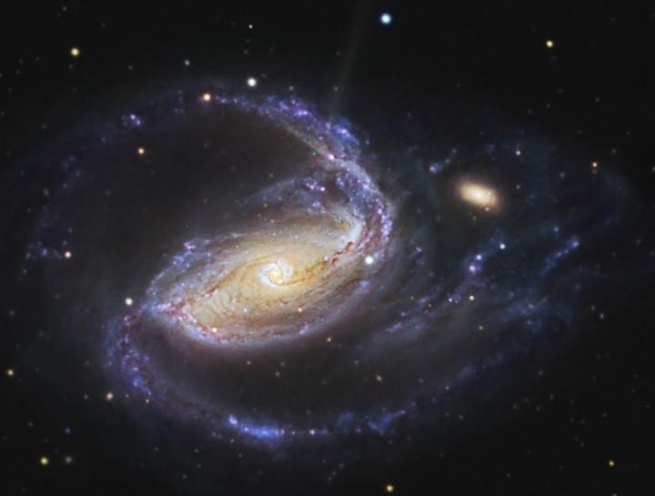
UNIVERSE’S FINE TUNING = DESIGN
If galaxies get too close together,
the result is that life can be impossible
NGC 1097: R. Jay GaBany (Cosmotography.com)

Slide 10
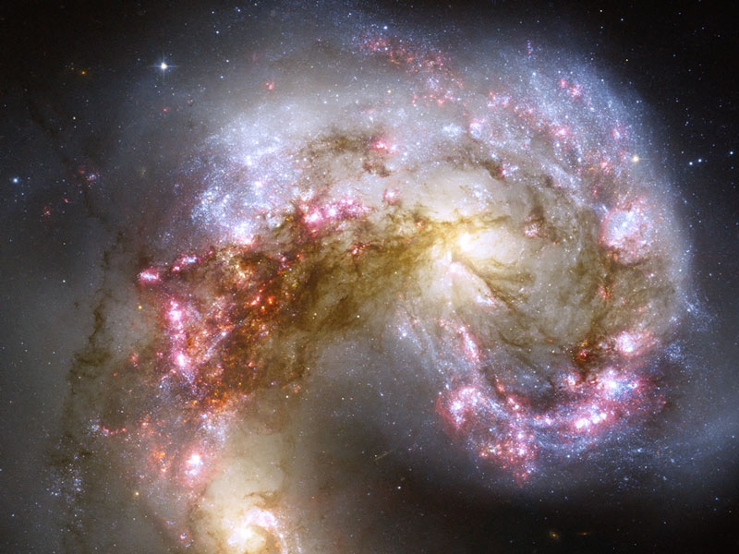
When galaxies collide…
ANTENNAE GALAXIES IN COLLISION: Credit – NASA, ESA, Hubble Heritage Team (STScI, AURA), Hubble Collaboration, Acknowledgement – B. Whitmore(STScI) et al

Slide 11
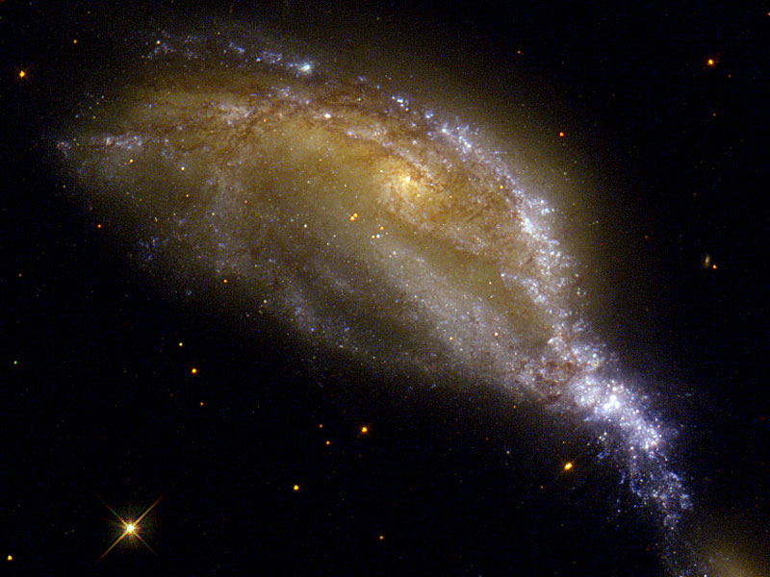
Another Galactic Collision
Credit – NASA, Hubble Heritage Team (STScI, AURA), ESA, Hubble Collaboration

Slide 12
  UNIVERSE’S FINE TUNING=DESIGN
  Our spiral galaxy cannot maintain its “required spiral shape/arms needed for life” unless it has a nearby dwarf galaxy from which it can get additional dust, etc. to help form additional stars, which in turn help maintain the needed galactic configuration.
GALAXIES: Credit – NASA, ESA, Hubble Heritage Team (STScI, AURA), Acknowledgement: J. Blakeslie (Washington State University)

Slide 13
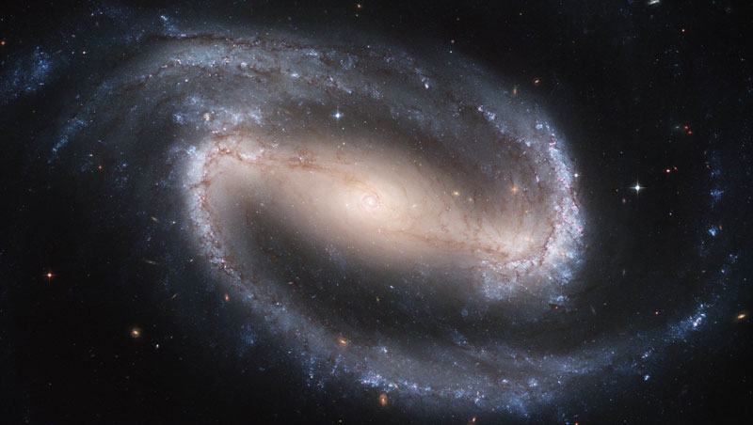
UNIVERSE’S FINE TUNING =DESIGN
    Galactic characteristics:
    Galaxy Size: Overall (10%)
    Size of galactic bulge
    Galaxy Age
    Galaxy Type (5%)
    Galaxy Mass Distribution (20%)
UNIVERSE’S FINE TUNING = DESIGN
BARRED SPIRAL GALAXY NGC 1300: Credit-Hubble Heritage Team, ESA, NASA

Slide 14
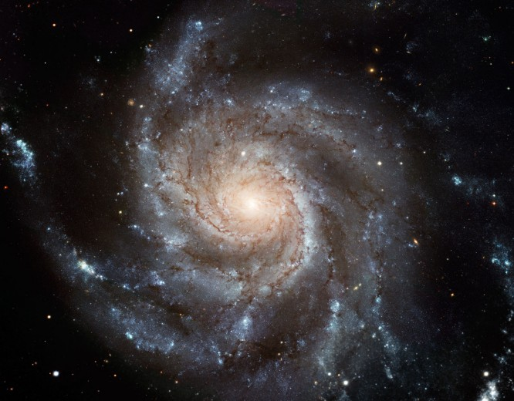
UNIVERSE’S FINE TUNING = DESIGN
Galaxy Bulge (center of galaxy)
MESSIER 101: Image Credit – NASA, ESA, CFHT, NOAO

Slide 15
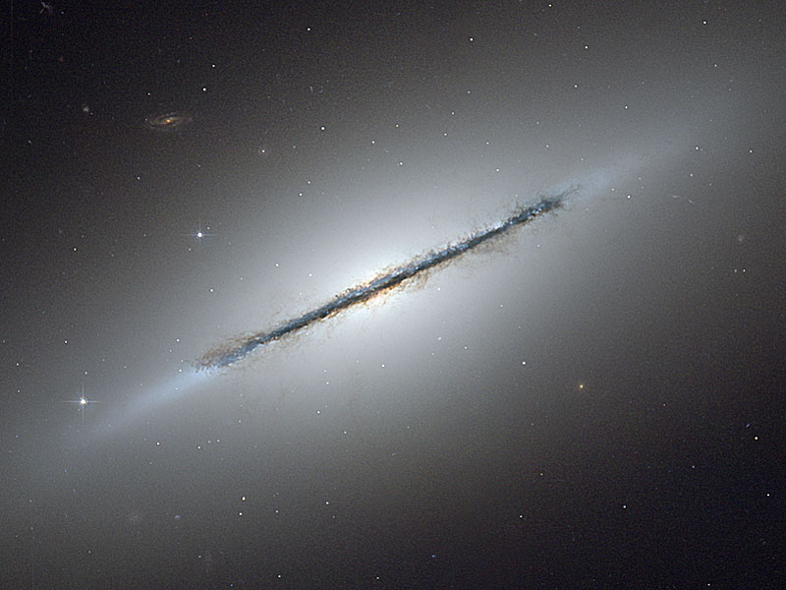
UNIVERSE’S FINE TUNING = DESIGN
Galaxy Bulge…
…if too large = lethal radiation
GALAXY NGC 5866 EDGE: Credit – NASA, ESA, Hubble Heritage Team (STScI, AURA), Acknowledgement: W. Keep (U. of Alabama)

Slide 16
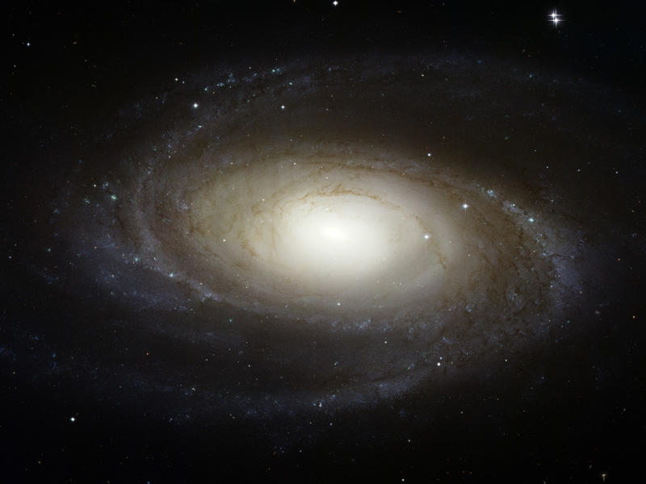
UNIVERSE’S FINE TUNING = DESIGN
Galaxy Age:
  If a galaxy is too young, it will not have enough generations of stars to produce rocky planets.
GALAXY M8l: Credit – NASA, ESA, Hubble Heritage Team (STScI, AURA)

Slide 17
UNIVERSE’S FINE TUNING = DESIGN
Galaxy Type:
  Only spiral galaxies (5% of total) are
capable of supporting life; galaxies
come in many non-spiral shapes.
MESSIER 101: Image Credit – NASA, EA, CFHT, NOAO

Slide 18
UNIVERSE’S FINE TUNING = DESIGN
Galaxy Type:
  If too elliptical, star formation
  would precede heavy elements
  (bad)
  If too irregular: occasionally too much radiation; no heavy elements
MESSIER 101: Image Credit – NASA, EA, CFHT, NOAO

Slide 19
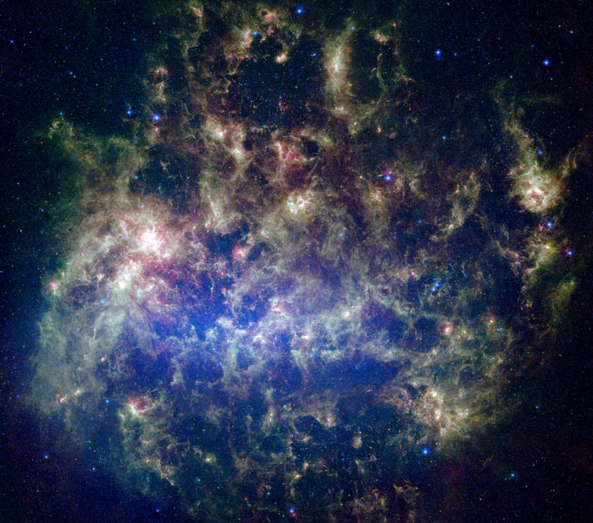
The Large Megallinic Cloud:
A small satellite galaxy to our Milky Way
LARGE MEGALLINC CLOUD IN INFRARED: Credit – NASA,JPL-Caltech, M. Meizner (STScI), and SAGE Legacy Team

Slide 20
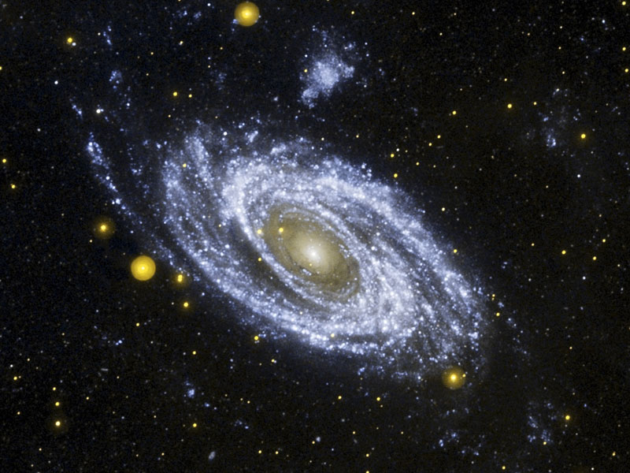
M81 GALAXY: Credit – NASA, JPL-Caltech, GALEX Team, J. Huchra et al (Harvard CFA)

Slide 21
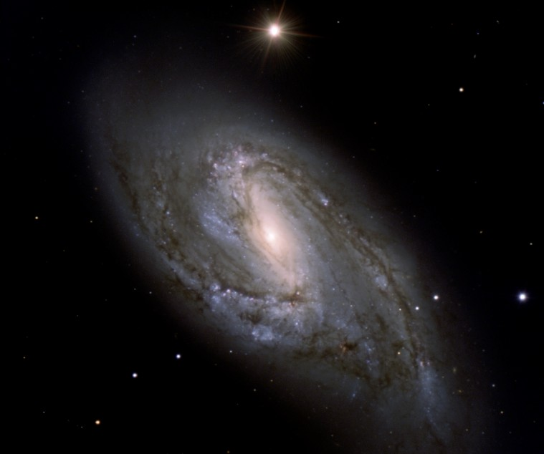
UNIVERSE’S FINE TUNING = DESIGN
Galaxy Parameters Summary
Due to all the various galactic
conditions that need to be just
right to make life possible, the
possibility of life is only feasible in
only about 1% of all galaxies!!!!
DUSTY SPIRAL M66 GALAXY: Credit-M. Neeser (U. of Sternwarte Munchen), P. Barthel (Kapteyn Astron Institute), H. Hayer, H. Boffin (ESO), ESO

Slide 22
THE SUN

Slide 23
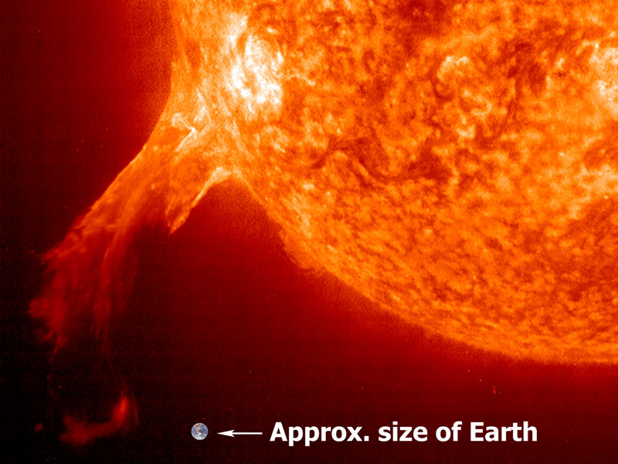
SOLAR PROMINENCE: Credit – SOHO-EIT Consortium, ESA, NASA
UNIVERSE’S FINE TUNING = DESIGN
  FOR POSSIBILITY OF LIFE NEED MORE THAN 140 FINELY TUNED STAR PARAMETERS; SOME ARE:
  (any numbers inside parentheses indicate
  the limit to which that factor can change
  without prohibiting life)

Slide 24
SOLAR PROMINENCE: Credit – SOHO-EIT Consortium, ESA, NASA
UNIVERSE’S FINE TUNING = DESIGN
Location, location, location!
  Distance to Galaxy Center (20%)
  Location Relative to Spiral Arm (10%)
  Distance to Galaxy co-rotation circle
  Orbital Eccentricity (10%)
  Location to white dwarf star nova
  Location to 3 types of supernovas

Slide 25
SOLAR PROMINENCE: Credit – SOHO-EIT Consortium, ESA, NASA
UNIVERSE’S FINE TUNING = DESIGN
Location, location, location!
  Location of solar nebula to
  supervova eruption
  No. of stars in system
  No. & timing of close encounters
  by nearby stars

Slide 26
UNIVERSE’S FINE TUNING = DESIGN
If Sun’s orbit
too elliptical
no life
Zone of Habitability;
If sun’s orbit distance (26 light yrs) from galaxy center varies by much, no life
If sun not between spiral arms, no life
Sun must have synchronous
co-rotational movement with spiral arms

Slide 27
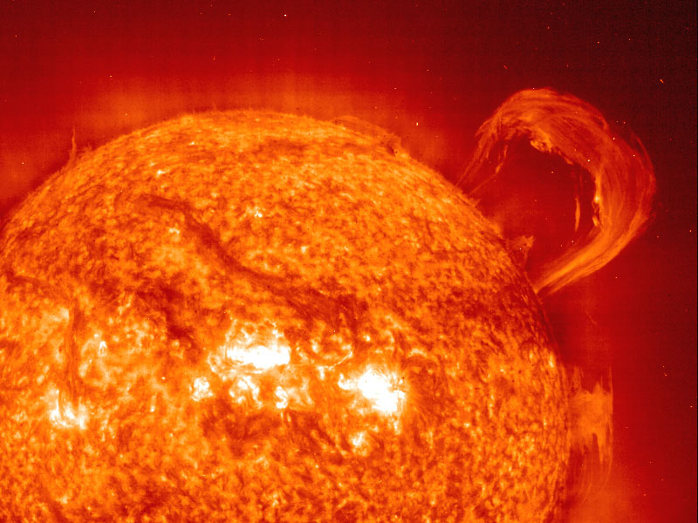
UNIVERSE’S FINE TUNING = DESIGN
  Our sun also had to be near enough,
  at the right time, to a nova of a white dwarf star.
  Size of earth
  The white dwarf star had to be in a
  binary system with a larger star
SUN PROMINANCE: Credit – SOHO-EIT Consortium, ESA, NASA

Slide 28
UNIVERSE’S FINE TUNING = DESIGN
  The two had to be close enough so
  the larger star would “donate”
  enough material to the smaller star.
  As a result, on surface of the white
  dwarf then, and only then, could
  the element “flourine” be made
  (this is the only source of it).
SUN PROMINANCE: Credit – SOHO-EIT Consortium, ESA, NASA

Slide 29
UNIVERSE’S FINE TUNING = DESIGN
  Eventually this star went nova
  Later, when our sun was first forming,
  it had to be near enough, at just the
  right time, to absorb the flourine.
SUN PROMINANCE: Credit – SOHO-EIT Consortium, ESA, NASA

Slide 30
UNIVERSE’S FINE TUNING = DESIGN
  Without flourine,
  NO LIFE!
  The flourine in your body came only from the above processes!
SUN PROMINANCE: Credit – SOHO-EIT Consortium, ESA, NASA

Slide 31
UNIVERSE’S FINE TUNING = DESIGN
Our sun, in its formation, had to be near enough, at just the right time, to three types of supernovas (a type I, type II, and a special type II) in order for the right heavy metal mix to be incorporated into our solar nebula which formed our sun/planets
SUN PROMINANCE: Credit – SOHO-EIT Consortium, ESA, NASA

Slide 32
UNIVERSE’S FINE TUNING = DESIGN
  Timing is Everything!
    Birth date
    Age (40%)
    Need 2nd or 3rd Generation Star
    Mentioned earlier, its birth had to
    just at the time in relation to nova
    of a white dwarf star & 3 types of
    supernovas.
SUN PROMINANCE: Credit – SOHO-EIT Consortium, ESA, NASA

Slide 33
UNIVERSE’S FINE TUNING = DESIGN
    Sun Characteristics:
      Luminosity (.001% relative to life
      type)
      Metalicity (5%)
      Color (40%)
      Mass (.1%)
      O to C Ratio(.5%)
SUN PROMINANCE: Credit – SOHO-EIT Consortium, ESA, NASA

Slide 34
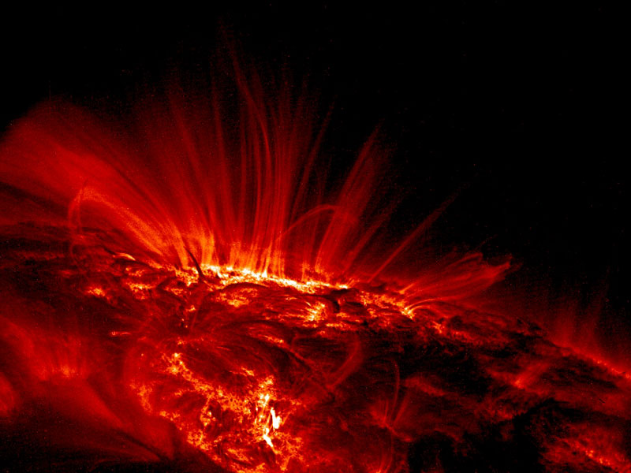
And, by the way, when it comes to stars, SIZE DOES MATTER!
Approximate size of earth to the sun
If a star is too large, it burns out too quickly to permit a life-sustaining planet
If a star is too small, it burns too erratically to permit a life-sustaining planet
SUN IN INFRARED: Credit-TRACE Project, NASA

Slide 35
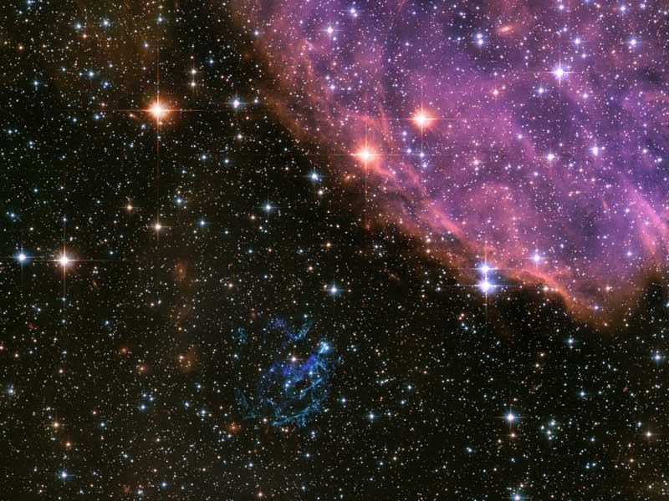
Remnants of a star after it goes supernova (one last explosion at the end of its life); these remnants join with other remnants to form new stars
SUPERNOVA REMNANT EOlO2

Slide 36
Other beautiful suns…
STARS ALMTAK, ALNILAM,MINTAKA: Credit – Digitized Sky Survey, ESA, ESO, NASA, FIS Liberator…Color Composite – Davide De Martin (Sky Factory)

Slide 37
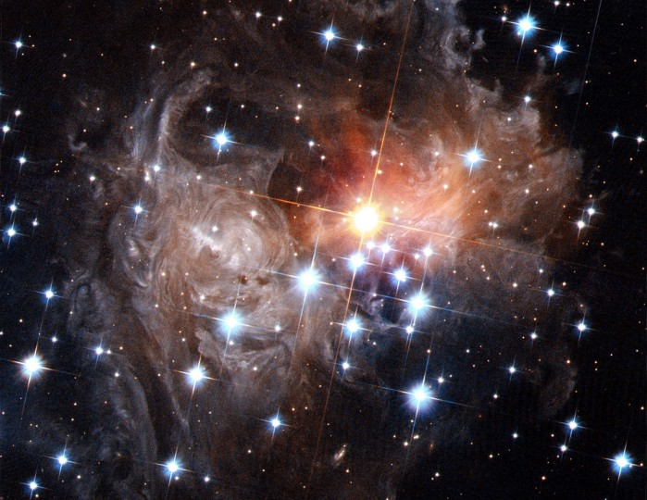
VARIABLE STAR u833 WITH SWIRLS OF DUST: Credit – NASA, ESA, H. Bond (STScI)

Slide 38
There are little stars, and BIG stars…
Our Sun
.
The Star
“Antares”
(not the
largest!)
…Our sun is a medium-sized star

Slide 39
A star’s luminosity changes over time.
Our sun’s luminosity is 30% greater
than when life first started: such a
change can exterminate life!...even a 1 – 2% change can kill life.
SUN IN INFRARED: Credit-TRACE Project, NASA

Slide 40
But this gradual change was exactly
matched by an decrease in greenhouse
efficiency (ability to trap heat heat) and other factors on earth (more on this later)
SUN IN INFRARED: Credit-TRACE Project, NASA

Slide 41
This efficiency caused by multiple factors like just right kinds of life forms (plant & animal), tectonics, volcanic activity, etc. at just the right times which absorb CO₂, methane, and water vapor.
SUN IN INFRARED: Credit-TRACE Project, NASA

Slide 42
There is no random process that can account for this perfect synchronistic sun-earth dance of luminosity and life!
SUN IN INFRARED: Credit-TRACE Project, NASA

Slide 43
SOLAR SYSTEM: THE PLANETS

Slide 44
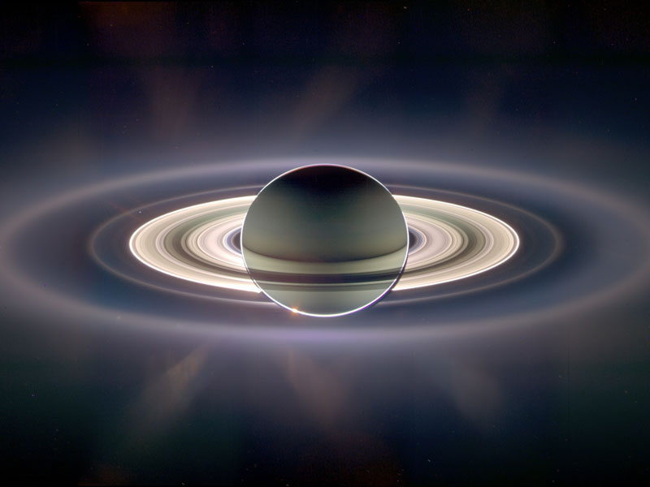
UNIVERSE’S FINE TUNING = DESIGN
Saturn Eclipsing Sun
FOR LIFE TO BE POSSIBLE, THERE ARE AT LEAST 137 SOLAR SYSTEM FACTORS THAT NEED TO BE FINELY TUNED; JUST A FEW ARE:
(any numbers inside parentheses indicate the limit to which that factor factor can change without prohibiting life)
.
Credit – CYCLOPS, JPL, ERSA, NASA

Slide 45
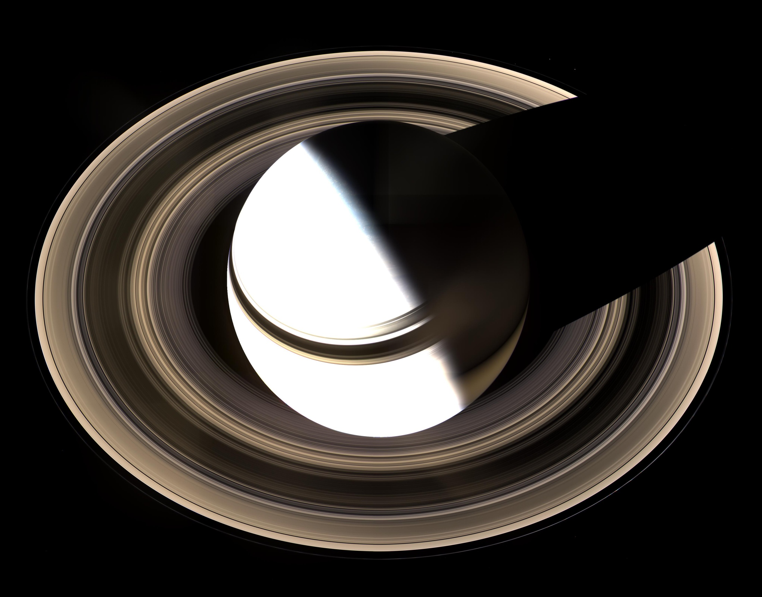
UNIVERSE’S FINE TUNING = DESIGN
  Location, location, location!
    Distance from star (1%)
    Distance from gas giants (2%)
    Distance from other nearby
    planets
Credit – NASA, JPL

Slide 46
UNIVERSE’S FINE TUNING = DESIGN
Distance from star (1%)
If the average distance of earth’s orbit around the sun were to vary by more than about 1%, you can kiss your “you
know what” goodbye.

Slide 47
UNIVERSE’S FINE TUNING = DESIGN
Distance from gas giants (2%)
The gas giants of our solar system are “Jupiter, Saturn, Uranus, and Neptune.”

Slide 48
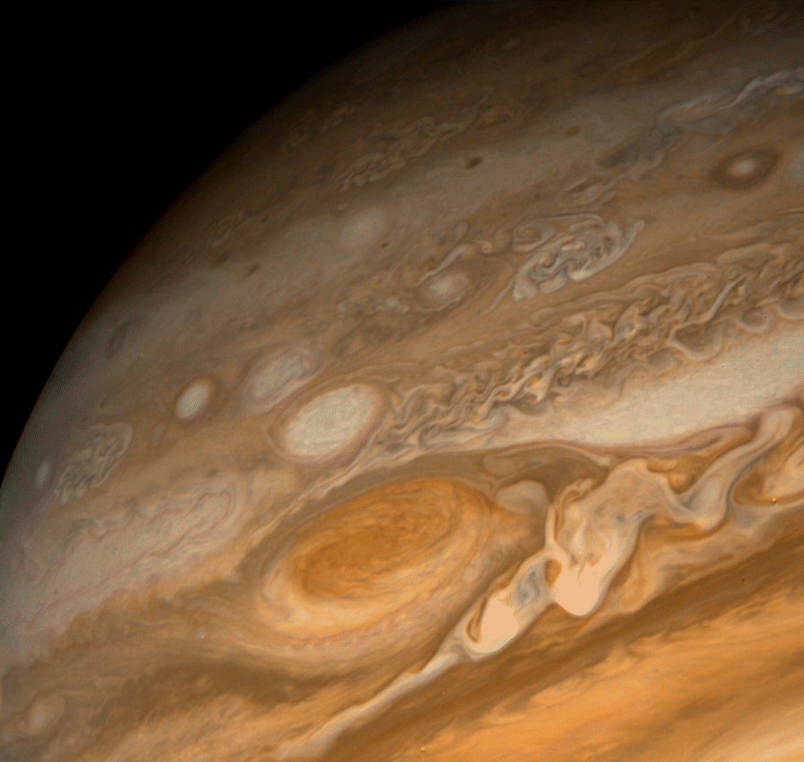
UNIVERSE’S FINE TUNING = DESIGN
  If Jupiter were just a little farther from
  earth (~1%) we probably would not be
  here as it protects earth from lethal
  hits by asteroids & comets due to its
  gravitational influence on them.
  If Jupiter were a little closer (~1%) to
  us its gravitational influence would
  have life-threatening effects on
  earth’s orbit.
Credit – JPL, NASA

Slide 49
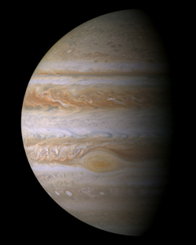
Jupiter: Largest Planet in our solar system
484 million miles
from sun (average)
395 million miles
from Earth’s orbit
Size of earth
(1,400 earths can fit inside)
Credit - NASA

Slide 50
Earth would be in fatal trouble if:
Jupiter’s mass were smaller
Jupiter’s orbit were less circular
Jupiter’s orbital plane were much
different
Credit - NASA

Slide 51
UNIVERSE’S FINE TUNING = DESIGN
If Jupiter’s formation had not been completed at the same “instant” that the disk of debris and gas around the sun had disappeared, Jupiter would have gradually spiraled inward toward the sun, and eventually would have destroyed earth.

Slide 52
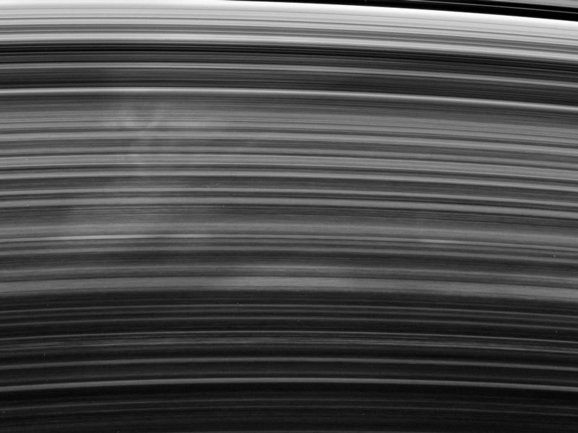
Saturn’s Rings
The other gas giants also play a critical role in protecting earth.
Credit – CYCLOPS, JPL, ESA, NASA

Slide 53
UNIVERSE’S FINE TUNING = DESIGN
  Orbit, Rotation, & Axis Factors, etc:
    Inclination of planetary orbits (50%)
    Major planet orbital instabilities (5%)
    Planetary rotation period (10%)
    Axis tilt of planet (30%)
    Rate of change of axial tilt (1%)
    No. & distribution of planets (1%)
    Etc, etc.
Credit – NASA, JPL

Slide 54
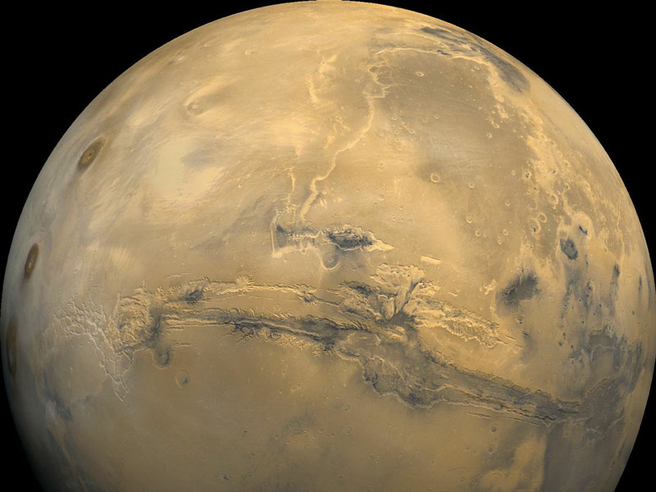
MARS
Credit – Viking Project, VSGS, NASA

Slide 55
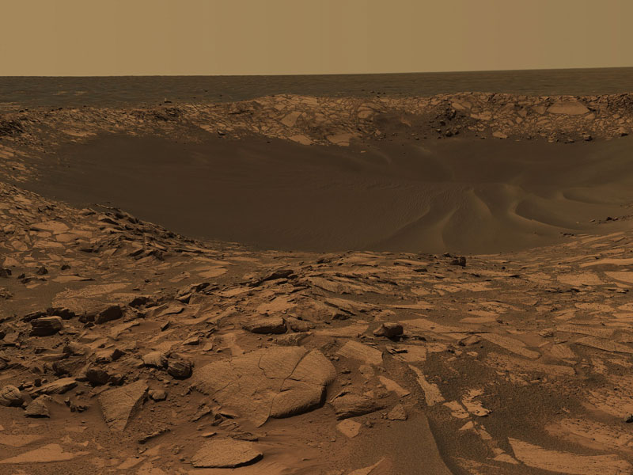
Crater on Surface of Mars
Credit – MER, Cornell, JPL, NASA

Slide 56
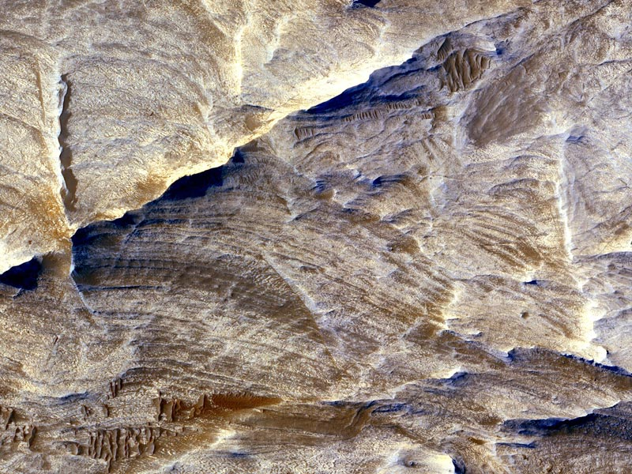
Mars’ Surface
Credit – HiRISE, MRO, LPL (U. of Arizona), NASA

Slide 57
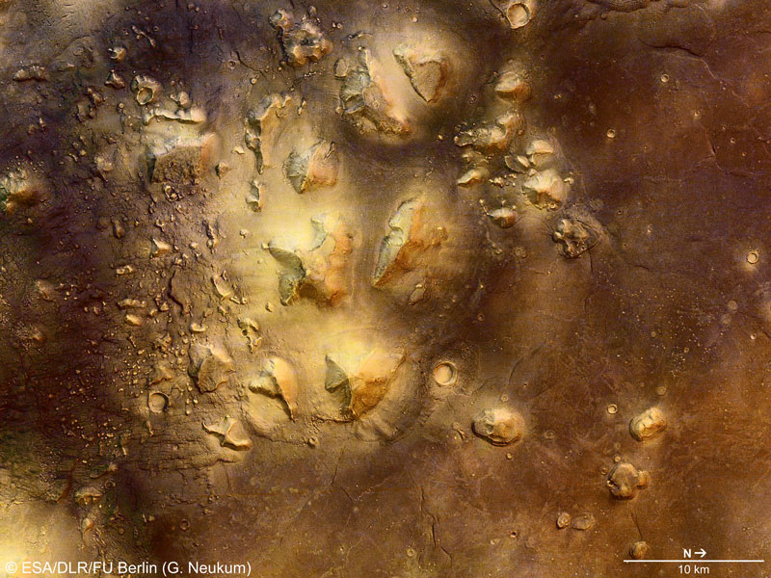
Mars’ Surface
ESA/DLR/FU Berlin (G. Neukum)

Slide 58
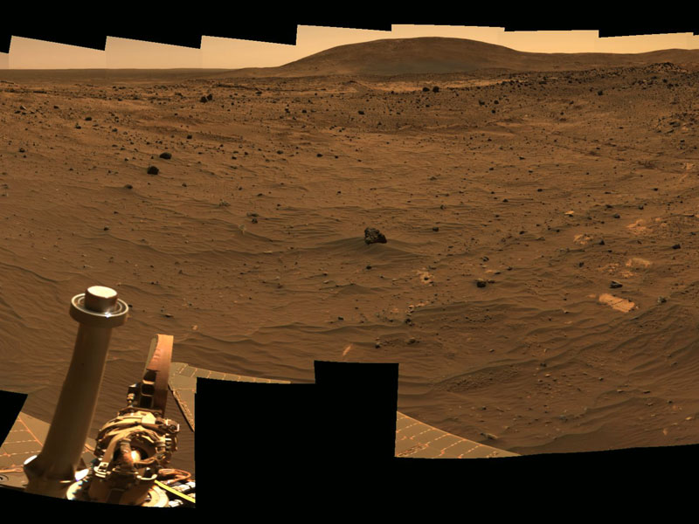
Mars’ Surface
Credit – MER, Cornell, JPL, NASA

Slide 59
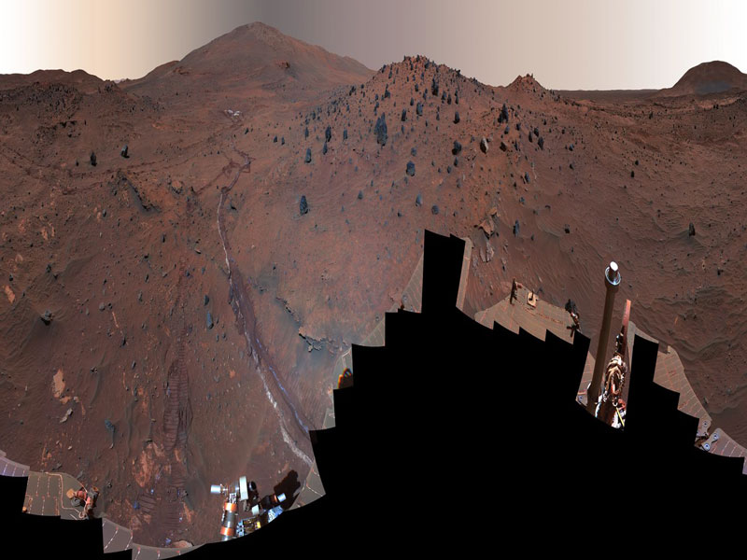
Mars’ Surface
Credit – NASA, Cornell, JPL, NASA

Slide 60
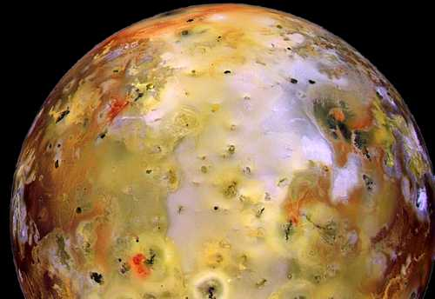
One of Jupiter’s 62 known moons: Io
(pizza anyone?)
Credit – JPL, NASA

Slide 61
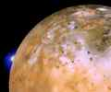
Volcanic activity on Io: First discovered volcanic activity in the solar system outside earth.
Plumes get up to 250 miles high. JPL’s spacecraft Galileo has observed up to 100 volcanoes erupting at a given time.
Credit – JPL, NASA

Slide 62
THE EARTH
& MOON

Slide 63
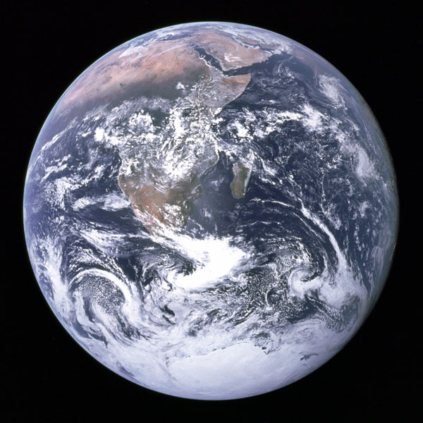
UNIVERSE’S FINE TUNING = DESIGN
And now, finally Earth:
There are over 268 finely tuned Earth parameters needed to make it possible to be a place for life, with 137 planetary features, PLUS 27 moon factors…
Credit – NASA’s Apollo 17 Crew

Slide 64
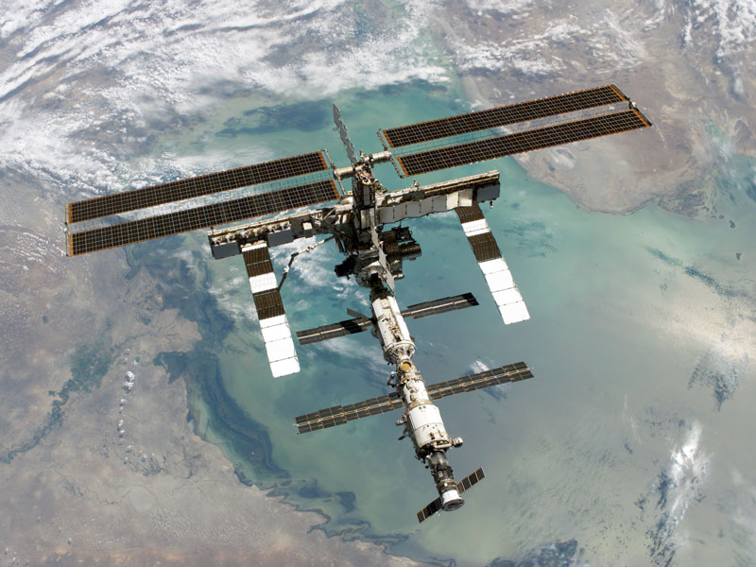

But that’s a subject of another presentation.
Space Station
However, we will mention just a few….
Credit – STS-114 Crew, NASA

Slide 65
UNIVERSE’S FINE TUNING = DESIGN
  Location, orbit, axis, gravity:
    Average distance from the sun (+ .5%)
    Elliptical orbit (30%)
    Axis tilt (+ 11%)
    Rotation rate (10%)
    Surface gravity (0.10%)
    Magnetic field (1%)
Credit: NASA’s
Apollo 17 Crew

Slide 66
UNIVERSE’S FINE TUNING= DESIGN
Atmospheric conditions :
  Transparency (1%)
  Pressure (1%)
  Electric discharge rate (1%)
  Oxygen (O) to nitrogen ratio (10%)
  Levels of O (1%), CO₂, water vapor
  (1%), ozone (.0001), chlorine (10%)
  Quantity, timing & placement of
  methanogens (methane absorbing
  bacteria) (.001%)

Slide 67
UNIVERSE’S FINE TUNING = DESIGN
  Surface Factors:
    Crust thickness (1%)
    Albedo (reflection of light)
    Seismic & volcanic activity
    Rate of decline in seismic/volcanic
    activity
    Ocean to continent ratio

Slide 68
UNIVERSE’S FINE TUNING = DESIGN
More Surface Factors:
  Quantity, timing & placement of
  carbonate producing animals (1%)
  If levels of the following were off by
  more than 10% in each case, no life:
  zinc, vanadium, chromium,
  selenium, iron, tin, phosphorus,
  nickel, manganese , iodine, flourine,
  boron, copper, arsenic, cobalt.

Slide 69
UNIVERSE’S FINE TUNING = DESIGN
The Many Factors of the Faint Sun Paradox (mentioned earlier):
  Compared to 3.8 billions years ago, when life first started, our sun is 15% more luminous today
  AND YET, a 2-4% change in the
  sun’s luminosity at this time would
  kill all life on earth!!!

Slide 70
UNIVERSE’S FINE TUNING = DESIGN
The Faint Sun Paradox:
  Therefore, for the past 3.8 billion
  years the earth had to grow less
  efficient in trapping heat in a
  perfectly inverted ratio to the
  increasing luminosity/heat of the
  sun or life would not be possible.

Slide 71
UNIVERSE’S FINE TUNING = DESIGN
The Faint Sun Paradox:
  There are many reasons contributing
  to this perfectly timed ability of the
  earth to retain heat less effectively.
  The mechanisms and all the reasons
  are too involved to discuss here.
  Just a few will be mentioned….

Slide 72
UNIVERSE’S FINE TUNING = DESIGN
The Faint Sun Paradox dependent on:
  Formation of sun had to be near in
  location and time to Type 1 and II
  supernovas.
  Collision of earth by a Mars-size
  object at just the right time – more
  later.
  Size and viscosity of iron core.

Slide 73
UNIVERSE’S FINE TUNING = DESIGN
The Faint Sun Paradox dependent on:
  Strength of magnetic dynamo
  Level of radioactivity
  Types of bacteria and life, and the
  timing thereof
  Types of plant life and the timing
  thereof
  Amount of continental land mass

Slide 74
UNIVERSE’S FINE TUNING = DESIGN
The Faint Sun Paradox:
  Level and timing of tectonic activity
  Rates of continental build up and
  erosion
  Amounts of silicates

Slide 75
  UNIVERSE’S FINE TUNING=DESIGN
  And so, so much more. Many of these
  factors also affect each other,
  complicating the issue.

Slide 76
  UNIVERSE’S FINE TUNING=DESIGN
  Many of the factors directly/indirectly
  affect the levels of CO₂, water vapor,
  and methane in the atmosphere and
  the degree to which they are absorbed
  in the earth’s surface. The less CO₂
  and methane in the atmosphere, the
  cooler earth can become.

Slide 77
  UNIVERSE’S FINE TUNING=DESIGN
This perfectly timed, “inverted” synchronistic dance of the sun and earth known as the “Faint Sun Paradox” defies any naturalistic explanation.

Slide 78
  UNIVERSE’S FINE TUNING=DESIGN
  PLUS THERE ARE NUMEROUS
  other earth factors (not related to the
  faint sun paradox) including level
  and degree of comet & meteor
  bombardment, sea salt aerosols, etc.,
  etc.
  AND THE FOLLOWING BIG ONE:

Slide 79
A long, long time ago, in THIS Galaxy, an object of just the right size (size of Mars) struck the earth at just the right moment (about 4.4 bya), at just the right angle (45º) and at just the right speed, to make just the right moon… OTHERWISE, we would not be here!

Slide 80
WHY??

Slide 81
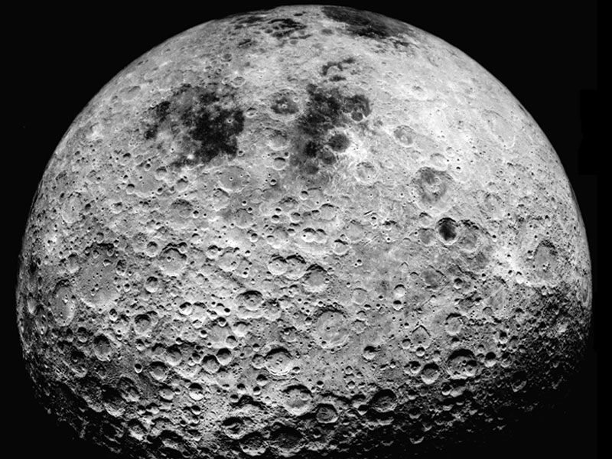
Far Side of Moon
Earth’s previously too heavy
atmosphere for life was made
thinner; without the moon
collision, Earth would be like
Venus where it is 800+ degrees
on the surface
Our unusually large, but perfectly
size, moon resulted

Slide 82
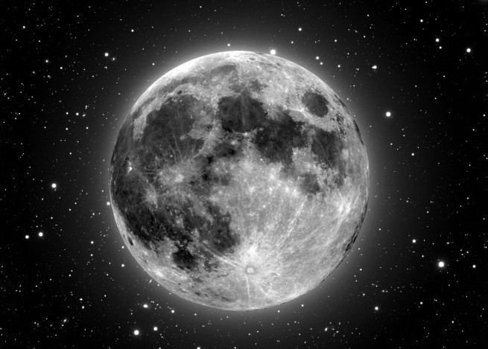
  The moon’s gravity makes the
  earth’s axis tilt at 23.5 degrees just
  right, and keeps it from varying too
  much
  Mineral composition of earth
  Created a just right magnetic field
  (protects us from radiation) resulted
Moon – Composite Image-T.A. Rector – LPP Dell’ Antonio-NOAO-AURA-NSF

Slide 83
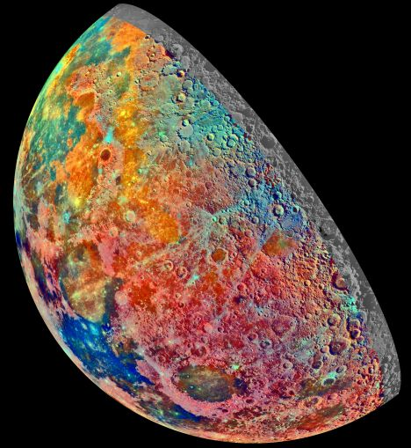
  Has slowed earth’s daily rotation
  from 4-6 hrs. at 3.8 billion years
  ago (wind speeds of about 2,000
  mph at 2 feet above surface)
  to the current daily 24 hrs.
  Has resulted in just right
  earthquakes, volcanic activity)
  Others
Moon – Credit – Galileo Project – JPL-NASA; seen thru filters to show elements

Slide 84
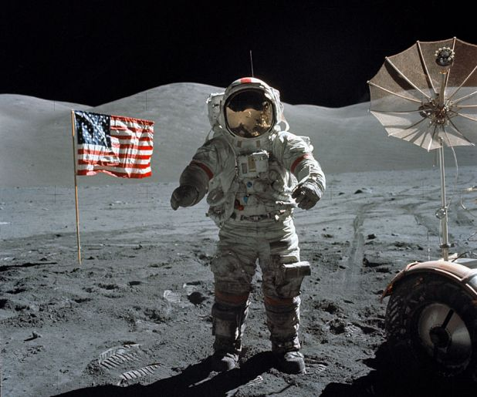
HI MOM!
Moon - Credit – Apollo 17 – NASA – Image scanned by Kapp Teague

Slide 85
UNIVERSE’S FINE TUNING = DESIGN
So, as stated earlier, as of end of 2006
there are about 676 finely tuned
parameters, the majority requiring
very fine tuning, to make life possible
This equals about a 1 out of a 10⁵⁵⁶
possibility that one planet could happen
by chance in the entire universe that is
capable of supporting life.

Slide 86
UNIVERSE’S FINE TUNING = DESIGN
1 out of 10⁵⁵⁶ is like saying:
Mark one dime, fill our universe with dimes, and multiply our universe:
by one trillion, by one trillion, by one trillion, by one trillion,
by one trillion, by one trillion, by one trillion, by one trillion,
by one trillion, by one trillion, by one trillion, by one trillion,
by one trillion, by one trillion, by one trillion, by one trillion,
by one trillion, by one trillion, by one trillion, by one trillion…

Slide 87
UNIVERSE’S FINE TUNING = DESIGN
by one trillion, by one trillion, by one trillion, by one trillion,
by one trillion, by one trillion, by one trillion, by one trillion,
by one trillion, by one trillion, by one trillion, by one trillion,
by one trillion, by one trillion, by one trillion, by one trillion,
by one trillion, by one trillion, by one trillion, by one trillion,
by one trillion, by one trillion, by one trillion, by one trillion,
by one trillion, by one trillion times!!!....And then…

Slide 88
UNIVERSE’S FINE TUNING = DESIGN
Remove one dime…You just eliminated all possibility of just one planet capable of supporting life anywhere in the universe!

Slide 89
UNIVERSE’S FINE TUNING = DESIGN
These are the random odds of getting
one planet capable of supporting
BACTERIA LIFE (not life itself)!
For a planet to support advanced life
like humans, there are 824 finely
tuned parameters needed, or a
random chance of 1 out of 10¹º⁵º!!!!

Slide 90
UNIVERSE’S FINE TUNING = DESIGN
  However, even these enormous
  odds are relatively small compared
  to the odds of a single, simple
  bacterium forming by chance.
  Physicist Harold Morowitz of Yale
  calculated just that: it is 1 chance
  out of 10¹ºº‚ººº‚ººº‚ººº!!!!
  Nothing can describe such odds!

Slide 91
UNIVERSE’S FINE TUNING = DESIGN
Now it can be understood why the universe is designed by God.
No wonder that the majority of the scientists from the hard sciences are now theists according to a 1997 survey.
Note the following sample quotes….

Slide 92
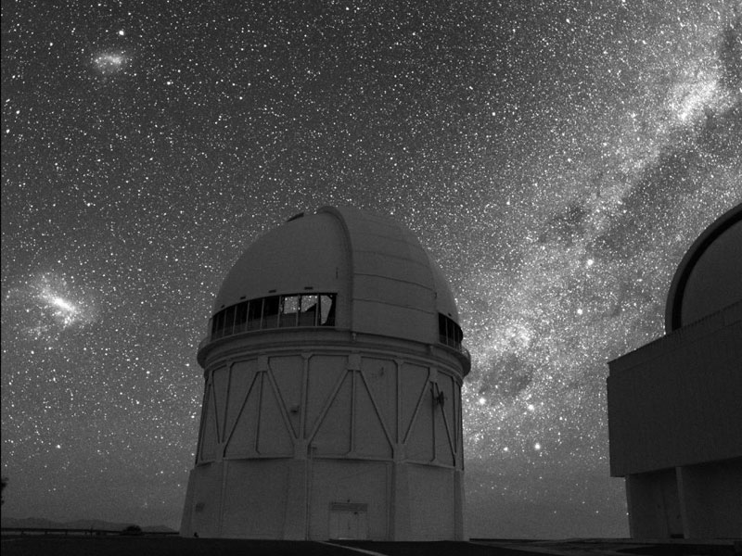
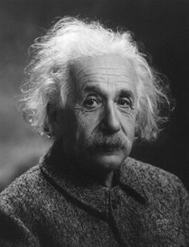
ALBERT EINSTEIN
“God does not play dice [with the universe].”
"In view of such harmony in the cosmos which I, with my limited human mind, am able to recognize, there are yet people who say there is no God. But what really makes me angry is that they quote me for the support of such views."
"I'm not an atheist and I don't think I can call myself a pantheist.”
Observatory in Chile: Credit – Roger Smith, AURA, NOAO, NSF

Slide 93
ALBERT EINSTEIN
“Science without religion is lame, religion without science is blind.” (1941, from an essay)
“Then I would feel sorry for the good Lord. The theory is correct anyway.” (1919, reply to his assistant, Ilse Rosenthal-Schneider, who asked what he would have done had Eddington's eclipse measurements not supported general relativity)
Observatory in Chile: Credit – Roger Smith, AURA, NOAO, NSF

Slide 94
ALBERT EINSTEIN
“What I am really interested in is whether
God could have created the world in a
different way;.…” (Mid-1940s, remark reported by Ernst Gabor Straus, then Einstein's assistant)
"I want to know how God created this world,…I want to know His thoughts, the rest are details."
However, it must be remembered that Einstein was a deist (did not believe that God did not involve himself with the affairs of man).

Slide 95
Stephen Hawking
(only believes a superior intelligence set up the initial laws of physics and mathematics):
“It would be very difficult to explain why the universe should have begun in just this way; except as the act of a God who intended to create beings like us.” (A Brief History of Time, p. 127)

Slide 96
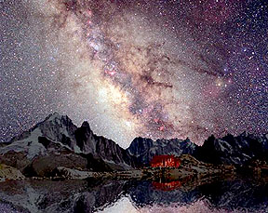
Sir Frederic Hoyle (famous British Astronomer/Mathematician; although he never became a theist, his comment below is interesting)
“…a super intellect has monkeyed with physics, as well as with chemistry and biology…” (The Universe, p. 16)
Time Exposure of Sky over the Alps

Slide 97
Allan Sandage
(winner of Crafoord Prize in Astronomy – equivalent to Nobel Prize):
“I find it quite improbable that such order comes out of chaos. There has to be some organizing principle. God to me is a mystery but is the explanation for the miracle of existence, why there is something instead of nothing.” (John Noble Wilford, “Sizing Up the Cosmos: An Astronomer’s Quest,” New York Times, 12 March 1991, p. B9)

Slide 98
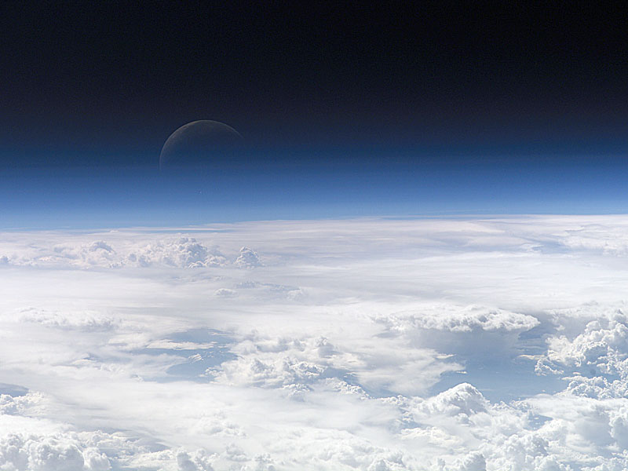
Robert Griffiths
(winner of Heinemann prize in mathematical physics)
“If we need an atheist for a debate, I go to the philosophy department. The physics department isn’t much use.” (Tim Stafford, “Cease-fire in the Laboratory,” Christianity Today, 3 April 1987, p. 18)
VIEW OF MOON: Credit – Expedition 13 Crew, International Space Station, NASA)

Slide 99
Paul Davies, Physicist:
“…the laws [of physics]…seem themselves to be the product of exceedingly ingenious design.” (Superforce, p. 243).
“[There] is for me powerful evidence that there is something going on behind it all…It seems as though somebody has fine-tuned nature’s numbers to make the Universe…impression of design is overwhelming.” (The Cosmic Blueprint, p. 203; “The Anthropic Principle,” Science Digest 191, No. 10 (October 1983), p. 24)
VIEW OF MOON: Credit – Expedition 13 Crew, International Space Station, NASA)

Slide 100
George Greenstein, Astronomer:
“As we survey all the evidence, the thought instantly arises that some supernatural agency – or, rather, Agency – must be involved. Is it possible that suddenly, without intending to, we have stumbled upon scientific proof of the existence of a Supreme Being? Was it God who stepped in and so providentially crafted the cosmos for our benefit?” (The Symbiotic Universe [New York: William Morrow, 1988] p. 27)
VIEW OF MOON: Credit – Expedition 13 Crew, International Space Station, NASA)

Slide 101
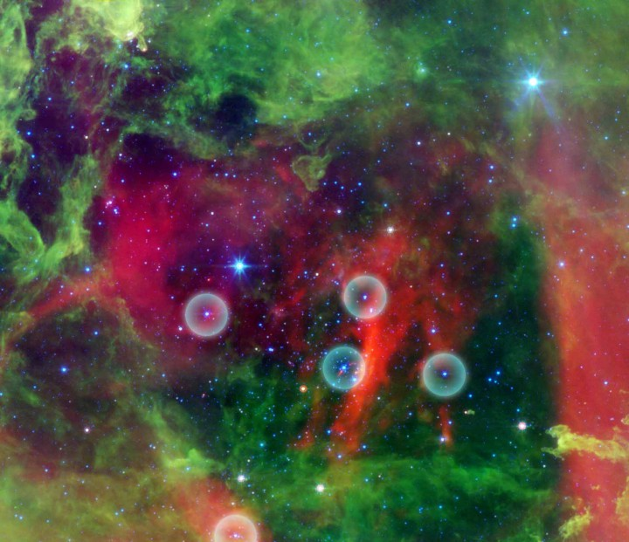
Vera Kistiakowsky
(MIT Physicist):
“The exquisite order displayed by our scientific understanding of the physical world calls for the divine.” (Henry Margenau and Roy Abraham Varghese, ed., Cosmos, Bios, and Theos (La Salle, IL: Open Court, 1992), p. 52
HOT STARS IN THE ROSETTED NEBULA Credit – Zoltan Balog (U. of Arizona, U. of Szeged) et al, JPL-Caltech, NASA)

Slide 102
Roger Penrose
(Distinguished Mathematician, Colleague of Stephen Hawking):
“I would say the universe has a purpose. It’s not there just somehow by chance.” (Roger Penrose, in the movie A Brief History of Time (Burbank,CA: Paramount Pictures Inc., 1992)
HOT STARS IN THE ROSETTED NEBULA Credit – Zoltan Balog (U. of Arizona, U. of Szeged) et al, JPL-Caltech, NASA)

Slide 103
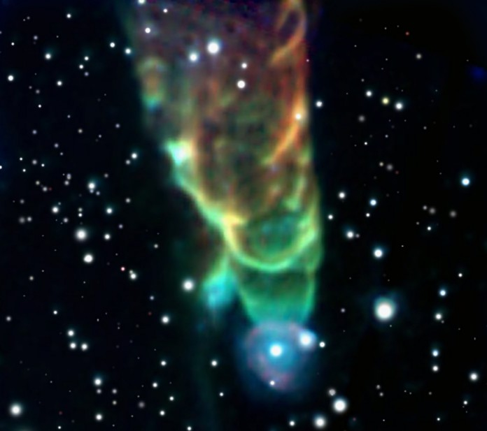
Alexander Polyakov
(Theoretician & fellow at Moscow’s Landau Institute):
“We know that nature is described by the best of all possible mathematics because God created it.” (Roger Penrose, in the movie A Brief History of Time (Burbank,CA: Paramount Pictures Inc., 1992)
COSMIC TORNADO HH49-50 Credit – J. Bally (U. of Colorado), et al, JPL-Caltech, NASA

Slide 104
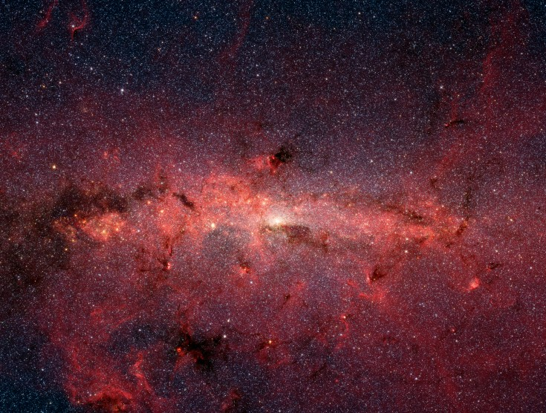
Edward Harrison, Cosmologist:
“Here is the cosmological proof of the existence of God…The fine tuning of the universe provides prima facie evidence of deistic design.” (Masks of the Universe, p. 252, 263)
STARS OF GALACTIC CENTER: Credit – Susan Stology (SSC-Caltech) et al, JPL – Caltech, NASA

Slide 105
Robert Jastrow, NASA Astrophysicist:
Concerning the Big Bang and Fine Tuning of the Universe: “For the scientist who has lived by his faith in the power of reason, the story ends like a bad dream. He has scaled the mountains of ignorance: he is about to conquer the highest peak; as he pulls himself over the final rock, he is greeted by a band of theologians who have been sitting there for centuries.” (God and the Astronomers, p. 116)
STARS OF GALACTIC CENTER: Credit – Susan Stology (SSC-Caltech) et al, JPL – Caltech, NASA

Slide 106
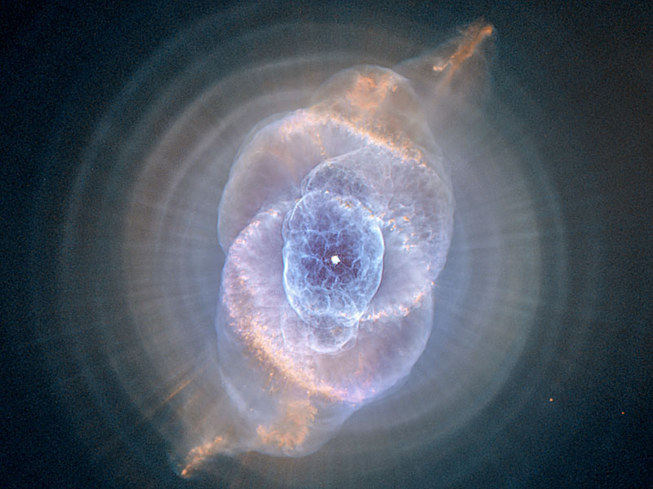
Geoffrey Brubridge
(UCSD Astronomer):
Complained that his fellow astronomers were rushing off to the “…First Church of Christ of the Big Bang.”!!! (Stephen Strauss, “An Innocent’s Guide to the Big Bang Theory: Fingerprint in Space Left by the Universe as a Baby Still Has Doubters Hurling Stones,” The Globe and the Mail (Toronto), 25 April 1992, page 1)
CATS EYE NEBULA: Credit – NASA, ESA, HEIC, Hubble Heritage Team (STScI, AURA)

Slide 107
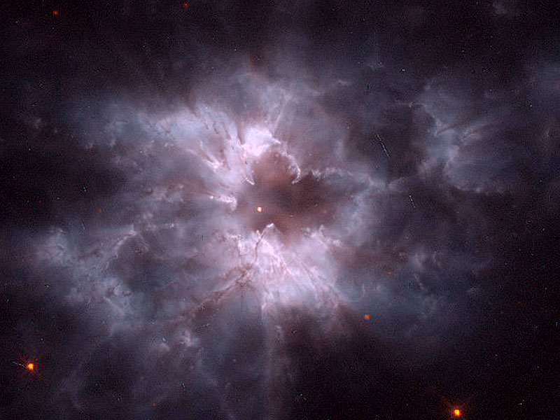
“In the beginning God created the heavens and the earth…”
GOD
HGC 2440 COCCOON OF A NEW WHITE DWARF: Credit – Bond (STScI), R. Clardullo (PSU), WFPC2, HST, NASA

Slide 108
Specifically, the odds of such a
planet by random chance are about
1 out of 10⁵⁵⁶, which is like saying:
  Fill the entire universe with dimes, and then multiply all that by:
  by one trillion, by one trillion, by one trillion,
  by one trillion, by one trillion, by one trillion,
  by one trillion, by one trillion, by one trillion,
  by one trillion, by one trillion, by one trillion,….

Slide 109
  by one trillion, by one trillion, by one trillion, by one trillion, by one trillion, by one trillion, by one trillion, by one trillion, by one trillion, by one trillion, by one trillion, by one trillion, by one trillion, by one trillion, by one trillion, by one trillion, by one trillion, by one trillion, by one trillion, by one trillion, by one trillion, by one trillion, by one trillion, by one trillion, by one trillion, by one trillion, by one trillion, by one trillion, by one trillion, by one trillion, by one trillion, by one trillion, by one trillion, by one trillion and then remove one dime…no possibility of life!!!

Slide 110
This overwhelming precision proves the universe has been designed to produce a planet (earth) capable of supporting life.

Slide 111
BUT NOW, THE MOST ASTOUNDING PHOTOGRAPHIC EVIDENCE EVER PRESENTED. A TOP SECRET, ORBITING TELESCOPE WAS ABLE TO PRODUCE THE STARTLING IMAGE ON THE NEXT PAGE WHICH, FOR THE FIRST TIME, IS FROM JUST BEFORE THE BIG BANG. THIS IMAGE WILL TOTALLY REVOLUTIONIZE OUR EXISTENCE…

Slide 112

THE EYE OF GOD

Slide 113
NOT “BUYING” THAT ONE, HUH?
Good! You are still awake.
Q&A TIME

