Slide 1
WAS JESUS A NICE GUY?

Slide 2
Rom 8:28 And we know that all things work together for good to those who love God, to those who are the called according to His purpose.
Rom 8:29 For whom He foreknew, He also predestined to be conformed to the image of His Son, that He might be the firstborn among many brethren.

Slide 3
1Jn 3:2 Beloved, now we are children of God; and it has not yet been revealed what we shall be, but we know that when He is revealed, we shall be like Him, for we shall see Him as He is.

Slide 4
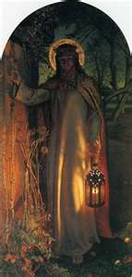
Notes:
1

Slide 5
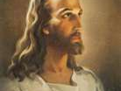
Notes:
1

Slide 6
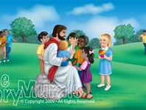
Notes:
1

Slide 7
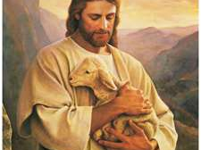
Notes:
1

Slide 8
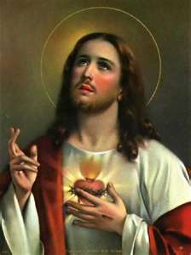
Notes:
1

Slide 9
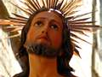
Notes:
1

Slide 10
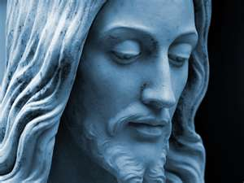
Notes:
1

Slide 11
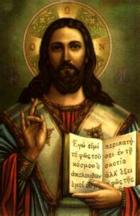
Notes:
1

Slide 12
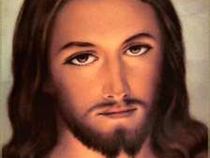
Notes:
1

Slide 13
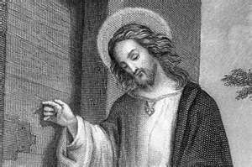
Notes:
1

Slide 14
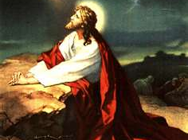
Notes:
1

Slide 15
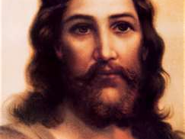
Notes:
1

Slide 16
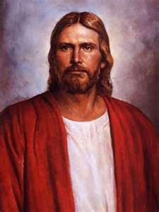
Notes:
1

Slide 17
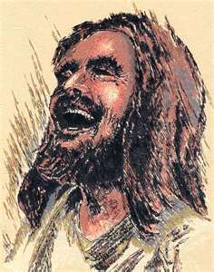
Notes:
2

Slide 18
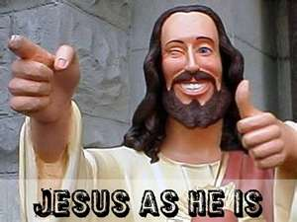
Notes:
2

Slide 19
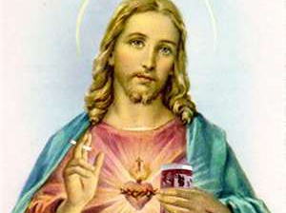
Notes:
2

Slide 20
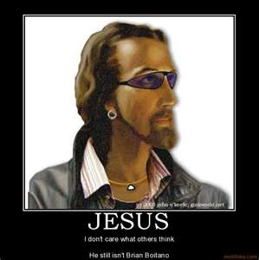
Notes:
2

Slide 21
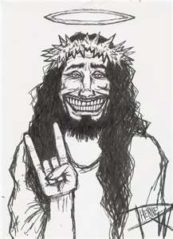
Notes:
2

Slide 22
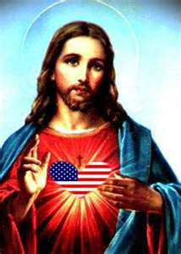
Notes:
2

Slide 23

Notes:
2

Slide 24
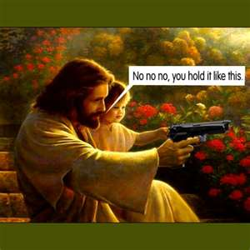
Notes:
2

Slide 25
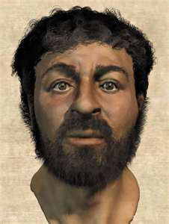
Notes:
3

Slide 26
1

Slide 27
Mat 5:23 Therefore if you bring your gift to the altar, and there remember that your brother has something against you,
Mat 5:24 leave your gift there before the altar, and go your way. First be reconciled to your brother, and then come and offer your gift.
Notes:
1

Slide 28
Mat 5:27 "You have heard that it was said to those of old, 'YOU SHALL NOT COMMIT ADULTERY.'
Mat 5:28 But I say to you that whoever looks at a woman to lust for her has already committed adultery with her in his heart.
Notes:
1

Slide 29
Mat 5:38 "You have heard that it was said, 'AN EYE FOR AN EYE AND A TOOTH FOR A TOOTH.'
Mat 5:39 But I tell you not to resist an evil person. But whoever slaps you on your right cheek, turn the other to him also.
Notes:
1

Slide 30
Mat 5:40 If anyone wants to sue you and take away your tunic, let him have your cloak also.
Mat 5:41 And whoever compels you to go one mile, go with him two.
Mat 5:42 Give to him who asks you, and from him who wants to borrow from you do not turn away.
Notes:
1

Slide 31
Mat 6:1 "Take heed that you do not do your charitable deeds before men, to be seen by them. Otherwise you have no reward from your Father in heaven.
Mat 6:3 But when you do a charitable deed, do not let your left hand know what your right hand is doing,
Mat 6:4 that your charitable deed may be in secret; and your Father who sees in secret will Himself reward you openly.
Notes:
1

Slide 32
Mat 5:43 "You have heard that it was said, 'YOU SHALL LOVE YOUR NEIGHBOR and hate your enemy.'
Mat 5:44 But I say to you, love your enemies, bless those who curse you, do good to those who hate you, and pray for those who spitefully use you and persecute you,
Notes:
1

Slide 33
Mat 5:10 Blessed are those who are persecuted for righteousness' sake, For theirs is the kingdom of heaven.
Mat 5:11 "Blessed are you when they revile and persecute you, and say all kinds of evil against you falsely for My sake.
Mat 5:12 Rejoice and be exceedingly glad, for great is your reward in heaven
Notes:
1

Slide 34
Mat 6:28 "So why do you worry about clothing? Consider the lilies of the field, how they grow: they neither toil nor spin;
Mat 6:29 and yet I say to you that even Solomon in all his glory was not arrayed like one of these.
Notes:
1

Slide 35
Mat 7:28 And so it was, when Jesus had ended these sayings, that the people were astonished at His teaching,
Mat 7:29 for He taught them as one having authority, and not as the scribes.

Slide 36
Mat 8:10 When Jesus heard it, He marveled, and said to those who followed, "Assuredly, I say to you, I have not found such great faith, not even in Israel!

Slide 37
Mat 7:21 "Not everyone who says to Me, 'Lord, Lord,' shall enter the kingdom of heaven, but he who does the will of My Father in heaven.
Mat 7:22 Many will say to Me in that day, 'Lord, Lord, have we not prophesied in Your name, cast out demons in Your name, and done many wonders in Your name?'
Mat 7:23 And then I will declare to them, 'I never knew you; depart from Me, you who practice lawlessness!'

Slide 38
Mat 8:18 And when Jesus saw great multitudes about Him, He gave a command to depart to the other side.
Mat 8:19 Then a certain scribe came and said to Him, "Teacher, I will follow You wherever You go."
Mat 8:20 And Jesus said to him, "Foxes have holes and birds of the air have nests, but the Son of Man has nowhere to lay His head."

Slide 39
Mat 8:21 Then another of His disciples said to Him, "Lord, let me first go and bury my father."
Mat 8:22 But Jesus said to him, "Follow Me, and let the dead bury their own dead."

Slide 40
Mat 8:24 And suddenly a great tempest arose on the sea, so that the boat was covered with the waves. But He was asleep.
Mat 8:25 Then His disciples came to Him and awoke Him, saying, "Lord, save us! We are perishing!"
Mat 8:26 But He said to them, "Why are you fearful, O you of little faith?" Then He arose and rebuked the winds and the sea, and there was a great calm.
Mat 8:27 So the men marveled, saying, "Who can this be, that even the winds and the sea obey Him?"

Slide 41
Mat 8:28 When He had come to the other side, to the country of the Gergesenes, there met Him two demon-possessed men, coming out of the tombs, exceedingly fierce, so that no one could pass that way.
Mat 8:29 And suddenly they cried out, saying, "What have we to do with You, Jesus, You Son of God? Have You come here to torment us before the time?"
Mat 8:30 Now a good way off from them there was a herd of many swine feeding.
Mat 8:31 So the demons begged Him, saying, "If You cast us out, permit us to go away into the herd of swine."
Mat 8:32 And He said to them, "Go." So when they had come out, they went into the herd of swine. And suddenly the whole herd of swine ran violently down the steep place into the sea, and perished in the water.
Mat 8:33 Then those who kept them fled; and they went away into the city and told everything, including what had happened to the demon-possessed men.
Mat 8:34 And behold, the whole city came out to meet Jesus. And when they saw Him, they begged Him to depart from their region.

Slide 42
Mat 9:10 Now it happened, as Jesus sat at the table in the house, that behold, many tax collectors and sinners came and sat down with Him and His disciples.
Mat 9:11 And when the Pharisees saw it, they said to His disciples, "Why does your Teacher eat with tax collectors and sinners?"
Mat 9:12 When Jesus heard that, He said to them, "Those who are well have no need of a physician, but those who are sick.

Slide 43
that hour.
Mat 9:23 When Jesus came into the ruler's house, and saw the flute players and the noisy crowd wailing,
Mat 9:24 He said to them, "Make room, for the girl is not dead, but sleeping." And they ridiculed Him.
Mat 9:25 But when the crowd was put outside, He went in and took her by the hand, and the girl arose.
Mat 9:26 And the report of this went out into all that land.

Slide 44
Mat 9:35 Then Jesus went about all the cities and villages, teaching in their synagogues, preaching the gospel of the kingdom, and healing every sickness and every disease among the people.
Mat 9:36 But when He saw the multitudes, He was moved with compassion for them, because they were weary and scattered, like sheep having no shepherd.

Slide 45
Mat 10:35 For I have come to 'SET A MAN AGAINST HIS FATHER, A DAUGHTER AGAINST HER MOTHER, AND A DAUGHTER-IN-LAW AGAINST HER MOTHER-IN-LAW';
Mat 10:36 and 'A MAN'S ENEMIES WILL BE THOSE OF HIS OWN HOUSEHOLD.'
Mat 10:37 He who loves father or mother more than Me is not worthy of Me. And he who loves son or daughter more than Me is not worthy of Me.

Slide 46
Mat 10:42 And whoever gives one of these little ones only a cup of cold water in the name of a disciple, assuredly, I say to you, he shall by no means lose his reward."

